Slide 1

Fiddler Overview
Presenter: Ketan Vyas
The views and opinions expressed during this workshop are those of the speaker alone and do not necessarily reflect the positions or opinions of employer or employer affiliates.

Slide 2
Agenda
About Fiddler
Debugging Proxy
Traffic Monitoring
Traffic Filtering & Intercepting
Replay & AutoResponse
Traffic Load, Save, Import & Export
Configuration

Slide 3
About Fiddler

Slide 4
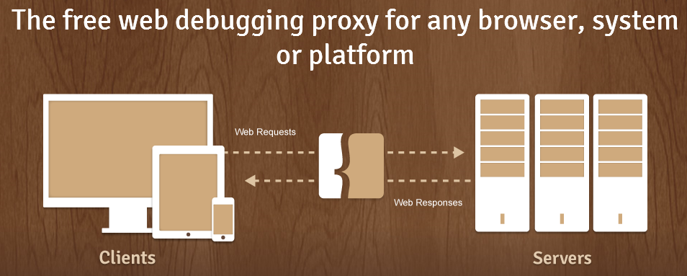

Fiddler Developer
About Fiddler
Developed by Eric Lawrence while working as Program Manager - Internet Explorer, Microsoft
Eric currently works with Telerik

Slide 5

Resources
About Fiddler
Official download site – http://fiddler2.com/
Book – Debugging with Fiddler by Eric Lawrence,
ISBN: 1475024487
blog - http://fiddler2.com/blog/
Back dated blog (Microsoft) - http://blogs.msdn.com/b/fiddler/
Videos – http://www.youtube.com/playlist?list=PLvmaC-XMqeBbw72l2G7FG7CntDTErjbHc
Discussion Forum – https://groups.google.com/forum/?fromgroups#!forum/httpfiddler
Add-ons – http://fiddler2.com/add-ons

Slide 6







Fiddler Concept
About Fiddler
Firefox
WinHTTP
Crypto API
Internet Explorer
WinINet
Upstream Proxy
Fiddler
Example.com
SPD
System.Net
Custom App

Slide 7
Debugging Proxy

Slide 8



Typical Proxy Setup
Debugging Proxy
In-House application
Hosted application
Clients
Fiddler
Fiddler
Example.com

Slide 9
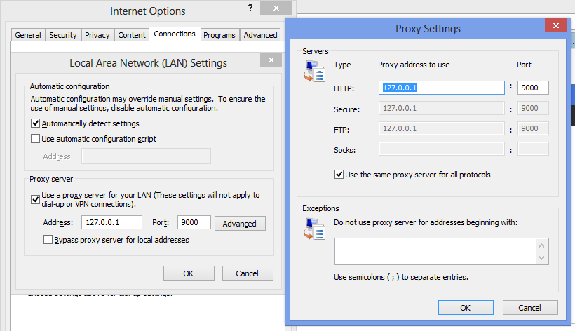
Proxy Settings
Debugging Proxy

Slide 10
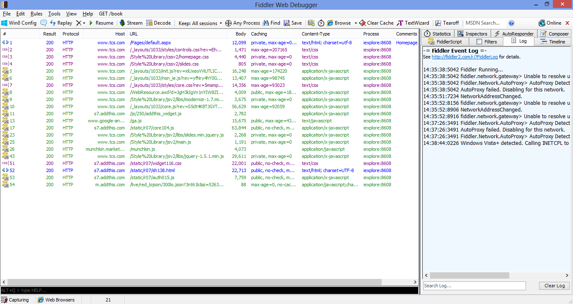
Exercise: Running Fiddler
Debugging Proxy
Start Fiddler, start browser and visit <your company site>
Web Session List
Extension Tabs
Fiddler Session Identifier
Response Size
Request Originating Process
QuickExec

Slide 11
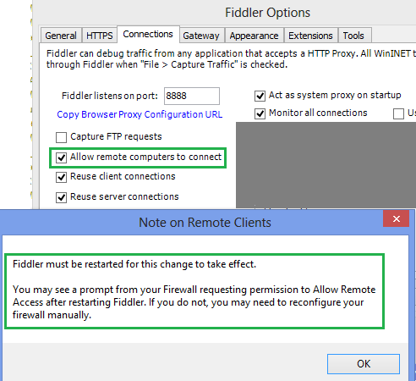
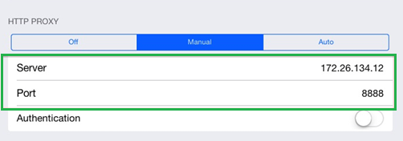
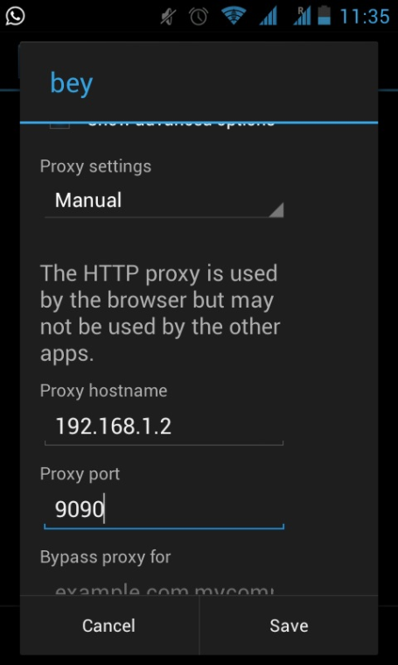
Traffic from Remote Client
Debugging Proxy
Fiddler Options
Proxy Settings on iPAD
Proxy Setting on Android Phone

Slide 12
Traffic from Localhost
Debugging Proxy
Many times proxy is bypassed while using localhost (127.0.0.1) (specially with IE < v9)
Instead of “http://127.0.0.1”, use your machine name http://computername or http://ipv4.fiddler (http://ipv6.fiddler for IPv6)
Create alias for localhost and add rule as following
static function OnBeforeRequest(oSession:Fiddler.Session)
{
if (oSession.HostnameIs(“myalias”))
{
oSession.host = "127.0.0.1:8081";
}
}

Slide 13
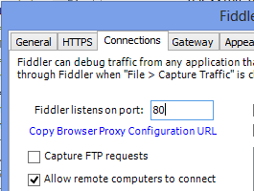

Fiddler as Reverse Proxy
Debugging Proxy
Browser opens www.example.com
Run Fiddler on Port 80 of www.example.com
Run webserver for www.example.com on 8080
Fiddler
Example.com

Slide 14
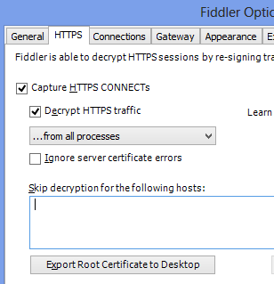
Capturing HTTPS Traffic
Debugging Proxy
https://www.
HTTPS secures channel between client and server
Fiddler works as Man-In-The-Middle (MITM)
User to accept Fiddler as a Certificate Authority
Generates certificates for websites on-the-fly

Slide 15
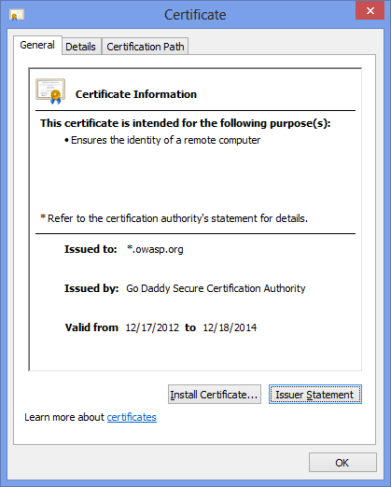
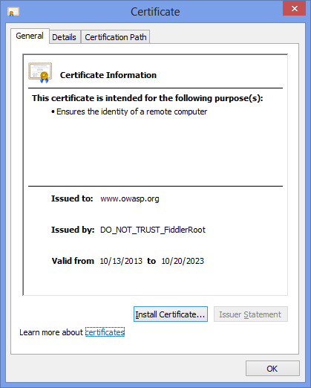
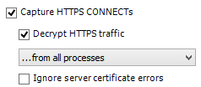
Exercise: Capturing HTTPS Traffic
Debugging Proxy
Start Fiddler, start browser and visit https://www.owasp.org
Opening https://www.owasp.org in browser
Enabling HTTPS in Fiddler
Opening https://www.owasp.org in browser again

Slide 16
Traffic Monitoring

Slide 17
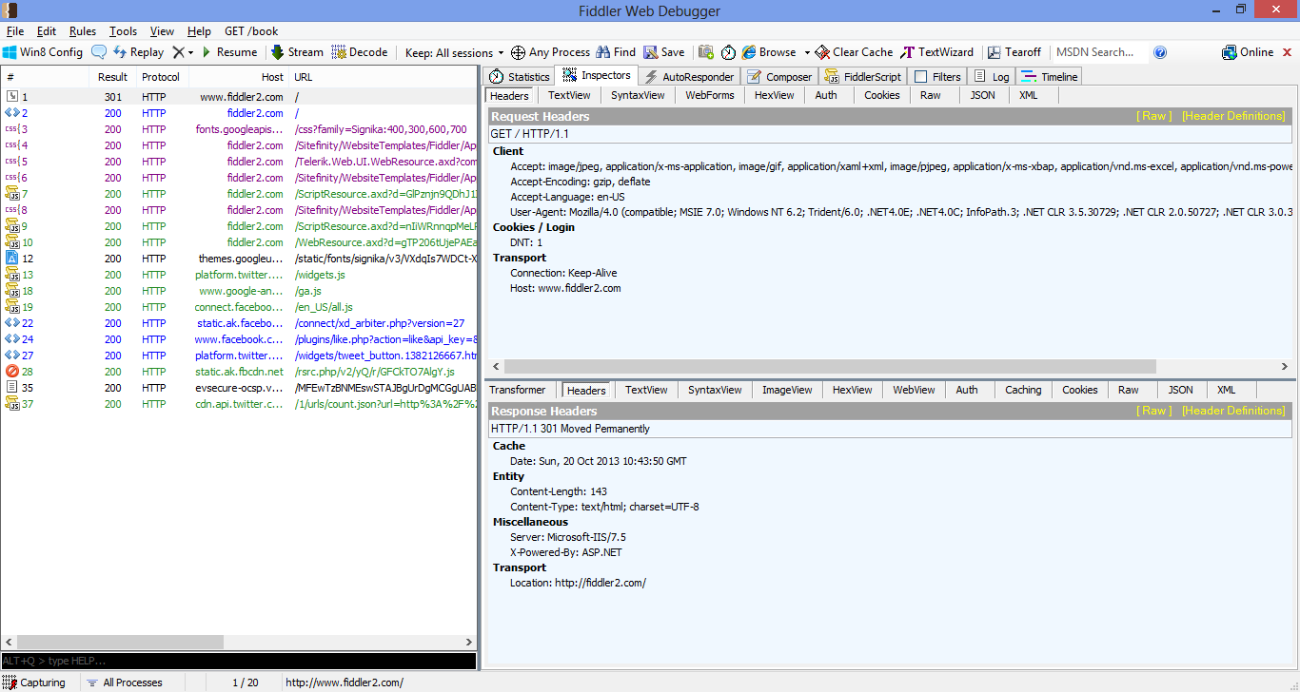
Inspectors
Traffic Monitoring

Slide 18
Demo: Inspectors

Slide 19
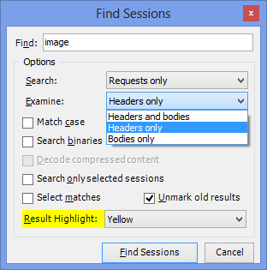
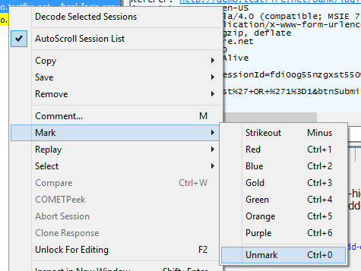
Finding Session
Traffic Monitoring
Ctrl + F
Keyword + RegEx based search
Request + Response
Headers + Body

Slide 20
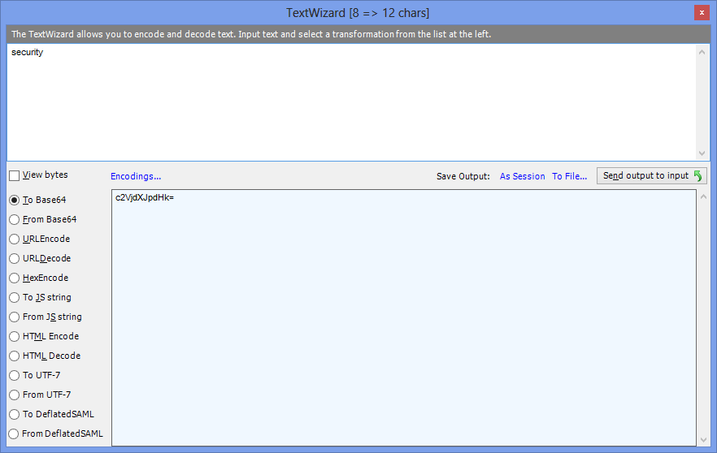
Conversion
Traffic Monitoring

Slide 21
Traffic Filtering & Intercepting

Slide 22
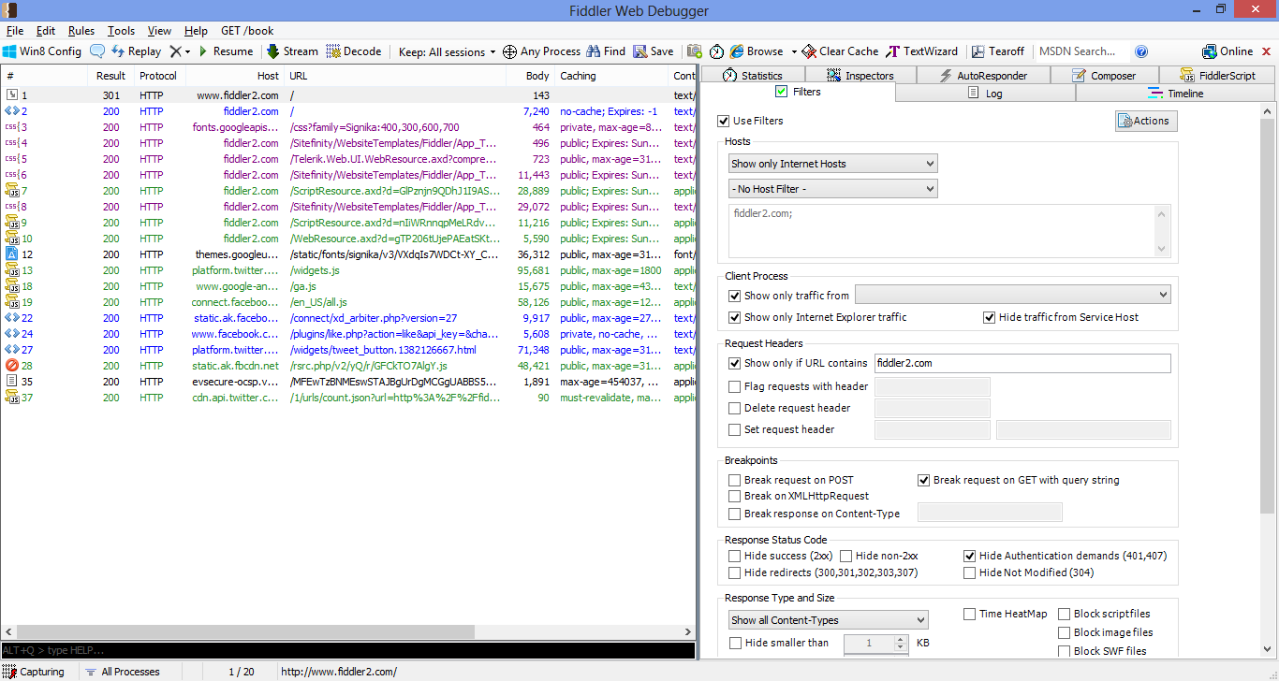
Filter by Process
Traffic Filtering & Intercepting
Specific Process
Process Name or ID
Process Type

Slide 23
Demo: Process Filters

Slide 24
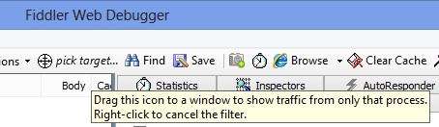
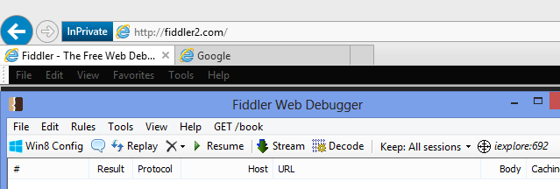
Exercise: Filter by Process
Traffic Filtering & Intercepting
Drag the icon on one of the IE tab
Fiddler will capture process ID for that tab
Visit “fiddler2.com” from that tab
Open new tab and visit “google.com”

Slide 25
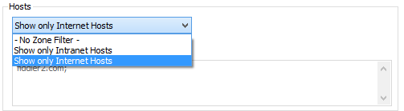
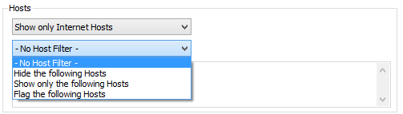
Filter by Hosts
Traffic Filtering & Intercepting
Hosts without dotted name
Focusing on targets

Slide 26
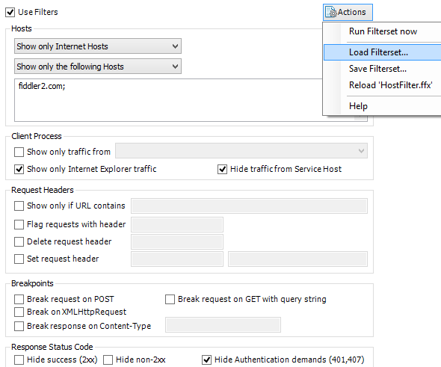
Exercise: Filter by Host
Traffic Filtering & Intercepting
Disable filter, visit “google.com”
Enable filter and load “HostFilter.ffx”
Visit “google.com” again
Visit “fiddler2.com” in Internet explorer
Visit “fiddler2.com” in Firefox

Slide 27
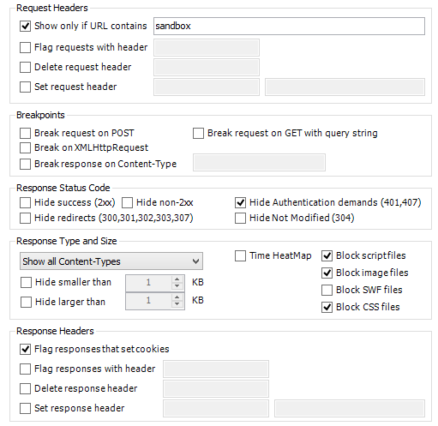
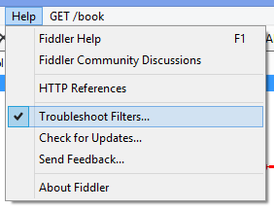
Filter by Request & Response Parameters
Traffic Filtering & Intercepting
Visit “fiddler2.com”
Click on “Features” link
Visit “http://www.bayden.com/sandbox/”

Slide 28

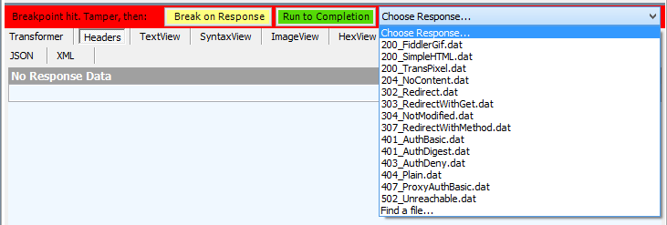
Intercepting Traffic with Breakpoints
Traffic Filtering & Intercepting

Slide 29
Demo: Tampering

Slide 30
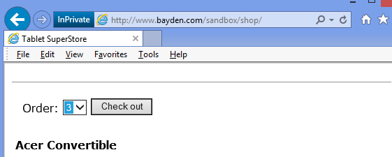
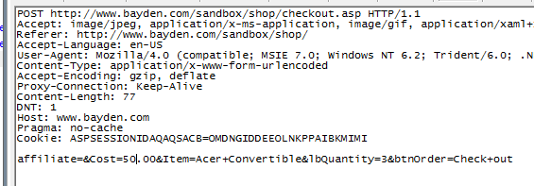
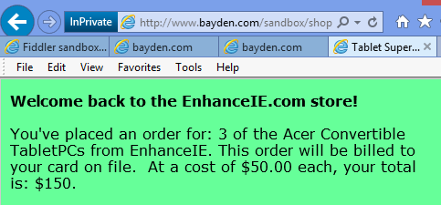
Exercise: Interception & Tampering
Traffic Filtering & Intercepting
Visit “http://www.bayden.com/sandbox”
Click on link “Response Status Code Generator”
Click on link “Shopping cart example”. For Acer Convertible, select order “3” and checkout
Change cost to “50.00”
Check response from shopping cart in Browser

Slide 31
Replay & AutoResponse

Slide 32
Demo: Replay Existing Requests

Slide 33
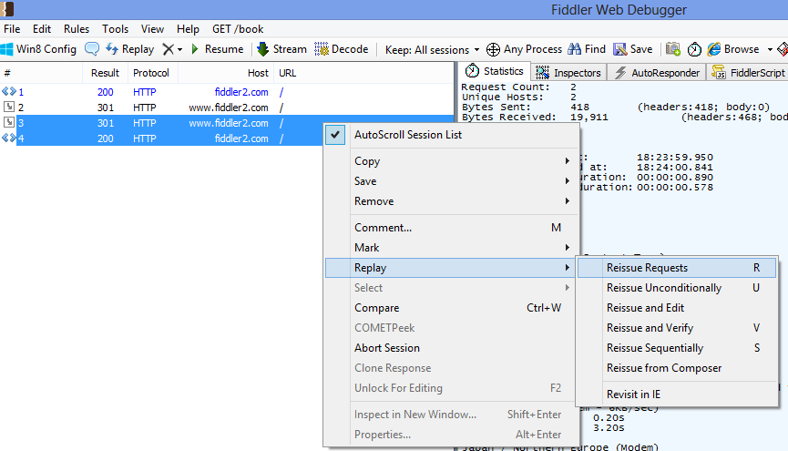
Exercise: Reissue Existing Requests
Replay & AutoResponse

Slide 34
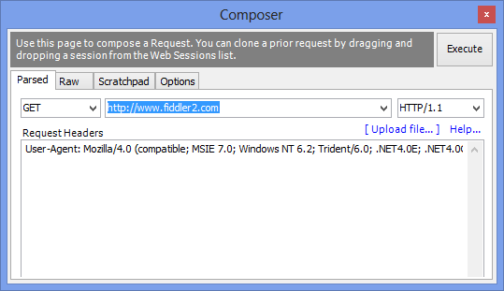
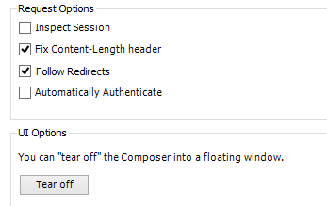
Exercise: Request Composer
Replay & AutoResponse
Create request from scratch or Drag & Drop requests from “Web Session List” to composer
Create GET request for http://www.fiddler2.com, Check “Follow Redirects”

Slide 35
Demo: AutoResponder

Slide 36
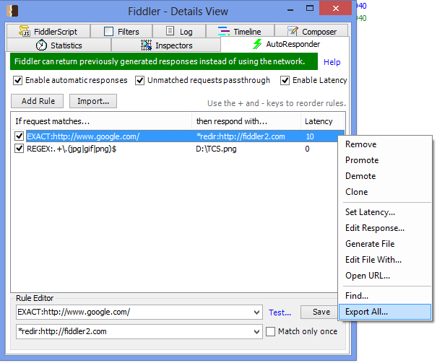
Demo: AutoResponder
Replay & AutoResponse
Import “AutoResponderSample.farx”
Uncheck “Pass through” and visit “google.com”
Check “Pass through” and visit “google.com”
Visit “www.google.com”

Slide 37
Traffic Load, Save, Import & Export

Slide 38
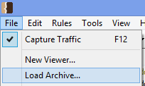
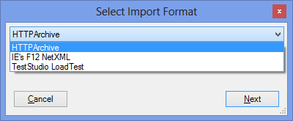
Import Formats
Traffic Load, Save, Import & Export
Fiddler’s native “Session Archive ZIP” (SAZ) Format
HTTPArchive

Slide 39
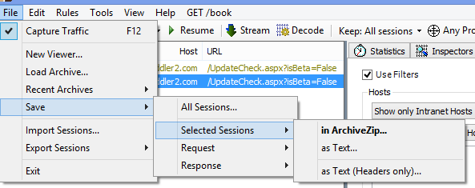
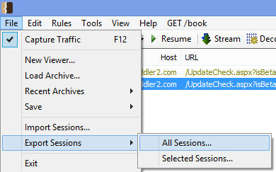
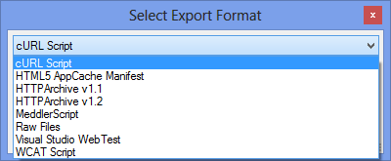
Output Formats
Traffic Load, Save, Import & Export
Copy sessions to the Clipboard or File
Fiddler’s native “Session Archive ZIP” (SAZ) Format
Write your own…

Slide 40
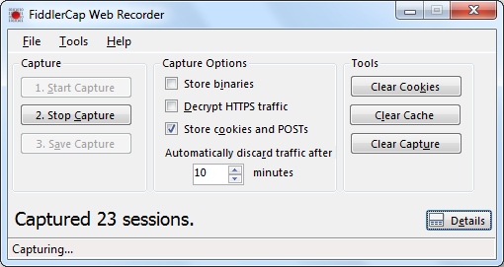
Exercise: FiddlerCap
Traffic Load, Save, Import & Export

Slide 41
QuickExec

Slide 42
Demo: QuickExec

Slide 43
Configuration

Slide 44
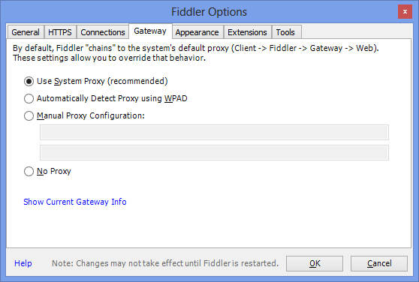
Understanding Configurations
Configuration

Slide 45
Section Summary
Fiddler is a easy to use http proxy
It can monitor http(s) traffic from various devices or platforms
It can intercept and manipulate traffic
It can filter traffic based given condition
It can generate traffic and autorespond
It can import /export requests

Slide 46
Thank you

