Slide 1

Fiddler Extensions
Presenter: Ketan Vyas
The views and opinions expressed during this workshop are those of the speaker alone and do not necessarily reflect the positions or opinions of employer or employer affiliates.
Notes:
My association with

Slide 2
Agenda
Popular Security Extensions
Building Your Own Security Extensions

Slide 3
Popular Security Extensions

Slide 4
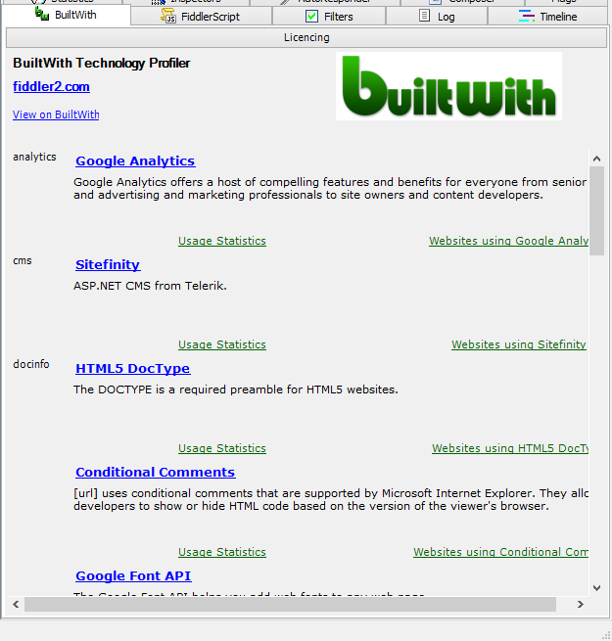
Builtwith Fiddler
Popular Security Extensions
Technology Profiler
Dependent on “Bare Web” Service database
Drag & Drop request
Source: http://builtwithfiddler.codeplex.com/

Slide 5
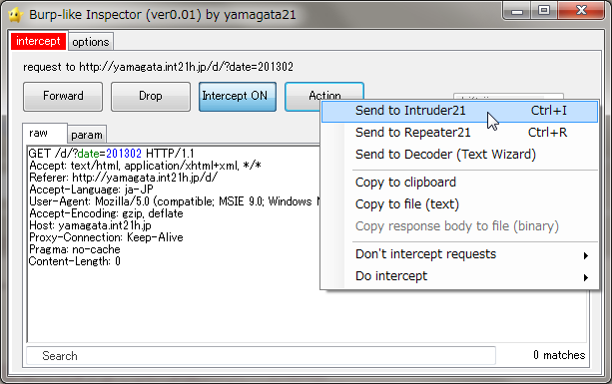
Demo: Burp-like Inspector
Popular Security Extensions
Injector
Parameter based Payload
Repeater
session handling macro
Source: http://yamagata.int21h.jp/tool/BurplikeInspector/

Slide 6
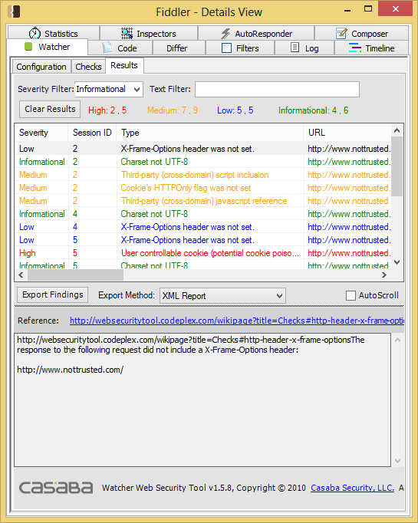
Demo: Watcher
Popular Security Extensions
Passive Scanner
Non-intrusive
Real-time analysis
Configurable platform
Source: https://websecuritytool.codeplex.com/

Slide 7
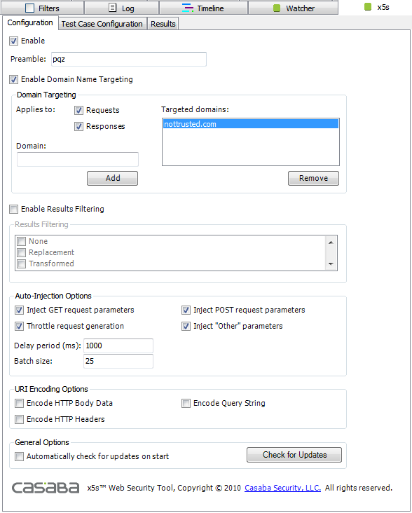
Demo: x5S
Popular Security Extensions
XSS Scanner
Detecting where safe encodings were not applied to emitted user-inputs
Detecting where Unicode character transformations might bypass security filters
Detecting where non-shortest UTF-8 encodings might bypass security filters
Source: http://xss.codeplex.com/

Slide 8
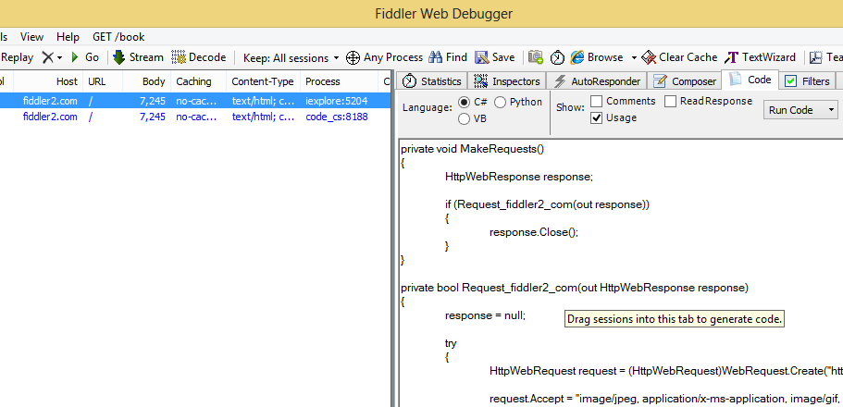
Demo: Request to Code
Popular Security Extensions
Submit form data programmatically
Easily codify web requests
Programmatically test differing header values
Run code directly from the Code tab
Automatically generate code in conjunction with FiddlerCore
Source: http://www.chadsowald.com/software/fiddler-extension-request-to-code

Slide 9
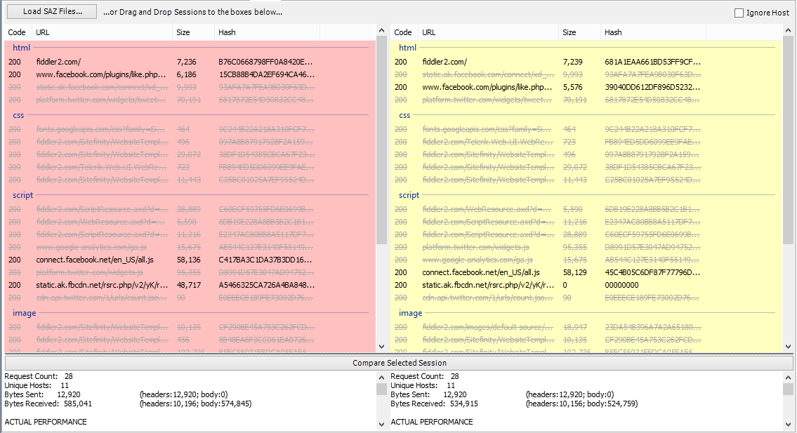
Demo: SAZ Differ
Popular Security Extensions
Source: http://fiddler2.com/docs/default-source/telerik-addons/fiddlersazdiffsetup.exe

Slide 10
Building Your Own Security Extensions

Slide 11
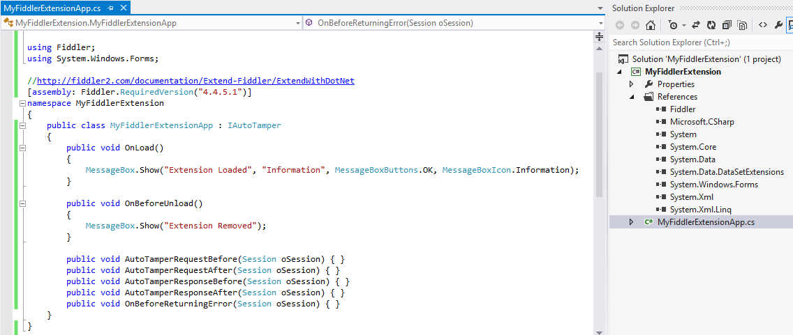
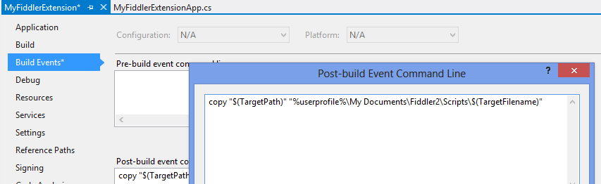
Exercise: Creating First Extension
Building Your Own Security Extensions

Slide 12
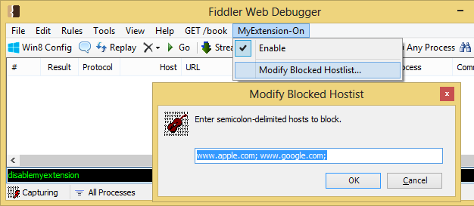
Exercise: Host Blocker Extension
Building Your Own Security Extensions
Block requests to specified hosts
Load / Save Configurations
Add Menu Items
QuickExec commands to enable/disable extension

Slide 13
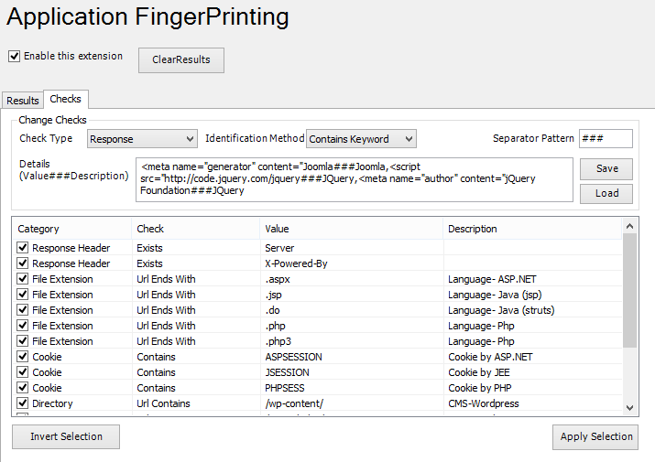
Demo: Application Fingerprinting
Building Your Own Security Extensions
Concept: https://www.owasp.org/index.php/Web-metadata

Slide 14
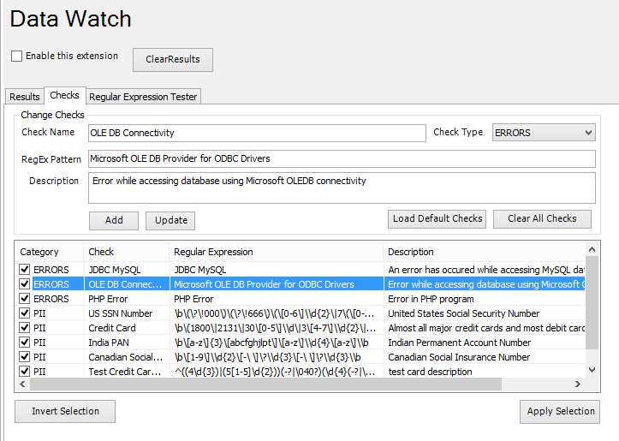
Exercise: Data Watch
Building Your Own Security Extensions
Do It Yourself
Concept: https://code.google.com/p/fuzzdb/

Slide 15
Section Summary
Fiddler Extensions provide better way to customize Fiddler functionality
Popular extensions enable testers to perform security testing
Fiddler interfaces help trap almost all important fiddler events

Slide 16
Thank you

