Slide 1
Distributed Online Clustering using LSH over Multiple Data Streams
Alok Kumbhare, Ketan Singh
University of Southern California

Slide 2
Motivation
Continuous streams of data in Social Networks.
Facebook, Quora, Twitter.
Variety of Applications require clustered streams
Sentiment analysis, trend predictions etc..
Variable Data Rate
Consider Christmas day feeds!!

Slide 3
Challenges
Distributed sources of streams.
Fast and Incremental Processing of new data points.
High memory requirements.
Changing set of “active” cluster

Slide 4
Related Work
Requirements for Online Clustering [1]
Online Clustering [2]
Online Clustering of data streams [3]
[1] Daniel Barbara, Requirements for clustering data streams. ACM SIGKDD Explorations Newsletter Homepage
archive Volume 3 Issue 2, January 2002
[2] Zhang, Dell, and Yisheng Dong. "Semantic, hierarchical, online clustering of web search results." Advanced Web Technologies and Applications (2004): 69-78.
[3]Beringer, Jürgen, and Eyke Hüllermeier. "Online clustering of parallel data streams." Data & Knowledge Engineering 58.2 (2006): 180-204.

Slide 5
Online Clustering
Find Best Match
Assign and Update

Slide 6
Naïve Online Clustering
Issues
Bad asymptotic performance since *all* clusters should be checked
Number of Candidates is unbounded.
In Memory storage of All clusters on single machine becomes infeasible.
No Concept of “active” clusters
Serial Execution

Slide 7
LSH Based Online Clustering
H1,h3, …
H99,h21
H10,h9
…
c1
c2
c3

Slide 8
LSH Based Online Clustering
Resolved
Number of Candidates is constant.
Performance is independent of total number of clusters.
Remaining Issues
In Memory storage of All clusters on single machine becomes infeasible.
No Concept of “active” clusters
Serial Execution
Additional Issue
Precision/Recall performance degrades

Slide 9
Distributed LSH Based Online Clustering
Dispatch To appropriate Node
Find Global Best
Find Best Local Match
(Bounded Search)
Assign and Update

Slide 10
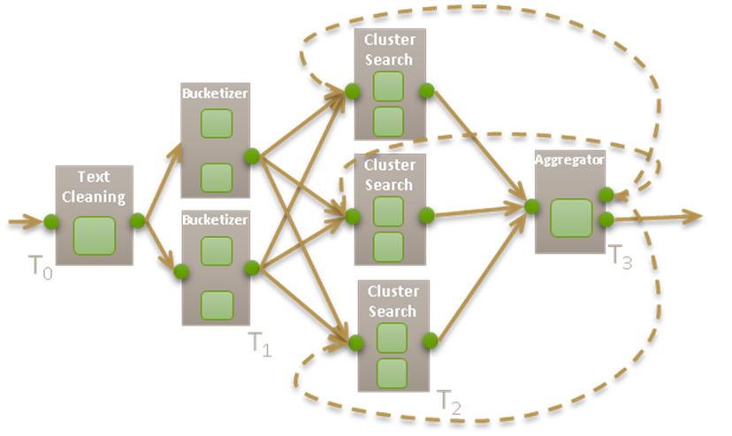
Distributed LSH Based Online Clustering

Slide 11
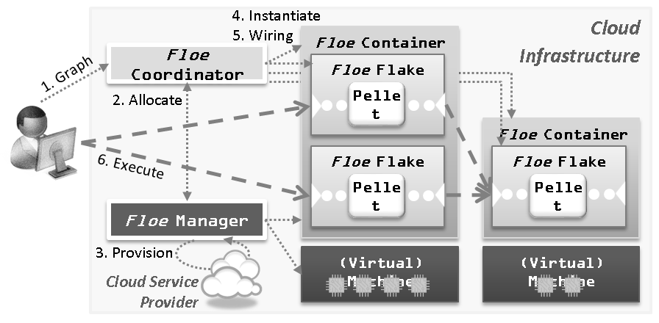
FLOE
Simmhan et. al. “Floe: A Continuous Dataflow Framework for Dynamic Cloud Applications”, CC Grid 2013 (under review)

Slide 12
Distributed LSH Based Online Clustering
Resolved:
Clusters are divided into several machines so that each node only handles a subset of clusters
Each node operates in parallel.
Remaining Issues:
No Concept of “active” clusters
Precision/Recall performance degrades

Slide 13
Local Cluster Sweep (future work)
Periodically, in background (every hour?)
Iterate through all local clusters
Check “last updated” timestamp
If earlier than “Now – Threshold” – Write to disk
Resolved:
“active” clusters are kept in memory, rest stored in disk
Remaining Issue:
Precision/Recall performance degrades

Slide 14
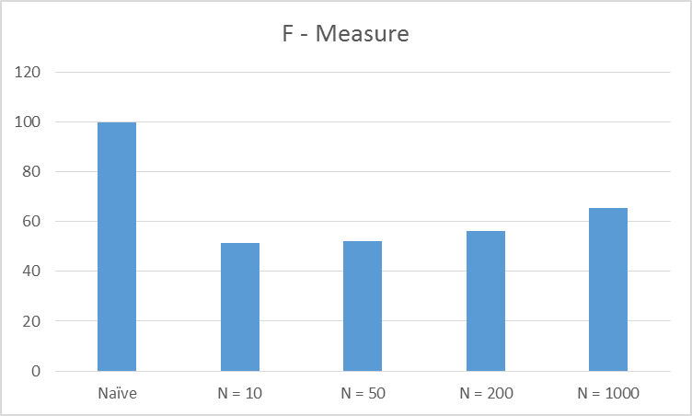
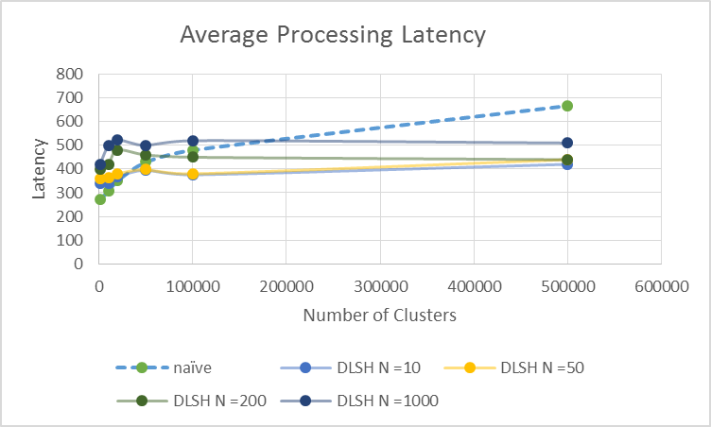
Results
Data Set: Memetracker dataset ( 100,000 Phrases ) by SNAP, Stanford And Data set by Calufa ( 100,000 Tweets )
Clustering Accuracy
Clustering Performance
F-Measure
Latency

Slide 15
Backup

Slide 16
Min Hash
Pr[h_{min}(A) = h_{min}(B)] = J(A,B).
k different hash functions, where k is a fixed integer parameter, and represents each set S by the k values of h_{min}(S) for these k functions.
Localilty sensitive.

Slide 17
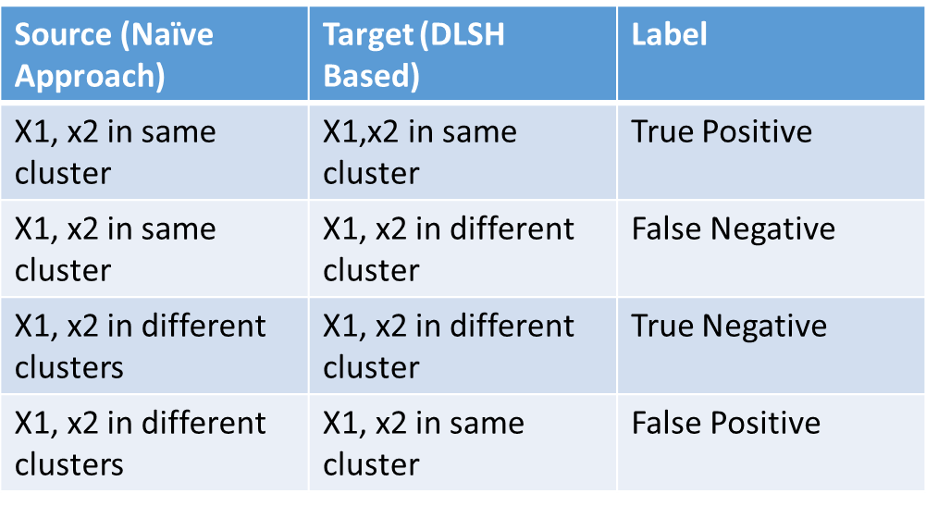
F1-Measure Calculations
One pair (x1,x2) at a time:
$$F1=2 \frac{precision . recall}{precision+recall} =\frac{\#true positive}{2 ∗ \#true positive+\#false negative+\#false positive }$$

