Slide 1



Using Quarto to Improve Formatting and Automate the Generation of Hundreds of Reports
Keaton Wilson – Solutions Developer – KS&R
Connect
GitHub Reprex
Notes:
Start w/ standard intro – KS&R Info
We’re a 43-year-old Market Research and Consulting Company
A variety of data and research focused solutions across different sectors and clients
I work as a Solutions Developer in Decision Sciences and Innovation, which handles survey design and development, statistical analyses and automation and AI solutions.
These data are often the result of surveys (frequently online), with a variety of question types (open ends, multi-select, single-select, etc.)
Sample sizes range from dozens to thousands of respondents per project

Slide 2
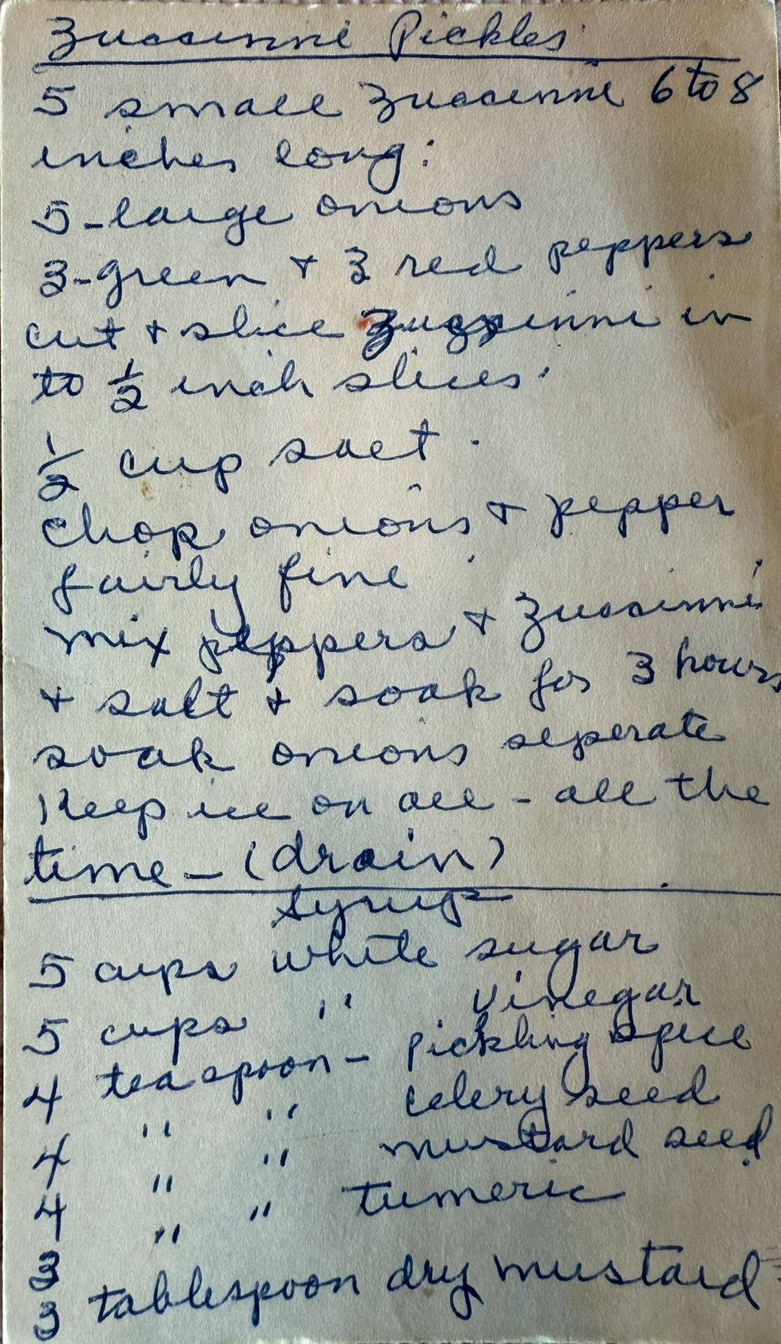
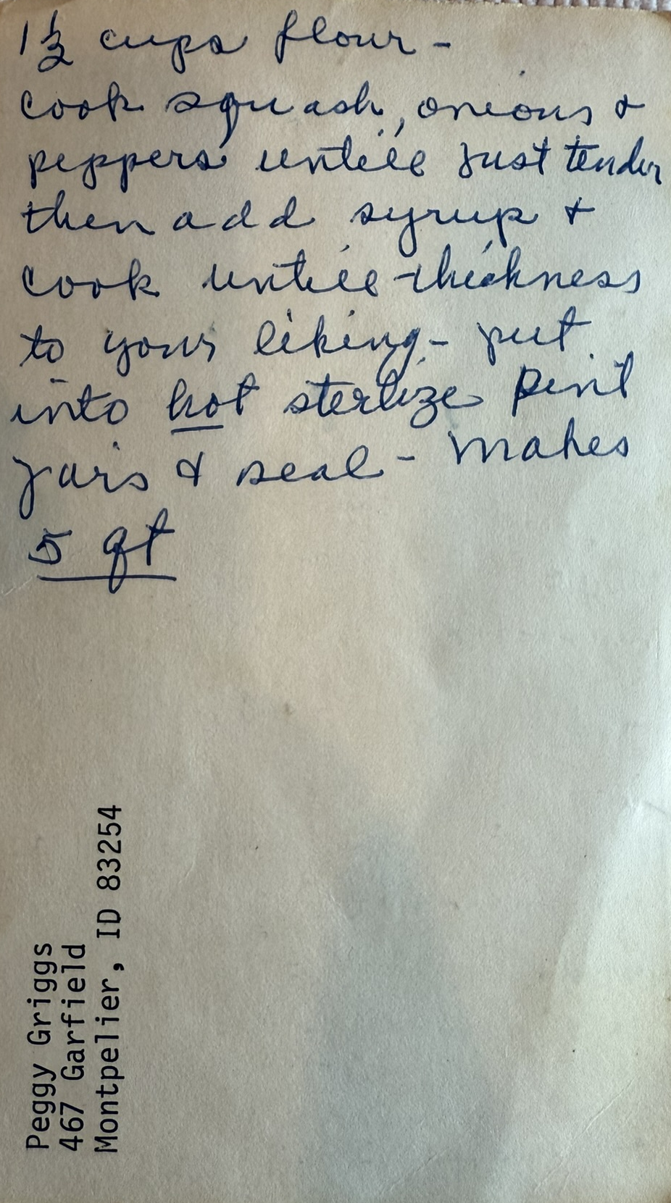
Hard to read
Self-edits
Ambiguous instructions
Scaling challenges
Retro or hard-to-find components
Can’t ask for clarification

Slide 3
Reporting and data pipelines are recipes
Up-to-date and thorough documentation doesn’t exist
Hard to read
Ambiguous instructions
Self-edits
No version control or GUI-based workflows
Retro or hard-to-find components
Why fix what isn’t broken? Outdated toolkits.
Scaling challenges
Speed, capacity, effort grow non-linearly as client-asks compound
Can’t ask for clarification
Team members leave or move on
Notes:
At least we have a recipe! Sometimes the recipe only lives in the head of a single person at your company!

Slide 4







Our recipe challenge
Survey data from a variety of global respondents
Client wants PDFs representing answers for every respondent
Hundreds of respondents per wave, repeated every year
Individual reports need to be generated every week
Historic pipeline and pdf formatting built in Mail Merge
Had a team member leave that had built the pipeline
Wide SPSS data is a dominant feature – cross-functional data structure and naming
De-silo pipeline with replicable infrastructure (GitHub) and documentation

Slide 5


Slide 6






Raw Survey Data
Helper functions
.qmd template
Network drive
Collaborative effort with survey programming team
Automated to be generated/updated hourly
YAML header
Wrangled, tidy(er) data
Main Automation Script
Data store
Report store
GitHub Reprex
Notes:
Transition gracefully to hurdles in the next slide – this is the how, but the reality is that the best laid plans are never really enough.

Slide 7

Notes:
We have a foundation, some infrastructure. But there were hurdles!

Slide 8


Automation <-> Flexibility
Spectrum
Updated Design + LaTeX

Slide 9
“We need it to be automated, but also need to pick and choose which date ranges we want to run reports for…”

Slide 10
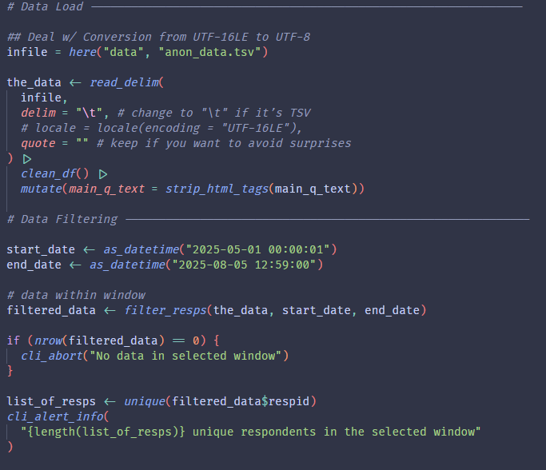
Read in all the data
Set up a filter window
Inform end-users
Pass IDs on to the rest of the automation
Notes:
1. Remind people that this lives in the main automation script. We wanted to put it in a single place for ease.
2. Liberal use of cli in development at KS&R – useful way to give end users quick feedback about what is going right (or wrong) in a script they’re running
3. A few custom functions here, nothing fancy, just some more bespoke cleaning happening on the backend that is better tucked away into a module or two
4. Skipping library calls at the top

Slide 11



Why does design matter?
Minimal upgrades improve trust and clarity
Professional look + upgrades = engagement
Internal impacts – faster QA/QC, better experience
Notes:
Why should we care about the design of a simple PDF?
Close with transition – what we did was really minimal – these are not crazy changes, and this is not the most beautiful, creative, pdf-report in the world.

Slide 12
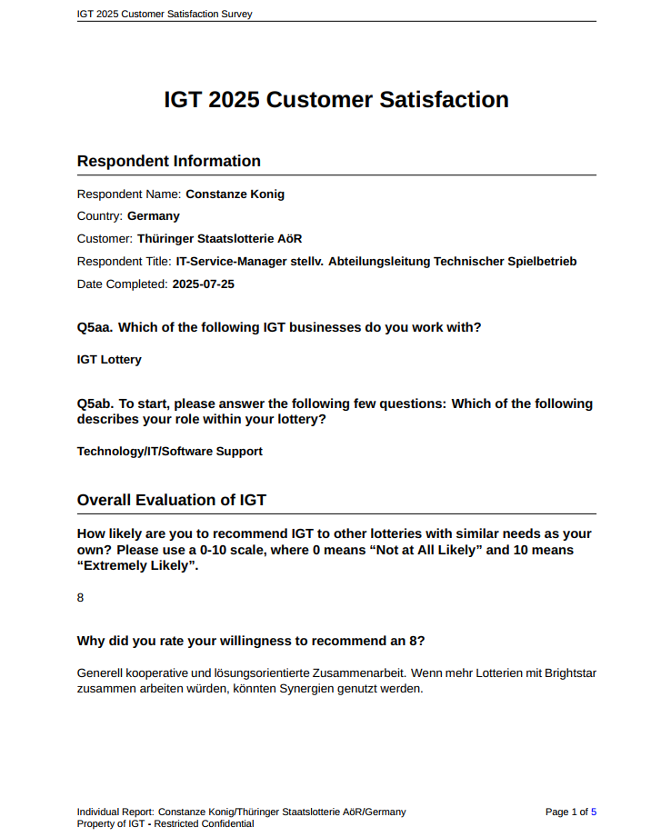
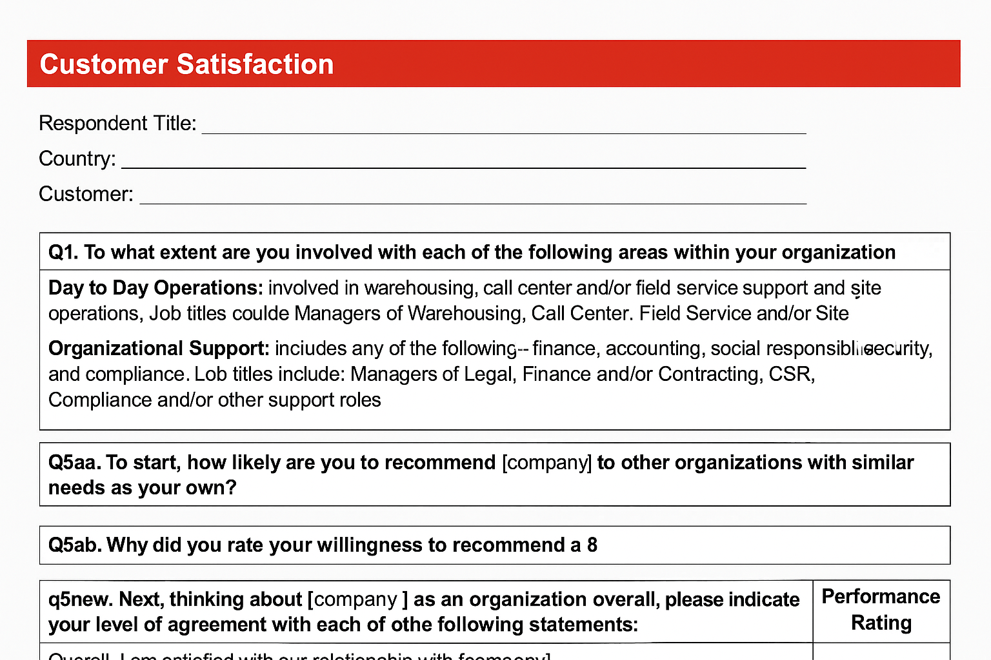
Space and breathing room
Clark Kent
CFO
USA
South Africa
Daily Planet
Oscorp, Inc.
Junior Reporter
2025-09-05
Subsections
The Daily Planet – Metropolis Branch
Junior Reporter
the vendor?
The Metropolis branch consistently provides a better working environment with colleagues than my experiences in other newspapers, particularly those in Kansas.
Remove boxing – this is a document
Custom headers and footers
Notes:
Note that some blank/white spaces are due to redaction/anonymization.
Old design vs New
Small changes, really, but some nice touches

Slide 13
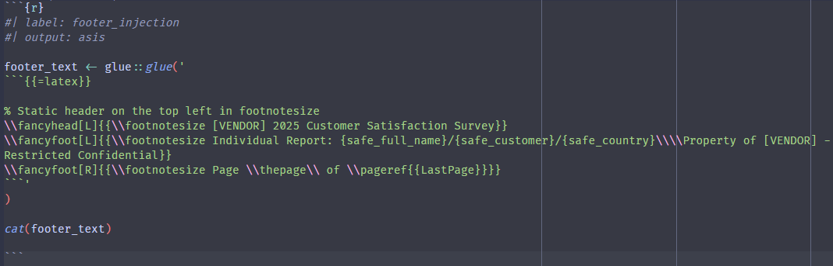
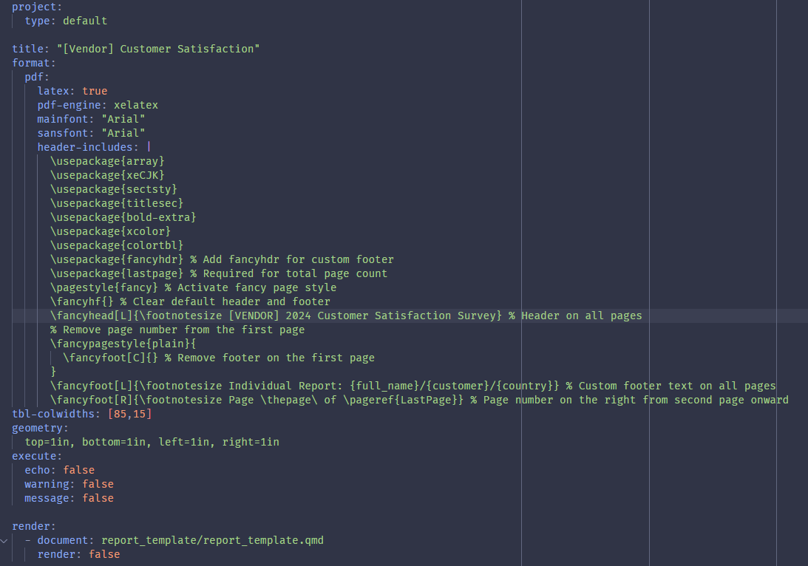
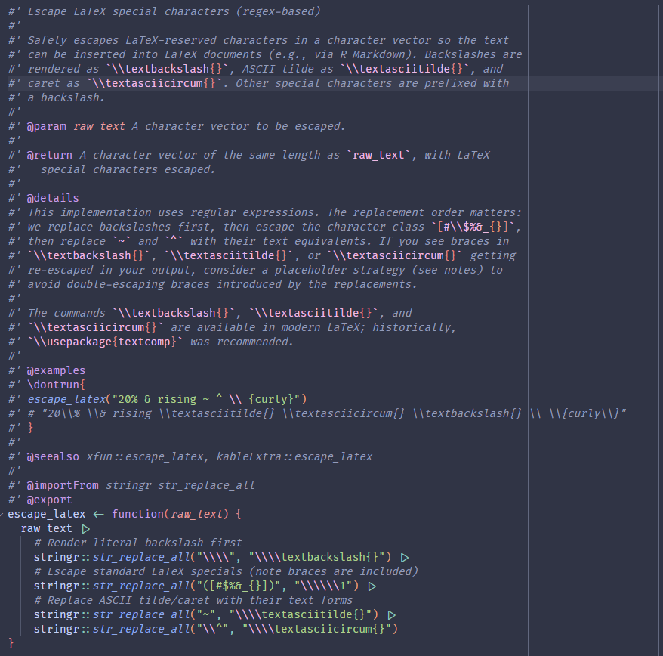
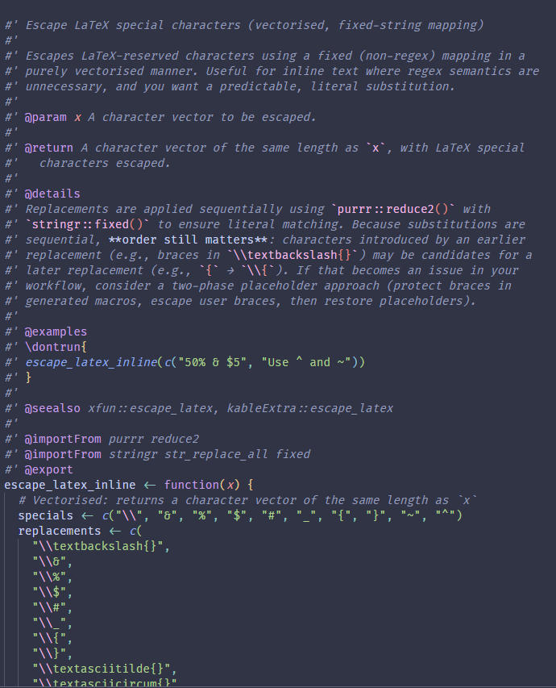


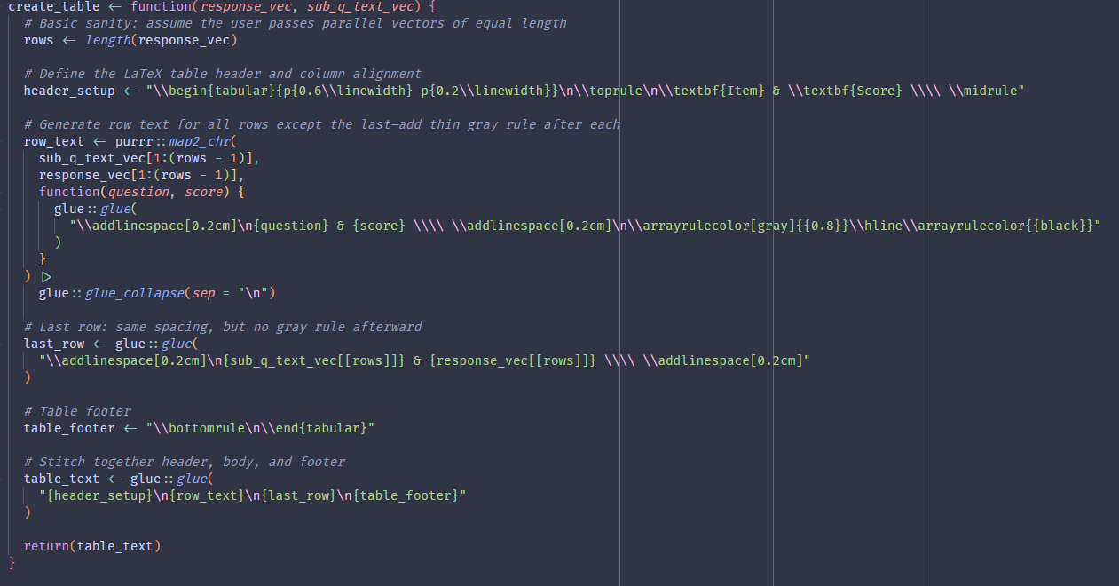
Notes:
I’m not a LaTeX expert, and we don’t really have anyone at our company that is.
This makes this portion brittle.
On our roadmap – lots of great talks on typst and integration into Quarto last year (and this year) – something we’d actively like to investigate, test and implement.
Beauty of this reproducible new approach is that we can do this from year-to-year, but roll back if we have to.

Slide 14

Impacts & Lessons
Efficiency gains
Design improvements
Level up skills for a modern toolkit
Consistent quality and fewer errors
Collaboration and shared ownership culture shift
Notes:
Take away – the open-source tooling helped, but people and process mattered as much or more!
Cust down report-preparation time by 50%

Slide 15
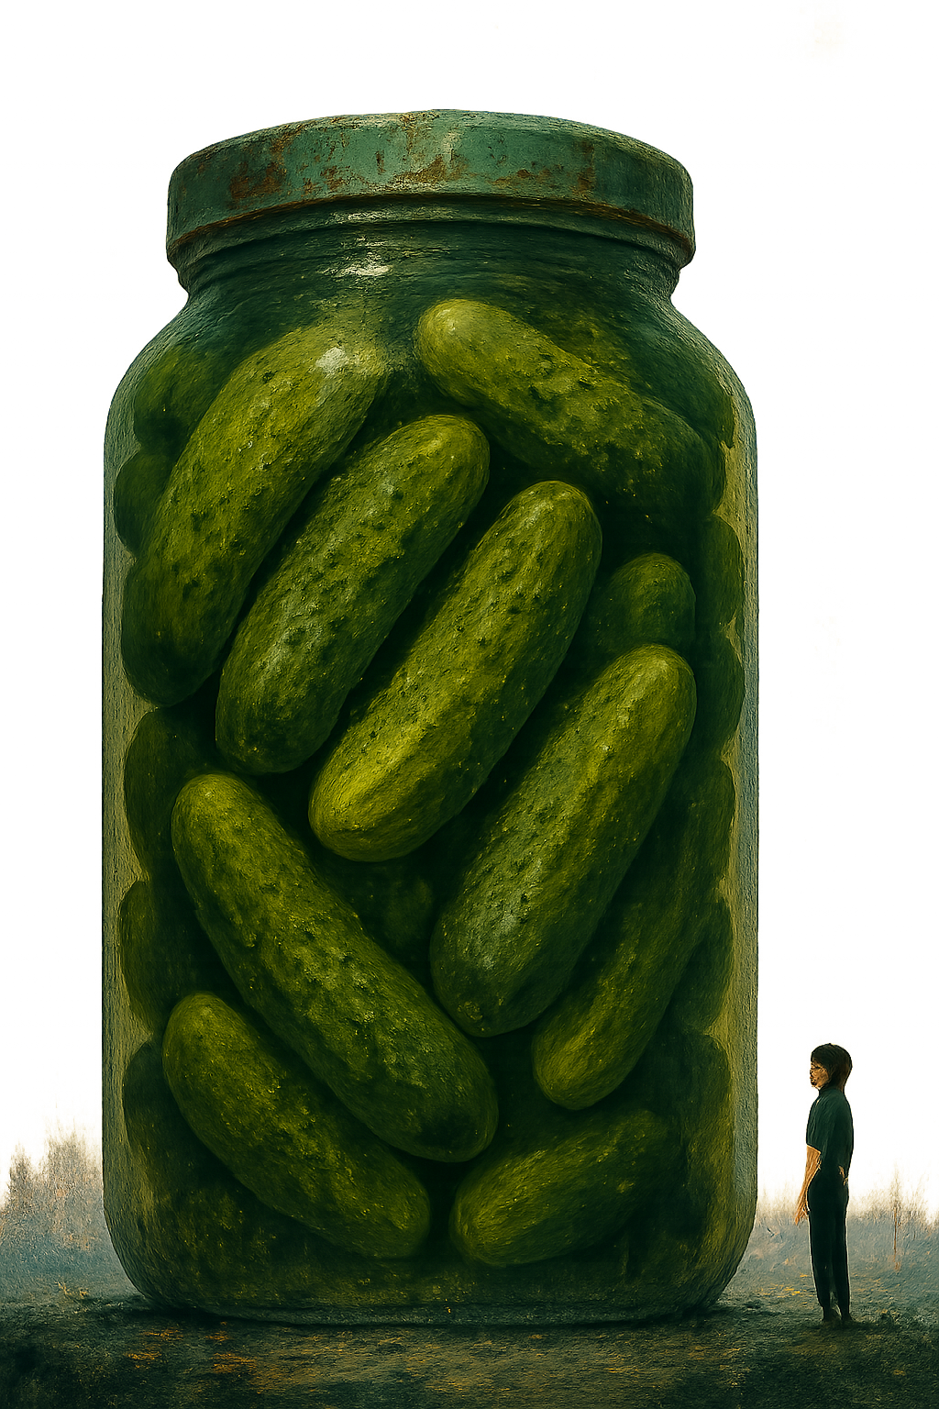




# Readme
## Detailed Instructions
### Liberal in-line comments

Slide 16






Thank you! Questions?
Decision Sciences and Innovation (DS&I)
Jamie Favata
Mike Colabello
Keaton Wilson
Project Team
Gunnar Hokanson
Amy Schaefer
Connect
GitHub Reprex

