Slide 1
POSIT::CONF(2026)
ORCA
a collaboration to build an AI-powered Shiny app, deployed on Posit Team
Keaton Wilson
Michael Thomas
(Previously) KS&R - Director, Solutions
Ketchbrook Analytics — Chief Data Scientist
Notes:
Keaton: welcome, introduce the talk and both presenters.
Share the function of what we do
Share the people that we help
Share the impact of that work
Feedback: let’s do our 2 intros and really emphasize the fact that we work w/ two different companies; set up that we’re going to talk about collaboration – talk about the different ways our brain works: “Michael is the X guy”, “Keaton is the Y guy”, etc.
Let’s be sure to make it very clear in our setup (this slide & beyond) that this talk is about *collaboration* with examples from our ORCA use case, as opposed to a deep-dive into a specific app

Slide 2
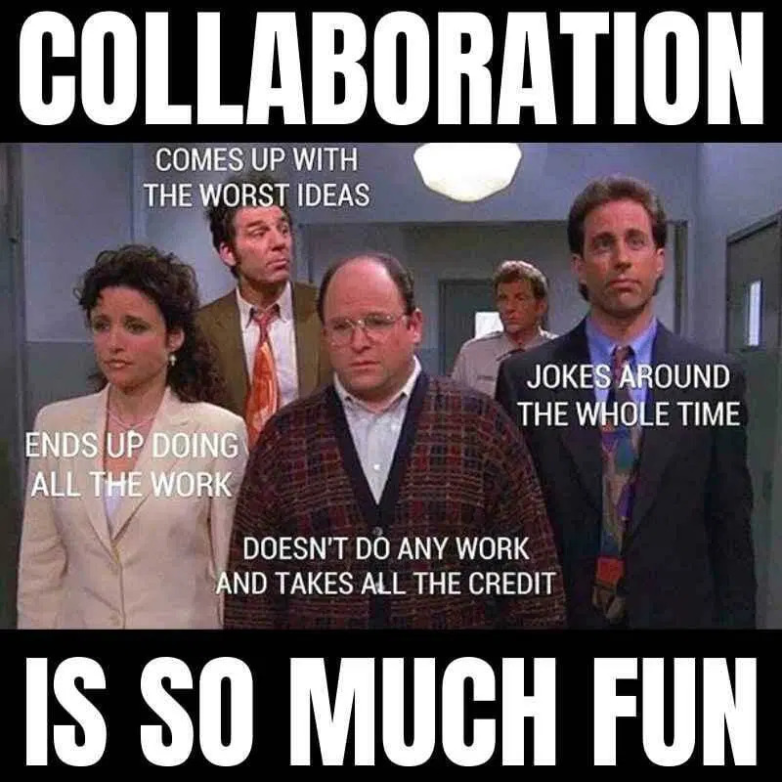
LET'S START HERE
We've all been on this team.
Notes:
Keaton, opening beat: hold for the laugh. Everyone in this room has been on this team - from group projects in school, to cross-functional committees at companies we work for, and even for business-consultant partnerships developing code and software.
How many folks in the room typically work as a lone wolf solo data scientist at their day job?
Feedback: Can we show another meme/gif either at the end (or pretty much right after this) with the Elaine dancing gif when we reveal that the collaboration actually worked great?

Slide 3
A FAMILIAR FAILURE MODE
Three ways cross-team builds fall apart
01
02
03
No clear division of labor
No shared tooling
No shared goals or guardrails
One person quietly ends up carrying the whole project.
Work happens in silos, stitched together at the last minute.
Different vision, even if division of labor is clear, serving the part and not the whole
Notes:
You might have good reason to avoid working on a team; maybe you’ve been burned by one of the three ways that team data science falls apart:
Yes, today's talk involves a Shiny app, but it's really a story about an effective collaboration model between a small team working in Market Research and a data and software development consultants. A model that leveraged UI/UX best practices, a careful and conscious division of labor and a Posit-enriched tech stack to facilitate.

Slide 4
This wasn't that.
A front-end team and a back-end team, at two different companies, who had to depend on each other to ship anything at all — and built the collaboration that made that dependency work.
Notes:
Keaton: pivot hard. This still happens in industry — a stakeholder handing over a one-paragraph spec with no back-and-forth. ORCA is the opposite story: two companies who had to depend on each other, and made that dependency work.
Feedback: We’re giving too much info here – we’re diving into the talk too quickly here; let’s do a little less of the collaboration setup
Start the story w/ the bookends: it started w/ a problem, ended with a solution, and *then* we’ll fill in the middle after that

Slide 5
WHY ORCA EXISTS
Coding open-end survey responses is slow, manual, and inconsistent at scale
AI can accelerate the work of categorizing thousands of free-text answers. But for a research firm's internal stakeholders and clients, speed means nothing without trust in the result.
Transparency
Trust
Reproducibility
Notes:
Keaton: open-end survey coding is slow, manual, and inconsistent at scale. AI can accelerate it — but internal stakeholders and clients won't accept a black box.

Slide 6
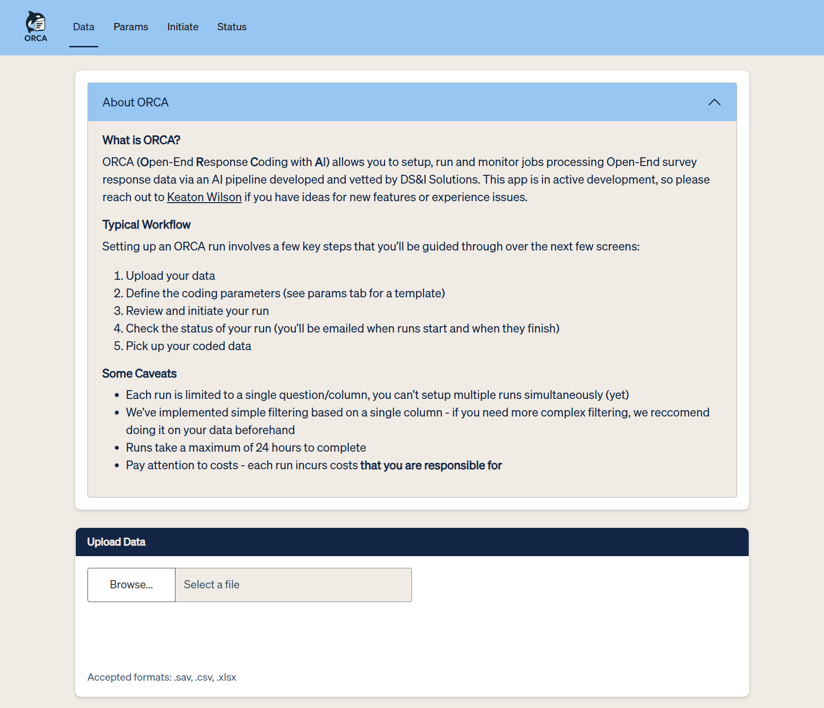
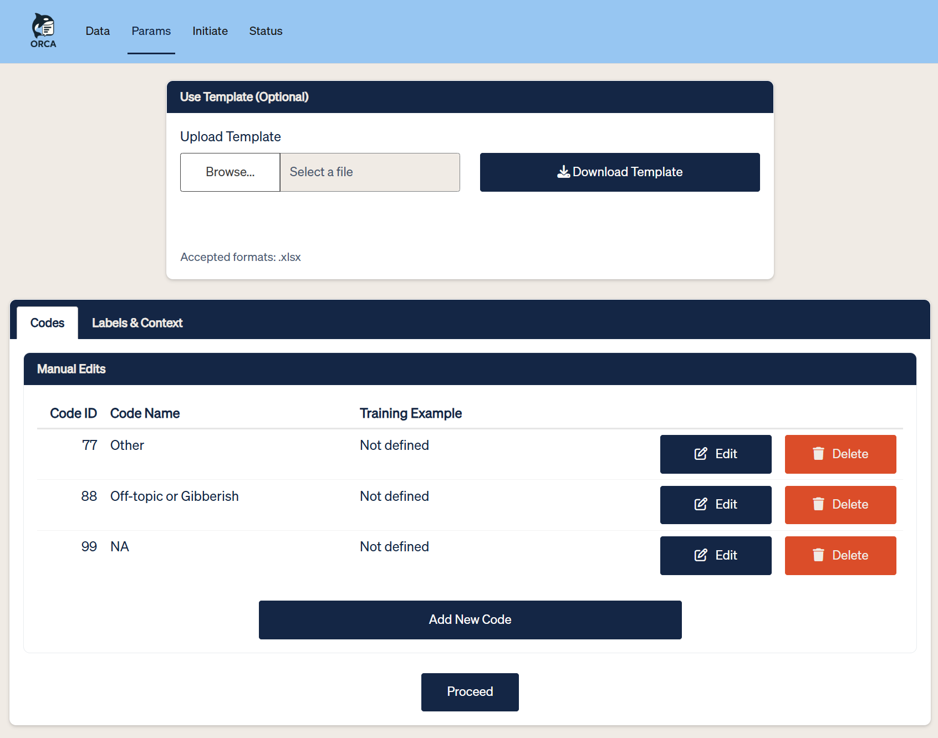
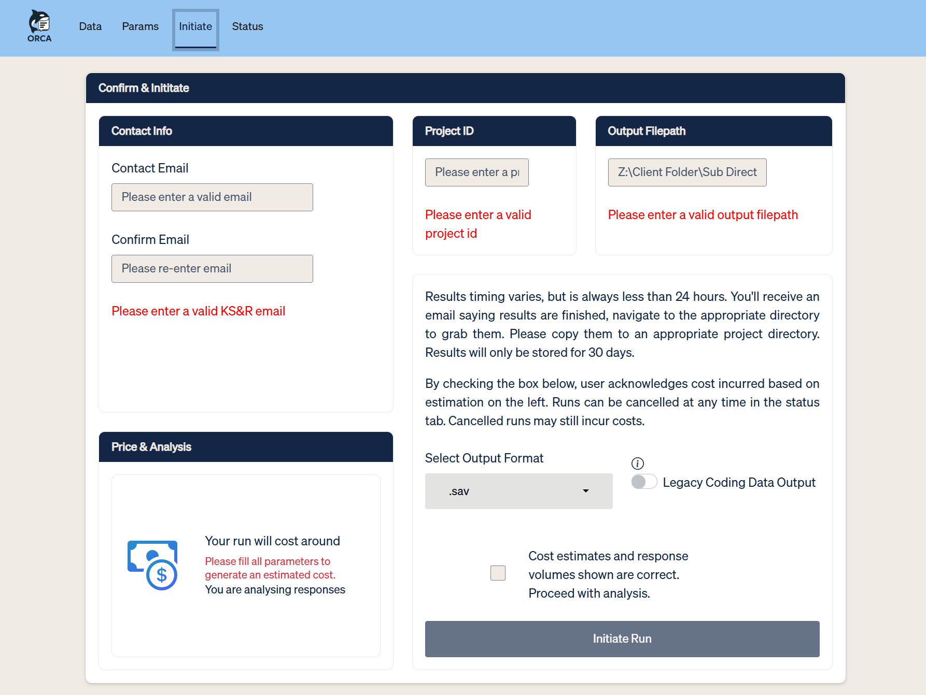
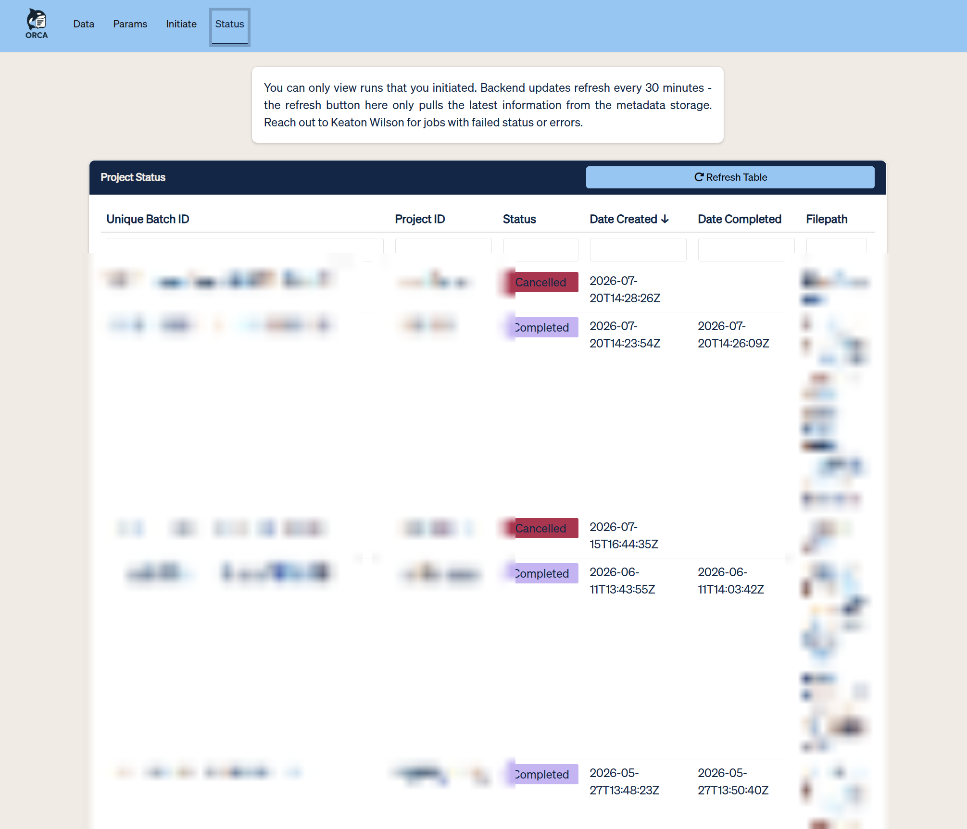
What is ORCA?
ORCA is now how KS&R's researchers code thousands of open-end responses
1
Upload data
2
Define codes
3
Review & initiate
4
Track & pick up
Notes:
Keaton: the proof is in the pudding. ORCA is now how KS&R's researchers code thousands of open-ended survey responses with AI — in production, in daily use.
-

Slide 7


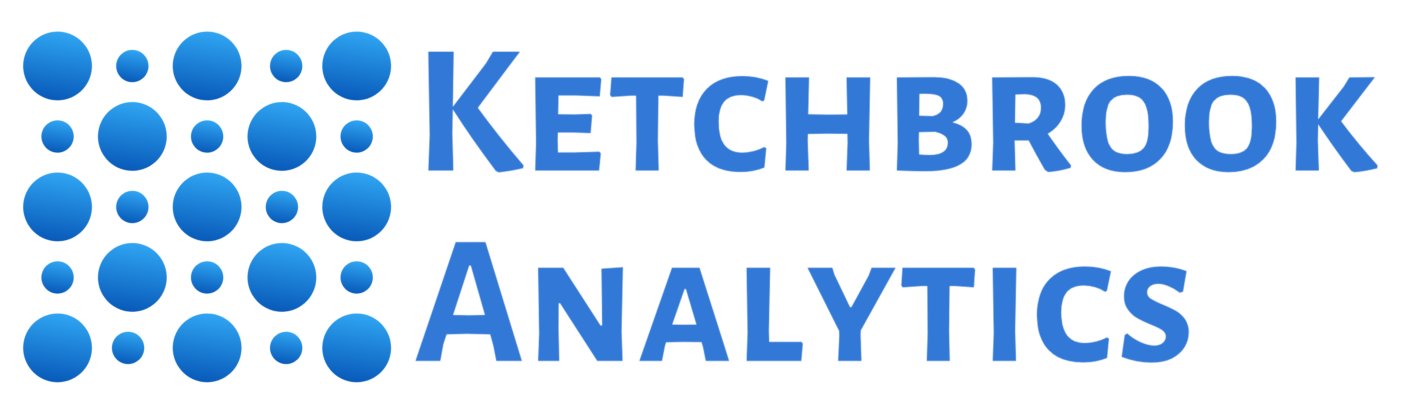
A CROSS-COMPANY BUILD
One system, two companies
Built as one of KS&R's DS&I project teams — a research firm and an external consultancy, one shared build.
+
Research firm Backend & infrastructure owner
Consultancy Front-end & UX owner
Notes:
The work to build this solution was very explicitly divided:
KS&R owned the back-end, server-side code
And the front-end user interface was Ketchbrook’s responsibility
Maybe this sounds scary, but there are some obvious benefits to this:
Speed: if you can truly work in parallel, obviously two people working simultaneously will get the job done faster than one
Error Catching: more eyes on the code is more likely to catch issues
Diversity of Thought: the best ideas will prevail (as opposed to only one person’s idea)
Specialization: no one individual person has to be a jack-of-all-trades – people can focus on what they’re best at
Keaton: ORCA is a collaboration talk, not just a tech talk. KS&R (research firm, backend/infra owner) and Ketchbrook Analytics (consultancy, front-end/UX owner) designed and built this together, across a company boundary, as part of KS&R's DS&I project-teams model.
Feedback: Have Keaton talk about *why* KS&R sought out an external collaborator as opposed to just doing it themselves in-house.

Slide 8
A DELIBERATE CONSTRAINT
Front-end external, back-end in-house
Keeping AI spend, API keys, and job orchestration in-house lowered institutional and financial risk — an external partner touching the backend carries more exposure than one shaping the UI.
It also meant Ketchbrook could move fast on the front end without waiting on KS&R's internal security review for every change.
Notes:
Keaton: why front-end external, back-end in-house? Lower institutional and financial risk for an external partner to touch the AI-spend backend versus the UI. This is a limitation worth naming early, not saving for the end.

Slide 9
TWO LENSES ON ONE BUILD
Michael
Keaton
The Shiny front end
The Posit-based back end
Job submission, response review, interactive category editing, all with golem for long term maintainability and modularity.
plumber middleware,
{pins}, and scheduled Quarto workflows.
The throughline: at every stage, a front-end decision made the back-end's job harder or easier — and vice versa.
Next — Michael, on designing together before writing code →
Notes:
Keaton: two lenses on what follows — Michael on the Shiny front end (job submission, response review, interactive code editing), me on the Posit-based back end (golem, plumber, pins, scheduled workflows). Over to Michael.

Slide 10
CHAPTER 1
Michael
Designing together, before writing a line of code
Mural
KS&R brand book
Design system & font files
Notes:
Michael takes over.

Slide 11
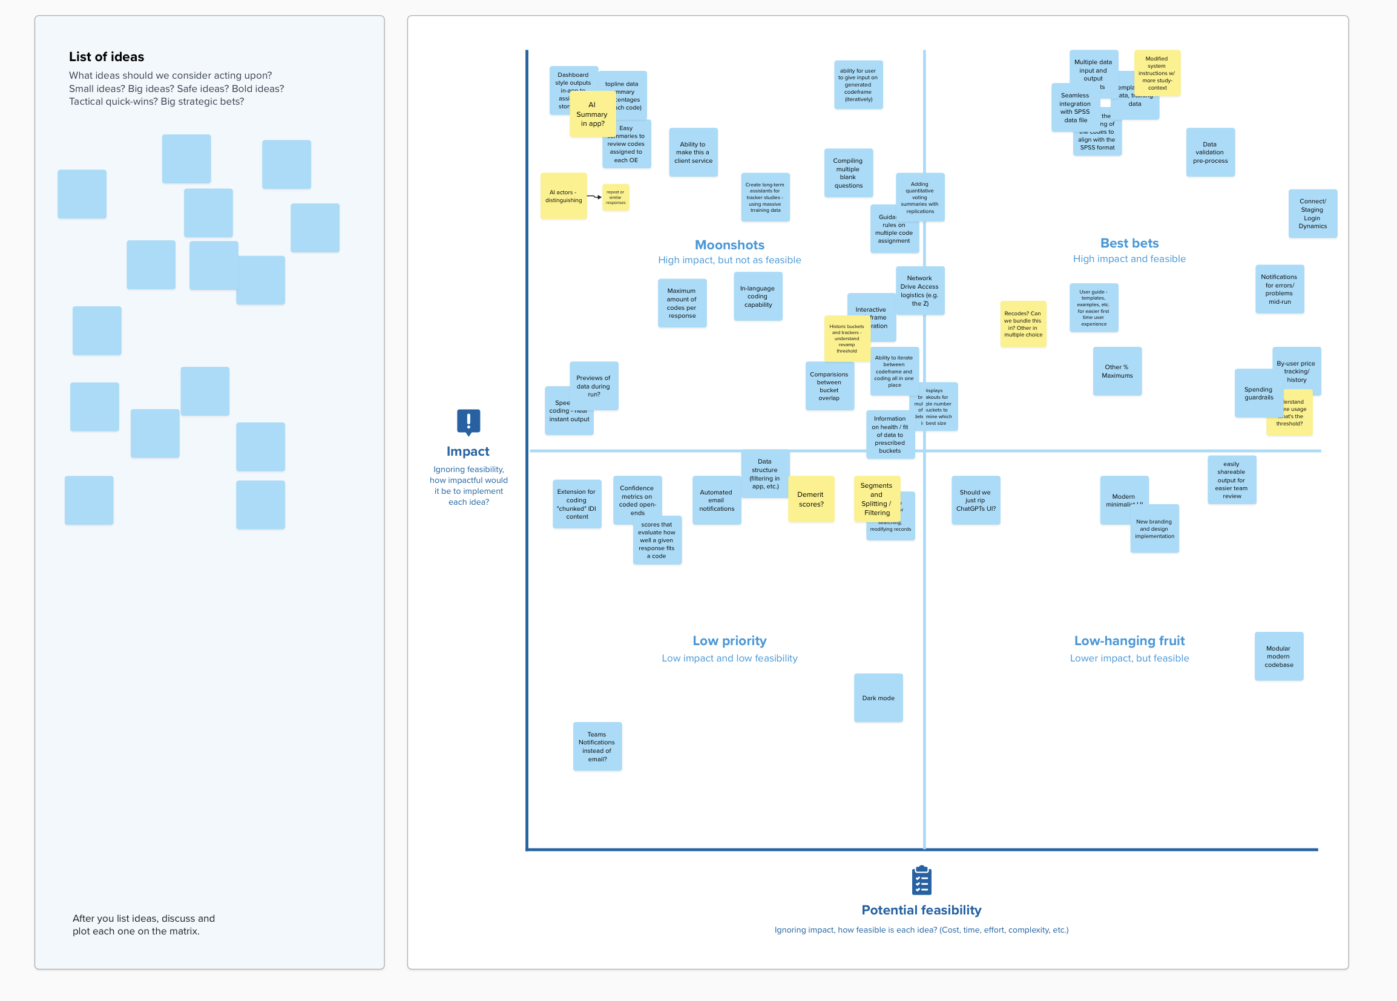
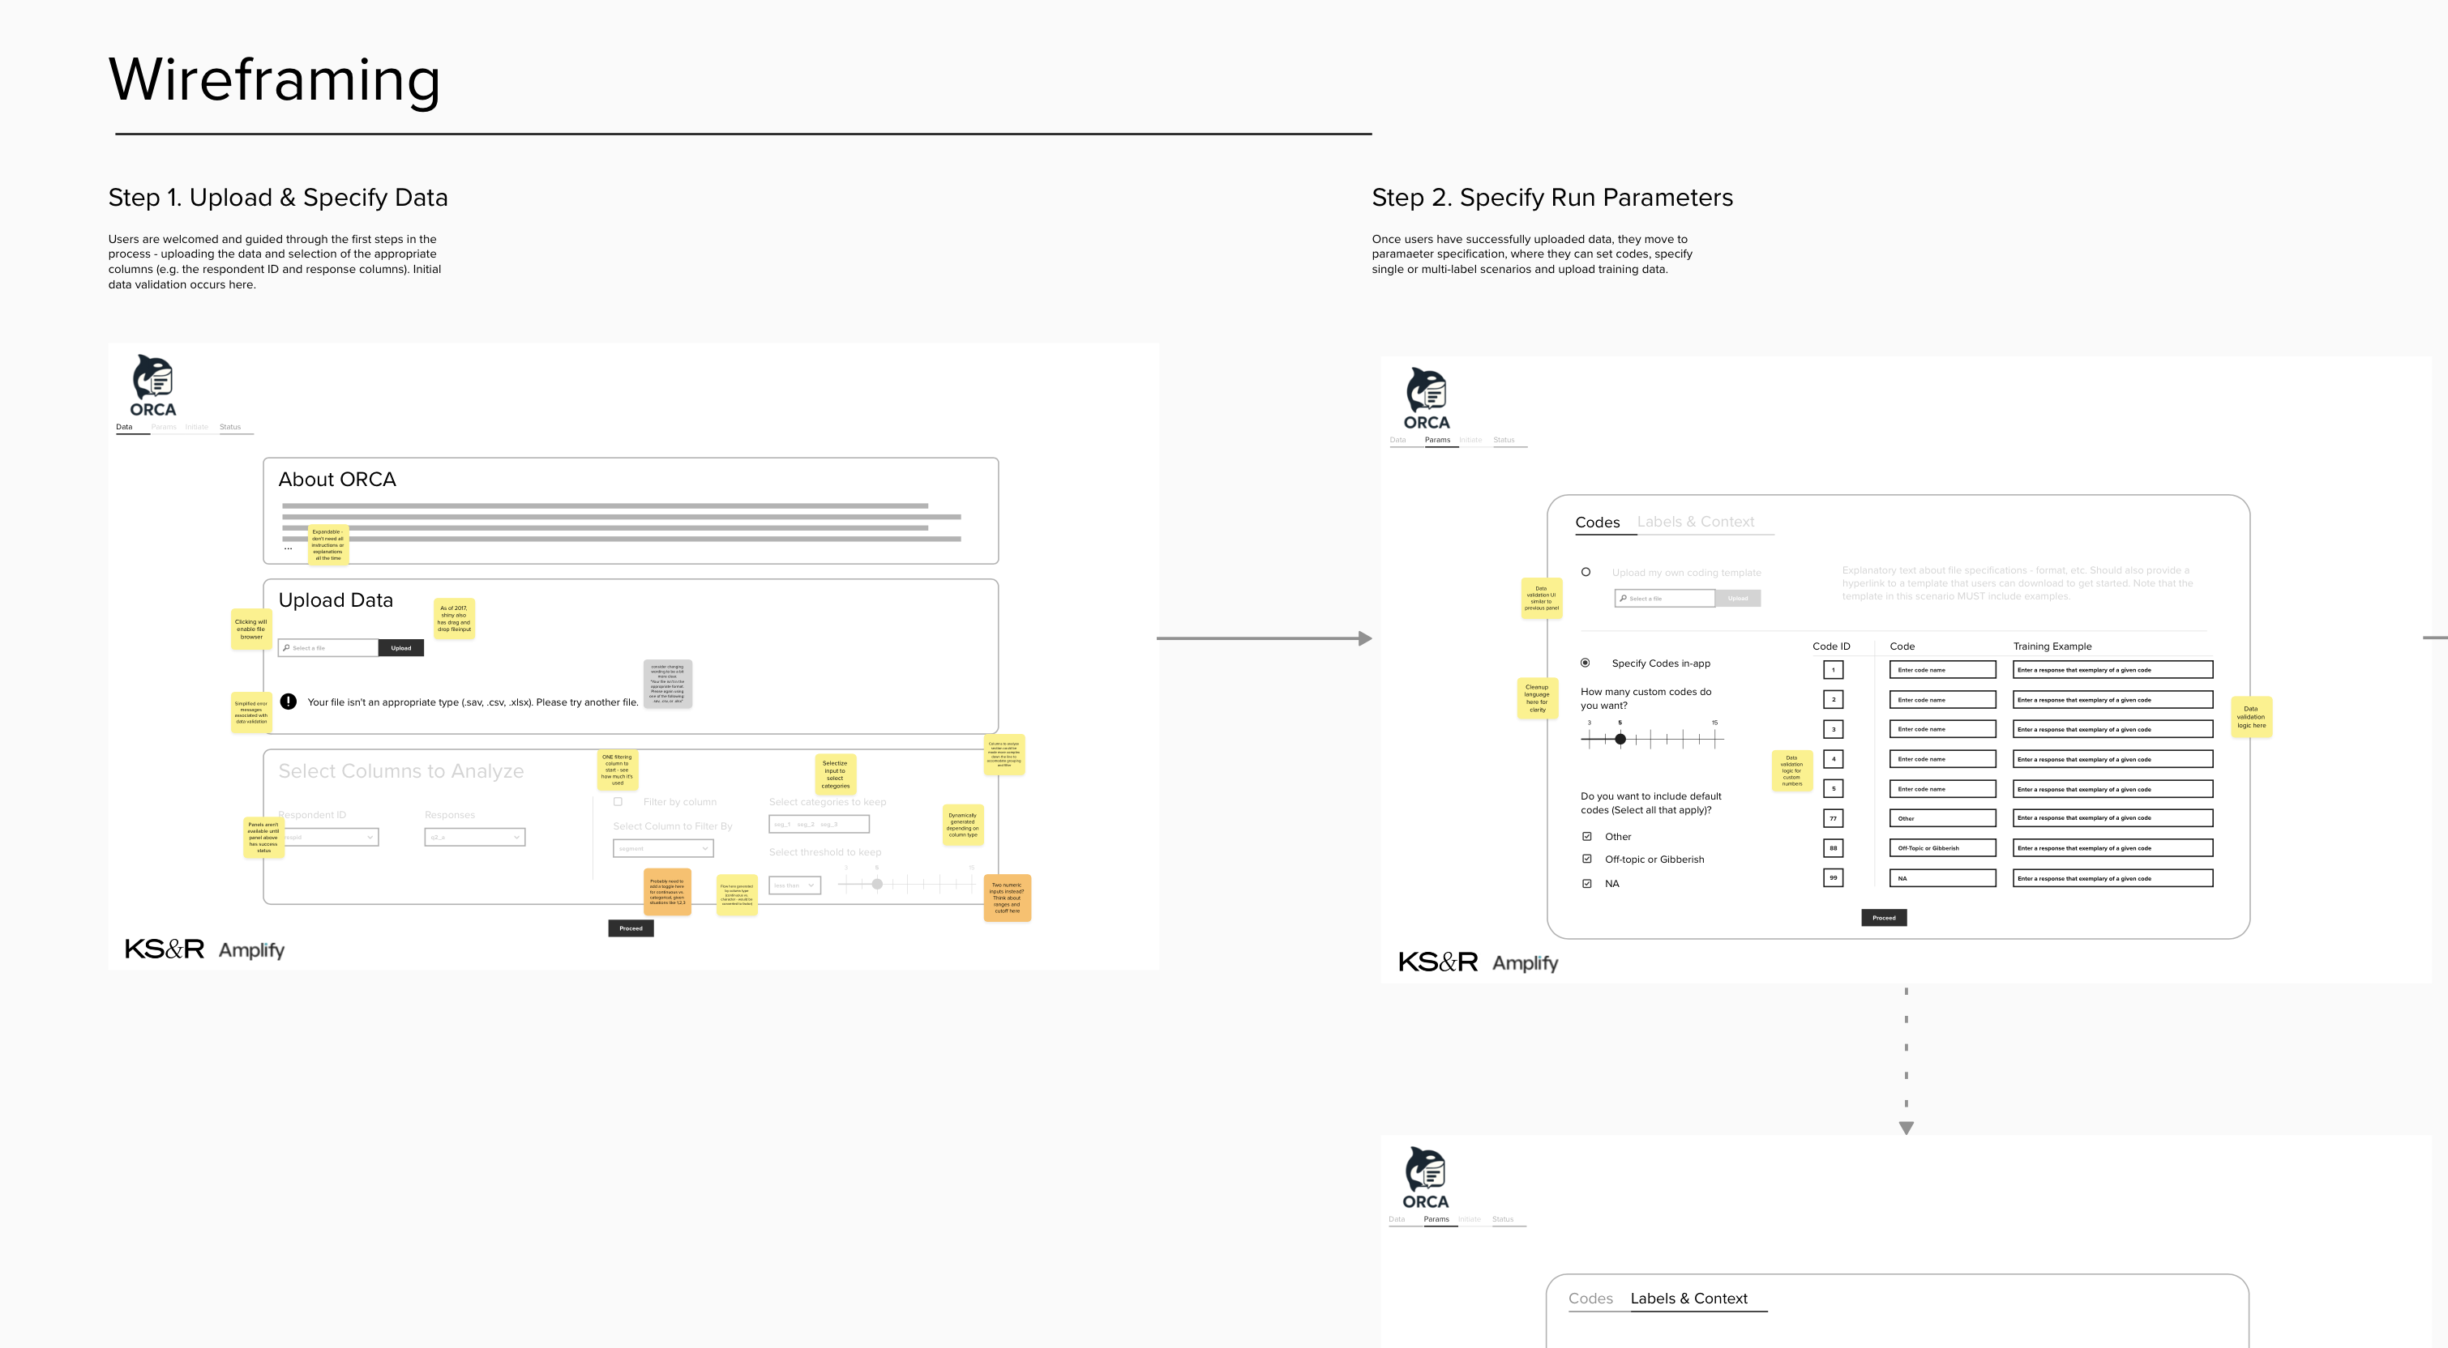
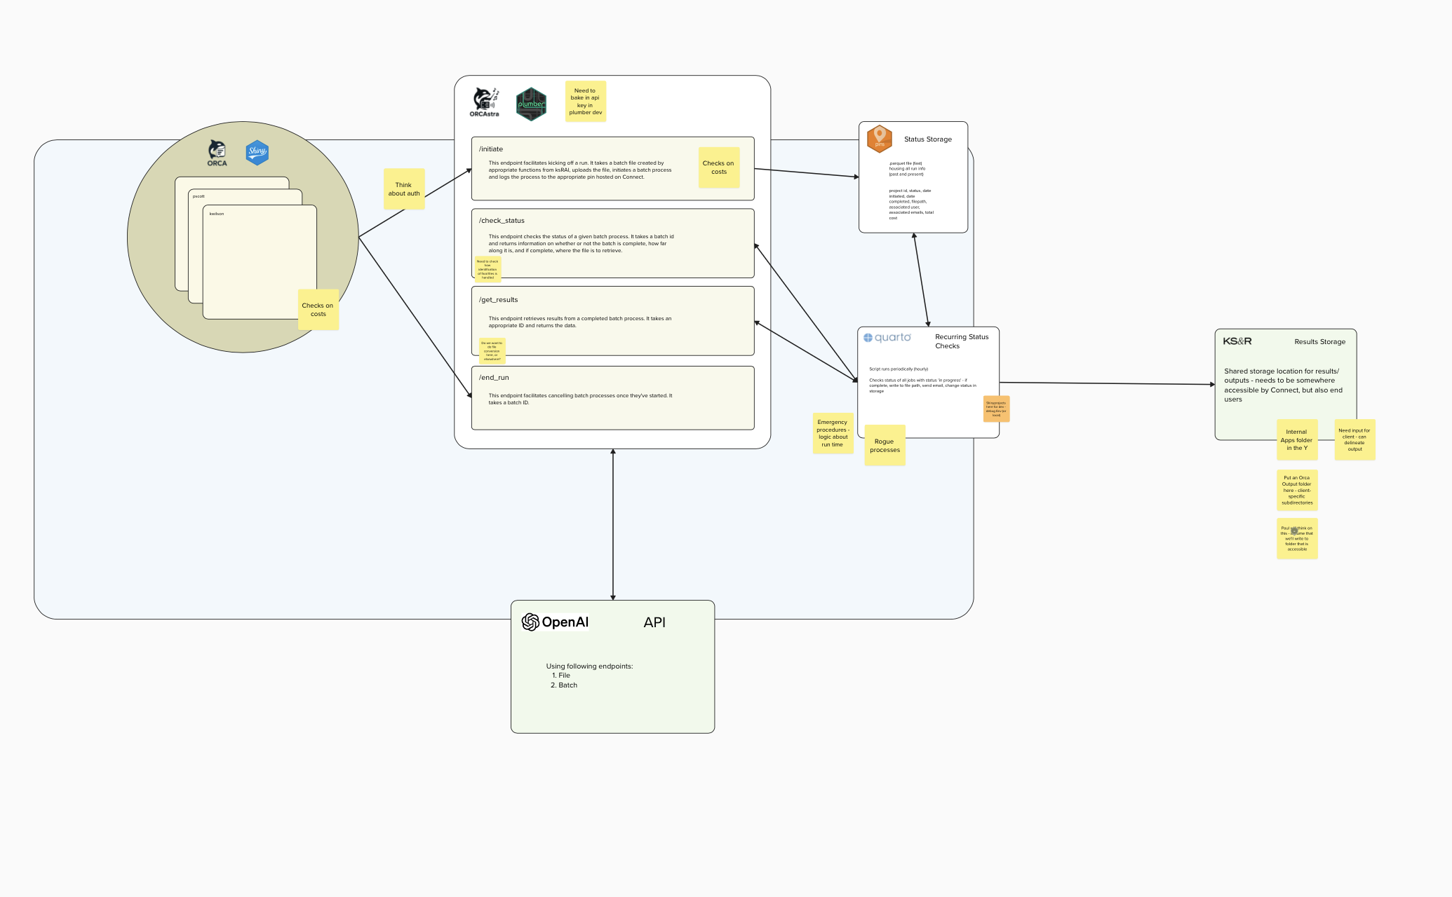
SHARED UNDERSTANDING, FIRST
Wireframing together before a single line of code
Stakeholder engagement, wireframes and API shape, sketched together in Mural - before either side committed to an implementation.
Notes:
Feedback: For each phase of the project (before, during, after), we need to have an *active takeaway* for the audience that reinforces the **collaboration**
Michael: shared understanding first. Wireframing sessions in Mural, where UI mockups and API/data shape were sketched in the same room before either side committed to an implementation.

Slide 12
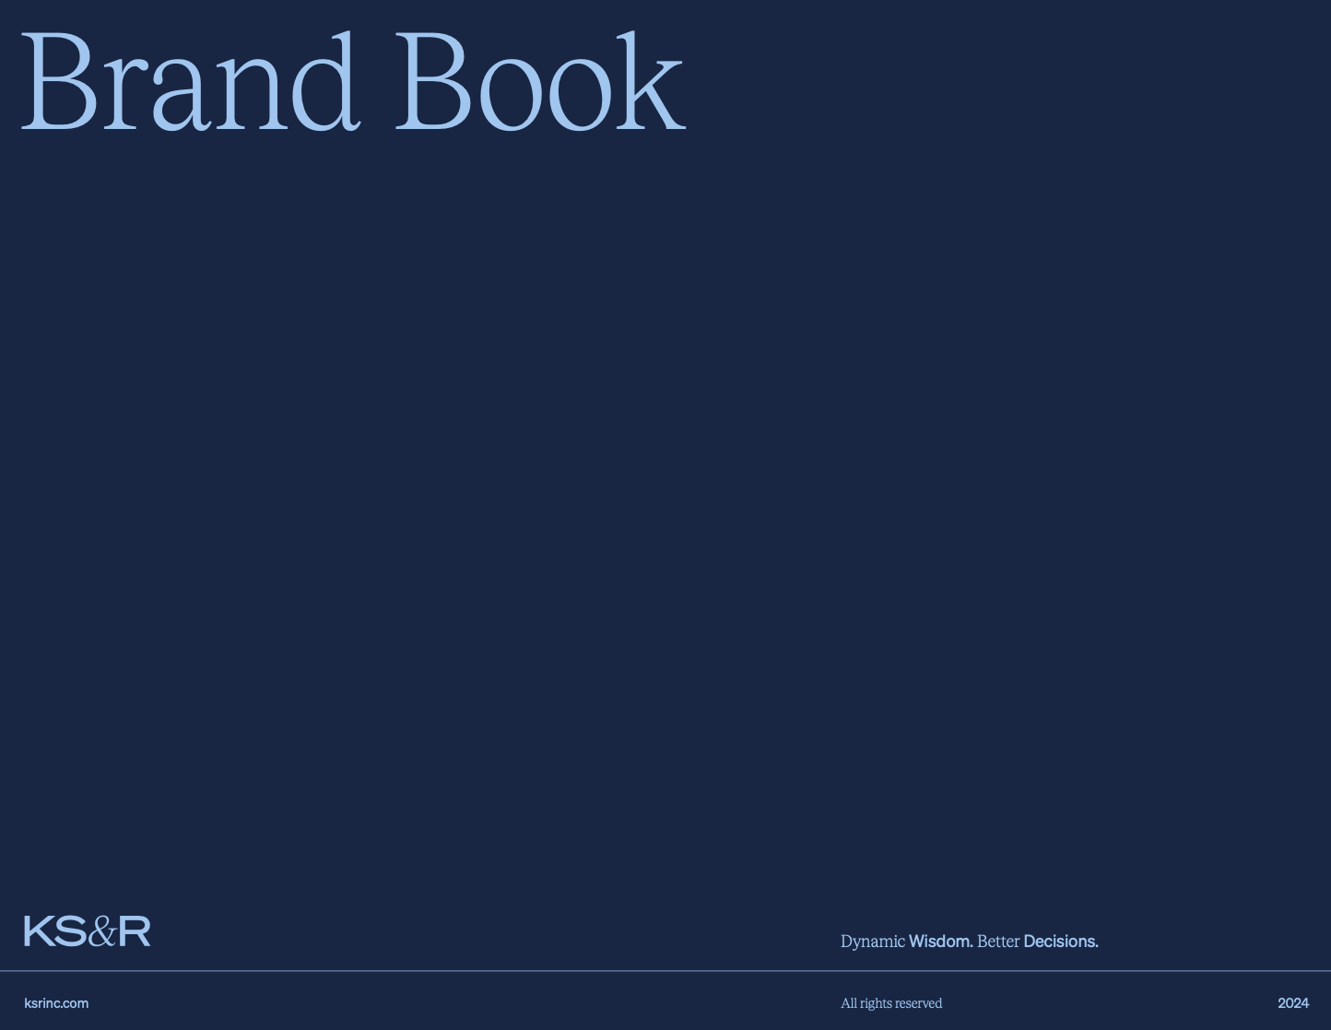




CONSTRAINTS AS A GIFT
The brand book as a forcing function
Early visual constraints gave the front end a fixed target — which in turn gave the back end a stable target: what data the UI would need, in what shape, on what cadence.
Notes:
Michael: KS&R's brand book and design system as a forcing function — it gave the front end constraints early, which gave the back end a stable target: what data the UI would need, in what shape, on what cadence.

Slide 13
THE KEY MOVE
One workflow, two contracts
Submit a coding job
Review AI suggestions
Edit & approve
↓
UI spec
API contract
Notes:
Michael: the key move — translating a research workflow (submit a job, review AI suggestions, edit/approve) into a UI spec and an API contract at the same time, so neither side was guessing about the other's needs.

Slide 14
A contract, agreed on visually, before a single {plumber} endpoint existed.
Notes:
Michael: this is the front end making the back end's life easier — a clear contract, agreed on visually, before a single plumber endpoint existed.

Slide 15
CHAPTER 2
Michael
Building in parallel, without blocking each other
GitHub Issues & PRs
{golem}
{plumber}
Notes:
Michael continues into chapter 2.

Slide 16
WORKING ASYNC, ACROSS COMPANIES
Issues and PRs as the shared source of truth
GitHub Issues tracked what needed to happen and who owned it — across two companies, with no shared Slack or shared employer.
A branching model let each side ship independently against the agreed contract, and merge without stepping on the other's work.
Notes:
Michael: how the teams worked async across two companies — GitHub Issues and PRs as shared source of truth, a branching model that let front-end and back-end ship independently against the agreed contract.

Slide 17
THE ARCHITECTURE THAT MADE IT POSSIBLE
A stable seam between two codebases
ORCA
ORCAstra
OpenAI
{golem} Shiny app
⇄
{plumber} API
⇄
Ketchbrook
KS&R
classification engine
The UI iterated against a stable API surface while the heavier logic behind it kept changing.
Notes:
Michael: the architecture that made this possible — a golem-based Shiny app decoupled from a plumber API for asynchronous job processing, so the UI could be built and iterated against a stable API surface while the heavier AI/coding logic evolved behind it.

Slide 18
IT WENT BOTH DIRECTIONS
UX needs and backend constraints, both ways
Live job status & inline editing of AI output
→
Async job handling, structured logging
Batch cost & timing
→
Progress states, review queues
The status table users asked for — and the structured logging behind it.
Notes:
Michael: a UX need — live job status, inline editing of AI output — drove a backend design decision (async job handling, structured logging). A backend constraint — batch cost and timing — shaped a front-end pattern (progress states, review queues).

Slide 19
Not an assertion — receipts.
Issues, PRs, and a contract everyone could point to — that's why this collaboration held together.
Next — Keaton, on earning trust in production →
Notes:
Michael: this answers Keaton's opening question directly — why did this collaboration succeed — with receipts, not just an assertion. Over to Keaton for chapter 3.

Slide 20
CHAPTER 3
Keaton
Separation of concerns, in production
{pins}
Posit Connect
Scheduled Quarto
Notes:
Keaton takes back over for chapter 3.

Slide 21


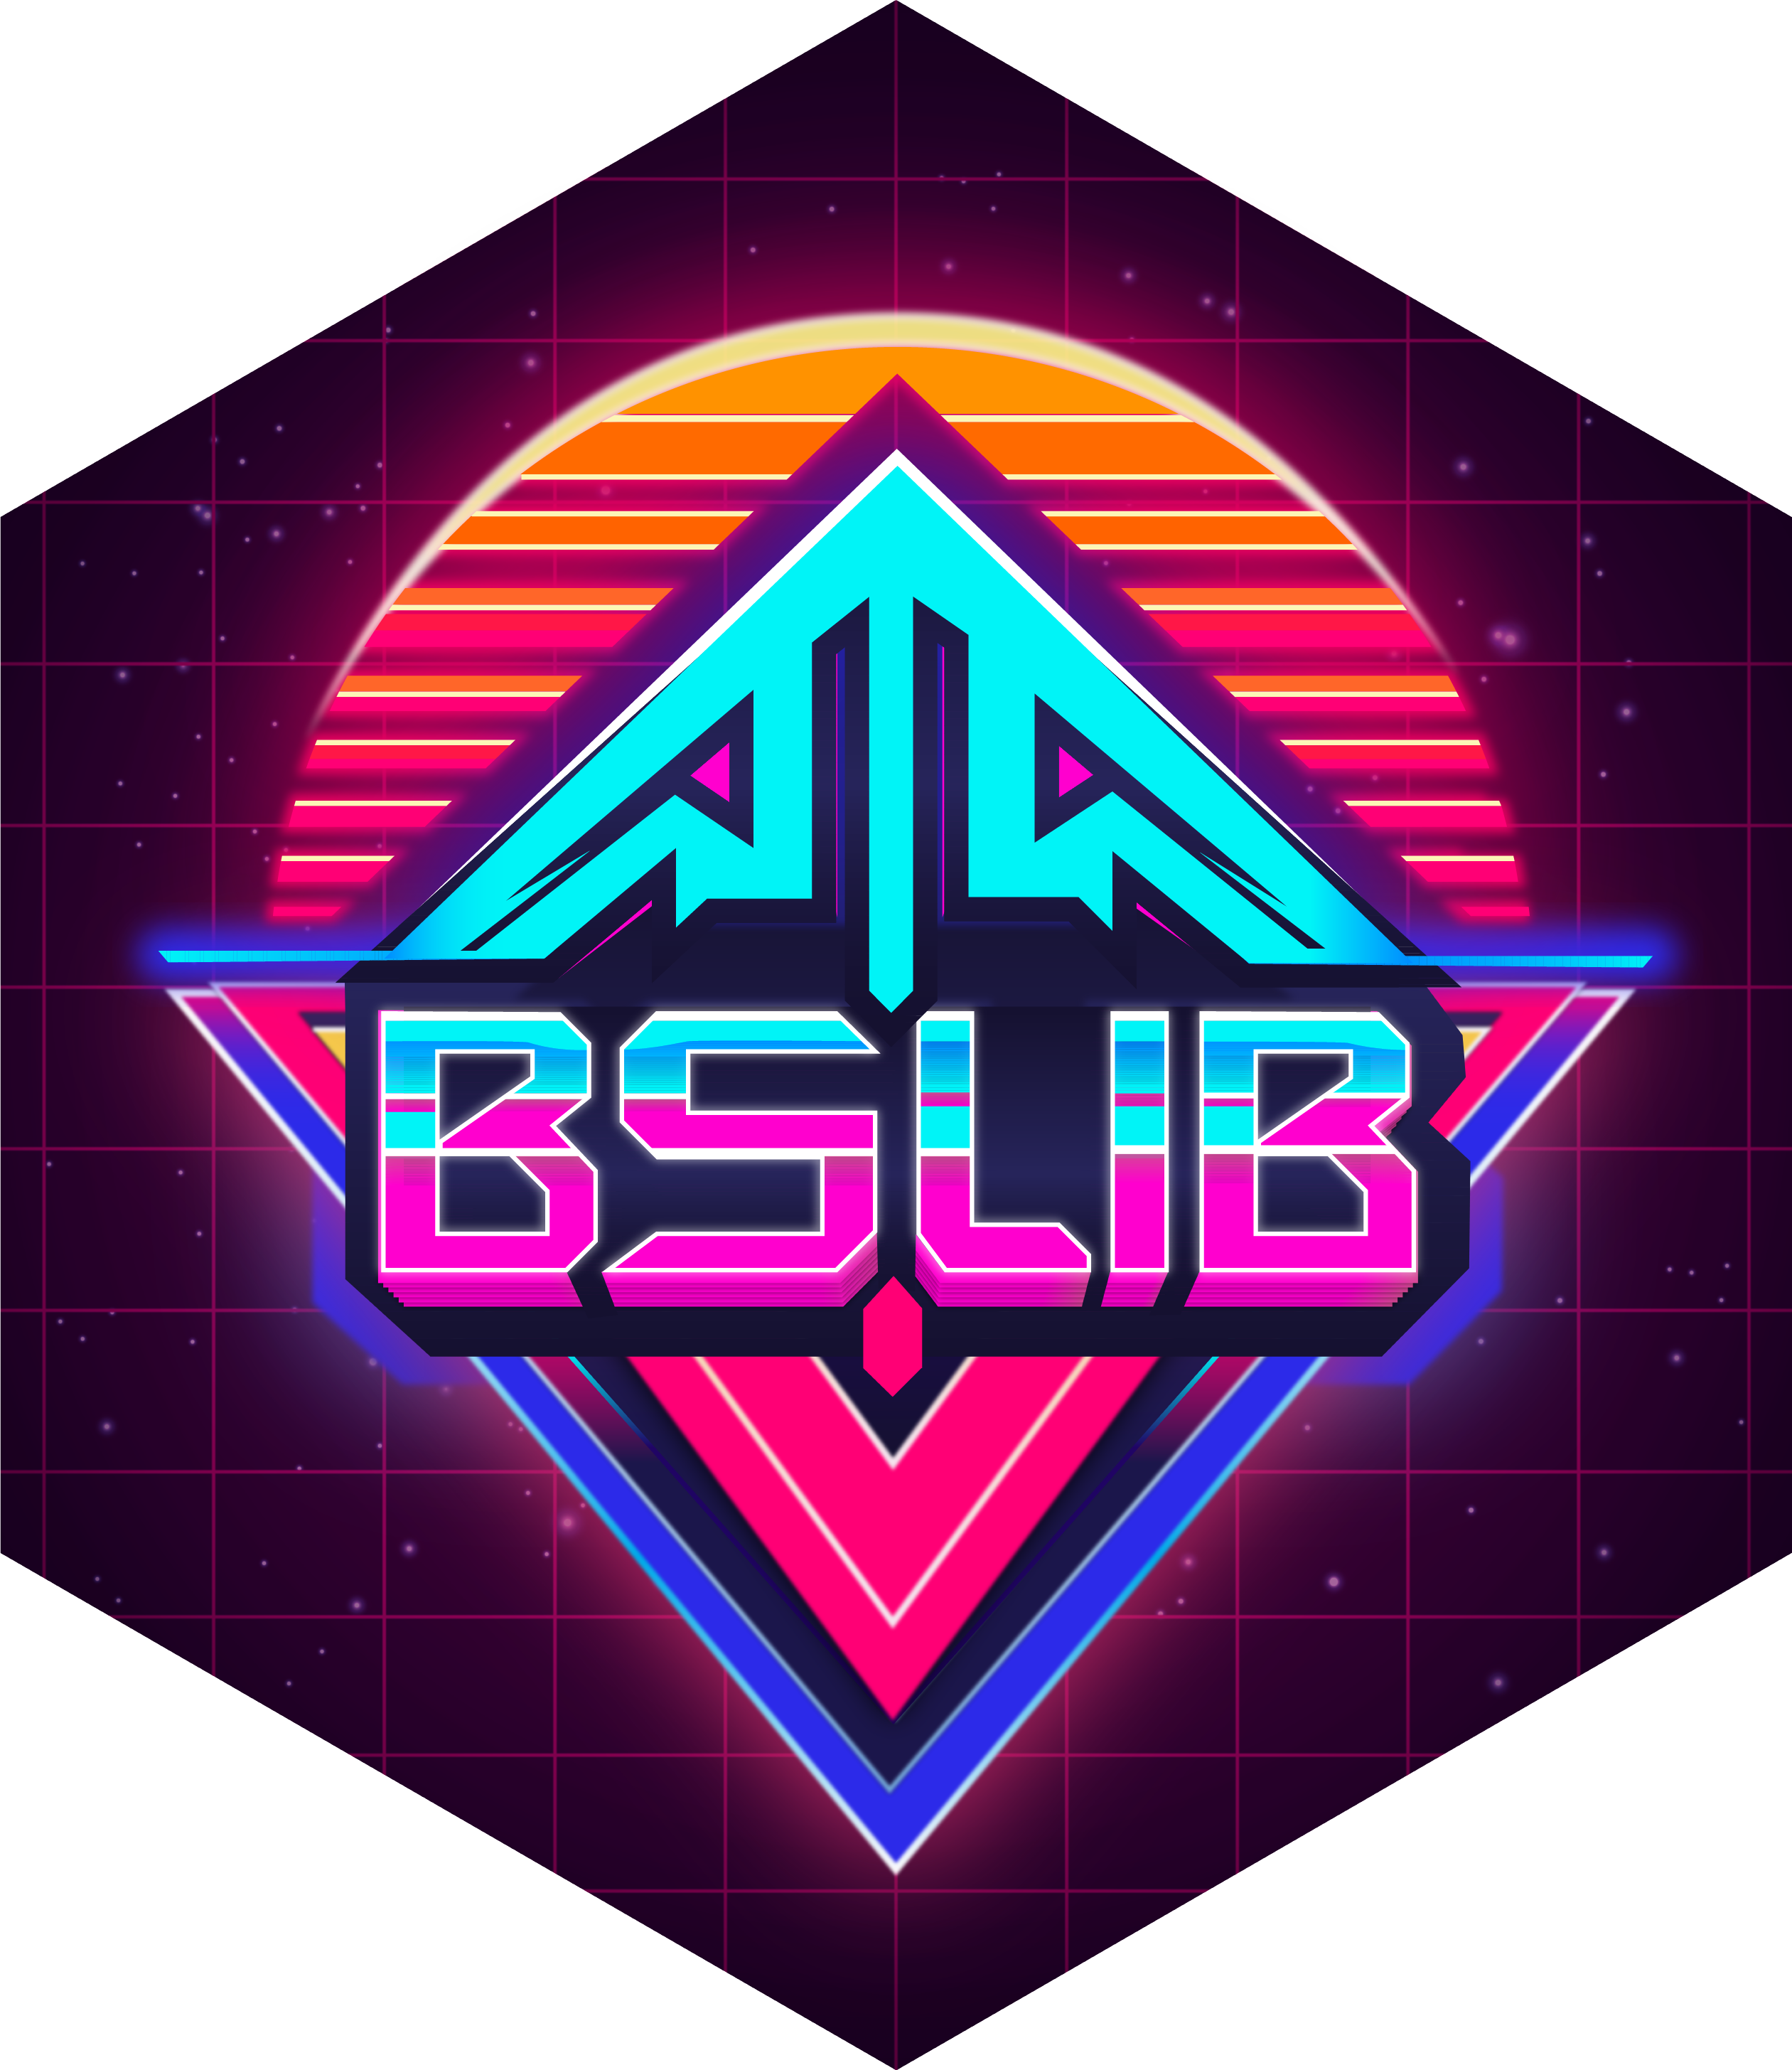
WHAT MADE PARALLEL WORK POSSIBLE
A modular backend, decoupled by design
ORCA
ORCAstra
ORCAdb
ORCAwatch
Shiny front end
Golem for modularity and maintainability
{plumber} async API
{pins} versioned metadata
Scheduled Quarto batch job
Four independently deployable pieces, each with one job — the same separation of concerns that let two companies build without blocking each other.
Blythe's test: would we have designed it this way even if it weren't an AI app? Yes — which is exactly the point.
Notes:
Keaton: modularizing the backend independently from the front end is what made the parallel, non-blocking collaboration possible. ORCAstra for async processing, ORCAdb/pins for versioned metadata, ORCAwatch for scheduled batch logging and delivery.

Slide 22
A QUICK ASIDE
I really wanted to dig into AI best practices here.
Prompt design, cost control, model versioning — genuinely interesting, and relevant to my new role. But this talk was never really about the AI. It was about the collaboration. Here's where to find it if you're curious.
Notes:
Keaton: I wanted to dig into AI-specific best practices here — prompt design, cost control, model versioning. But this talk isn't really about the AI, it's about the collaboration. Here's what I want you to know if you're curious — it's all in a repo, QR code TBD.

Slide 23
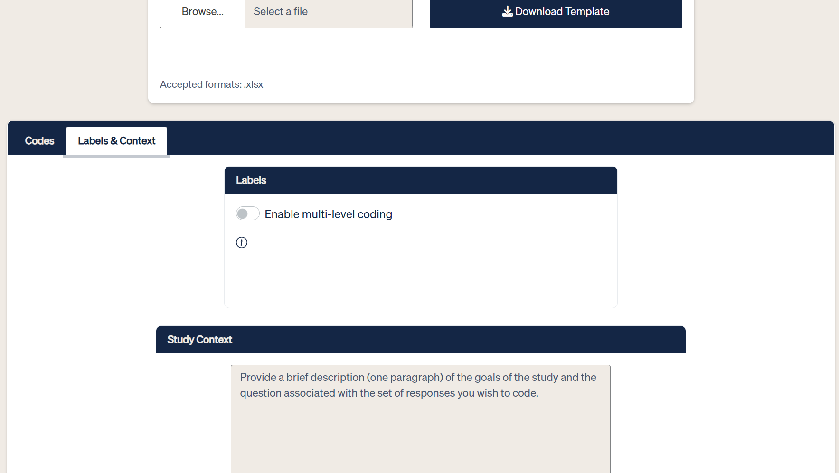
Trust is a joint deliverable.
Versioned metadata and an audit trail keep every AI-coded result traceable to a model and a data snapshot. Human judgment stays in the loop at the front end — and it only works because the back end guarantees what's underneath is reproducible.
Study context and coding labels — where the researcher's judgment enters the pipeline.
Next — Michael, closing us out →
Notes:
Keaton: pins for versioned metadata mean every AI-coded result is traceable to a model version and data snapshot. Scheduled batch workflows leave an audit trail. Ties back to the front end: the categorization spec and context interface is where human judgment stays in the loop — and it only works because the backend guarantees what's underneath is versioned and reproducible.

Slide 24
THE REAL PRODUCT
Not just ORCA — a repeatable model for cross-company collaboration on the Posit stack.
Notes:
Michael: the real product wasn't just ORCA — it was a repeatable model for cross-company, cross-discipline collaboration on the Posit stack.

Slide 25
IF YOU'RE BUILDING WITH A PARTNER TEAM
Bring a design artifact to your next cross-team project — not just code
A shared visual contract — Mural, Excalidraw, or a whiteboard, before anyone opens an editor
Issue-driven development — a shared source of truth across company lines. Don’t skimp on detail in your Issues & PR bodies.
An architecture — {golem} + {plumber} + {pins} — that lets both sides move independently
Notes:
Michael: if you're building Shiny apps with a partner team — agency/client, research/engineering, frontend/backend — invest early in shared visual contracts, issue-driven development, and an architecture that lets both sides move independently against a stable interface.

Slide 26
Thank you
Notes:
Both: thank the audience, invite questions.

