Slide 1








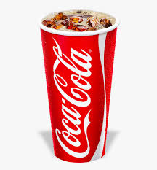




Suppose a lunch consists of one sandwich, one side, one drink, and one desert.
You have a choice of 4 types of sandwich, 4 sides, 3 drinks, and two desserts.
How many different lunch combinations are there?

Slide 2
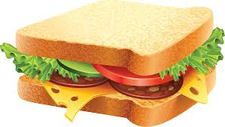
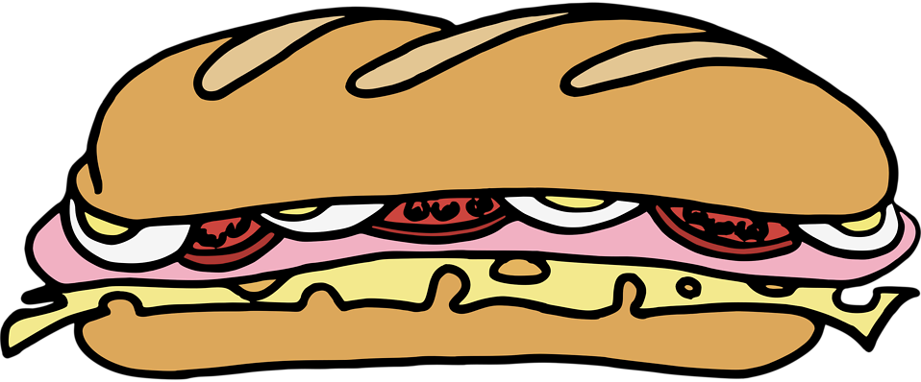
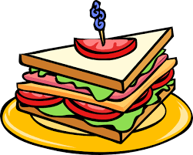

Suppose a lunch consists of one sandwich, one side, one drink, and one desert.
You have a choice of 4 types of sandwich, 4 sides, 3 drinks, and two desserts.
How many different lunch combinations are there?
There are 4 ways to choose the sandwich.

Slide 3




Suppose a lunch consists of one sandwich, one side, one drink, and one desert.
You have a choice of 4 types of sandwich, 4 sides, 3 drinks, and two desserts.
How many different lunch combinations are there?
For each choice of sandwich, there
are 4 ways to choose a side.

Slide 4
Suppose a lunch consists of one sandwich, one side, one drink, and one desert.
You have a choice of 4 types of sandwich, 4 sides, 3 drinks, and two desserts.
How many different lunch combinations are there?
For each choice of sandwich, there
are 4 ways to choose a side.

Slide 5
Suppose a lunch consists of one sandwich, one side, one drink, and one desert.
You have a choice of 4 types of sandwich, 4 sides, 3 drinks, and two desserts.
How many different lunch combinations are there?
For each choice of sandwich, there
are 4 ways to choose a side.

Slide 6
Suppose a lunch consists of one sandwich, one side, one drink, and one desert.
You have a choice of 4 types of sandwich, 4 sides, 3 drinks, and two desserts.
How many different lunch combinations are there?
For each choice of sandwich, there
are 4 ways to choose a side.
There are a total of 4 × 4 = 16 ways of
choosing a sandwich and a side.

Slide 7
Suppose a lunch consists of one sandwich, one side, one drink, and one desert.
You have a choice of 4 types of sandwich, 4 sides, 3 drinks, and two deserts.
How many different lunch combinations are there?
For each choice of sandwich
and side there are 3 ways to
Choose a drink.

Slide 8
Suppose a lunch consists of one sandwich, one side, one drink, and one desert.
You have a choice of 4 types of sandwich, 4 sides, 3 drinks, and two deserts.
How many different lunch combinations are there?
For each choice of sandwich
and side there are 3 ways to
Choose a drink.

Slide 9
Suppose a lunch consists of one sandwich, one side, one drink, and one desert.
You have a choice of 4 types of sandwich, 4 sides, 3 drinks, and two deserts.
How many different lunch combinations are there?
For each choice of sandwich
and side there are 3 ways to
Choose a drink.

Slide 10
Suppose a lunch consists of one sandwich, one side, one drink, and one desert.
You have a choice of 4 types of sandwich, 4 sides, 3 drinks, and two deserts.
How many different lunch combinations are there?
For each choice of sandwich
and side there are 3 ways to
Choose a drink.

Slide 11
Suppose a lunch consists of one sandwich, one side, one drink, and one desert.
You have a choice of 4 types of sandwich, 4 sides, 3 drinks, and two deserts.
How many different lunch combinations are there?
For each choice of sandwich
and side there are 3 ways to
Choose a drink.
There are 4 × 4 × 3 ways of choosing
a sandwich, a side, and a drink.

Slide 12
Suppose a lunch consists of one sandwich, one side, one drink, and one desert.
You have a choice of 4 types of sandwich, 4 sides, 3 drinks, and two desserts.
How many different lunch combinations are there?
For each of the 4 × 4 × 3 ways
to choose a sandwich, side, and
drink, there are 2 ways to choose
dessert.

Slide 13
Suppose a lunch consists of one sandwich, one side, one drink, and one desert.
You have a choice of 4 types of sandwich, 4 sides, 3 drinks, and two deserts.
How many different lunch combinations are there?
For each of the 4 × 4 × 3 ways
to choose a sandwich, side, and
drink, there are 2 ways to choose
dessert.

Slide 14
Suppose a lunch consists of one sandwich, one side, one drink, and one desert.
You have a choice of 4 types of sandwich, 4 sides, 3 drinks, and two deserts.
How many different lunch combinations are there?
For each of the 4 × 4 × 3 ways
to choose a sandwich, side, and
drink, there are 2 ways to choose
dessert.

Slide 15
Suppose a lunch consists of one sandwich, one side, one drink, and one desert.
You have a choice of 4 types of sandwich, 4 sides, 3 drinks, and two deserts.
How many different lunch combinations are there?
For each of the 4 × 4 × 3 ways
to choose a sandwich, side, and
drink, there are 2 ways to choose
dessert.

Slide 16
Suppose a lunch consists of one sandwich, one side, one drink, and one desert.
You have a choice of 4 types of sandwich, 4 sides, 3 drinks, and two desserts.
How many different lunch combinations are there?
There are a total of 4 × 4 × 3 × 2 ways to choose a
Complete lunch.

Slide 17
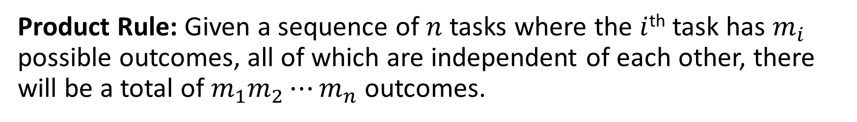
The Product Rule
Product Rule: Given a sequence of $n$ tasks where the $i$^{th} task has $m_{i}$ possible outcomes, all of which are independent of each other, there will be a total of $m_{1}m_{2}⋯m_{n}$ outcomes.

Slide 18

Example 1: Five ping-pong balls are drawn from a set of 40 numbered ping-pong balls without replacement and where order matters. How many possible outcomes are there?
Consider the task of choosing the five balls in order. This is essentially a series of five tasks.
Task 1: Draw a ball and set it aside.
11

Slide 19
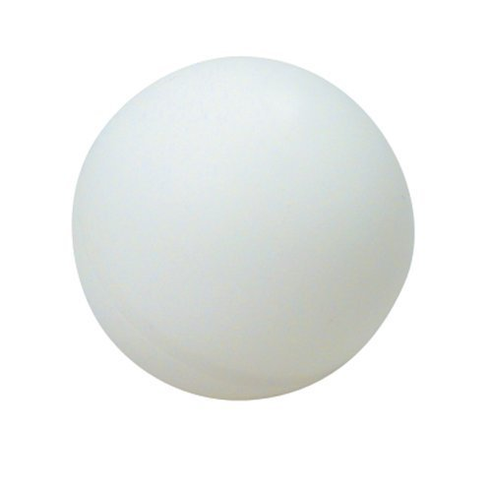
Example 1: Five ping-pong balls are drawn from a set of 40 numbered ping-pong balls without replacement and where order matters. How many possible outcomes are there?
Consider the task of choosing the five balls in order. This is essentially a series of five tasks.
Task 1: Draw a ball and set it aside.
Task 2: Draw a second ball and set it aside.
11
32

Slide 20
Example 1: Five ping-pong balls are drawn from a set of 40 numbered ping-pong balls without replacement and where order matters. How many possible outcomes are there?
Consider the task of choosing the five balls in order. This is essentially a series of five tasks.
Task 1: Draw a ball and set it aside.
Task 2: Draw a second ball and set it aside.
...
Task 5: Draw a fifth ball and set it aside.
11
32
21
7
29

Slide 21
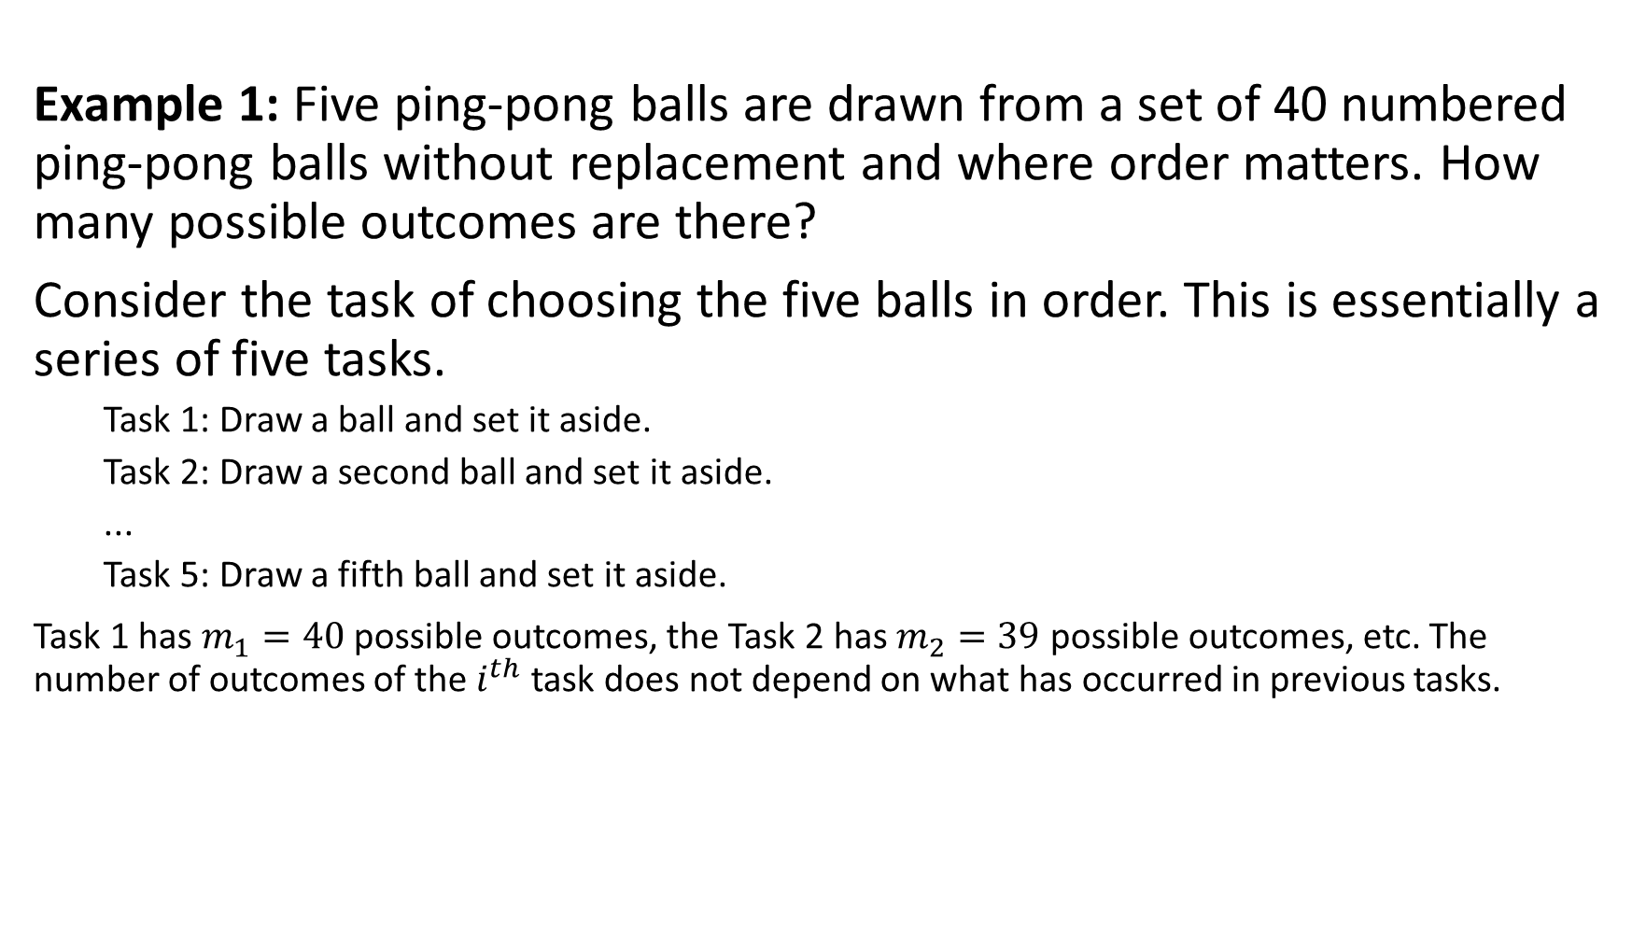
Example 1: Five ping-pong balls are drawn from a set of 40 numbered ping-pong balls without replacement and where order matters. How many possible outcomes are there?
Consider the task of choosing the five balls in order. This is essentially a series of five tasks.
Task 1: Draw a ball and set it aside.
Task 2: Draw a second ball and set it aside.
...
Task 5: Draw a fifth ball and set it aside.
Task 1 has $m_{1}=40$ possible outcomes, the Task 2 has $m_{2}=39$ possible outcomes, etc. The number of outcomes of the $i^{th}$ task does not depend on what has occurred in previous tasks.
11
32
21
7
29

Slide 22
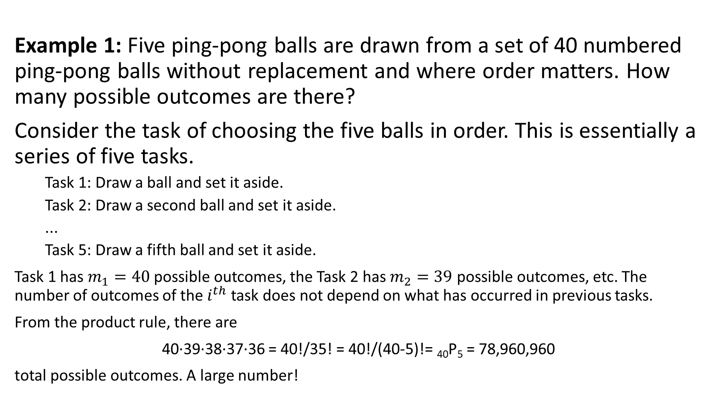
Example 1: Five ping-pong balls are drawn from a set of 40 numbered ping-pong balls without replacement and where order matters. How many possible outcomes are there?
Consider the task of choosing the five balls in order. This is essentially a series of five tasks.
Task 1: Draw a ball and set it aside.
Task 2: Draw a second ball and set it aside.
...
Task 5: Draw a fifth ball and set it aside.
Task 1 has $m_{1}=40$ possible outcomes, the Task 2 has $m_{2}=39$ possible outcomes, etc. The number of outcomes of the $i^{th}$ task does not depend on what has occurred in previous tasks.
From the product rule, there are
40∙39∙38∙37∙36 = 40!/35! = 40!/(40-5)!= ₄₀P₅ = 78,960,960
total possible outcomes. A large number!
11
32
21
7
29

Slide 23
Example 2: Suppose we change the above a tiny bit. This time we draw five balls, but on each draw record what we drew, replace it, mix the balls up again, then repeat.

Slide 24
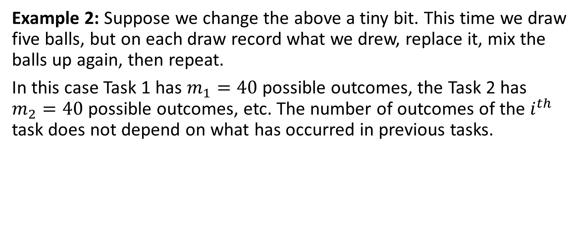
Example 2: Suppose we change the above a tiny bit. This time we draw five balls, but on each draw record what we drew, replace it, mix the balls up again, then repeat.
In this case Task 1 has $m_{1}=40$ possible outcomes, the Task 2 has $m_{2}=40$ possible outcomes, etc. The number of outcomes of the $i^{th}$ task does not depend on what has occurred in previous tasks.

Slide 25
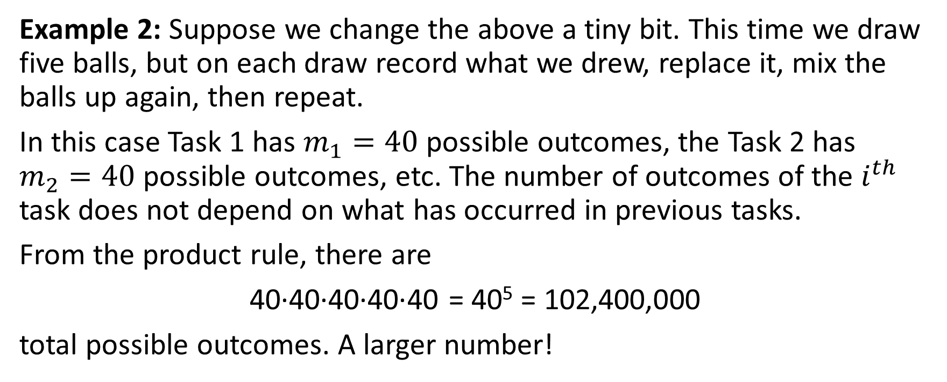
Example 2: Suppose we change the above a tiny bit. This time we draw five balls, but on each draw record what we drew, replace it, mix the balls up again, then repeat.
In this case Task 1 has $m_{1}=40$ possible outcomes, the Task 2 has $m_{2}=40$ possible outcomes, etc. The number of outcomes of the $i^{th}$ task does not depend on what has occurred in previous tasks.
From the product rule, there are
40∙40∙40∙40∙40 = 40⁵ = 102,400,000
total possible outcomes. A larger number!

Slide 26
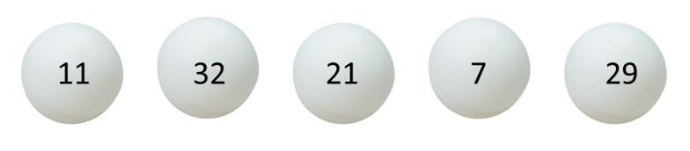
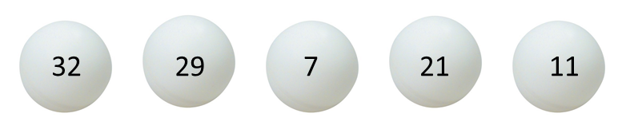
Example 3: As a twist on Example 1, suppose we draw five balls from a set of 40 numbered balls, without replacement. Now instead of asking how many ways to do this where order matters, we just ask, how many sets of five balls can we draw?
Equivalently we might just reach in and grab five balls at once. How many sets of five balls might we grab?
To be clear, suppose we select we might also select this and several other orderings of the same set of balls. How many orderings are there?
This is yet another counting task.

Slide 27
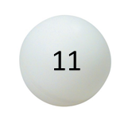
Example 3: As a twist on Example 1, suppose we draw five balls from a set of 40 numbered balls, without replacement. Now instead of asking how many ways to do this where order matters, we just ask, how many sets of five balls can we draw?
Equivalently we might just reach in and grab five balls at once. How many sets of five balls might we grab?
To be clear, suppose we select we might also select this and several other orderings of the same set of balls. How many orderings are there?
This is yet another counting task.
Task 1: How many ways are there to place the ball?

Slide 28
Example 3: As a twist on Example 1, suppose we draw five balls from a set of 40 numbered balls, without replacement. Now instead of asking how many ways to do this where order matters, we just ask, how many sets of five balls can we draw?
Equivalently we might just reach in and grab five balls at once. How many sets of five balls might we grab?
To be clear, suppose we select we might also select this and several other orderings of the same set of balls. How many orderings are there?
This is yet another counting task.
Task 1: How many ways are there to place the ball? Answer 5

Slide 29
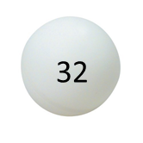
Example 3: As a twist on Example 1, suppose we draw five balls from a set of 40 numbered balls, without replacement. Now instead of asking how many ways to do this where order matters, we just ask, how many sets of five balls can we draw?
Equivalently we might just reach in and grab five balls at once. How many sets of five balls might we grab?
To be clear, suppose we select we might also select this and several other orderings of the same set of balls. How many orderings are there?
This is yet another counting task.
Task 1: How many ways are there to place the ball? Answer 5
Task 2: How many ways are there to place the ball?

Slide 30
Example 3: As a twist on Example 1, suppose we draw five balls from a set of 40 numbered balls, without replacement. Now instead of asking how many ways to do this where order matters, we just ask, how many sets of five balls can we draw?
Equivalently we might just reach in and grab five balls at once. How many sets of five balls might we grab?
To be clear, suppose we select we might also select this and several other orderings of the same set of balls. How many orderings are there?
This is yet another counting task.
Task 1: How many ways are there to place the ball? Answer 5
Task 2: How many ways are there to place the ball? Answer 4

Slide 31
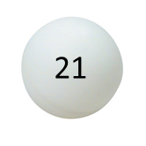
Example 3: As a twist on Example 1, suppose we draw five balls from a set of 40 numbered balls, without replacement. Now instead of asking how many ways to do this where order matters, we just ask, how many sets of five balls can we draw?
Equivalently we might just reach in and grab five balls at once. How many sets of five balls might we grab?
To be clear, suppose we select we might also select this and several other orderings of the same set of balls. How many orderings are there?
This is yet another counting task.
Task 1: How many ways are there to place the ball? Answer 5
Task 2: How many ways are there to place the ball? Answer 4
Task 3: How many ways are there to place the ball?

Slide 32
Example 3: As a twist on Example 1, suppose we draw five balls from a set of 40 numbered balls, without replacement. Now instead of asking how many ways to do this where order matters, we just ask, how many sets of five balls can we draw?
Equivalently we might just reach in and grab five balls at once. How many sets of five balls might we grab?
To be clear, suppose we select we might also select this and several other orderings of the same set of balls. How many orderings are there?
This is yet another counting task.
Task 1: How many ways are there to place the ball? Answer 5
Task 2: How many ways are there to place the ball? Answer 4
Task 3: How many ways are there to place the ball? Answer 3

Slide 33
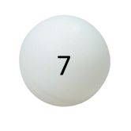
Example 3: As a twist on Example 1, suppose we draw five balls from a set of 40 numbered balls, without replacement. Now instead of asking how many ways to do this where order matters, we just ask, how many sets of five balls can we draw?
Equivalently we might just reach in and grab five balls at once. How many sets of five balls might we grab?
To be clear, suppose we select we might also select this and several other orderings of the same set of balls. How many orderings are there?
This is yet another counting task.
Task 1: How many ways are there to place the ball? Answer 5
Task 2: How many ways are there to place the ball? Answer 4
Task 3: How many ways are there to place the ball? Answer 3
Task 4: How many ways are there to place the ball?

Slide 34
Example 3: As a twist on Example 1, suppose we draw five balls from a set of 40 numbered balls, without replacement. Now instead of asking how many ways to do this where order matters, we just ask, how many sets of five balls can we draw?
Equivalently we might just reach in and grab five balls at once. How many sets of five balls might we grab?
To be clear, suppose we select we might also select this and several other orderings of the same set of balls. How many orderings are there?
This is yet another counting task.
Task 1: How many ways are there to place the ball? Answer 5
Task 2: How many ways are there to place the ball? Answer 4
Task 3: How many ways are there to place the ball? Answer 3
Task 4: How many ways are there to place the ball? Answer 2

Slide 35
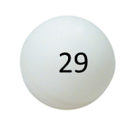
Example 3: As a twist on Example 1, suppose we draw five balls from a set of 40 numbered balls, without replacement. Now instead of asking how many ways to do this where order matters, we just ask, how many sets of five balls can we draw?
Equivalently we might just reach in and grab five balls at once. How many sets of five balls might we grab?
To be clear, suppose we select we might also select this and several other orderings of the same set of balls. How many orderings are there?
This is yet another counting task.
Task 1: How many ways are there to place the ball? Answer 5
Task 2: How many ways are there to place the ball? Answer 4
Task 3: How many ways are there to place the ball? Answer 3
Task 4: How many ways are there to place the ball? Answer 2
Task 5: How many ways are there to place the ball?

Slide 36
Example 3: As a twist on Example 1, suppose we draw five balls from a set of 40 numbered balls, without replacement. Now instead of asking how many ways to do this where order matters, we just ask, how many sets of five balls can we draw?
Equivalently we might just reach in and grab five balls at once. How many sets of five balls might we grab?
To be clear, suppose we select we might also select this and several other orderings of the same set of balls. How many orderings are there?
This is yet another counting task.
Task 1: How many ways are there to place the ball? Answer 5
Task 2: How many ways are there to place the ball? Answer 4
Task 3: How many ways are there to place the ball? Answer 3
Task 4: How many ways are there to place the ball? Answer 2
Task 5: How many ways are there to place the ball? Answer 1

Slide 37

Using the product rule again, there are
5∙4∙3∙2∙1 = 5!
ways to select the specific set of five balls.

Slide 38
Using the product rule again, there are
5∙4∙3∙2∙1 = 5!
ways to select the specific set of five balls.
We knew from Example 1 that there are ₄₀P₅ = 40!/35! ways of selecting five balls where order matters.

Slide 39
Using the product rule again, there are
5∙4∙3∙2∙1 = 5!
ways to select the specific set of five balls.
We knew from Example 1 that there are ₄₀P₅ = 40!/35! ways of selecting five balls where order matters.
For each such choice there are 5! selections that correspond to the same set of five balls.

Slide 40
Using the product rule again, there are
5∙4∙3∙2∙1 = 5!
ways to select the specific set of five balls.
We knew from Example 1 that there are ₄₀P₅ = 40!/35! ways of selecting five balls where order matters.
For each such choice there are 5! selections that correspond to the same set of five balls.
Putting these two together we see there are
₄₀C₅ = ₄₀P₅/5! = (40!/35!)/5! = 40!/((40-5)!5!) = 658,008
sets of five balls that can be chosen from a set of 40 balls.

Slide 41
Example 4: Let’s do the same thing with example 2 that we did with Example 1. Suppose we draw five balls from a set of 40 numbered balls, where we replace the ball draw each time. How many sets of five balls can we draw, where order does not matter.

Slide 42
Example 4: Let’s do the same thing with example 2 that we did with Example 1. Suppose we draw five balls from a set of 40 numbered balls, where we replace the ball draw each time. How many sets of five balls can we draw, where order does not matter.
This counting involves a new trick, basically, suppose you have 40 numbered boxes or bins and you take five unnumbered balls and randomly toss them into the forty bins. Say you throw balls into box 4, 4, 17, 23, 23, this will be your set the order does not matter.

Slide 43
Example 4: Let’s do the same thing with example 2 that we did with Example 1. Suppose we draw five balls from a set of 40 numbered balls, where we replace the ball draw each time. How many sets of five balls can we draw, where order does not matter.
This counting involves a new trick, basically, suppose you have 40 numbered boxes or bins and you take five unnumbered balls and randomly toss them into the forty bins. Say you throw balls into box 4, 4, 17, 23, 23, this will be your set the order does not matter.
Here is a way to count this put down 40 + 5 + 1 = 46 lines:
||||||||||||||||||||||||||||||||||||||||||||||

Slide 44
Example 4: Let’s do the same thing with example 2 that we did with Example 1. Suppose we draw five balls from a set of 40 numbered balls, where we replace the ball draw each time. How many sets of five balls can we draw, where order does not matter.
This counting involves a new trick, basically, suppose you have 40 numbered boxes or bins and you take five unnumbered balls and randomly toss them into the forty bins. Say you throw balls into box 4, 4, 17, 23, 23, this will be your set the order does not matter.
Here is a way to count this put down 40 + 5 + 1 = 46 lines:
||||||||||||||||||||||||||||||||||||||||||||||
Select 5 of the 44 lines not on the end, these will become the balls:

Slide 45
Example 4: Let’s do the same thing with example 2 that we did with Example 1. Suppose we draw five balls from a set of 40 numbered balls, where we replace the ball draw each time. How many sets of five balls can we draw, where order does not matter.
This counting involves a new trick, basically, suppose you have 40 numbered boxes or bins and you take five unnumbered balls and randomly toss them into the forty bins. Say you throw balls into box 4, 4, 17, 23, 23, this will be your set the order does not matter.
Here is a way to count this put down 40 + 5 + 1 = 46 lines:
||||||||||||||||||||||||||||||||||||||||||||||
Select 5 of the 44 lines not on the end, these will become the balls:
||||OO|||||||||||||O||||||OO||||||||||||||||||

Slide 46
Example 4: Let’s do the same thing with example 2 that we did with Example 1. Suppose we draw five balls from a set of 40 numbered balls, where we replace the ball draw each time. How many sets of five balls can we draw, where order does not matter.
This counting involves a new trick, basically, suppose you have 40 numbered boxes or bins, and you take five unnumbered balls and randomly toss them into the forty bins. Say you throw balls into box 4, 4, 17, 23, 23, this will be your set the order does not matter.
Here is a way to count this put down 40 + 5 + 1 = 46 lines:
||||||||||||||||||||||||||||||||||||||||||||||
Select 5 of the 44 lines not on the end, these will become the balls:
||||OO|||||||||||||O||||||OO||||||||||||||||||
There are ₄₄C₅ = 44!/(39!5!) = 1,086,008 such sets.

Slide 47
General Rules Corresponding to the four examples
Permutation without replacement: Select m items from a set of n distinct items without replacement and where order matters.
_{n}P_{m} = n!/(n-m)!

Slide 48
General Rules Corresponding to the four examples
Permutation without replacement: Select m items from a set of n distinct items without replacement and where order matters.
_{n}P_{m} = n!/(n-m)!
Permutation with replacement: Select m items from a set of n items with replacement where order matters.
n^{m}

Slide 49
General Rules Corresponding to the four examples
Permutation without replacement: Select m items from a set of n distinct items without replacement and where order matters.
_{n}P_{m} = n!/(n-m)!
Permutation with replacement: Select m items from a set of n items with replacement where order matters.
n^{m}
Combination without replacement: Select m items from a set of n items without replacement where order does not matter. Equivalently, select a subset of m elements from a set of n elements.
_{n}C_{m} = _{n}P_{m}/m! = n!/((n-m)!m!)

Slide 50
General Rules Corresponding to the four examples
Permutation without replacement: Select m items from a set of n distinct items without replacement and where order matters.
_{n}P_{m} = n!/(n-m)!
Permutation with replacement: Select m items from a set of n items with replacement where order matters.
n^{m}
Combination without replacement: Select m items from a set of n items without replacement where order does not matter. Equivalently, select a subset of m elements from a set of n elements.
_{n}C_{m} = _{n}P_{m}/m! = n!/((n-m)!m!)
Combination with replacement: Select m items from n items with replacement where order does not matter.
_{(n + m - 1)}C_{m} = (n+m-1)!/((n-1)!m!)

