Slide 1


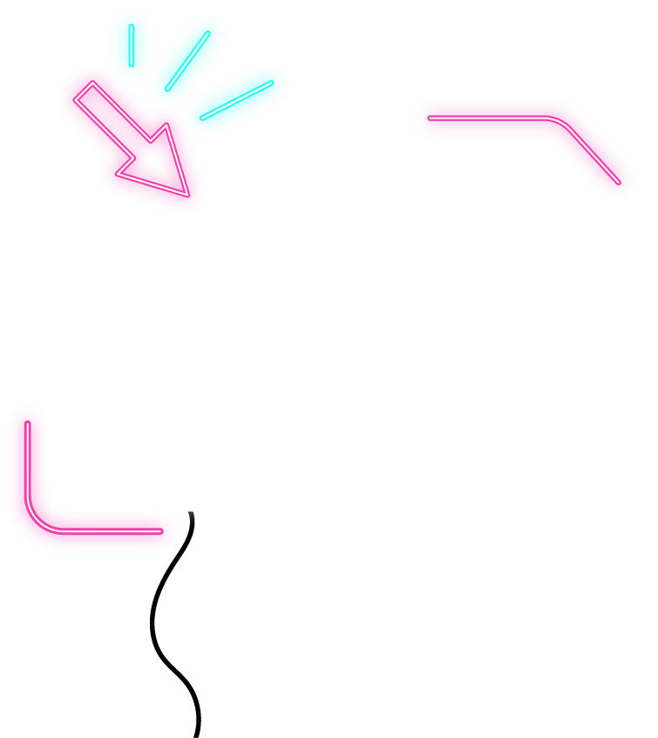



INTERNET OF THINGS

Slide 2





CONCEPT
ADVANTAGES , DISADVANTAGES
INTERNET OF THINGS
EXAMPLES APPLICATIONS
NUMBERS AND POTENTIAL
By Nguyen Van Vu
By Nguyen Le Huu Duy
By Nguyen Ket Doan
By Bui Thi Huong Giang

Slide 3


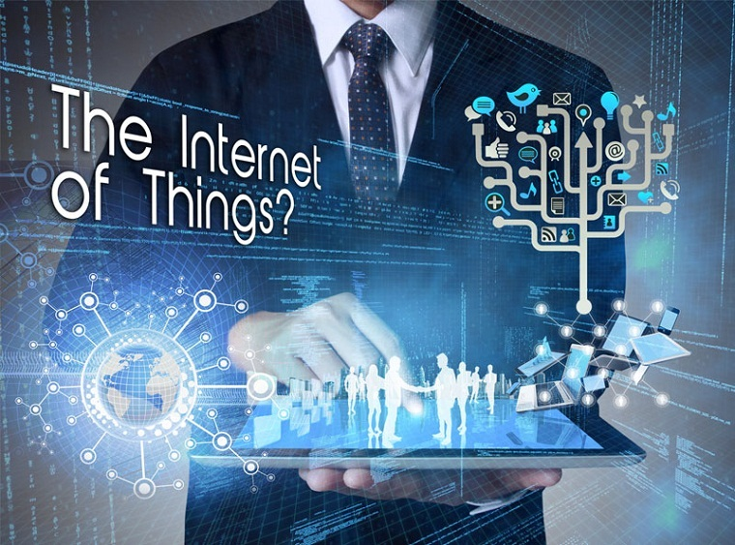

What is the internet of things?
By Nguyen Le Huu Duy

Slide 4

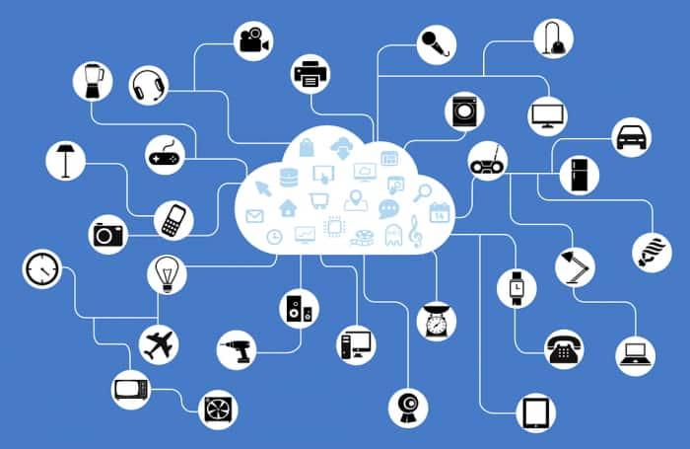
cloud computing
By Nguyen Le Huu Duy

Slide 5
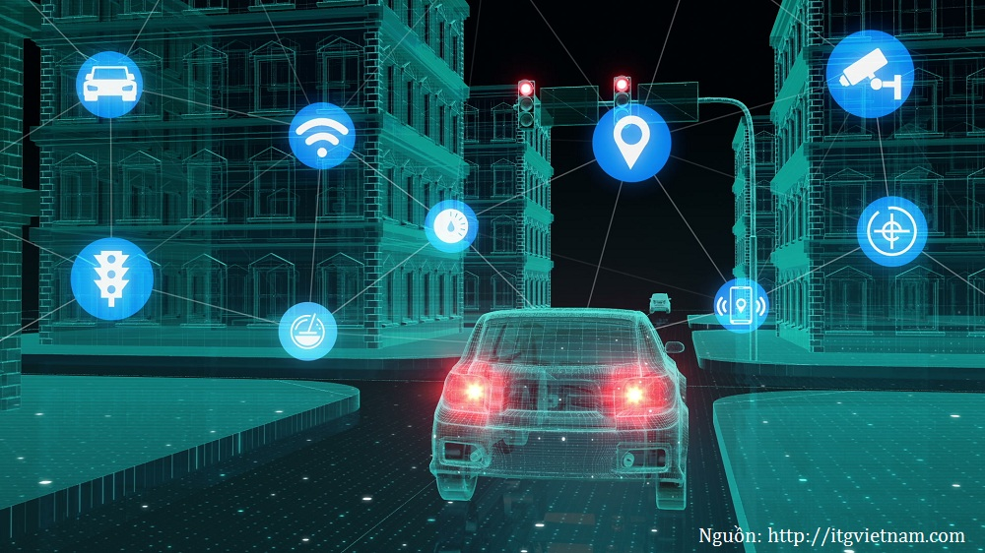
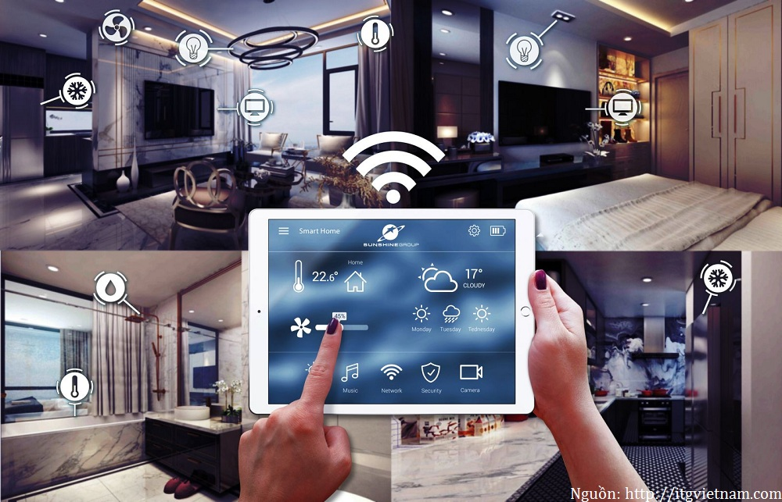
EXAMPLES AND APPLICATIONS
1.Application in driverless vehicles
2. Smart indoor application
By Nguyen Ket Doan

Slide 6
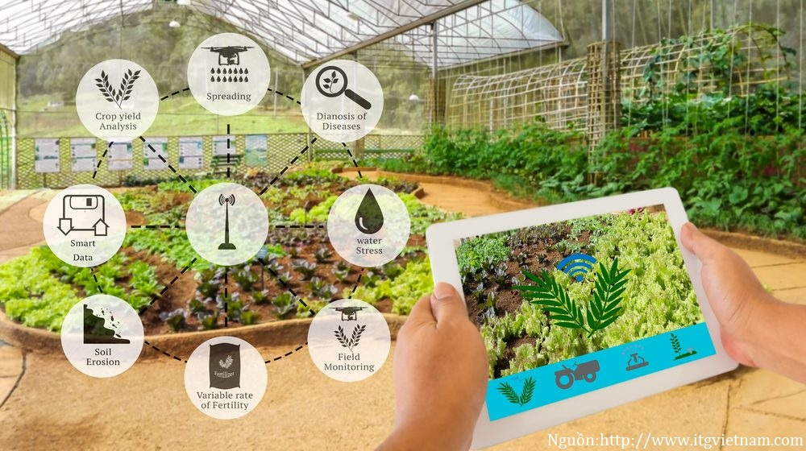
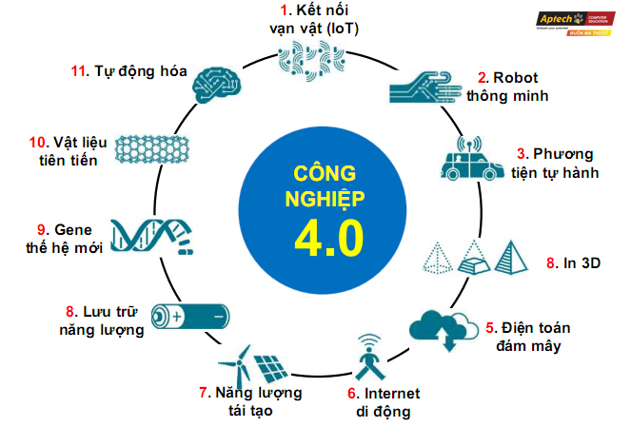
EXAMPLES AND APPLICATIONS
3.Application in agriculture
4. Other applications
By Nguyen Ket Doan

Slide 7


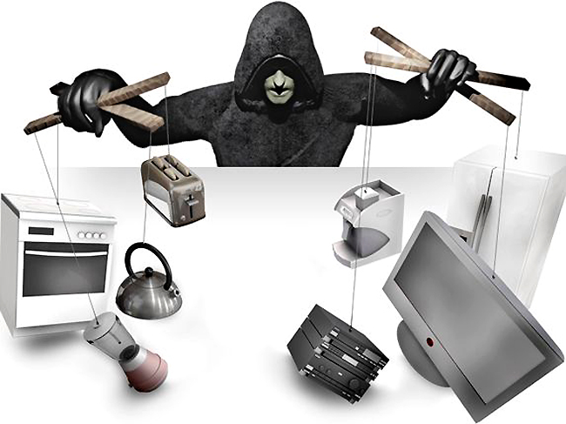


effects of the internet of things
Advantage
Egative aspects
By Nguyen Van Vu

Slide 8
> 4 billion
>25000000
>50000 billion
NUMBERS AND POTENTIAL
people connected with each other
Application
Gigabytes of data
$ 4000 billion
Revenue
By Bui Thi Huong Giang

Slide 9


