Slide 1
FRIDAY DEPLOYMENT CLUB
DevOps Roadmap
DAY 2 · Your Complete Learning Map
Build · Automate · Monitor · Deploy

Slide 2
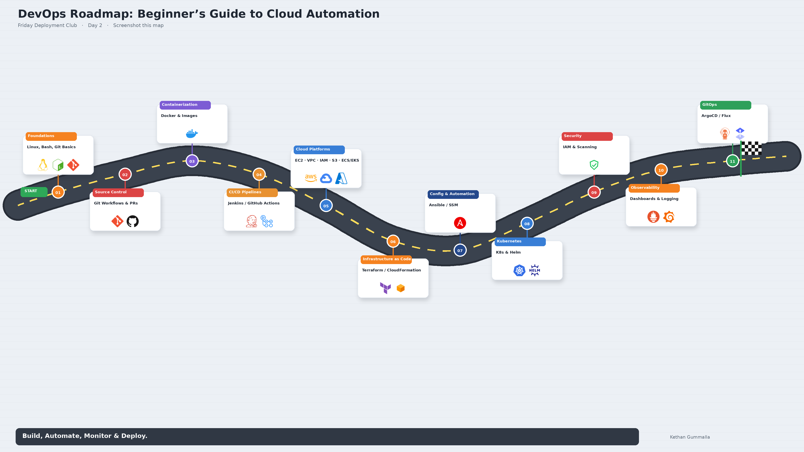

Slide 3
The DevOps Roadmap
5 phases · 10 stops · One learning path
PHASE 1
PHASE 2
PHASE 3
PHASE 4
PHASE 5
Foundations
Containers & CI/CD
Cloud
Infrastructure & Orchestration
Security & Monitoring
Linux · Bash · Git
Docker · Jenkins · GitHub Actions
AWS Core Services
IaC · Config · K8s · GitOps
Secure · Observe · Alert
1 Foundations
3 Containerization
5 Cloud Platforms
6 IaC
9 Security
2 Source Control
4 CI/CD
7 Config
10 Observability
8 Kubernetes
10 GitOps
GOAL → BUILD · AUTOMATE · MONITOR · DEPLOY

Slide 4

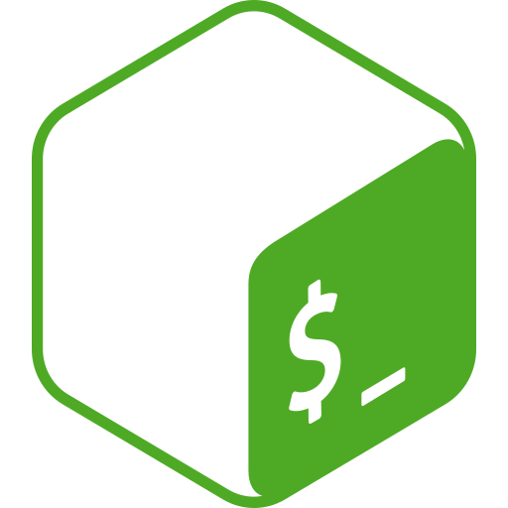
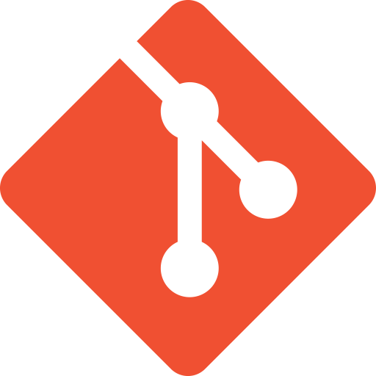
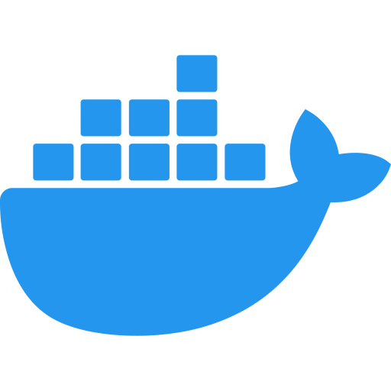

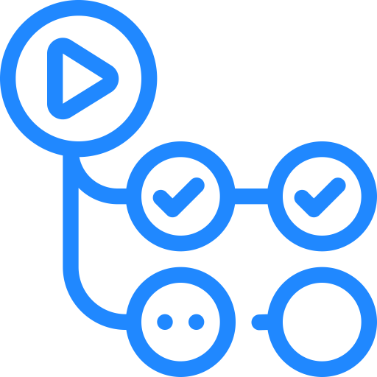
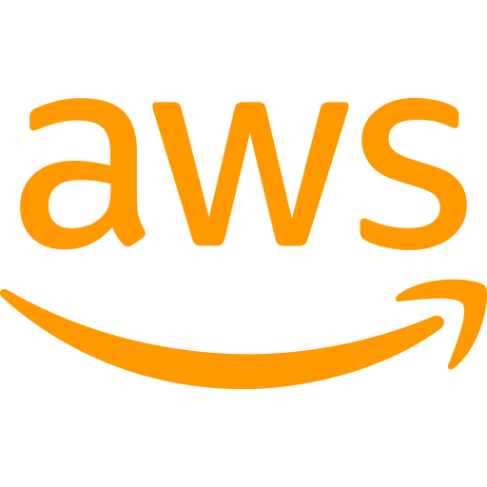
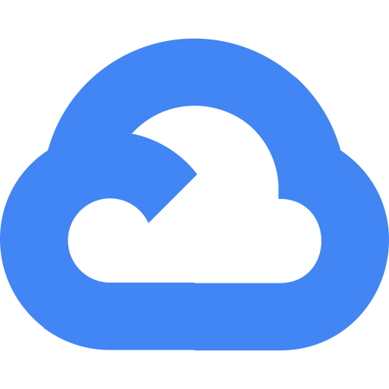


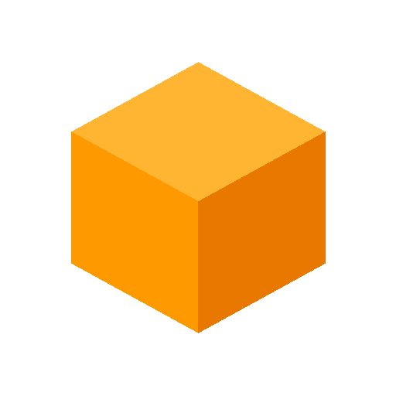
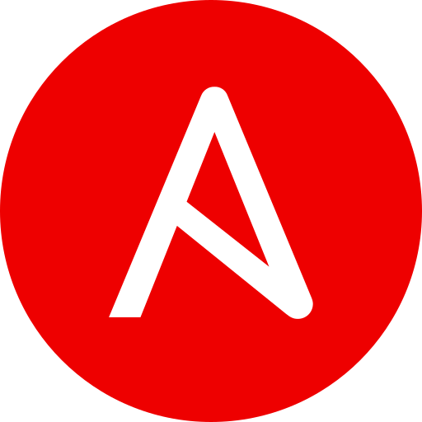
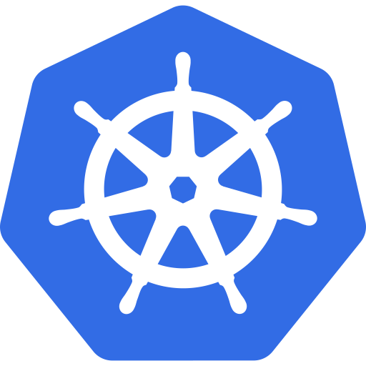





DEVOPS ROADMAP 2025
#1
Foundations
#2
Source Control
Linux · Bash · Git
Branches · PRs · Reviews
#3
Containerization
#4
CI / CD
Docker
Jenkins · GH Actions
#5
Cloud — AWS
#6
Infrastructure as Code
EC2 · VPC · IAM · S3 · ECS · EKS
Terraform · CloudFormation
#7
Config & Automation
#8
Kubernetes & Helm
Ansible · AWS SSM
Scale · Manage · Deploy
#9
Security
#10
Observability
IAM · Scanning · Secrets
Prometheus · Grafana · Logs
GitOps
ArgoCD · Flux · Git-driven deploys

Slide 5
STOP 1
Foundations
Linux · Bash · Git · ~2–3 weeks
Linux
Bash
Git
▸ Navigate Linux terminals & file systems
▸ Automate tasks with Bash scripts
▸ Track code changes with Git
Series Days 3–9 cover these in depth

Slide 6
STOP 2
Source Control
Git for real-world team workflows
Git
Branches
Pull Requests
Code Reviews
Merge Conflicts

Slide 7
STOP 3
Containerization
Package apps + dependencies into portable containers
Docker
Your App
→
Container Image
→
Runs Anywhere
Solves: "It works on my machine"

Slide 8
STOP 4
CI / CD
Automate build · test · deploy pipelines
Jenkins
GitHub Actions
Push Code
→
Build
→
Test
→
Deploy
Less manual work · Faster releases · Fewer mistakes

Slide 9
STOP 5
Cloud Platforms — AWS
Core services every DevOps engineer needs
AWS
GCP
Azure
EC2
VPC
IAM
S3
Virtual Machines
Networking
Access & Permissions
Object Storage
ALB
ECS
EKS
Load Balancer
Containers
Kubernetes
One video · One concept · One service at a time

Slide 10
STOP 6
Infrastructure as Code
Define infrastructure in code — repeatable & version-controlled
Terraform
CloudFormation
Code → Plan → Apply → Reusable Infrastructure

Slide 11
STOP 7
Configuration & Automation
Terraform creates it · Ansible configures it
Ansible
AWS SSM
▸ Install software
▸ Create users
▸ Manage settings
▸ Multi-server automation

Slide 12
STOP 8
Kubernetes & Helm
Run, scale & manage containers at production scale
Kubernetes
Helm
Auto-restart
Auto-scale
Helm charts
Failed containers
Traffic spikes
App deployment

Slide 13
STOP 9
Security
Protect access, scan for vulnerabilities, stay compliant
IAM Security
Least privilege · Roles · Policies
Vulnerability Scanning
Images · Dependencies · Configs
Secrets Management
Credentials · Keys · Tokens

Slide 14
STOP 10
Observability
Metrics · Dashboards · Logs · Alerts
Logs
Prometheus
Grafana
▸ What's happening?
▸ Why is it slow?
▸ What broke?
▸ Alert the team

Slide 15
GITOPS
Git as the Source of Truth for Deployments
ArgoCD · Flux · Git-driven deploys
ArgoCD
Flux
Git
Git commit → Sync → Cluster matches desired state

Slide 16
The DevOps Goal
BUILD
AUTOMATE
MONITOR
DEPLOY
That's the core of DevOps

Slide 17
Beyond DevOps → AI & Modern Tech
MLOps
AI Pipelines
Local LLMs
AI Agents
Emerging Tech
Friday Deployment Club — building modern tech skills step by step

Slide 18
Day 2 Challenge
1
Screenshot the roadmap
2
Circle your top 3 topics
3
Comment them below 👇
NEXT → Day 3: Linux Terminal · File System · Live Demo
Learn it. Build it. Ship it.

