Slide 1



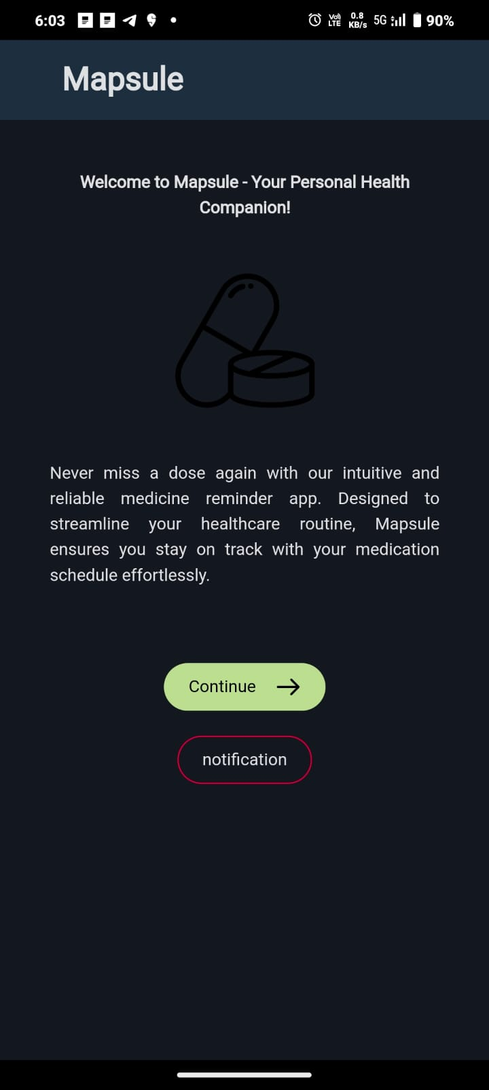
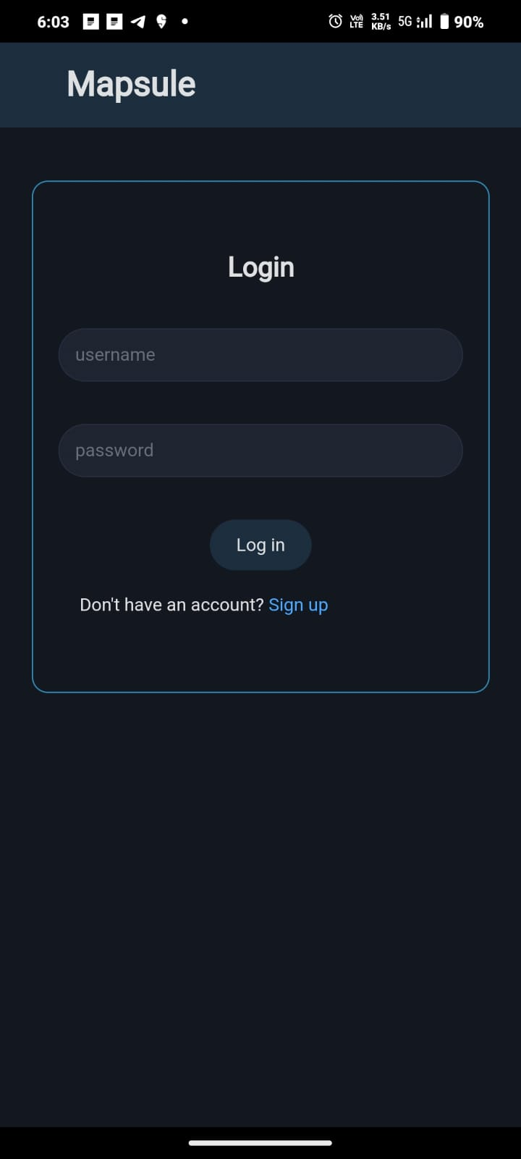
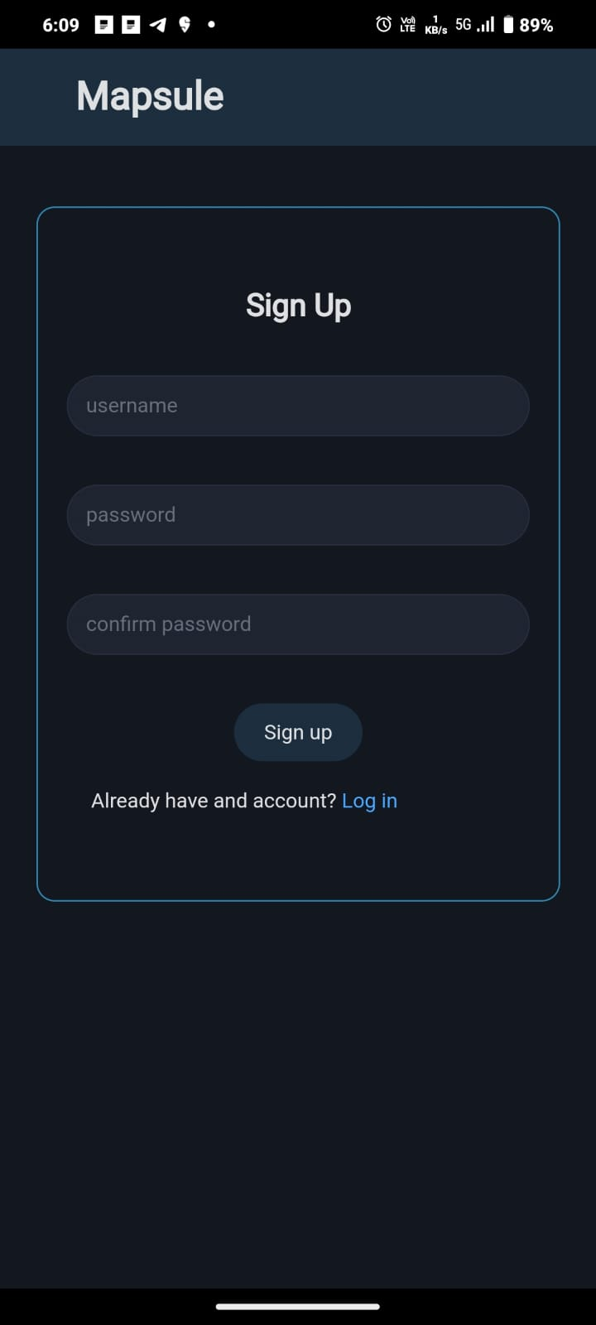
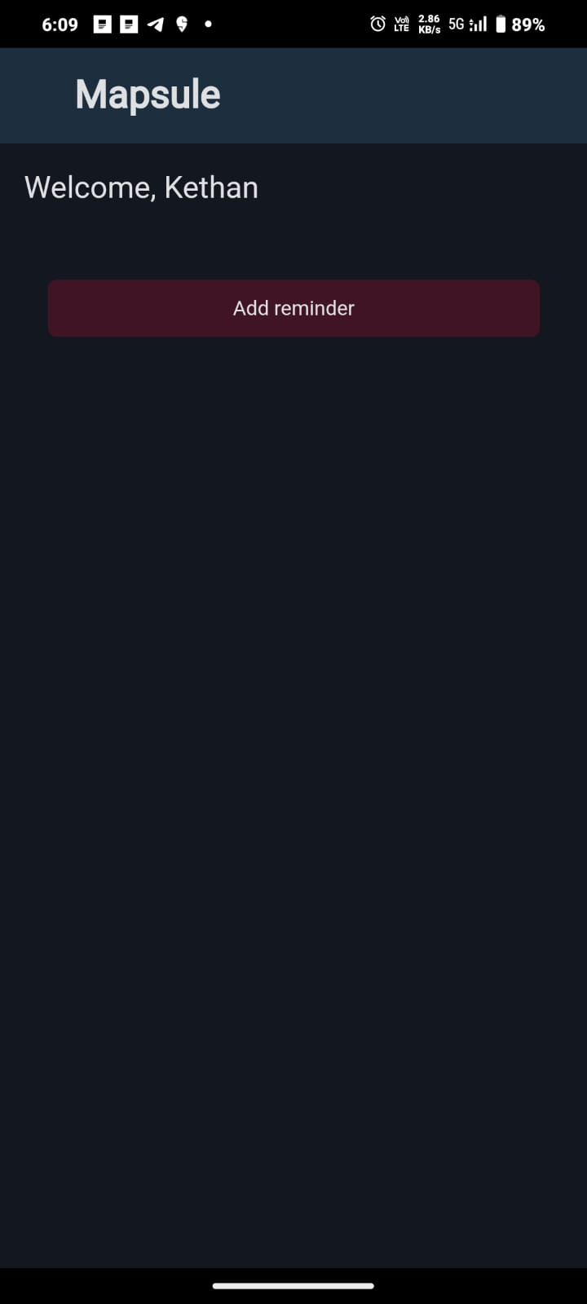
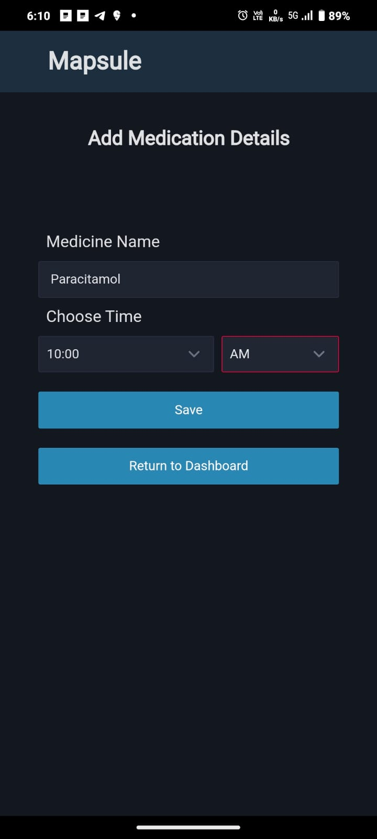
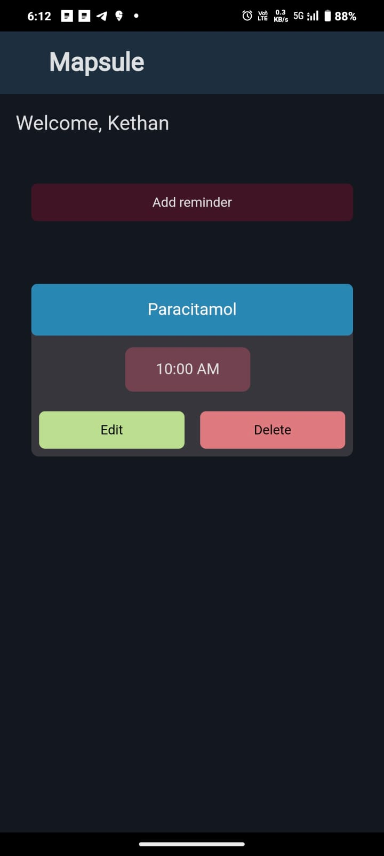
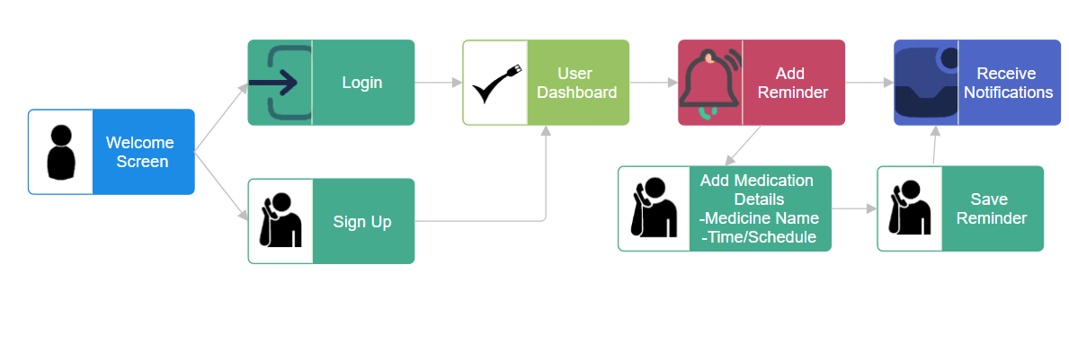
Mapsule: A Cross-Platform Medication Reminder App Powered by Svelte, Capacitor.js, and Supabase
TEAM :- 19
2103A51554 G.VAMSHI KRISHNA 2103A51075 V.KETHAN 2103A51215 G.ABHIRAM
ABSTRACT
Guide : Mr. Y.Chanti
Assistant Professor of CS &AI
RESULT
Mapsule is a cross-platform medication reminder app developed using Svelte for the user interface, Capacitor.js for native mobile deployment, and Supabase for backend services. It allows users to easily manage their medication schedules, set reminders, receive notifications, and track adherence. With its intuitive design and robust infrastructure, Mapsule aims to simplify medication management and improve health. outcomes
OBJECTIVES
Enhance Medication Adherence and Patient Compliance:The primary objective of this project is to develop a user-friendly application that aids individuals in effectively managing their medication schedules and adhering to prescribed regimens, ultimately improving patient compliance and health outcomes.
Harness the Power of Modern Web Frameworks and Services:The project seeks to harness the power of modern web frameworks and services, including Svelte for building the user interface, Capacitor.js for enabling cross-platform deployment, and Supabase for providing robust backend functionalities, to create a feature-rich and efficient medication reminder application.
EXISTING METHODS VS PROPOSED METHOD
Aspect | Existing System | Proposed System
Medication Management | Limited functionality for managing medications and schedules. | Comprehensive medication management with reminders, notifications, and adherence tracking
Authentication | Basic or limited authentication methods. | Robust authentication provided by Supabase's authentication services.
Data Storage | Potentially siloed or insecure data storage. | Secure and scalable data storage with Supabase's PostgreSQL database.
CONCLUSION
The Medication Reminder Application empowers users to improve medication adherence, leading to better health outcomes and reduced hospitalizations through timely reminders and personalized support.
With its user-friendly interface and intelligent reminders tailored to individual needs, the application acts as a virtual health companion, offering friendly guidance to help users stay on track with their medication regimens.
REFERENCES
http://surl.li/swebl
https://www.ncbi.nlm.nih.gov/pmc/articles/PMC5544449/
Proposed Solution

