Slide 1
Name Of Project :
Bank Account
Management

Slide 2
Course Title : Software Development Project and Industrial Tour
Course Code:CSE-2112
Submitted By: Supervisor:
Ketharin Sukhi Tazo Mohammad Ashraful Islam
ID:CE-18059 Assistant Professor
Dept. of Computer Science and
Engineering,MBSTU

Slide 3
Introduction :
This program is based on bank management system .The bank management system is an application for maintaining a person’s account in a bank.The System provides the access to the customer to check balance, transfer/deposite/withdraw the cash from his account.
The project is developed by using C.

Slide 4
How it works :
First of all we will take the bank account number and will input the account balance.
There are five options.We will choose to our requirements.
In case of balance check we will check the balance with the account number.
In case of withdraw we will input the account number after that we will input the amount we want to take out of that account.

Slide 5
In case of Transfer we will input our first account number and after that we will input the second account number that we want to transfer the money and after that we will input the amount and transfer the money from first account to second account number.
In case of Deposit we input our account number and the amount of money we want to keep on that account.
In case of Exit we simply don’t do any amount transfer,check amount or withdraw .

Slide 6
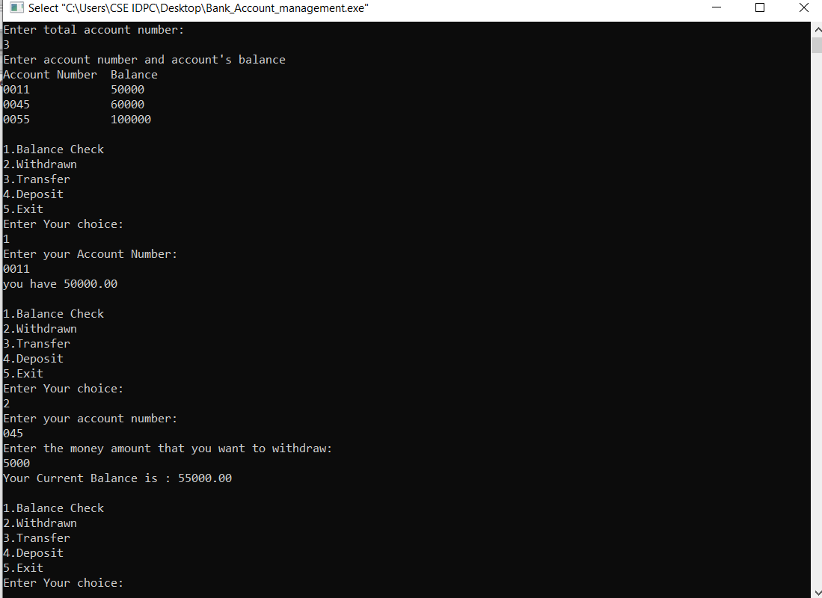

Slide 7
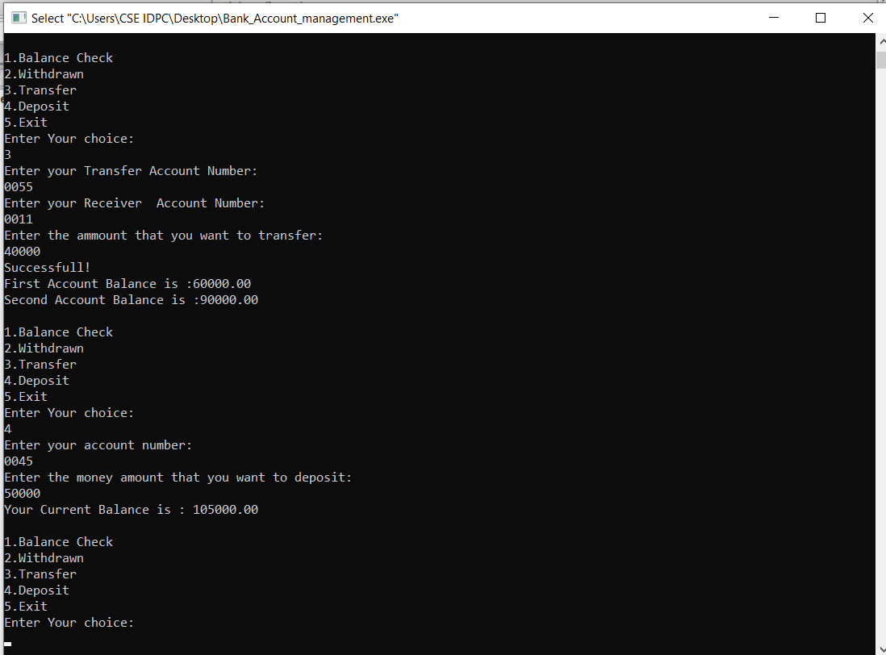

Slide 8
Thank You

