Slide 1
Insights from Software Carpentry
“The effective use of genAI to produce code and – even more importantly – the ability to critically evaluate what is produced, requires that the user first has a grasp of the fundamentals of coding.”
“I fear a growing misconception that good practices for reproducibility and robustness of analysis are no longer necessary or important.”
“…early-career researchers and data scientists are under just as much pressure as they always have been to get results and publish them.”
“How would researchers feel about admitting to relying on genAI to craft or understand results within a paper, a conference talk, or a poster, or hearing about others who have done the same?”
“How can The Carpentries best reach people at risk of making mistakes with these tools: integrating incorrect code or fabricated results into their analyses, de-skilling themselves, and/or producing software that cannot be maintained or sustained in the long term?”
AI Carpentry? Helping learners make better choices with genAI.
Software Carpentry AI blog posts
Community Session Report: The Ethics of Teaching LLMs in Carpentries Workshops

Slide 2
Considerations
Major ethical concerns raised by LLMs:
Environmental costs associated with training and running LLMs
Possible copyright infringement and uncredited use of material to train the models
Exploitation of workers in model training
Harmful use of the tools
Reducing critical thinking and problem solving ability
Propagation and reinforcement of biases
Data privacy and operational security concerns
Unequal access to models
“Community Session Report: The Ethics of Teaching LLMs in Carpentries Workshops” by Toby Hodges, 19 February, 2025 https://carpentries.org/blog/2025/02/the-ethics-of-teaching-llms-in-carpentries-workshops/

Slide 3
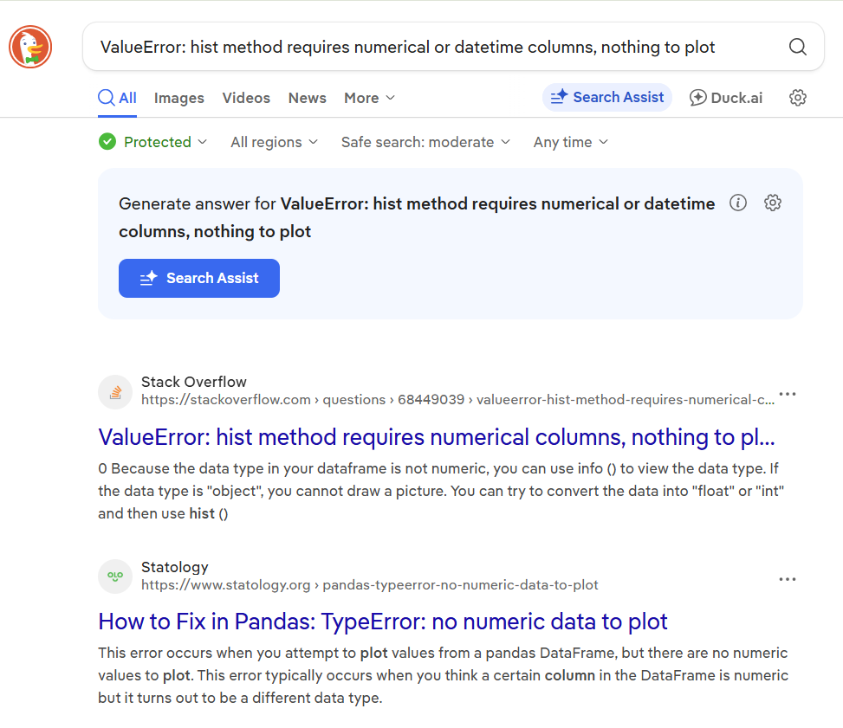
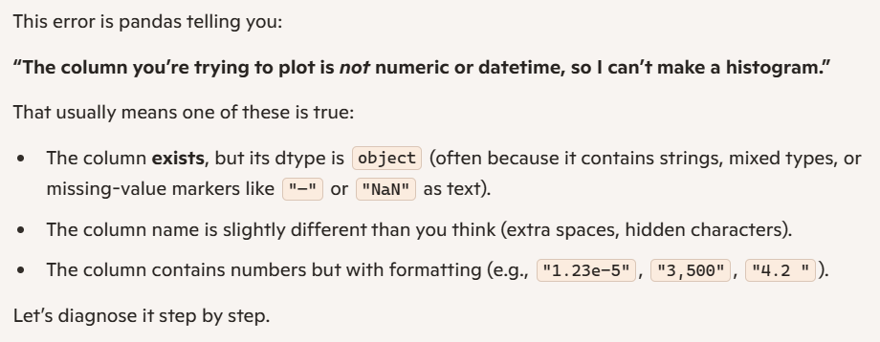

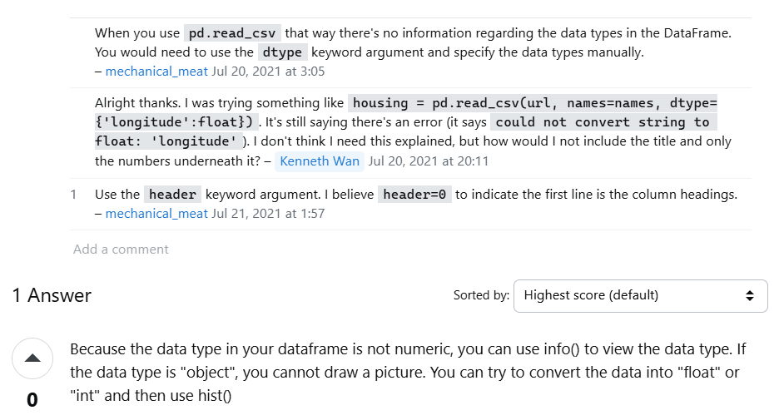
Compare and contrast: LLM vs search engine

Slide 4
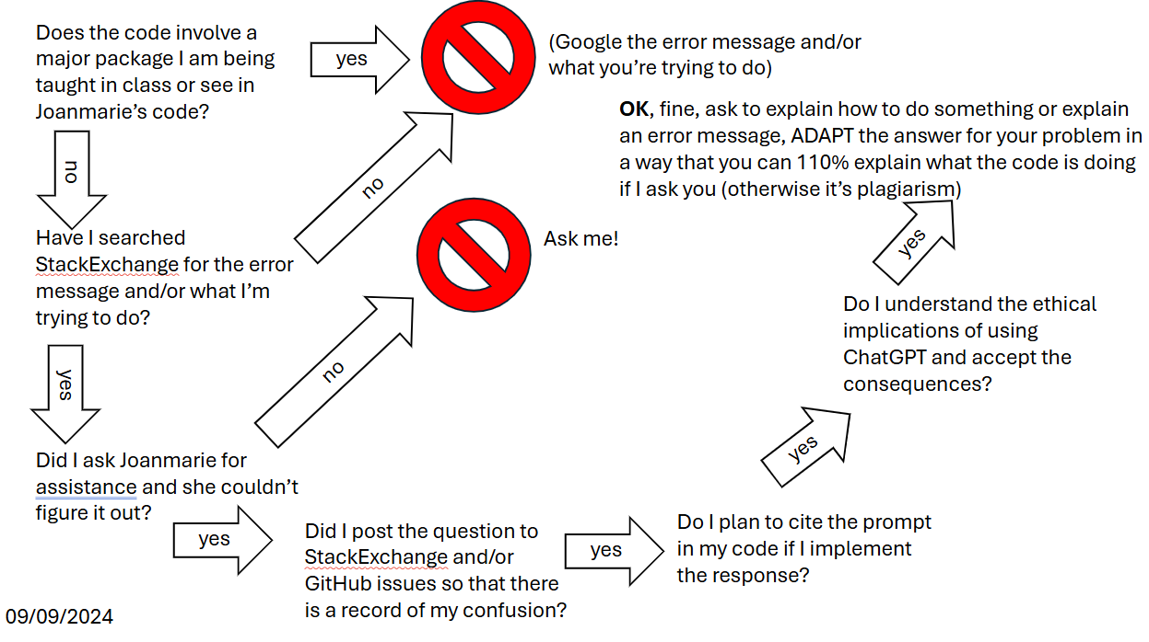
My policy

Slide 5
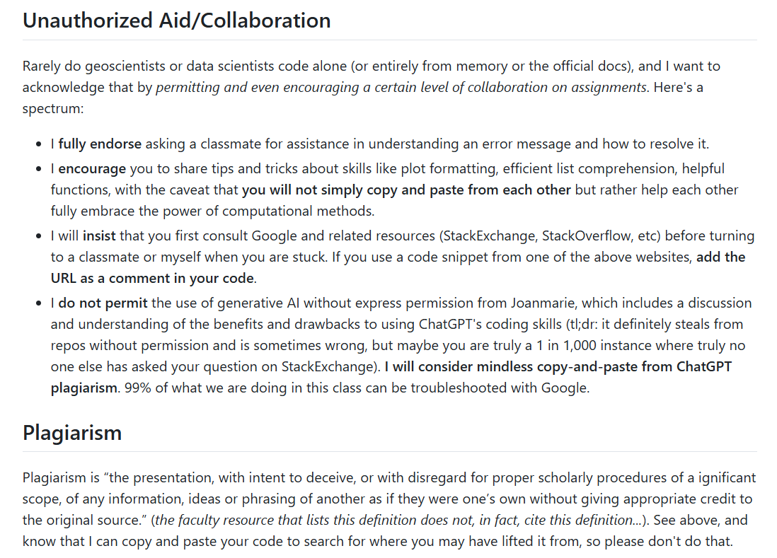

Slide 6
For your perusal: William and Mary’s writing center has an AI statement, and its Center for Teaching and Learning has an Approaches to Teaching With Generative AI and an Instructor GenAI Policy Communication Guidelines document.

