Slide 1
Telemedical Consultation System
Database Systems Final Project
Group Members: add names and student IDs
Instructor: Dr. Howlader
Presentation Date: May 05, 2026

Slide 2
Project Purpose and Main Features
Purpose: manage remote patient consultations in one database system.
Register and view patients.
Add doctors and availability.
Book telemedical appointments.
Update appointment status.
Store diagnosis, prescription, treatment, and follow-up notes.

Slide 3
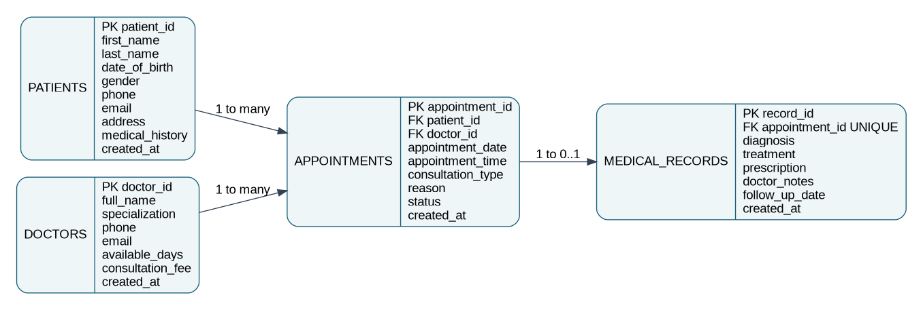
ER Model and Database Design

Slide 4
Front-End and Back-End
Front-end: Flask web pages with forms and tables.
Back-end: MySQL database.
Python connects forms to database operations.
Primary keys uniquely identify records.
Foreign keys connect patients, doctors, appointments, and records.

Slide 5
Live Demonstration Plan
1. Show dashboard summary.
2. Add a new patient.
3. Show doctor list.
4. Book an appointment.
5. Update appointment status.
6. Add a medical record and prescription.

