Slide 1
Docker

Slide 2
What and Why
Docker Objects
Docker Container Networking
Swarm

Slide 3
What is Docker
Docker is an open platform for developing, shipping, and running applications.
Docker allows you to package an application with all of its dependencies into a standardized unit for software development.

Slide 4
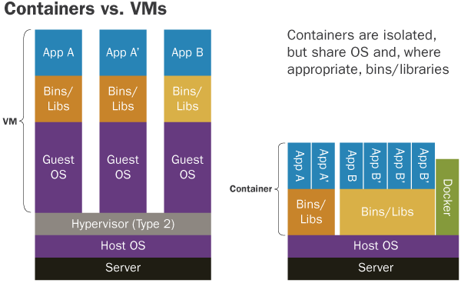

Slide 5
Docker Benefits
Fast (deployment, migration, restarts)
Secure
Lightweight (save disk & CPU)
Open Source
Portable software
Microservices and integrations (APIs)
Simplify DevOps
Version control capabilities

Slide 6
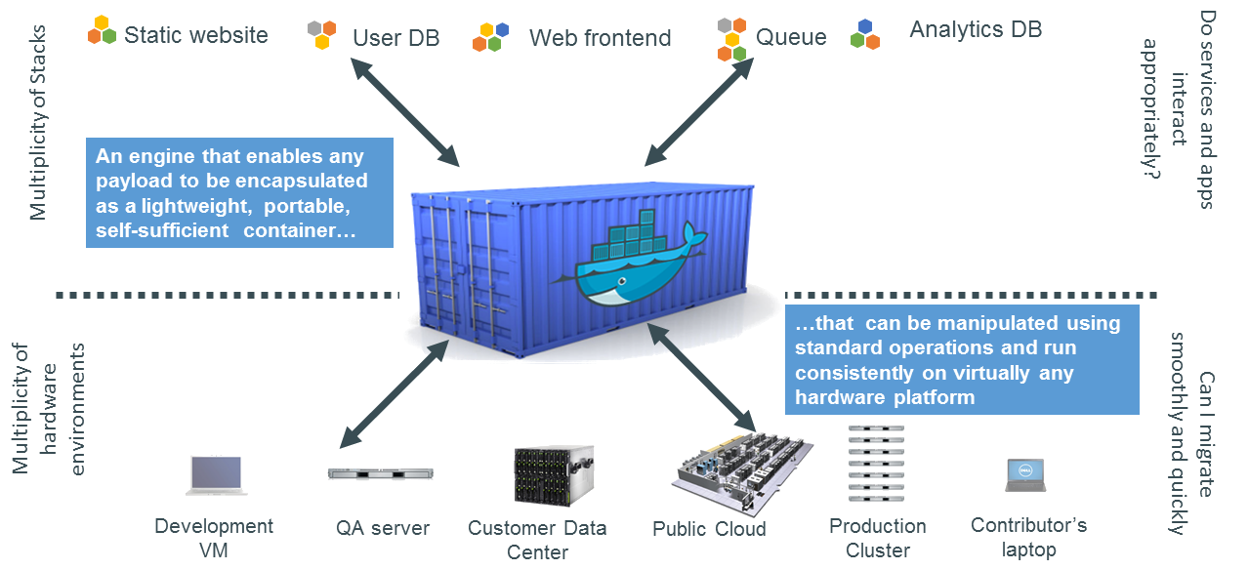
Docker is a Container System for Code

Slide 7
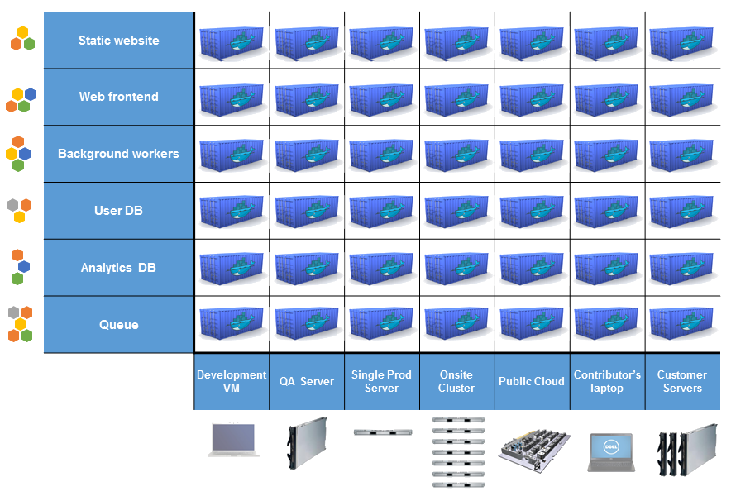
Docker Eliminates the Matrix from Hell

Slide 8
The Docker architecture
(Docker) client
daemon
engine
machine
compose
swarm
registry

Slide 9
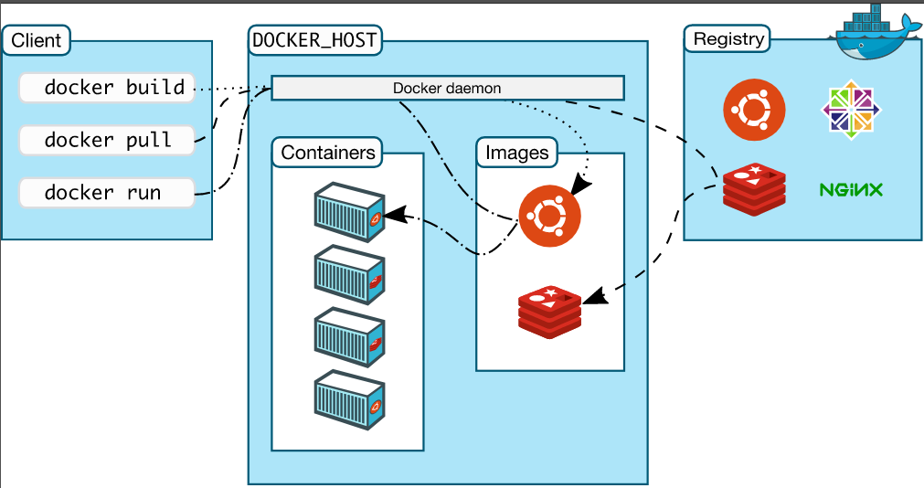

Slide 10
Docker client
It is the primary user interface to Docker. It accepts commands from the user and communicates back and forth with a Docker daemon.

Slide 11
Docker daemon
It runs on a host machine. The user does not directly interact with the daemon, but instead through the Docker client with the RESTful api or sockets.

Slide 12
Docker engine
A Client with a Daemon as also as the docker-compose tool. Usually referred simply as "docker".

Slide 13
Docker machine
A tool which makes it really easy to create Docker hosts on your computer, on cloud providers and inside your own data center. It creates servers, installs Docker on them, then configures the Docker client to talk to them. Required for Mac, Windows users.

Slide 14
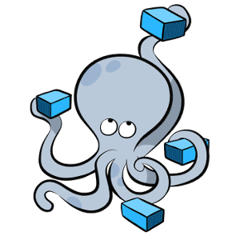
Docker compose
A tool for defining and running complex applications with Docker (eg a multi-container application) with a single file.

Slide 15
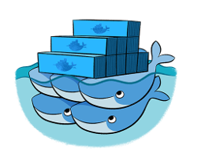
Docker swarm
A native clustering tool for Docker. Swarm pools together several Docker hosts and exposes them as a single virtual Docker host. It scale up to multiple hosts.

Slide 16
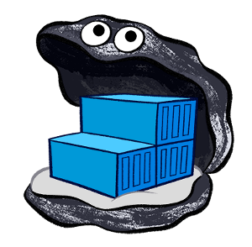
Docker distribution
A (hosted) service containing repositories of images which responds to the Registry API.

Slide 17
Docker Objects
When you use Docker, you are creating and using images, containers, networks, volumes, plugins, and other objects.

Slide 18
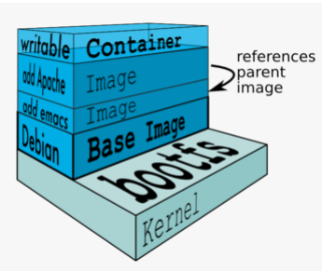
IMAGES
An image is a read-only template with instructions for creating a Docker container. Often, an image is based on another image, with some additional customization.

Slide 19
CONTAINERS
A container is a runnable instance of an image. You can create, start, stop, move, or delete a container using the Docker API or CLI. You can connect a container to one or more networks, attach storage to it, or even create a new image based on its current state.

Slide 20
Networking
Docker containers and services are so powerful is that you can connect them together, or connect them to non-Docker workloads. Docker containers and services do not even need to be aware that they are deployed on Docker, or whether their peers are also Docker workloads or not.

Slide 21
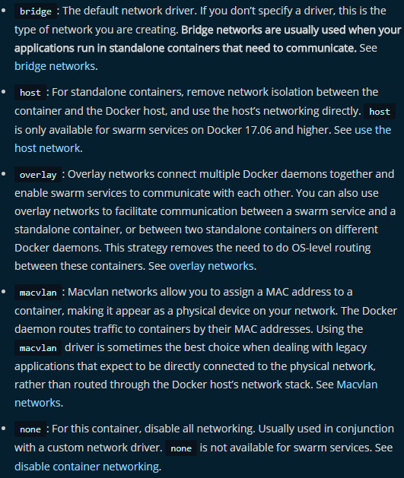

Slide 22
Storage Overview
Docker has two options for containers to store files in the host machine, so that the files are persisted even after the container stops: volumes, and bind mounts. If you’re running Docker on Linux you can also use a tmpfs mount.

Slide 23
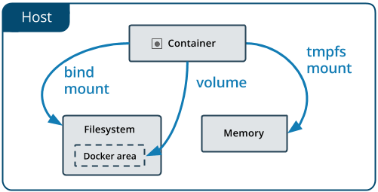
Volumes are stored in a part of the host filesystem which is managed by Docker (/var/lib/docker/volumes/ on Linux). Non-Docker processes should not modify this part of the filesystem. Volumes are the best way to persist data in Docker.
Bind mounts may be stored anywhere on the host system. They may even be important system files or directories. Non-Docker processes on the Docker host or a Docker container can modify them at any time.
tmpfs mounts are stored in the host system’s memory only, and are never written to the host system’s filesystem.

Slide 24
Dockerfile
Docker can build images automatically by reading the instructions from aDockerfile. A Dockerfile is a text document that contains all the commands a user could call on the command line to assemble an image. Using docker buildusers can create an automated build that executes several command-line instructions in succession.

Slide 25
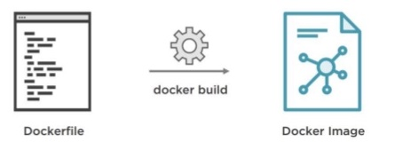
FROM ubuntu:latest
MAINTAINER john doe
RUN apt-get update
RUN apt-get install -y python python-pip wget
RUN pip install Flask ADD hello.py /home/hello.py
WORKDIR /home

Slide 26
Docker Compose
is a tool for defining and running multi-container Docker applications.
define the services that make up your app in docker-compose.yml so they can be run together in an isolated environment.
get an app running in one command by just running docker-compose up

Slide 27

version: '3'
services:
web:
build: .
ports:
- "5000:5000"
volumes:
- .:/code
- logvolume01:/var/log
links:
- redis
redis:
image: redis
volumes:
logvolume01: {}

Slide 28
Swarm Cluster
A swarm is a group of machines that are running Docker and joined into a cluster. After that has happened, you continue to run the Docker commands you’re used to, but now they are executed on a cluster by a swarm manager. The machines in a swarm can be physical or virtual. After joining a swarm, they are referred to as nodes.

Slide 29
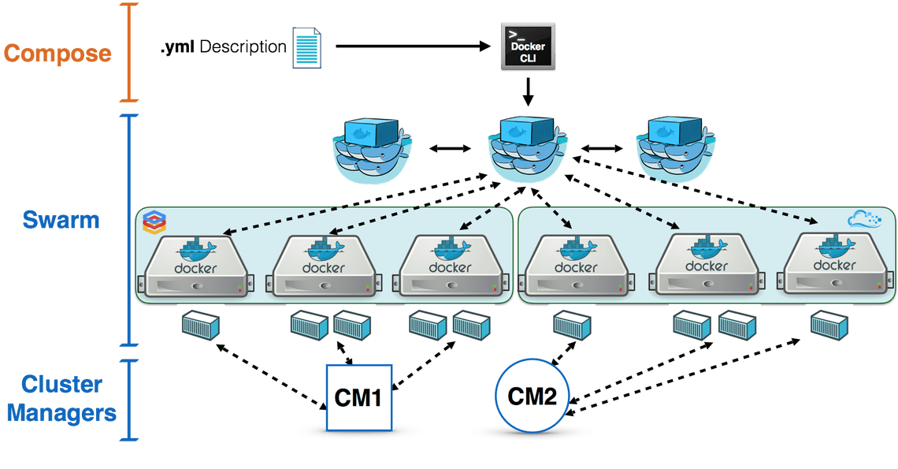

Slide 31


