Slide 1

Sector-wise Financial Performance Analysis using Web Scraping and Exploratory Data Analysis

Slide 2
Team Members & Education
G.Ravikiran B.Tech(DS)
https://www.linkedin.com/in/ravi-kiran-gandupalli-56482b291/
https://github.com/raviguna901
K.Srikanth B.Tech(CSE)
http://linkedin.com/in/srikanth
https://github.com/kethineneisrikanth

Slide 3
Agenda
Business Problem
Project Objectives
Data Source
Web Scraping Process
Data Collection
Data Understanding & Cleaning
Exploratory Data Analysis
Business Insights
Challenges
Conclusion

Slide 4
Business Problem
Problem Statement :
Financial information of listed companies is distributed across multiple sector-wise webpages, making comparison and analysis time-consuming. Investors and analysts face difficulties in evaluating companies based on key financial metrics such as Market Capitalization, ROCE, and P/E Ratio. Manual data collection is inefficient and prone to errors, especially when dealing with a large number of sectors and companies. Therefore, an automated solution is needed to collect, organize, and analyze sector-wise financial data for better business and investment decision-making.
Solution :
An automated web scraping system was developed using Python, Requests, and BeautifulSoup to collect financial data from Screener.in across multiple sectors. The extracted data was cleaned, organized into a structured dataset, and analyzed using Exploratory Data Analysis (EDA). Key financial metrics such as Market Capitalization, ROCE, P/E Ratio, Dividend Yield, Quarterly Sales, and Quarterly Profit Growth were used to compare companies and sectors. This solution enables faster, accurate, and data-driven identification of high-performing sectors and companies.

Slide 5
Objective Of The Project
Automate data extraction from Screener.in.
Scrape financial data from all available sectors.
Build a structured master dataset.
Clean and preprocess the collected data.
Analyze sector-wise financial performance.
Identify companies with strong profitability, growth, and capital efficiency.

Slide 6
Introduction
The Indian stock market consists of companies from various sectors with important financial information available online. However, comparing this information manually is difficult because it is spread across multiple webpages. This project uses Python, Requests, and BeautifulSoup to automatically scrape sector-wise financial data from Screener.in. The collected data is cleaned and analyzed using Exploratory Data Analysis (EDA) to identify high-performing companies and sectors, supporting better financial analysis and decision-making.

Slide 7
Web Scraping
Workflow:
Screener.in
↓
Requests
↓
BeautifulSoup
↓
Extract href links
↓
Loop through sectors
↓
Scrape company tables
↓
Dataset

Slide 8
Data Collection
Data Collected:
Company Name
Sector
Current Market Price
Market Capitalization
P/E Ratio
Dividend Yield
Quarterly Profit
Quarterly Sales
Quarterly Profit Growth
Quarterly Sales Growth
ROCE
Dataset Summary
180 sectors
2411 companies
12 features

Slide 9
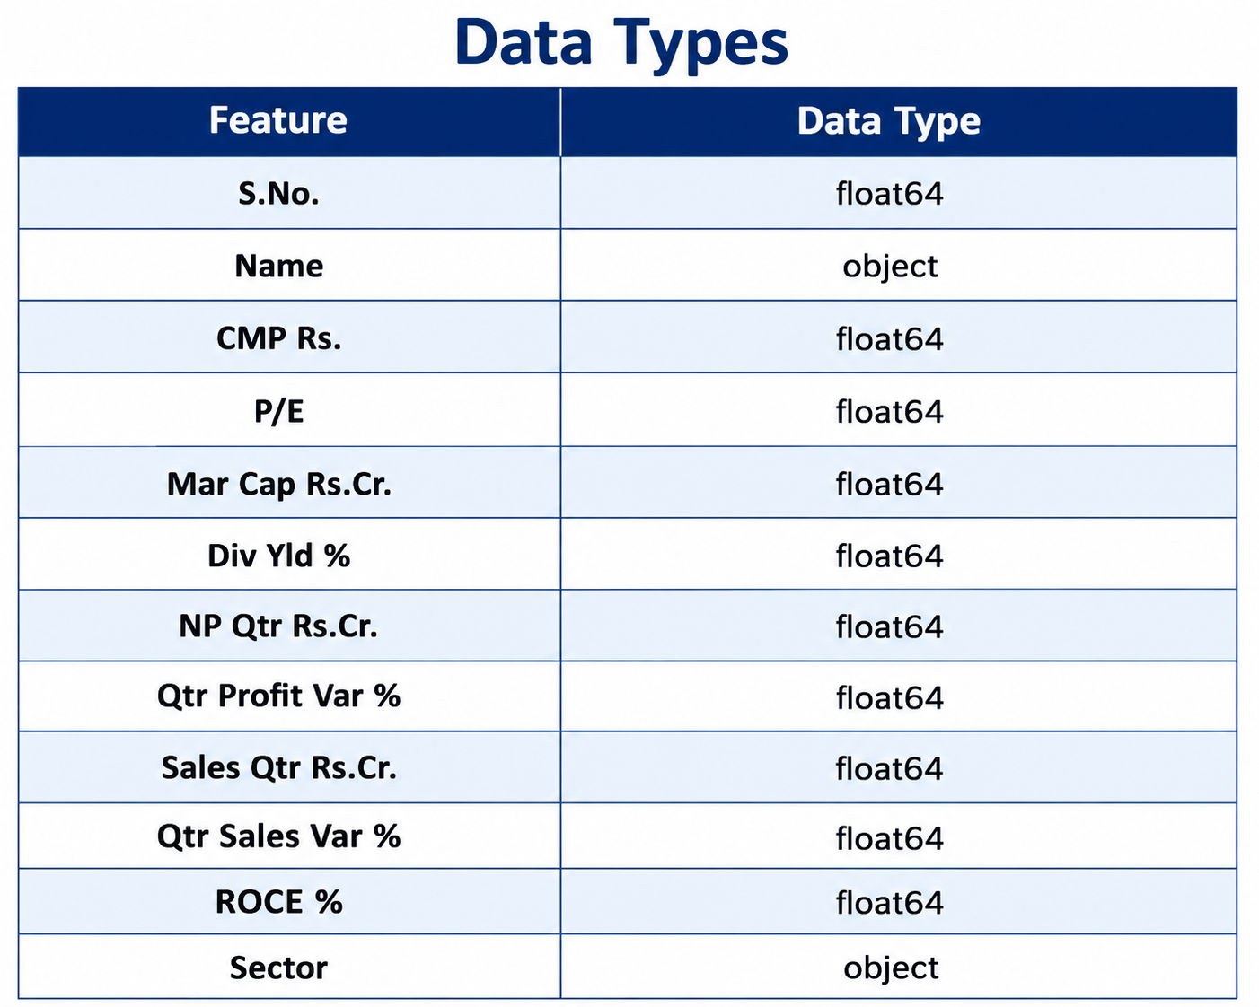
Data Understanding & Cleaning
Data Understanding
Dataset Shape : (2411, 12)
Data Types :

Slide 10
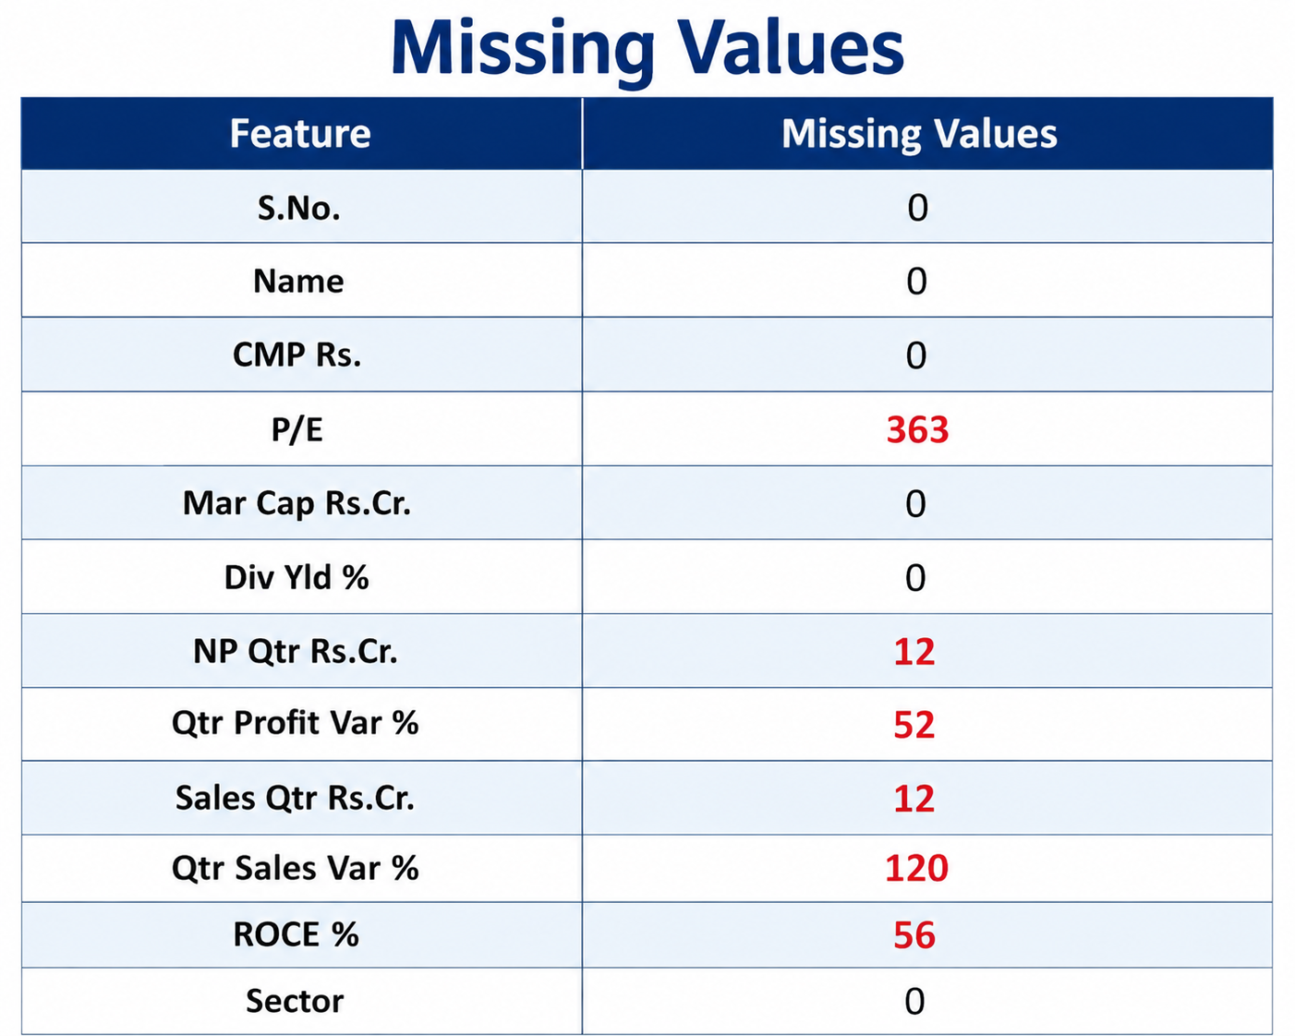
Missing Values :
Duplicate Records : 0

Slide 11
Data Cleaning
Removed commas and special symbols
Converted financial columns into numeric format
Missing values filled using sector-wise median :
for col in numeric_cols:
df[col] = master_df.groupby("Sector")[col].transform(
lambda x: x.fillna(x.median())
)
Verified no missing values remained:
df.isnull().sum()

Slide 12
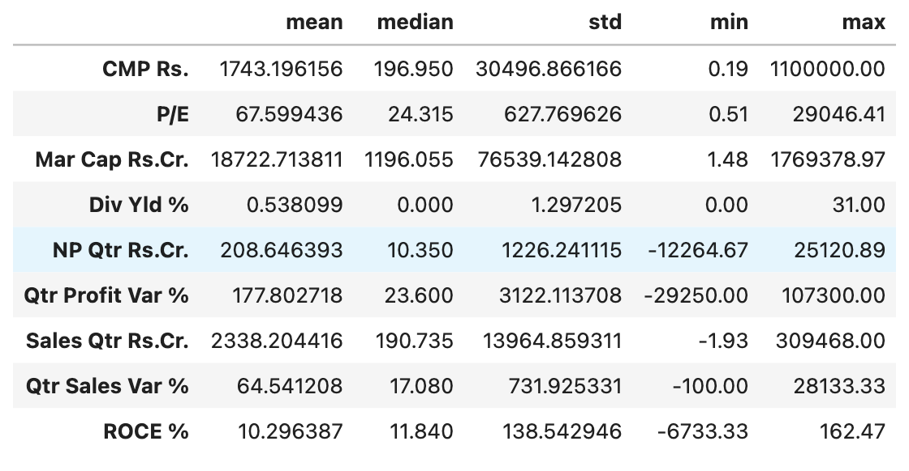
Descriptive Statistics

Slide 13
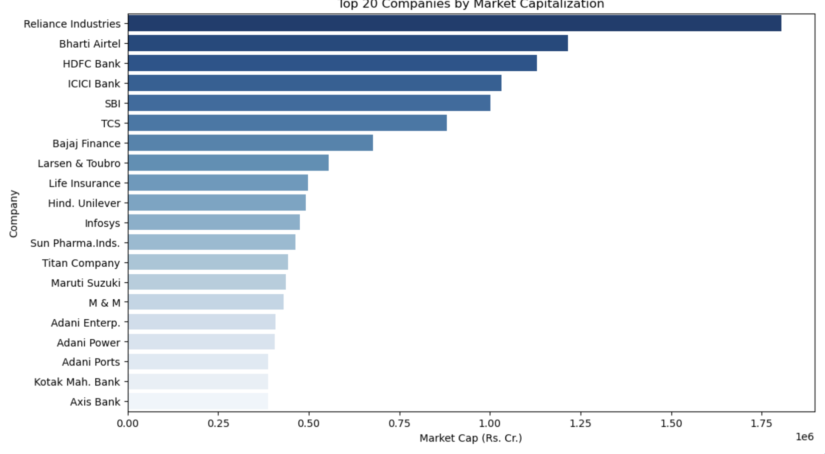
Exploratory Data Analysis
1. Top 20 Companies by Market Capitalization

Slide 14
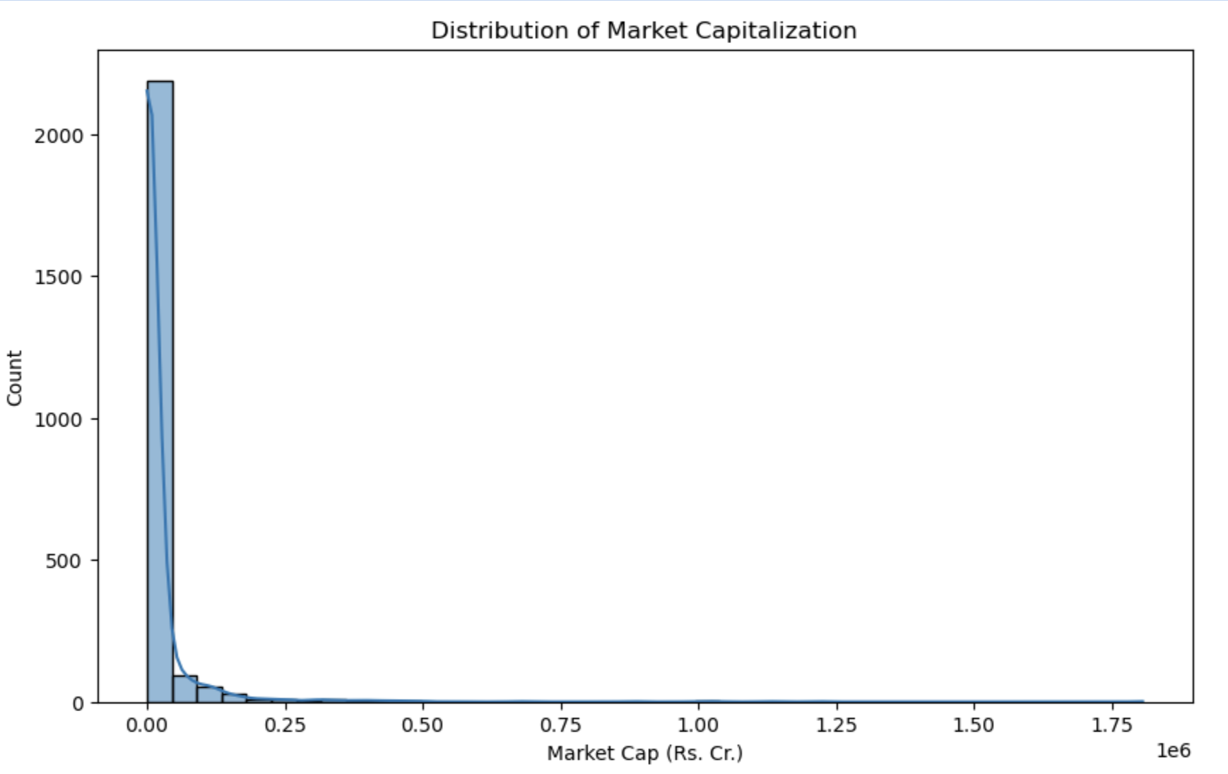
2.Market Cap Distribution

Slide 15
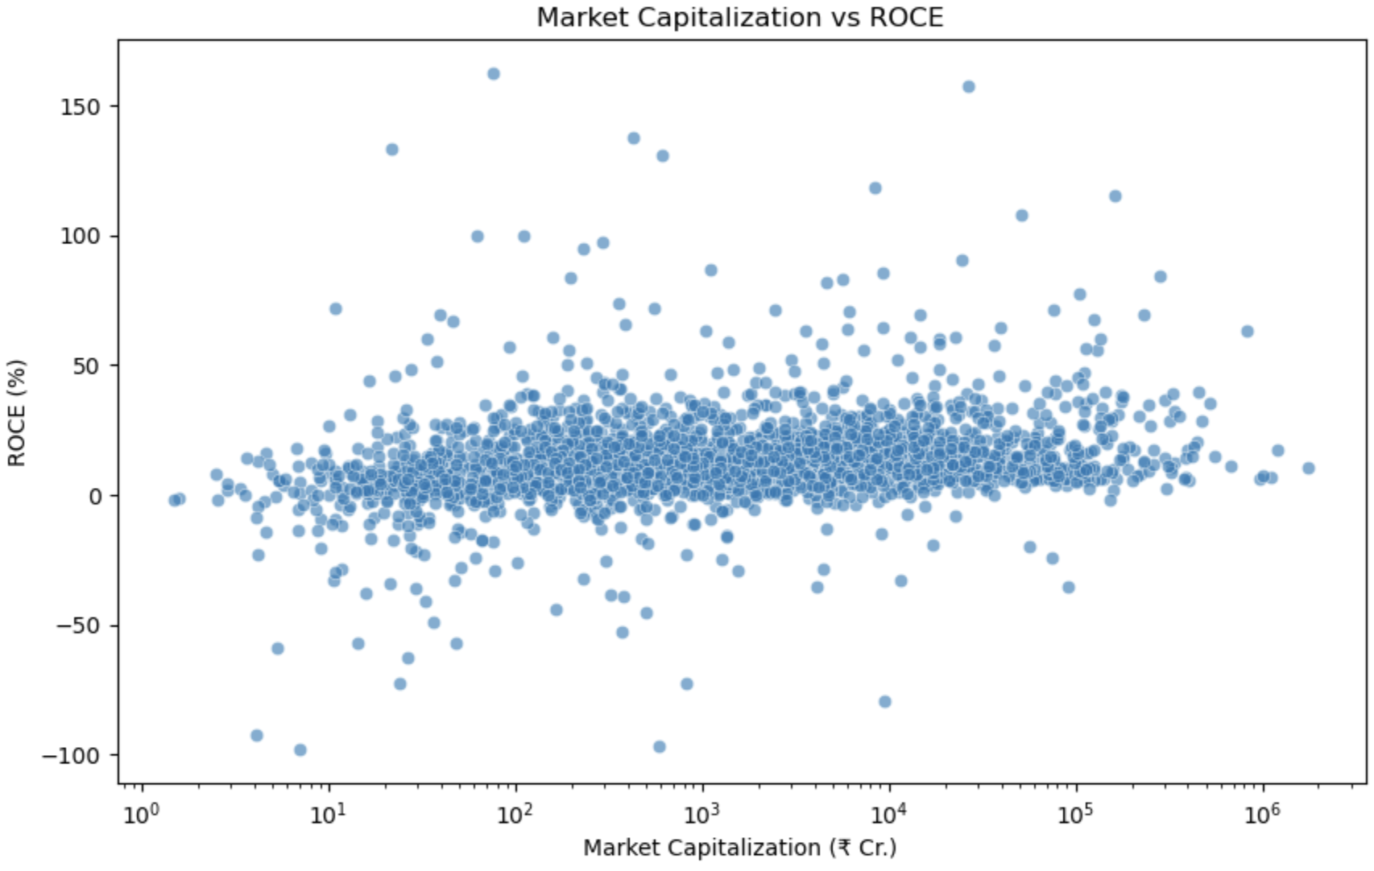
3. Do larger companies use their capital more efficiently?

Slide 16
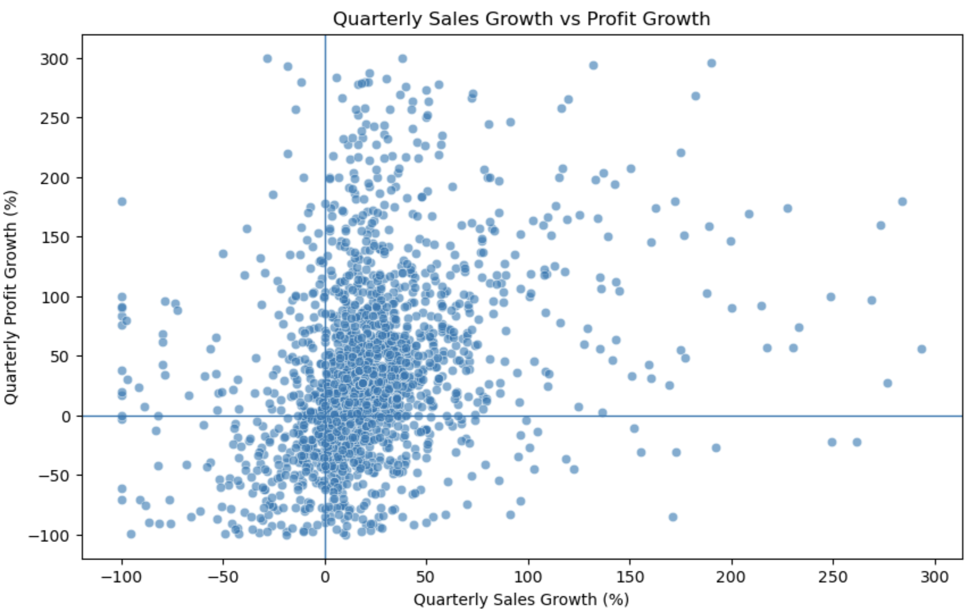
4. Does increasing sales translate into increasing profit?

Slide 17
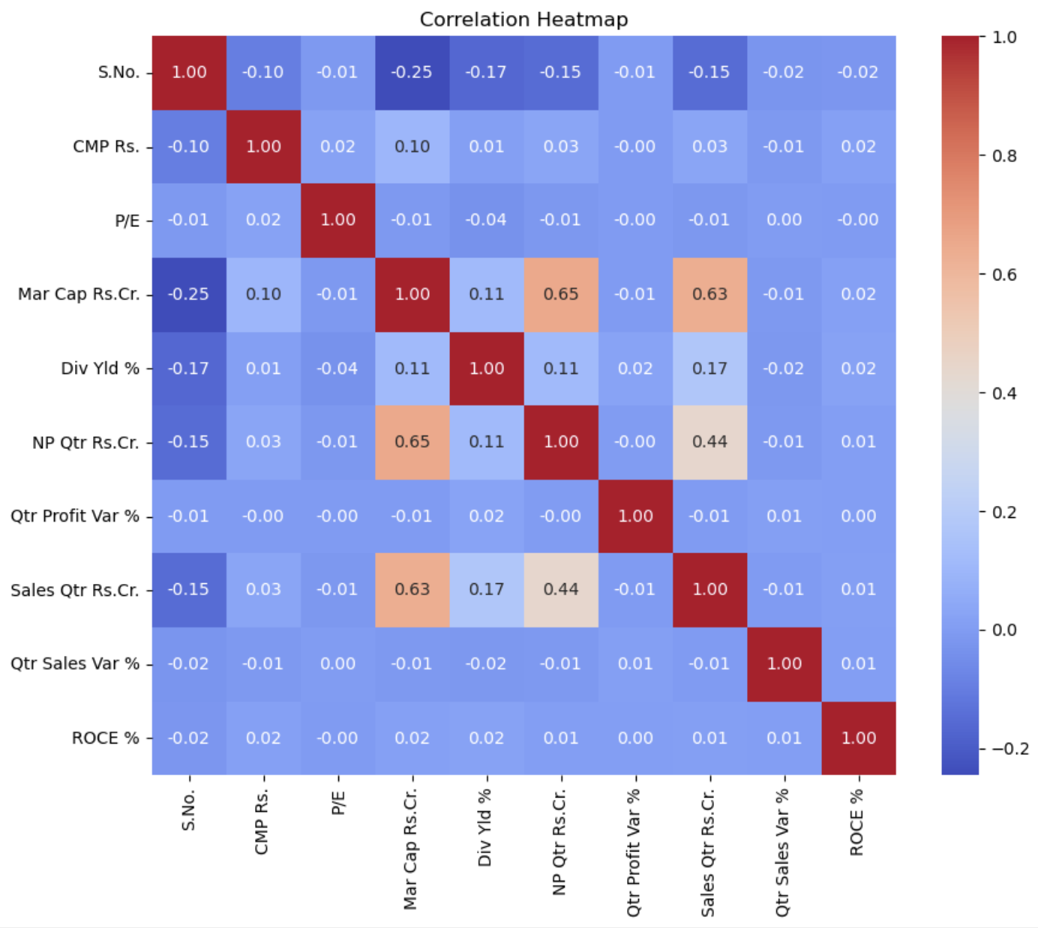
5.Correlation Heatmap

Slide 18
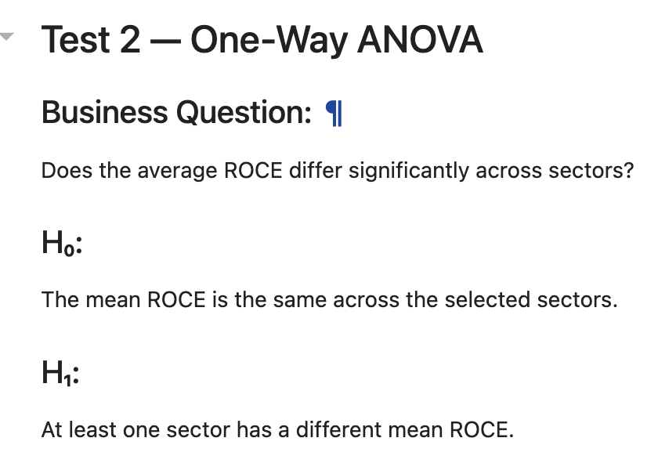

Inferential Statistics
Conclusion:
Reject H0
There is a statistically significant difference in mean ROCE across the selected sectors.

Slide 19
Business Insights
Large-cap companies are concentrated in a few sectors such as Banking, IT, Energy, and Telecom.
High ROCE companies demonstrate stronger capital utilization and operational efficiency.
The Indian stock market contains many small- and mid-cap companies, with relatively few very large companies.
Sector-level analysis provides a clearer picture of industry performance than evaluating individual companies alone.
Correlation analysis shows that different financial indicators capture different aspects of company performance, so investment decisions should not rely on a single metric.

Slide 20
Challenges
Understanding the HTML structure of Screener.in.
Extracting correct href links.
Automating scraping across multiple sector pages.
Handling missing financial values.
Converting financial values into numeric format.
Managing a large dataset containing over 2400 companies.

Slide 21
Conclusion
This project successfully automated the extraction of financial data from Screener.in using Requests and BeautifulSoup. Financial information from 180 sectors covering 2,411 companies was collected, cleaned, and organized into a structured dataset for analysis.
Exploratory Data Analysis (EDA) helped identify top-performing companies and sectors based on Market Capitalization, ROCE, and other key financial metrics. The project demonstrates how web scraping and data analysis can efficiently convert publicly available financial data into meaningful business insights for better decision-making.

Slide 22

THANK YOU

