Slide 1

Mathematical modelling of p53 basal dynamics and DNA damage response
Student name: Ket Hing Chong
Supervisors: Prof. Sandhya Samarasinghe
Prof. Don Kulasiri
Centre for Advanced Computational Solutions (C-fACS)
1
Notes:
Good morning everyone. My name is Ket. My supervisors are: Professor Sandhya Samarasinghe and Professor Don Kulasiri. I am going to present you my research titled “Mathematical modelling of p53 basal dynamics and DNA damage response”. The main objective of this research is to study p53 regulation from a theoretical perspective based on some experimental findings of p53 responses.

Slide 2
Outline
  Introduction ─ p53 signalling network
  Problems ─ Quantitative p53 responses
  Methods ─ Deterministic modelling
  Results ─ Computer simulation results
  Summary
2
Notes:
This is the outline. First I will give you an introduction about p53 signalling network. Then, we will look at the specific problems that I am investigating about p53 quantitative responses.
In the methods, I will show you our model hypothesis that is implemented in a deterministic modelling approach. And some computer simulation results and finally end with a summary.

Slide 3
Background:
Introduction
The tumour suppressor protein, p53, is regarded as “the guardian of the genome” (Lane, 1992)
Normal p53 protects us from cancer
One of the p53 functions:
To stop cell cycle progression in response to conditions that could induce genetic instability, such as DNA damage ─DNA double strand breaks (DSBs).
3
Notes:
Cancer is a genetic disease because of mutations in genes, and the question is how do we prevent from having mutations?
P53 is the answer, which is a tumour suppressor protein and is regarded as the guardian of the genome. Because normal p53 protects us from mutations and cancer. My research is focusing on one of the p53 functions that is to stop cell cycle progression in response to conditions that could induce genetic instability, such as DNA damage.

Slide 4
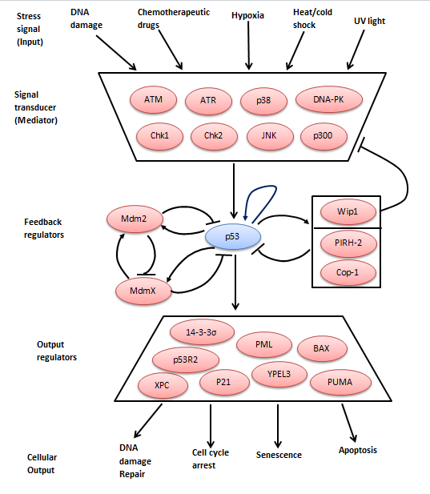
The p53 signalling network
Adapted from Hunziker, PhD Thesis, 2010 & Batchelor et al., Nature Reviews Cancer, 2009
4
Notes:
Here is the p53 signalling network where p53 is a key node that integrates various stress signals that control cell life and death. For example, when there is DNA damage, it activates ATM, the signalling protein kinase. Then pass the stress signal to p53. The activated p53 then acts as a transcription factor to turn on the gene expression of its target genes that can result in DNA damage repair, and cell cycle arrest. To stop cell cycle progressing to the next phases and stimulates DNA damage repair. If the repair fails, p53 can trigger senescence or permanent arrest. And even trigger apoptosis or programme cell death to eliminate cell that contains dangerous mutations. All these cellular outputs from p53 activation can protects us from mutations and cancer. However, some of the p53 activation are irreversible or can kill cell. So, p53 activity needs to be controlled tightly. One of the effective ways is that p53 activates some genes, called feedback regulators, to regulate its activity. For example, p53 activates Mdm2 and then Mdm2 inhibits p53 activity.

Slide 5
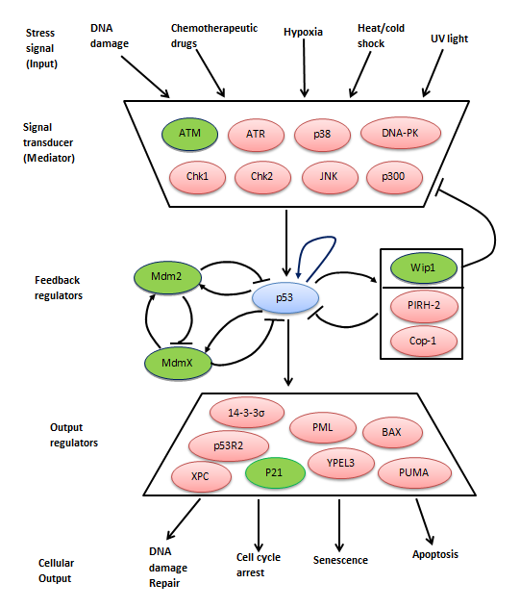
The p53 signalling network
p53 auto-regulation
Adapted from Hunziker, PhD Thesis, 2010 & Batchelor et al., Nature Reviews Cancer, 2009
5
Notes:
Please take note of some of these proteins that are labeled with green colour, which will appear in my model. They are ATM protein kinase, the signalling protein. Three feedback regulators Mdm2, MdmX and Wip1. And p53 activation of p21 protein that can result in cell cycle arrest. One important factor is p53-autoregulation, a positive feedback loop, where p53 activates its own gene expression.

Slide 6
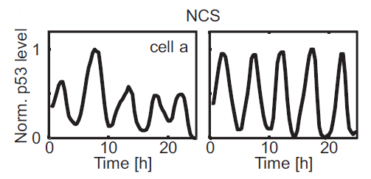
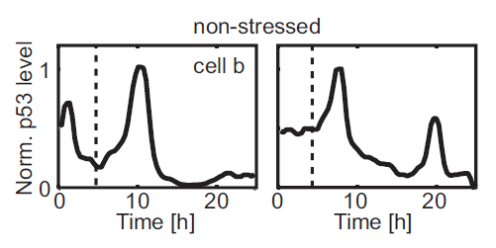
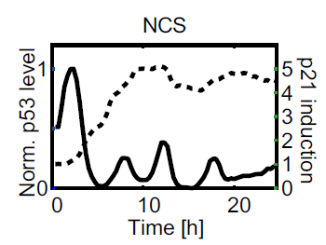
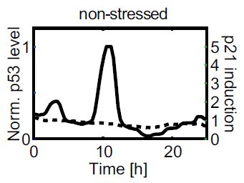
p53 dynamics in stress and non-stressed conditions
Problem 1:
(period: 4-7 hours);
p53 is active
p53 is not active
Problem 2:
p21 induction
p21 was induced
p21 stayed at basal levels
Loewer et al., Cell, 2010
6
Notes:
My model is based on an experimental findings from a group of researchers from Harvard Medical School, where they studied p53 activation using single-cell microscopy in two different conditions. One is under stress conditions where cells were exposed to an agent called NCS that can cause DNA damage. The second condition is non-stressed conditions where cells proliferate under normal conditions. Here is their results published in Cell journal. Under stress condition, p53 levels shown with a series of repeated pulses of approximately fixed amplitude and duration. What it means? It means p53 is active and activates its target genes. Under non-stressed condition, p53 levels show spontaneous pulses. What it mean? It mean p53 is not fully active, even though there is spontaneous pulses. These spontaneous pulses are due to intrinsic DNA damage from normal cellular biochemical reactions. This is my first problem, can I find a mathematical model to explain these observations of repeated pulses and spontaneous pulses? The second problem is about p21 induction. Under stress conditions, p53 is active and p21 was induced as shown with the dotted graph that is increasing over time. Whereas under non-stressed condition, p21 stayed at basal levels, even though there is one spontaneous pulse. So, p21 is off. The question is what are the mechanism that regulate p53 activation of p21 that is on when it is needed and off when it is not needed?

Slide 7
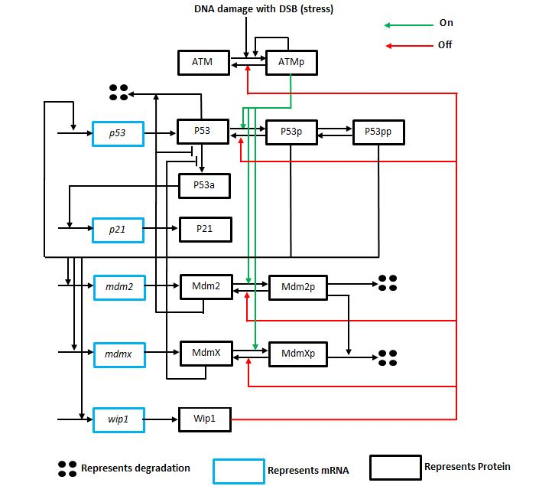
Proposed model
7
Notes:
We propose a model that incorporates the latest molecular interactions and gene regulations as shown in this schematic diagram. First, the DNA damage with DSB as the input. DSB activates ATM. ATM then pass this signal to p53 and activates p53 as shown with the green arrows. Then, the activated p53 turn on gene expression of itself, and three feedback regulators Mdm2, MdmX and Wip1.
The wip1 then feedback to turn off the stress signal and p53. So that p53 is not on persistently. At the same time p53 activated Mdm2 and MdmX inhibit p53 acetylation and activation of p21.

Slide 8
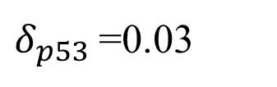
Methods: Deterministic modelling
Use delay differential equations (DDEs)
19 Eqns and 78 parameters
The model of DDEs were solved by using XPP
One of the equations:
Rate of change for p53 mRNA
$$\frac{d[p53]}{dt}=s_{p53}+e_{5}\frac{{[P53p\left(t−τ_{5}\right)+P53pp\left(t−τ_{5}\right)]}^{4}}{K_{p53}^{4}+{[P53p(t−τ_{5})+P53pp\left(t−τ_{5}\right)]}^{4}}−δ_{p53}[p53]$$
parameter:
$δ_{p53}$=0.03
8
Notes:
We use deterministic modelling. Based on the molecular interactions from the schematic diagram in the previous slide, we formed 19 equations for 19 molecular species with 78 parameters. These parameters were estimated to fit the experimental observations that I have shown you just now. The model equations were solved using a software called XPP. For example, one of the equation for p53 mRNA is shown here.

Slide 9
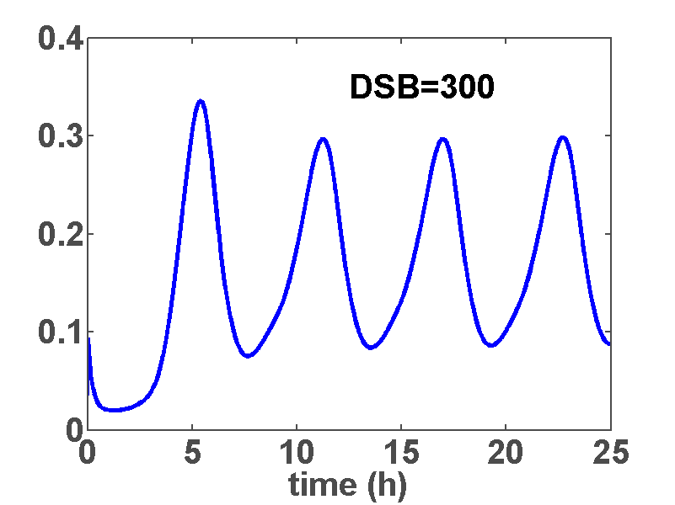
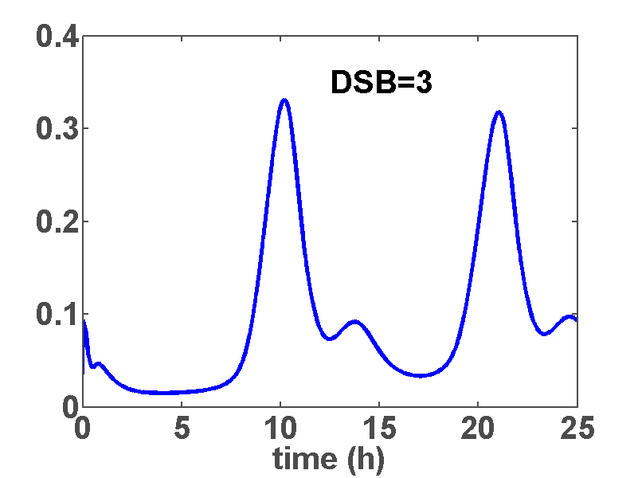
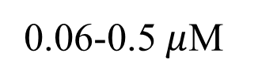
Results:
Problem 1
(Experiments 4-7 hours)
Loewer et al., Cell, 2010
0.06-0.5 $μ$M
Stressed
non-stressed
period: 5.8 hours
9
Notes:
Here are our simulation results. To mimic the stress conditions we set DSB to 300 and the simulation result show repeated pulses of approximately fixed amplitude and duration. For non-stressed condition, we set DSB to 3 in this case, we manage to get spontaneous pulses. These results were in good agreement with the experimental results.

Slide 10
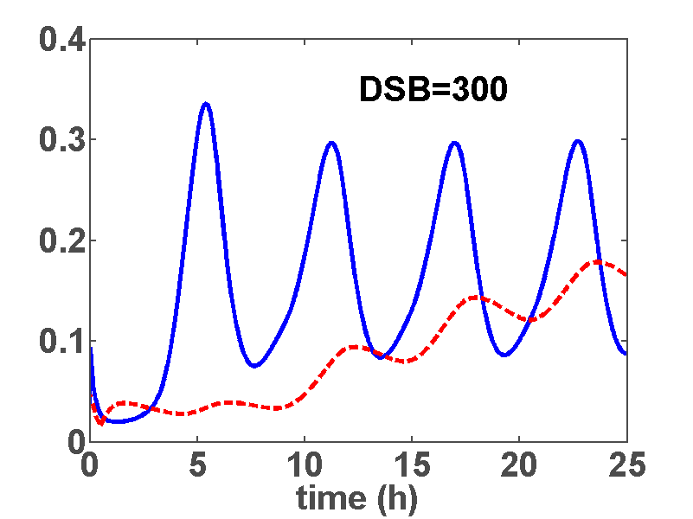
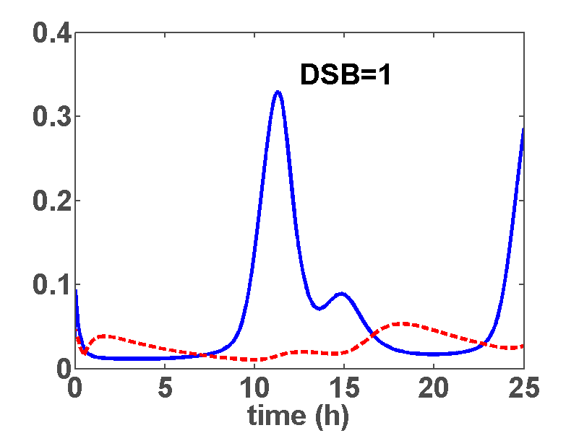
Results:
Problem 2
Loewer et al., Cell, 2010
Stressed
non-stressed
p21 was induced
p21 stayed at basal levels
10
Notes:
For the p21 induction, here are our results where p21 mRNA are shown in green graphs. In stressed condition, p21 is increasing over time and in non-stressed condition where we set the DSB=1 in this case, p21 stayed at basal levels even though there is one spontaneous pulse. So, accurate activation of p53 in arresting cell cycle is necessary to prevent propagation of damaged DNA templates during DNA replication and mitosis.

Slide 11
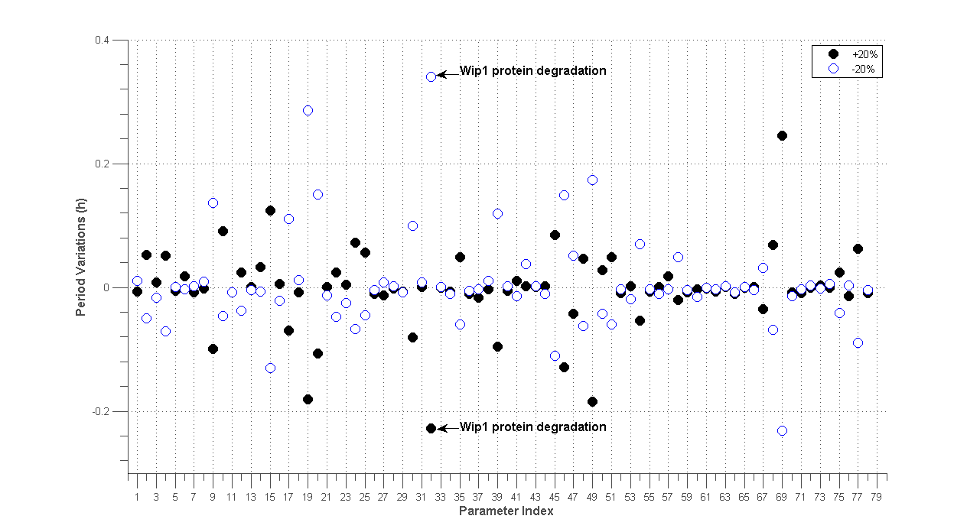
Local Parameter sensitivity analysis
Nominal parameter period: 5.8 hours
(Experiments 4-7 hours)
19
32
49
69
Wip1 mRNA degradation rate
Wip1 protein degradation rate
ATM auto-activation rate
Wip1 transcription delay
11
Notes:
To identify which parameters that are important in controlling p53 oscillations period under stressed conditions. We perform local parameter sensitivity analysis. Where one parameter value is increase/decrease by 20% while holding the other parameters at nominal value. The period for standard parameter is 5.8 hours. The black dots represent the +20% and the circle represents the -20% for each parameter. Overall, it shows that period of p53 oscillations is robust to perturbation with 5.8 ± 0.2 hours. The most important parameter is parameter 32: Wip1 protein degradation rate.

Slide 12
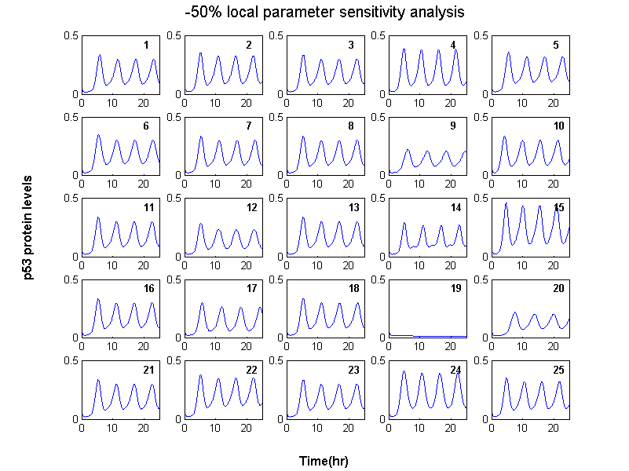
Model predictions: 3 targets in reactivating p53
p53 oscillations
are lost
Wip1 mRNA degradation rate
19
12
Notes:
So, our model has captured the important features of the p53 system. Then, we can use it to make some theoretical predictions. Further analysis from our model by reducing 50% of each parameter from its nominal value. We found 3 targets in reactivating p53. The first one is parameter 19 wip1 mRNA degradation rate.

Slide 13
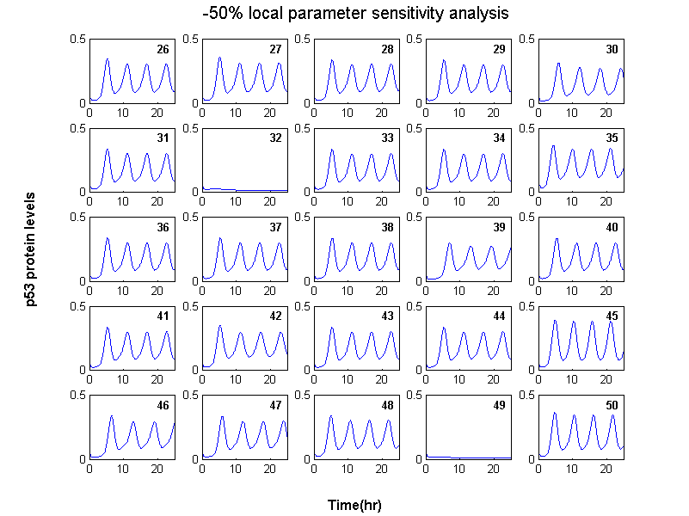
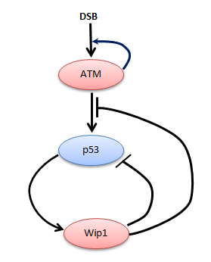
Model predictions: 3 targets in reactivating p53 (cont.)
p53 oscillations
are lost
32
Wip1 protein degradation rate
ATM auto-activation rate
49
13
Notes:
The second is parameter 32 Wip1 protein degradation rate and the third one is parameter 49 ATM auto-activation rate. Our model prediction shows that by reducing these parameter inactivate p53. Thus, any strategy to increase these parameters may be helpful in reactivating p53.

Slide 14
Results:
Summary
Our model simulation results were consistent with the experimental findings
Contribution:
The model advances our understanding of the mechanisms underlying p53 regulation
3 targets to modulate p53 oscillations and function
Wip1 mRNA degradation rate
19
32
Wip1 protein degradation rate
ATM auto-activation rate
49
14
Notes:
In summary: In this study, we proposed a mathematical model of the core regulatory feedback mechanisms that regulate p53 activation in arresting cell cycle, and our model simulation results were consistent with the experimental findings. The contribution of this research: the model advances our understanding of the mechanisms underlying p53 regulation and this theoretical model provides some useful prediction of p53-based therapy. Thank you for your attention.

Slide 15
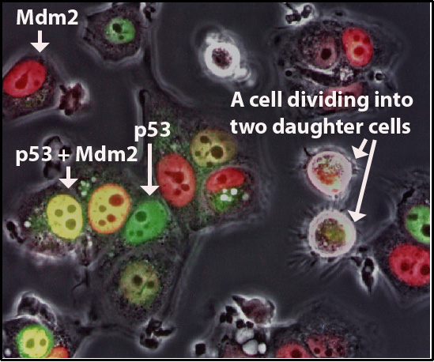
Thank you
  Individual cells study of p53 dynamics (Lahav et al., Nature Genetics, 2004)
source:
http://www.techtransfer.harvard.edu/crop/investigators/investigator.php?id=27
Questions & Answers
15

