Slide 1

Computational techniques in mathematical modelling of biological switches
presented by Ket Hing Chong
Ket Hing Chongª, Sandhya Samarasinghe^{b}, Don Kulasiri^{b} & Jie Zhengª
ªSchool of Computer Engineering,
Nanyang Technological University, Singapore
^{b}Centre for Advanced Computational Solutions (C-fACs),
Lincoln University, New Zealand
Date of Presentation: 3 December 2015
MODSIM 2015, Gold Coast Australia
Notes:
Good morning everyone. My name is Ket and I am from Nanyang Technological University, Singapore. Today I am going to present to you our paper titled “Computational techniques in mathematical modelling of biological switches” Before I start, I would like to thank my supervisors: Sandhya, Don and Jie; for their support in this work.

Slide 2
Outline
Introduction
—Bistable biological switches
Methods
—Phase plane and saddle-node
bifurcation diagram with an
example
Summary
—Computational techniques in
modelling biological switches
Notes:
This is the outline of my presentation. First I will give you an introduction about what it means by bistable biological switches. The concept of bistability and hysteresis behaviour is very difficult to understand, especially for someone new to this concept because it involves dynamical system theory, computation and the biology. Thus, the purpose of this paper is to review and demonstrate this concept through a simple example by using the methods of phase plane and bifurcation diagram. Lastly, end with a summary.

Slide 3
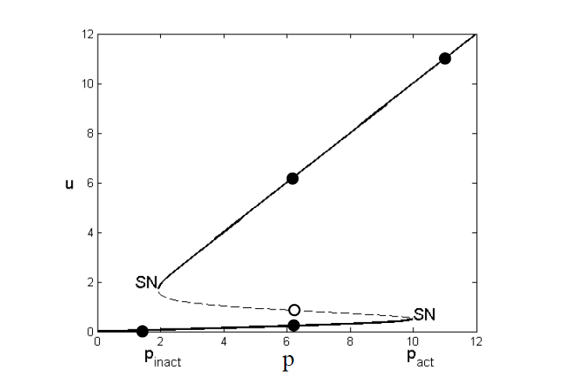

Introduction
Bistable biological switches
—The concept of bistability and
hysteresis
—Saddle-node bifurcation diagram
ON
Toggle switch
OFF
http://www.tandyonline.co.uk/spst-toggle-switch-with-on-off-label-plate.html
Notes:
Biological switch can be explained by a saddle-node bifurcation diagram that captured the concept of bistability and hysteresis behaviour. Shown here is a typical saddle-node bifurcation diagram.
It is often linked to the toggle switch. Toggle switch is an engineer system that consists of two stable steady states of ‘ON’ or ‘OFF’, as a switch it must be reliable, consistent and be able to function as a switch.
Biological system is assumed to have similar design. In the bifurcation diagram, y axis represents a variable and x axis represents a parameter. For parameter value between the two thresholds of P_{act} and P_{inact}, there is bistability. The solid line represent stable steady sate and the dashed line represent unstable steady state.

Slide 4
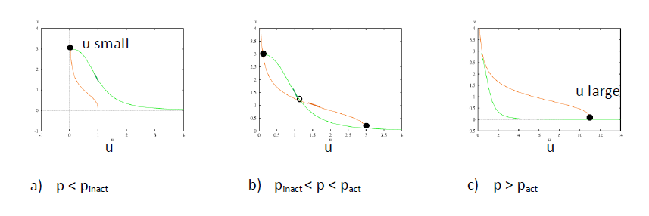
Introduction
Bistable biological switches
—Phase plane
node
Saddle
node
At p=pact
saddle-node coalesce
saddle-node bifurcation
Notes:
This bistability can be view in a phase plane. The intersection points from the nullclines are steady states. For b) the parameter value between the two thresholds of P_{act} and P_{inact} there are two stable nodes and one saddle point. For c) p > P_{act} or a) p < P_{inact} there is one stable node. What happens at the two thresholds value? The saddle and one of the nodes coincide or coalesce and that’s why it is called saddle-node bifurcation.

Slide 5
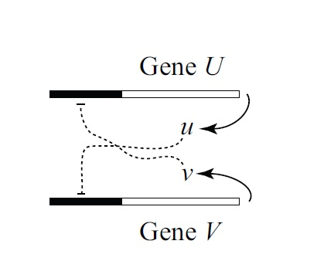
Methods: Bistable biological switches illustrated with an example
A synthetic genetic switch from Gardner et al. (2000)
—The concept of bistability
—Saddle-node bifurcation diagram
Two equations
du/dt=α1/(1+v^{n})–u
dv/dt=α2/(1+u^{m})–v
Parameter | value
α₁ | 3
α₂ | 3
n | 3
m | 3
Segel & Edelstein-Keshet, SIAM, 2013
Notes:
To demonstrate the concept of bistability and hysteresis behaviour, we have chosen a simple example. A synthetic genetic switch from Gardner et al. (2000). This is the genetic circuit, which consist of two genes mutually inhibiting its transcription. The system is represented by two ODEs. The first term represents inhibition and the second term is degradation. For a set of parameter values, alpha 1, alpha 2, n and m equal to 3, we can show bistability and hyeteresis behaviour.

Slide 6
Methods using the Software XPPAUT
Gardner_2000_model.ode
u'=alpha1/(1+v^n)-u
v'=alpha2/(1+u^m)-v
param alpha1=3, alpha2=3, n=3, m=3
@ total=500, xp=t, yp=u, dt=0.01, xlo=0, xhi=300, ylo=0, yhi=4, maxstor=500000
# AUTO stuff
@ AutoXMin=0, AutoXMax=15
@ AutoYMin=0, AutoYMax=15
@ Nmax=1000, NPr=200, ParMin=0, ParMax=20, Ds=0.01
done
Free XPPAUT download
http://www.math.pitt.edu/~bard/xpp/xpp.html
Notes:
We used the software called XPPAUT. First, save an ode file. The definition of equations are similar as the ODEs I have shown you in the previous slide. Then, set the parameter values. Some setting to draw graph.
AUTO stuff is to set the setting for drawing bifurcation diagram.

Slide 7
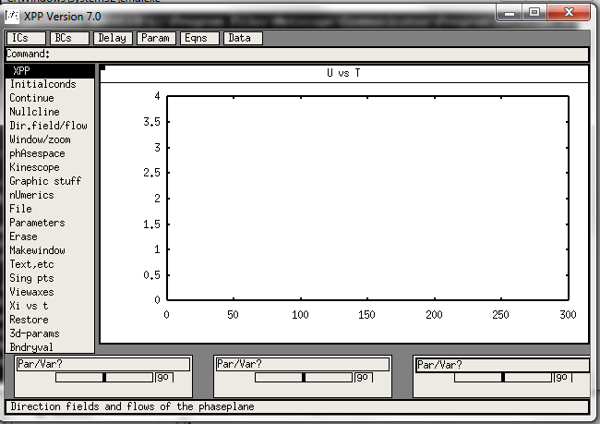
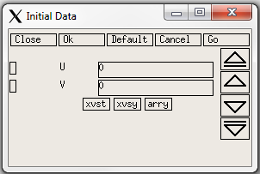
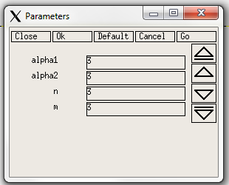
Bistable biological switches illustrated with an example
XPPAUT graphical interface
Notes:
This is the graphical interface for the XPPAUT software. It is very easy to use. For example, when we click on Ics which stands for Initial Conditions. A screen to set the initial conditions will pop up and by clicking go we can simulate the time course simulation. Similarly, by clicking the Param the Parameter screen will pop up and we can set the parameter values we want and click the Go button to do time course simulation.

Slide 8
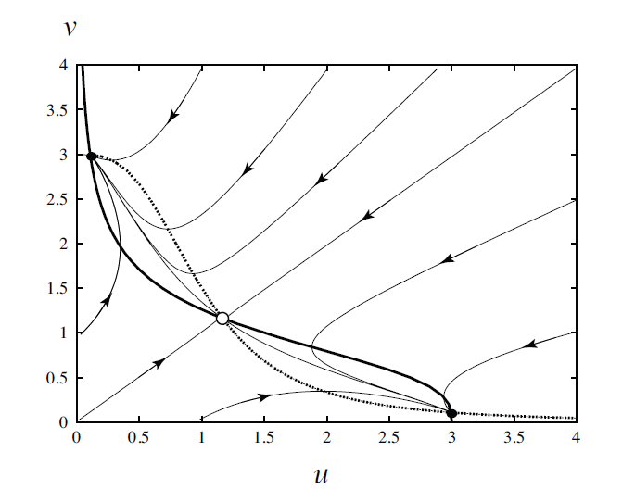
Methods using the Software XPPAUT
Bistable biological switches illustrated with an example
—The concept of bistability
—Saddle-node bifurcation diagram
separatrix
u is low
OFF
Two attractors
ON
u is high
Segel & Edelstein-Keshet, SIAM, 2013
Notes:
By using this software, we can draw a phase plain. A phase plane is shown here, the vector field of the system can be view as flow of the dynamical system. It shows two attractors or stable steady states.
There is one separatrix that separate the two basin of attractors one for ‘ON’ and another for ‘OFF’. For example, when we consider two points, the red and black dots here. One will be attracted to ‘ON’ and the other will be attracted to ‘OFF’.

Slide 9
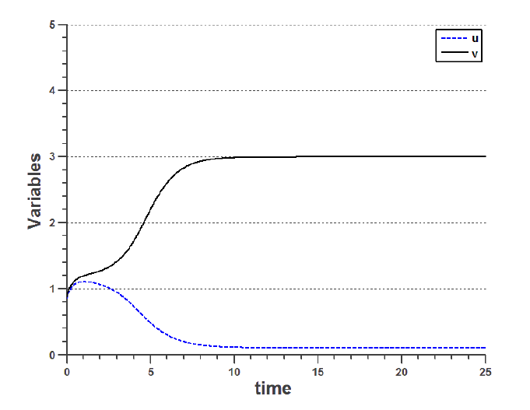
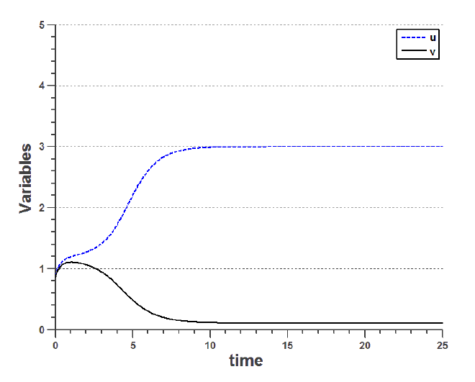
Bistable biological switches illustrated with an example
time course simulations
Initial conditions:
u=0.84, v=0.87
Initial conditions:
u=0.87, v=0.84
u is high
ON
u is low
OFF
Notes:
The bistability can be viewed in time course simulation as seen on this slide. For one set of initial conditions, u is attracted to low stable steady state (reached horizontal line) which stands for ‘OFF’ state. And for another set of initial conditions, u is attracted to high which stands for ‘ON’ state.

Slide 10
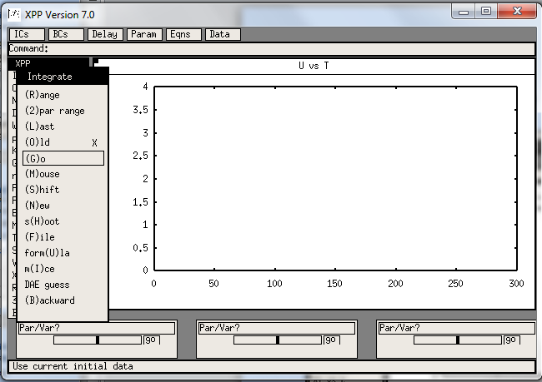
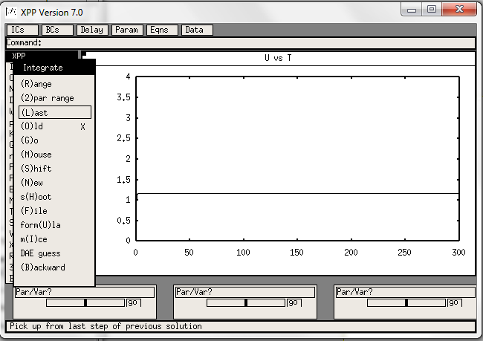
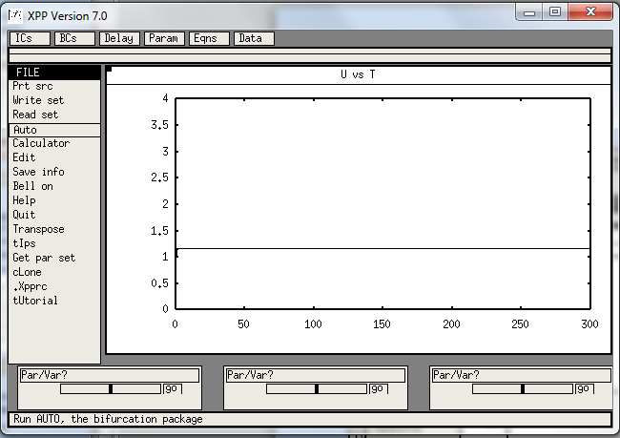
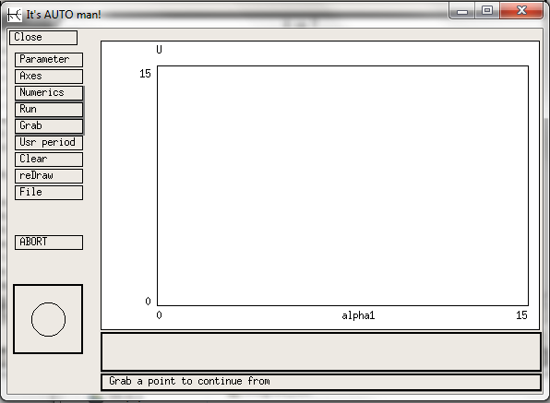
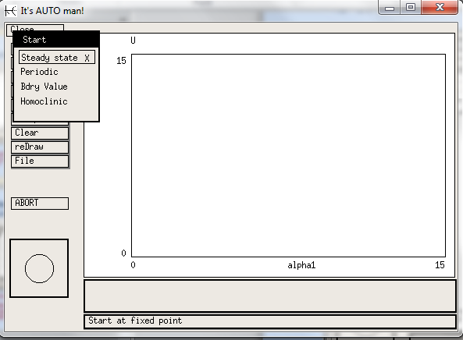
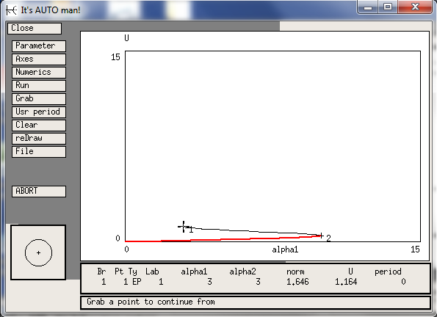
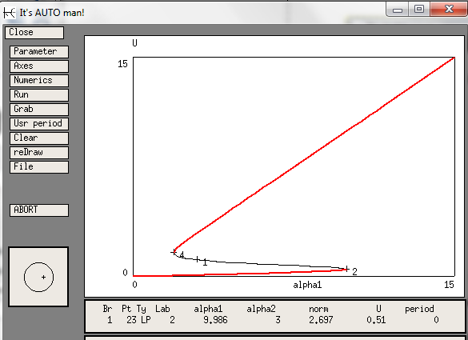
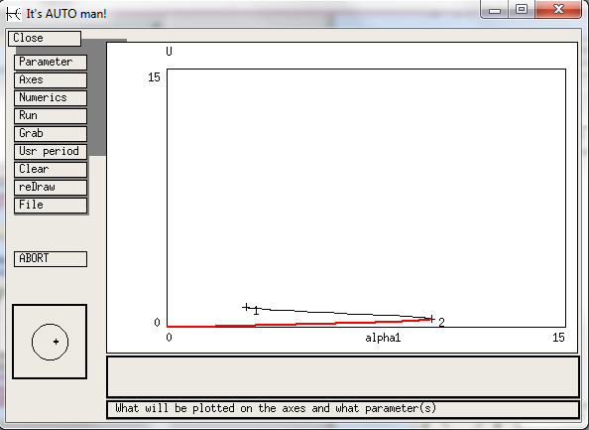
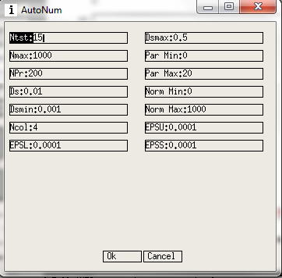
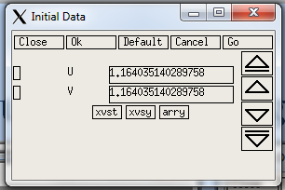
Saddle-node bifurcation diagram
Tab
Enter
(to choose
a point)
(to select/grab the selected point)
AUTO is a bit tricky
Not fully automatic
1. Integrate→Go
then
2. Integrate→Last
(repeat Integrate→Last
a few times)
RUN in opposite
Direction
Add minus sign
DS=-0.01
Notes:
Next, I would like to demonstrate how to draw bifurcation diagram. The XPP is linked to AUTO and AUTO is a bit tricky to use because it is not fully automatic. You need to follow a few key steps.
First, you use Integrate Go, then you use Integrate Last (the end points of the previous integration will be used as the initial conditions for current integration) and repeat Integrate Last a few times until it reaches stable steady state or horizontal line. Secondly, when you get half of the saddle-node bifurcation diagram you need to select an end point and run in the opposite direction by adding a negative sign in the DS=-0.01.

Slide 11
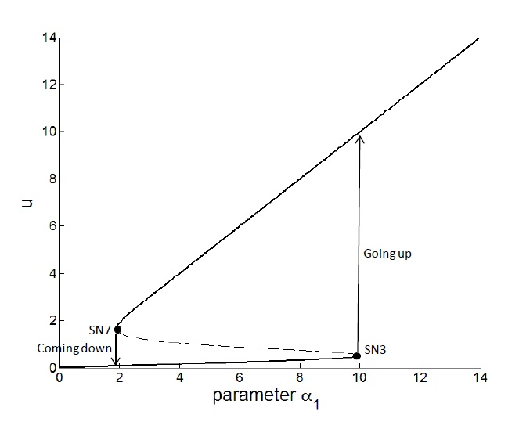
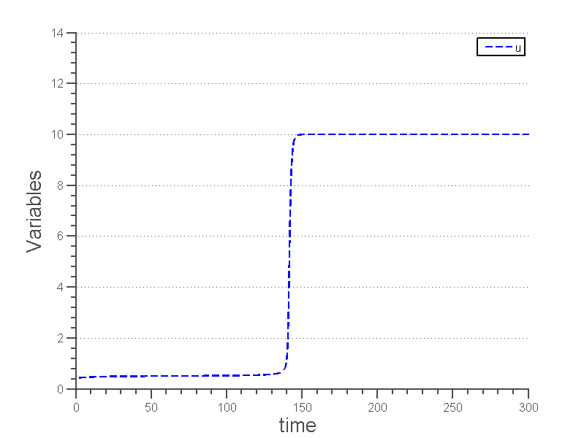
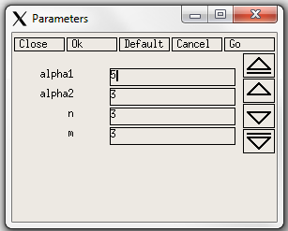
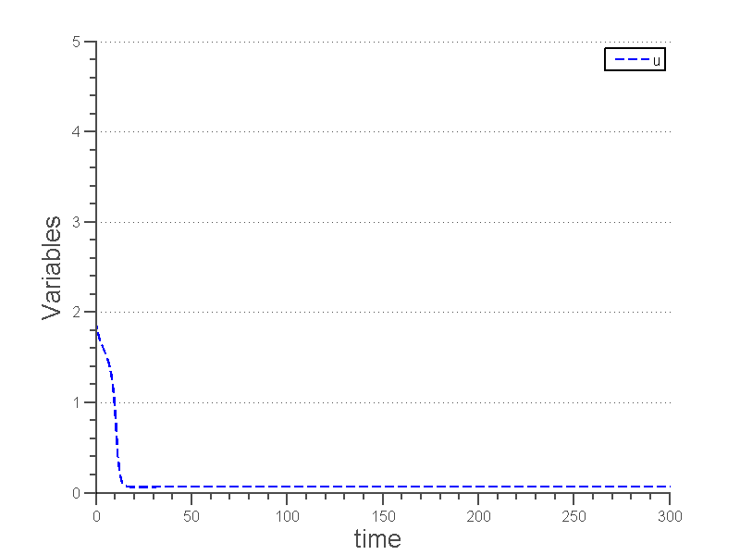
hysteresis behaviour
Saddle-node bifurcation diagram
Decreases then
Integrate→Last
α1
α1=1.8
α1=10
Increases then
Integrate→Last
α1
Two thresholds:
We proposed:
α1=1.91,
α1=9.98
1. Integrate→Go
Repeat 2 & 3
2. Changes then
3. Integrate→Last
α1
Notes:
In order to see the hysteresis behaviour, we propose to run these three steps: 1. Integrate, Go and then repeat 2 & 3. changes the parameter value (increase or decrease) then use Integrate Last (kind of maintaining the memory of the current state).
The going up or coming down can only been seen when the parameter crosses the thresholds as show with the time course simulations.

Slide 12
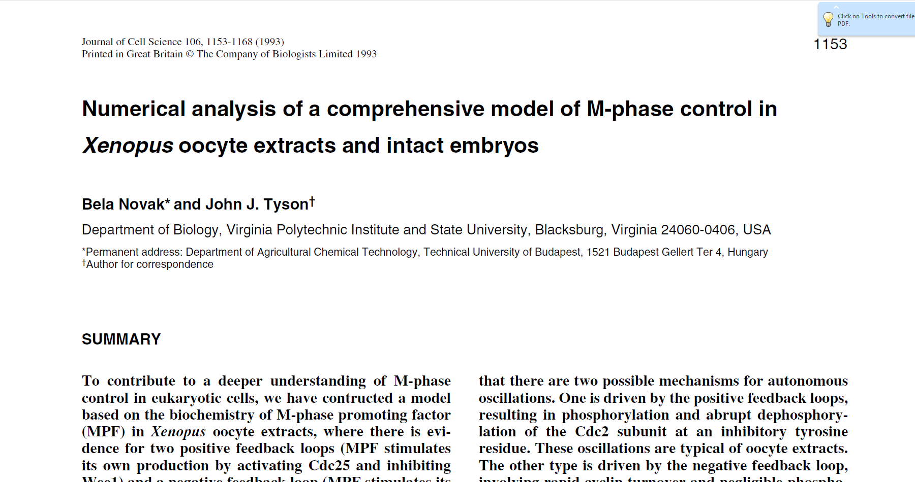
successful case: model
10 ODEs
Novak & Tyson, J. Cell Sci, 1993
Notes:
Saddle-node bifurcation diagram is a very powerful tool for studying bistable biological switch. In the literature, one successful case is a model constructed by Novak and Tyson in 1993. They used 10 ODEs and made a prediction of the hysteresis behaviour with two thresholds of entering and exiting mitosis in frog egg cell cycle.

Slide 13
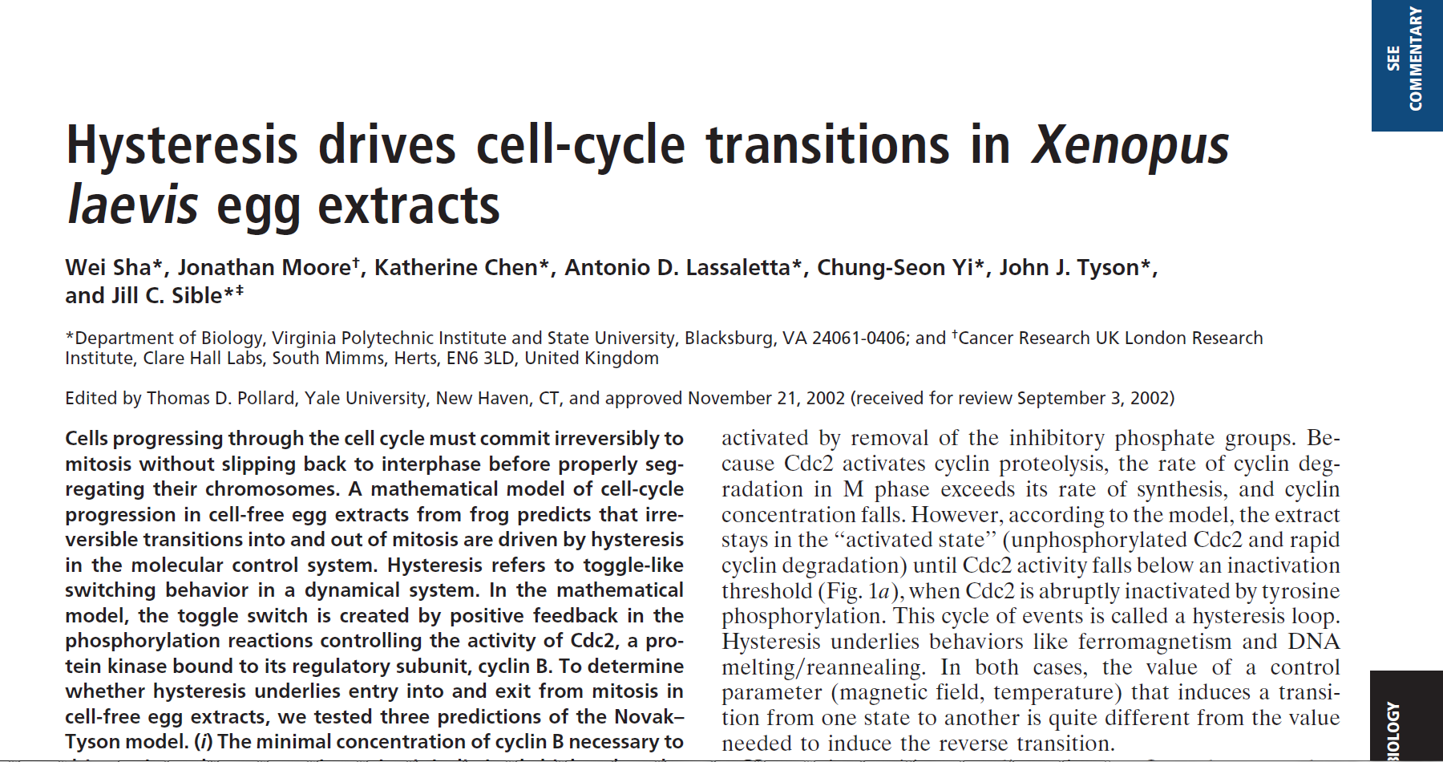
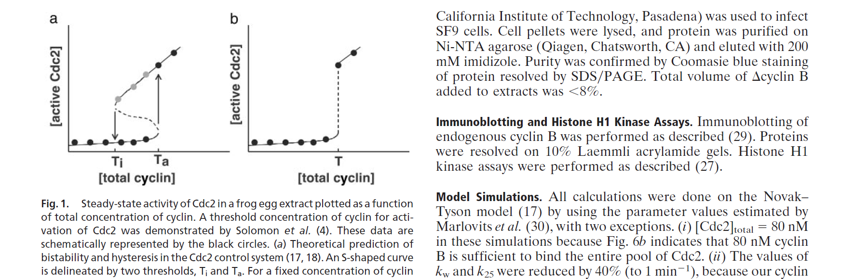
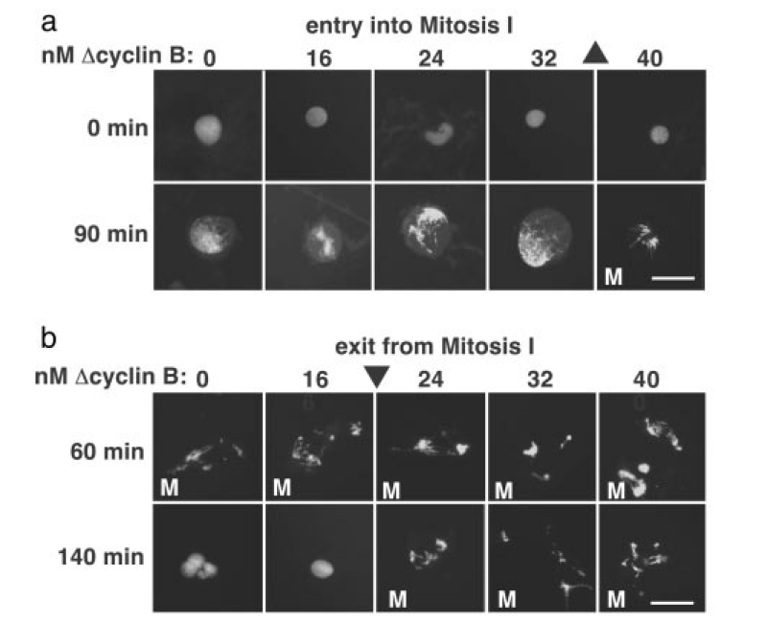
successful case: experiment
1. Sha et al., PNAS, 2003
2. Pomerening, J. R., Sontag, E. D., Ferrell, J. E., Jr., 2003. Building a cell cycle oscillator: hysteresis and bistability in the activation of Cdc2. Nat Cell Biol 5, 346-51.
Notes:
Ten years later, Novak and Tyson prediction has been validated by two experiments listed by references one and two here. Especially, in the references one: The saddle-node bifurcation diagram was used to capture the hysteresis behaviour with two thresholds one large value between 32 and 40 for entry into mitosis and the other small value between 16 and 24 to exit from mitosis.

Slide 14
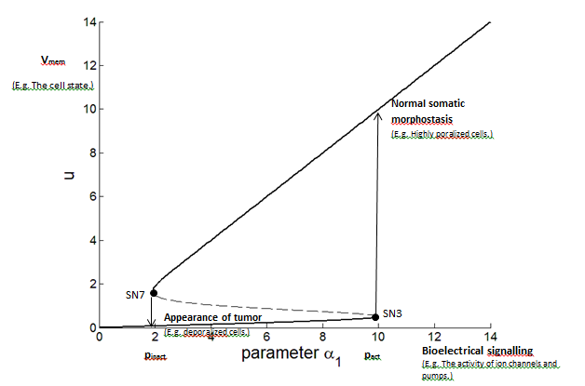
The saddle-node bifurcation can be use to model other open questions:
Levin, M. (2013). Reprogramming cells and tissue patterning via bioelectrical pathways: molecular mechanisms and biomedical opportunities. Wiley Interdisciplinary Reviews: Systems Biology and Medicine, 5(6), 657-676.
Our hypothesis:
Vmem
=transmembrane voltage potential
Notes:
The saddle-node bifurcation diagram can be used to model many other biological switches. One example is the problem highlighted by Levin in his paper listed here.
He mentioned that bioelectric signals can induced two different states of healthy and tumour states. We hypothesized that it can be modelled as the saddle-node bifurcation diagram shown here.

Slide 15
Summary
Computational techniques in
modelling biological switches
—The concept of bistability
illustrated in phase plane
—XPPAUT to draw saddle-node
bifurcation diagram
— Can be used to study complex
biological switches
Notes:
In summary, in this paper, we reviewed and demonstrate the concept of bistability and hysteresis behaviour by using a simple example from Gardner et al. (2000) and synthetic toggle switch. The computational techniques of phase plane and saddle-node bifurcation diagram were demonstrated.
Especially, saddle-node bifurcation diagram is a powerful tool to study biological switch of more complex biological system.

Slide 16
Acknowlegements
Bard Ermentrout for providing the use of XPPAUT
SIAM and the authors of the book for the permission to use two figures
Ministry of Education Singapore
MOE AcRF Tier 1 Seed Grant on
Complexity
Notes:
This is the acknowledgements. Specially, I would like to thank Ministry of Education Singapore for funding of this work.

Slide 17
Thank you.
Questions & Answers
Notes:
Thank you for your attention.

