Slide 1
LightGradientBoosting (LG-Boosting)
Regressor

Slide 2
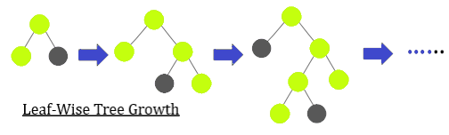
What is LightGBM regressor? LightGBM is a gradient boosting ensemble method that is used by the Train Using AutoML tool and is based on decision trees. As with other decision tree-based methods, LightGBM can be used for both classification and regression. LightGBM is optimized for high performance with distributed systems.
framework based on decision trees to increase the efficiency of the model and reduces memory usage. It uses two novel techniques: Gradient-based One Side Sampling(GOSS) Exclusive Feature Bundling (EFB) x

Slide 3
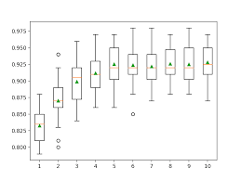
How to Develope the LG Boosting

Slide 4
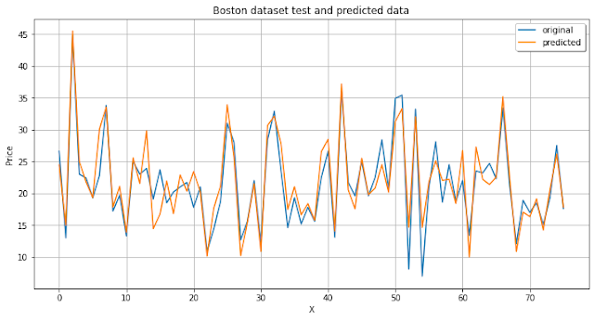
LGBM Graph

Slide 5
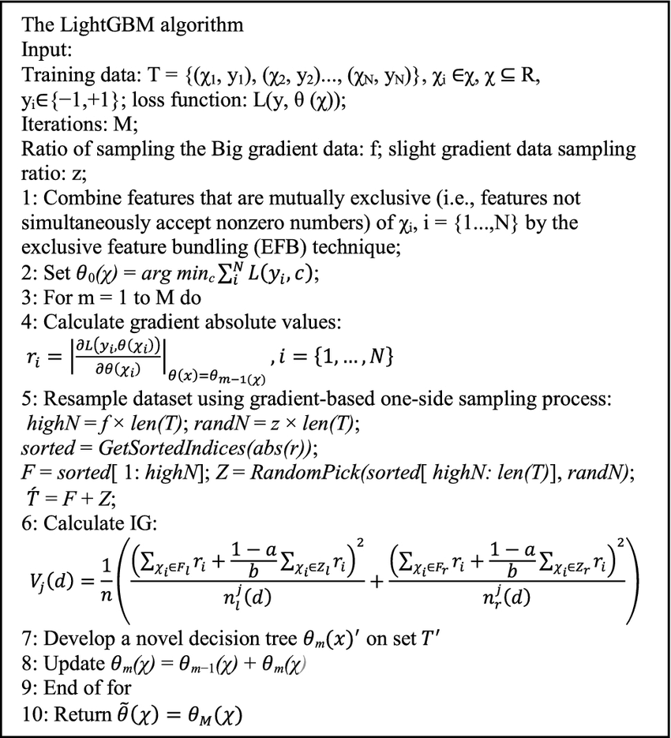
The Light Gradient Boosting Alogorithm

Slide 6
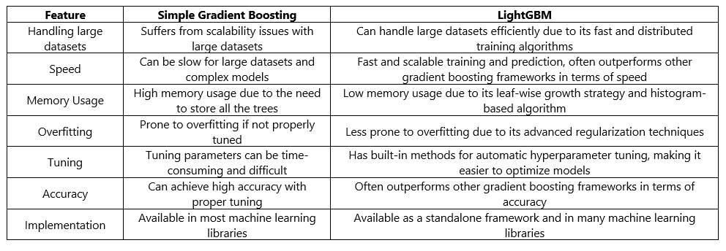
Features of LGBM

