Slide 1
Affinity Propagation (Unsupervised Learning)

Slide 2
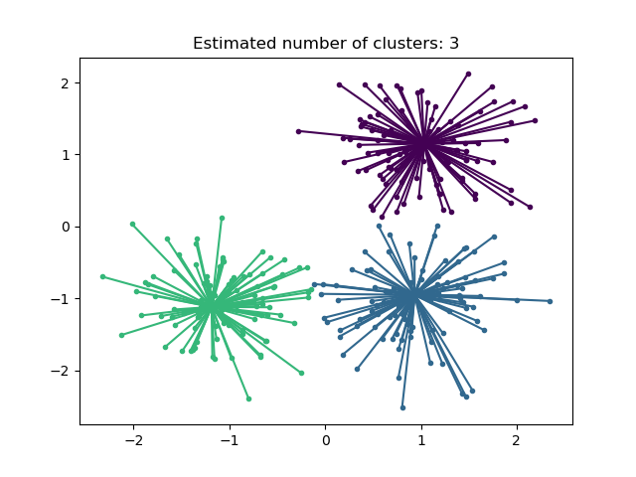
Affinity Propagation is a clustering algorithm used in machine learning for identifying exemplars, or representative data points, within a dataset. Unlike traditional clustering algorithms that require the user to specify the number of clusters in advance, Affinity Propagation determines the number of clusters automatically based on the input data.

Slide 3
Affinity Propagation can be interesting as it chooses the number of clusters based on the data provided.
For this purpose, the two important parameters are the preference, which controls how many exemplars are used, and the damping factor which damps the responsibility and availability messages to avoid numerical oscillations when updating these messages.
Affinity Propagation has been successfully applied in various domains, including image segmentation,bioinformatics, natural language processing, and social network analysis.
In summary, Affinity Propagation is a valuable clustering algorithm
for situations where the number of clusters is unknown, and it can be
particularly useful in applications where automatic cluster detection and
exemplar-based representation are important.

Slide 4
Drawback:
The main drawback of Affinity Propagation is its complexity. The algorithm has a time complexity of the order O(N2T), where N is the number of samples and T is the number of iterations until convergence.
Further, the memory complexity is of the order O(N2) if a dense similarity matrix is used, but reducible if a sparse similarity matrix is used.
This makes Affinity Propagation most appropriate for small to medium sized datasets.

