Slide 1
OPTICS (Ordering Points To Identify the Clustering Structure) (Unsupervised Learning)

Slide 2
The OPTICS algorithm shares many similarities with the DBSCAN algorithm, and can be considered a generalization of DBSCAN that relaxes the eps requirement from a single value to a value range.
The key difference between DBSCAN and OPTICS is that the OPTICS algorithm builds a reachability graph, which assigns each sample both a reachability_ distance, and a spot within the cluster ordering_ attribute;
these two attributes are assigned when the model is fitted, and are used to determine cluster membership.
https://colab.research.google.com/drive/1_fCmpW71z4xredEo3HZ-or0A93zY8795#scrollTo=mximiM7miWO6

Slide 3
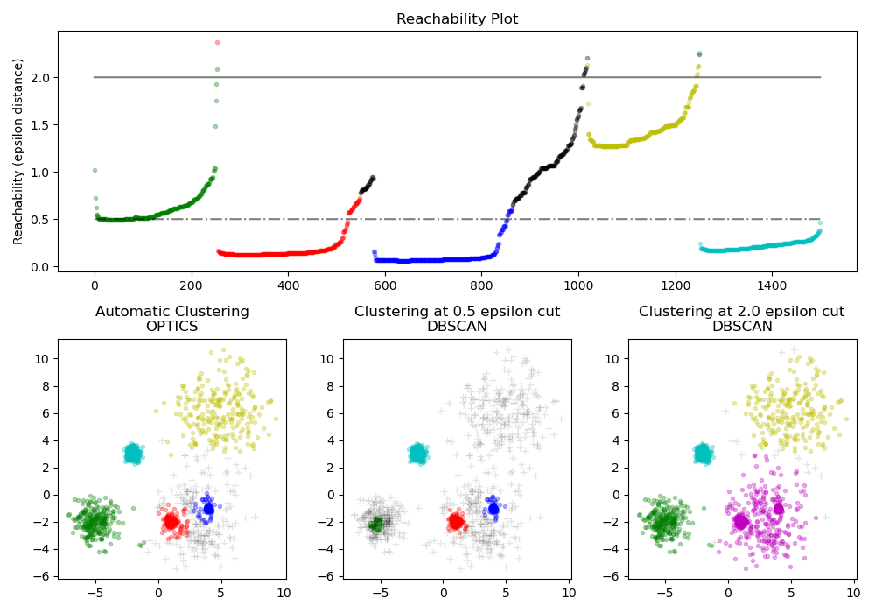

Slide 4
Density Reachability:
OPTICS introduces the concept of "density reachability," which is used to order points based on their local densities.
Reachability Plot:
Instead of forming explicit clusters, OPTICS generates a reachability plot that visualizes the density-based hierarchy of the data. The reachability plot helps identify the natural clusters and their hierarchical relationships.
Core Distance:
Core distance is defined as the radius of the smallest circle that contains at least min_samples data points, including the point itself. It represents the local density around a data point.
Reachability Distance:
Reachability distance measures the distance between a point and its neighbor, considering the core distances. It is used to order points in the reachability plot.
Ordering Points:
OPTICS orders points based on their reachability distances, creating a reachability plot.
Cluster Extraction:
Clusters can be extracted from the reachability plot by identifying points that have low reachability distances and are thus part of dense regions.

Slide 5
Algorithm Steps:
Compute Core Distances:
For each data point, compute its core distance, which represents the local density around that point.
Order Points:
Order the points based on their core distances and reachability distances, creating a reachability plot.
Extract Clusters:
Identify clusters in the reachability plot by looking for points with low reachability distances and
specific parameters may need to be adjusted based on your data and clustering requirements.

