Slide 1
DENSITY BASED SPATIAL CLUSTERING OF APLLICATION WITH NOISE (Unsupervised Learning)

Slide 2
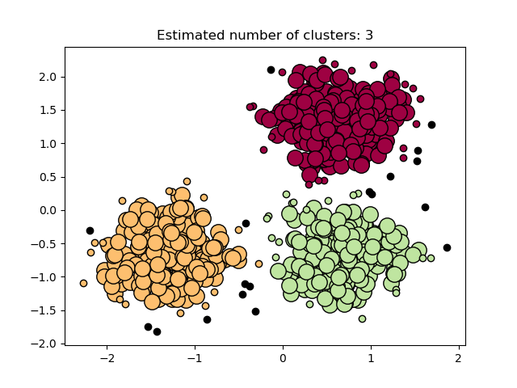
DBSCAN (Density-Based Spatial Clustering of Applications with Noise) is a clustering algorithm that groups together data points that are close to each other based on a density criterion.

Slide 3
The central component to the DBSCAN is the concept of core samples, which are samples that are in areas of high density.
There are two parameters to the algorithm, min_samples and eps, which define formally what we mean when we say dense.
Higher min_samples or lower eps indicate higher density necessary to form a cluster.
we define a core sample as being a sample in the dataset such that there exist min_samples other samples within a distance of eps, which are defined as neighbors of the core sample

Slide 4
First, even though the core samples will always be assigned to the same clusters, the labels of those clusters will depend on the order in which those samples are encountered in the data.
Second and more importantly, the clusters to which non-core samples are assigned can differ depending on the data order.
This would happen when a non-core sample has a distance lower than eps to two core samples in different clusters
. By the triangular inequality, those two core samples must be more distant than eps from each other, or they would be in the same cluster.
The non-core sample is assigned to whichever cluster is generated first in a pass through the data, and so the results will depend on the data ordering.

