Slide 1


Yo Dawg I Heard You Like CQRS
Ryan Hansen
ketikochofax

Slide 2
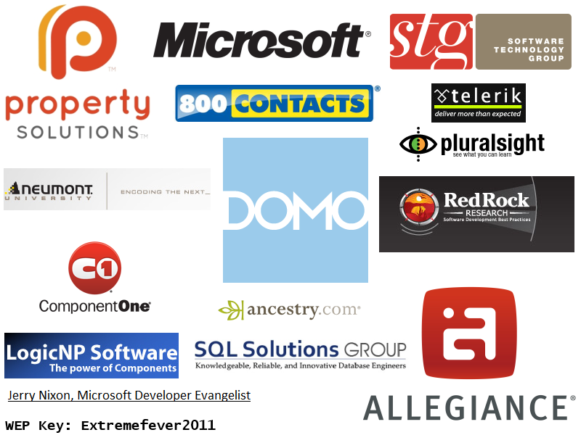

Slide 3
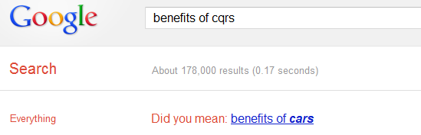
Why ‘Yo Dawg’?

Slide 4
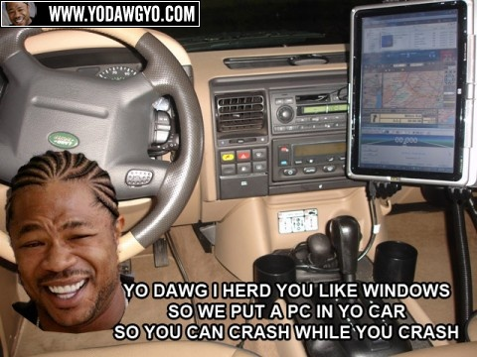

Slide 5
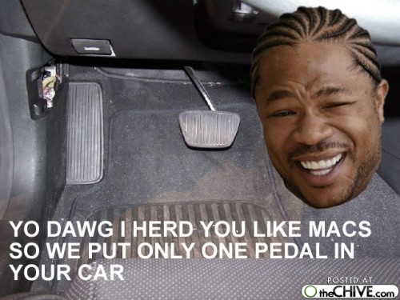

Slide 6
What is CQRS?
Command Query Responsibility Segregation
“A single model cannot be appropriate for reporting, searching, and transactional behaviors.” – Greg Young
Based on CQS by Bertrand Meyer
“Every method should either be a command that performs an action, or a query that returns data to the caller, but not both. In other words, asking a question should not change the answer.”

Slide 7
demo
Data Storage
Domain Object
Domain Object
Application Services
Remote Facade
Send up DTO
Status returned
Request DTO
DTO returned
Client

Slide 8
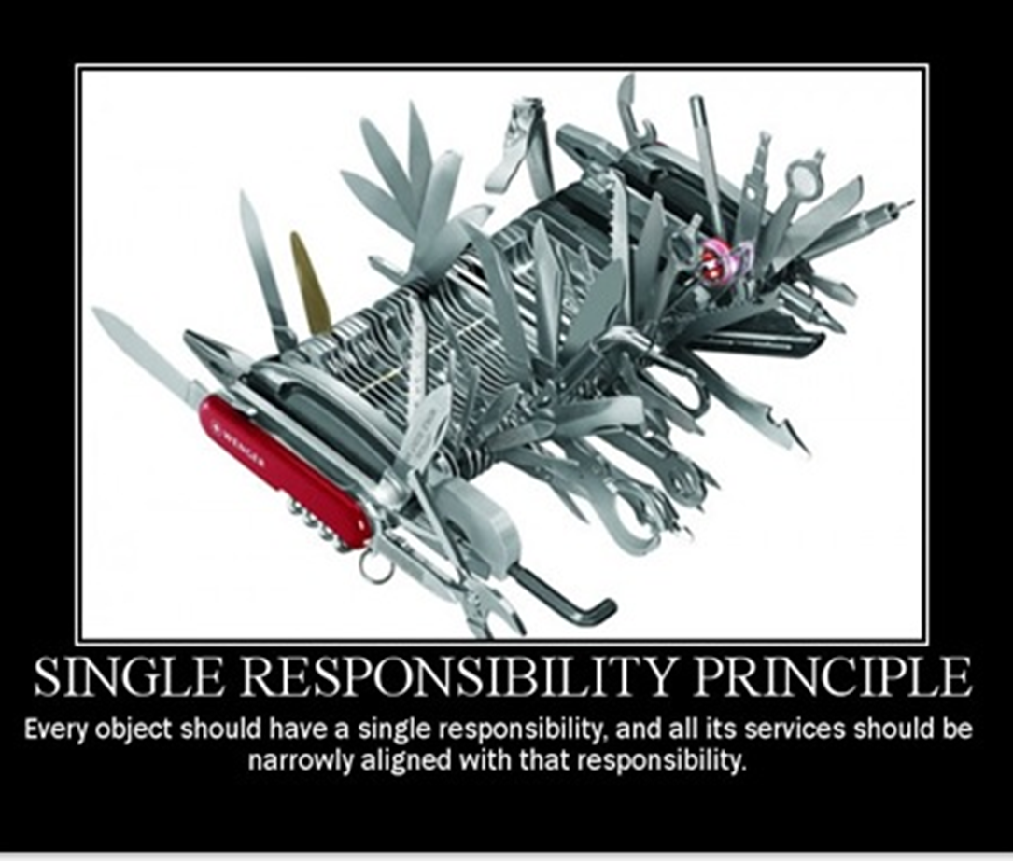

Slide 9
Write (Command)
Data Storage
Read (Query)
Domain Object
Domain Object
Application Services
Thin Read Layer (Direct to DTO)
Remote Facade
Remote Facade
Message Sent
Ack/Nak Response
Request DTO
DTO returned
Client Client

Slide 10
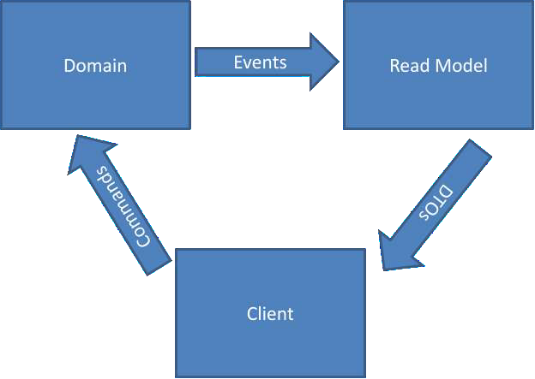
How does it work?
Event Log

Slide 11
Commands
demo
Event Log

Slide 12
Benefits:
Requires discussion and analysis with business
Development gains greater understanding of domain
UI is modeled after actual business workflow
UI is more intuitive for new users
Removes dependency on users being trained to use the system

Slide 13
Anti-Patterns:
Commands in the past tense
Commands can be accepted or rejected
Example: Permissions on invoking an action
CRUD based commands
Bad – ChangeAddress
Good - MoveEmployee

Slide 14
Events
demo
Event Log

Slide 15
Benefits:
Ability to create new projections
Can replay events to populate new views for business
Can switch to event sourcing if cost efficient
Replace 3nf DB altogether and load aggregates from events

Slide 16


Slide 17
Item Added
Purchase Cart
Item Added
Item Added

Slide 18
Item Added
Purchase Cart
Item Added
Item Removed
Item Added

Slide 19
Anti-Patterns:
Events in present tense
Bad – MoveCustomer
Good - CustomerMoved
Events have already happened you cannot change them

Slide 20
Queries
demo
Event Log

Slide 21
Benefits:
Allows optimizations to be made on read and write models separately
CAP Theorem
Consistency, Availability , Partionability
Most systems are restricted to single CAP
Typically Consistency and Availablity
CQRS allows for Read and Write to be optimized
Read = Availability and Partionability
Write = Consistency and Availability

Slide 22
Benefits:
Removes need for public properties on domain model
Domain becomes strictly behavioral
Queries become simplified
SELECT * FROM MyTable
Removes need for an ORM tool
Opens us up to use different databases
PostgreSQL, MySQL, SQL Express
How about document based – RavenDB or MongoDb?

Slide 23
Q & A
Who’s got a question?

Slide 24
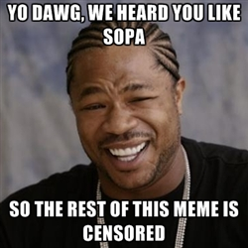

Slide 25
More Resources
Presentation located at http://github.com/ketikochofax/CQRS.Presentation
http://martinfowler.com/bliki/CQRS.html
http://cqrs.wordpress.com/documents/

