Slide 1


Yo Dawg I Heard You Like CQRS
Ryan Hansen
ketikochofax

Slide 2
Sponsors

Slide 3
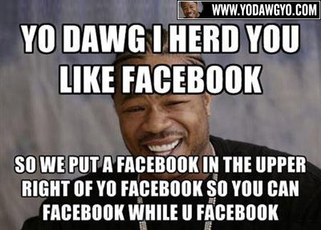

Slide 4
What is CQRS?
Command Query Responsibility Segregation
“A single model cannot be appropriate for reporting, searching, and transactional behaviors.” – Greg Young
Based on CQS by Bertrand Meyer
“Every method should either be a command that performs an action, or a query that returns data to the caller, but not both. In other words, asking a question should not change the answer.”

Slide 5
What does that mean?
Capturing user intent through commands
Simplifying reads with a separate model
Decoupling read and write models with events

Slide 6
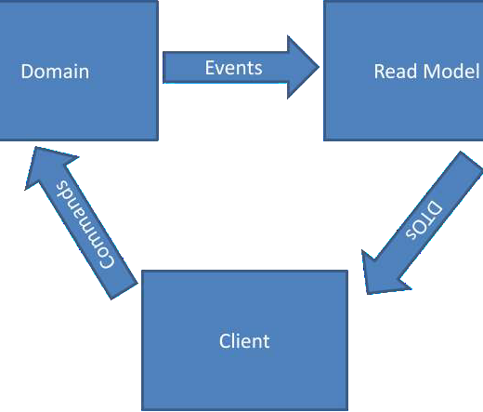
CQRS Pattern

Slide 7
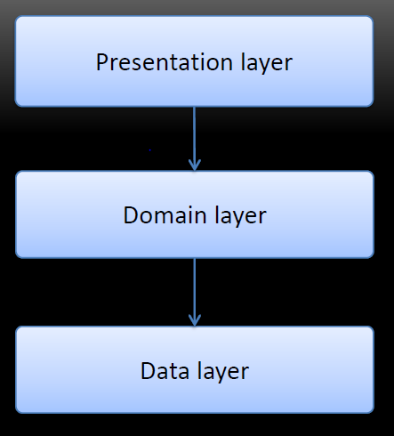
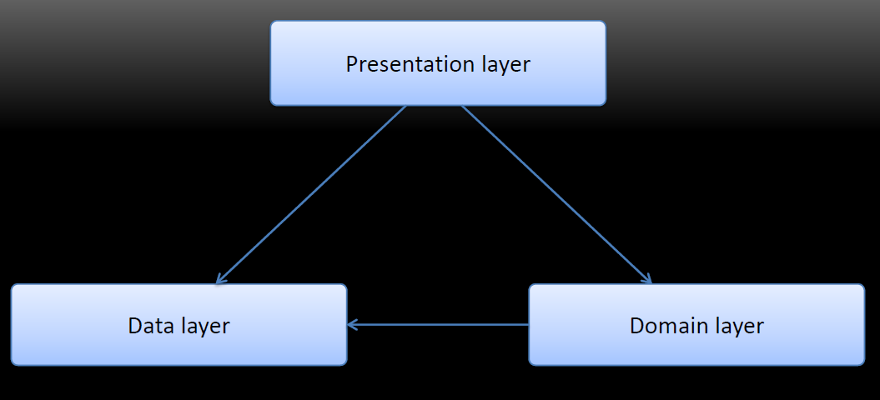
What do we want?
Before
After

Slide 8
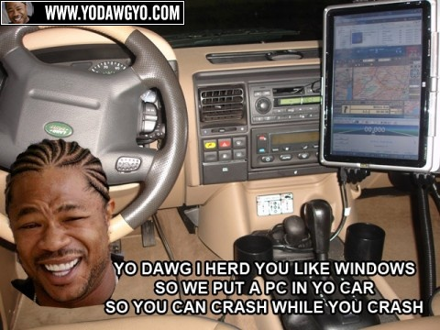

Slide 9
Capturing user intent through commands

Slide 10
Problem: Losing intent of the user
Why does intent matter?
Users have to be trained to use the system
Developers don’t know how the system is being used

Slide 11
Solution:
Explicitly capture user actions through commands
Tasked based User Interfaces
Gear screens towards a specific action

Slide 12
Benefits:
Requires discussion and analysis with business
Development gains greater understanding of domain
UI is modeled after actual business workflow
UI is more intuitive for new users
Removes dependency on users being trained to use the system

Slide 13
Anti-Patterns:
Commands in the past tense
Commands can be accepted or rejected
Example: Permissions on invoking an action
CRUD based commands
ChangeAddressCommand

Slide 14
Simplifying reads with a separate model

Slide 15
Problem:
Using same model for read/write bloats our domain objects and complicates executing complex queries

Slide 16
Data Storage
Domain Object
Domain Object
Application Services
Remote Facade
Send up DTO
Status returned
Request DTO
DTO returned
Client

Slide 17
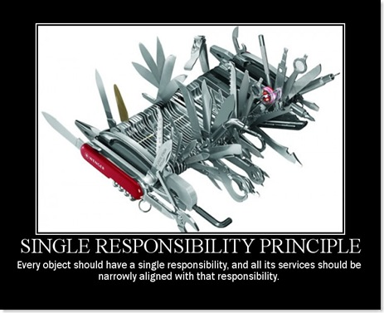
Domain Objects
You’ve got to keep them separated!

Slide 18
Write (Command)
Data Storage
Read (Query)
Domain Object
Domain Object
Application Services
Thin Read Layer (Direct to DTO)
Remote Facade
Remote Facade
Message Sent
Ack/Nak Response
Request DTO
DTO returned
Client Client

Slide 19
Public Properties
Cause
Instead of
Domain objects to expose state for DTOs
Preference to use ORM frameworks
Lazy loading objects for performance
Exposing behavior
Simply returning data required by view
Optimizing queries

Slide 20
Object-Relational Mappings
Result in
Instead of
Training and ramp up time for new developers
Third Normal Form Database
Scaling by buying bigger SQL servers or Clustering (ugh!)
Basic knowledge of SQL
Simple ‘select * from table’
Distributing load across more ‘low-end’ machines

Slide 21
Solution:
Support queries through ‘Reporting Database’ pattern
Denormalize data so each view has it’s own table
Create a ‘Thin Read Layer’ that maps the db query to DTO objects

Slide 22
Benefits:
Removes need for public properties on domain model
Domain becomes strictly behavioral
Queries become simplified
SELECT * FROM MyTable
Removes need for an ORM tool
Opens us up to use different databases
PostgreSQL, MySQL, SQL Express
How about document based – RavenDB or MongoDb?

Slide 23
Biggest Benefit:
Allows optimizations to be made on read and write models separately
CAP Theorem
Consistency, Availability , Partionability
Most systems are restricted to single CAP
Typically Consistency and Availablity
CQRS allows for Read and Write to be optimized
Read = Availability and Partionability
Write = Consistency and Availability

Slide 24
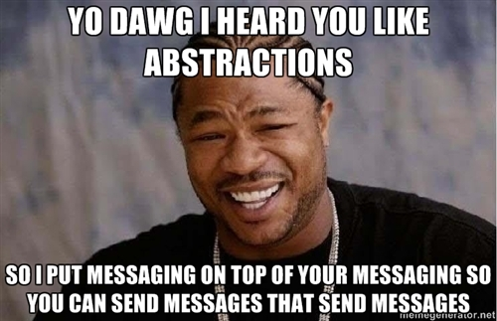

Slide 25
Decoupling read and write models with events

Slide 26
Problem:
Keeping write database in sync with read database

Slide 27
Solution:
Use events to update both databases
Persist events to an append only log

Slide 28
Data Storage
Data Storage
Domain Object
Domain Object
Thin Read Layer (Direct to DTO)
Remote Facade
Application Services
Remote Facade
Message Sent
Ack/Nak Response
Request DTO
DTO returned
Client

Slide 29
Data Storage
Eventually
Data Storage
Domain Object
Domain Object
Thin Read Layer (Direct to DTO)
Remote Facade
Application Services
Remote Facade
Message Sent
Ack/Nak Response
Request DTO
DTO returned
Client

Slide 30
Data Storage
Data Storage
handlers
handlers
Events
Events
Domain Object
Domain Object
Thin Read Layer (Direct to DTO)
Remote Facade
Application Services
Remote Facade

Slide 31
Benefits:
Ability to create new projections
Can replay events to populate new views for business

Slide 32
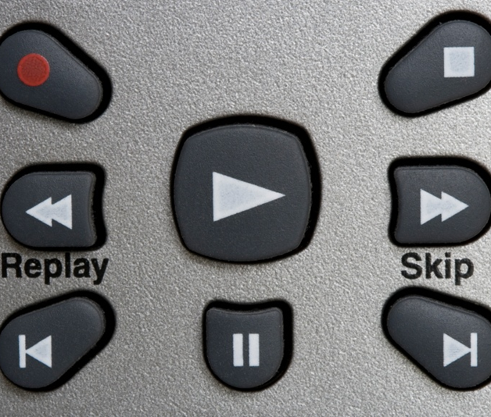
Replay Events

Slide 33
Cart Created
3 Items Added
Shipping Information Added

Slide 34
Cart Created
3 Items Added
Shipping Information Added
1Item Removed

Slide 35
Benefits:
Ability to create new projections
Can replay events to populate new views for business
Can switch to event sourcing if cost efficient
Replace 3nf DB altogether and load aggregates from events

Slide 36
Data Storage
Data Storage
handlers
handlers
Events
Events
Domain Object
Domain Object
Thin Read Layer (Direct to DTO)
Remote Facade
Application Services
Remote Facade

Slide 37
Event Storage
Data Storage
Events
handlers
Events
Domain Object
Domain Object
Thin Read Layer (Direct to DTO)
Remote Facade
Application Services
Remote Facade

Slide 38
Anti-Patterns:
Events in present tense
MoveCustomer
Events have already happened you cannot change them
You cannot, repeat, cannot throw an exception when handling an event

Slide 39
Where are we at now?
Independent scaling
Opens up parallel development within team(s)

Slide 40
Q & A
Who’s got a question?

Slide 41
More Resources
Presentation and source located on GitHub at github.com/ketikochofax/CQRS.Presentation
http://martinfowler.com/bliki/CQRS.html
http://cqrs.wordpress.com/documents/

