Slide 1
TAG Regional and Local Analysis by Machine Learning
KetilH, 16. March 2021

Slide 2
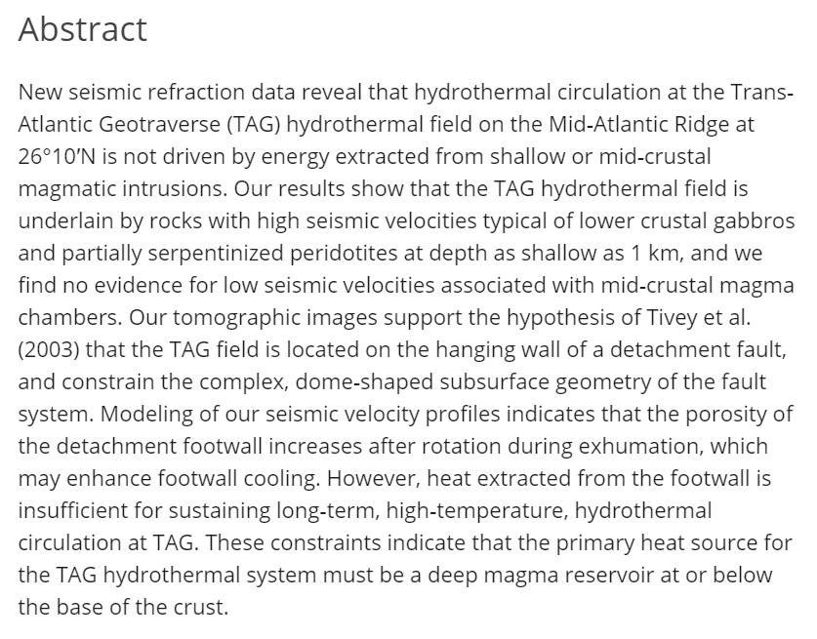
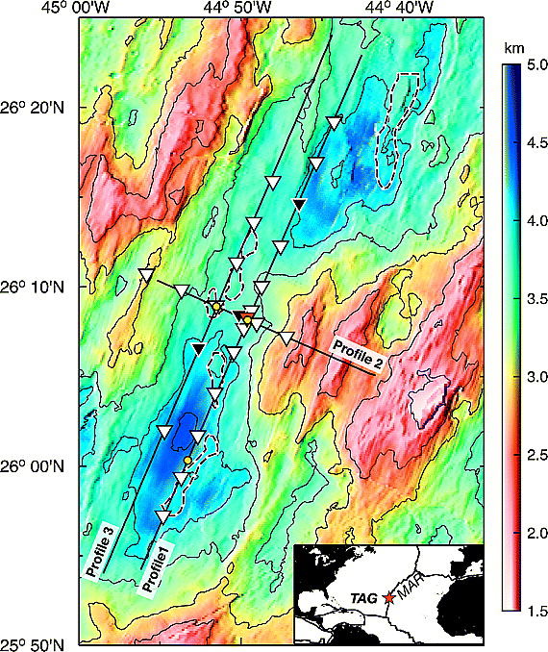
TAG refraction tomography (Canales et al., 2007)
Canales et al, 2007, Crustal structure of the Trans‐Atlantic Geotraverse (TAG) segment (Mid‐Atlantic Ridge, 26°10′N): Implications for the nature of hydrothermal circulation and detachment faulting at slow spreading ridges

Slide 3
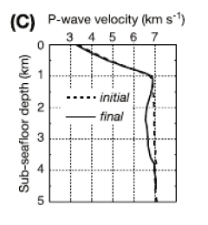
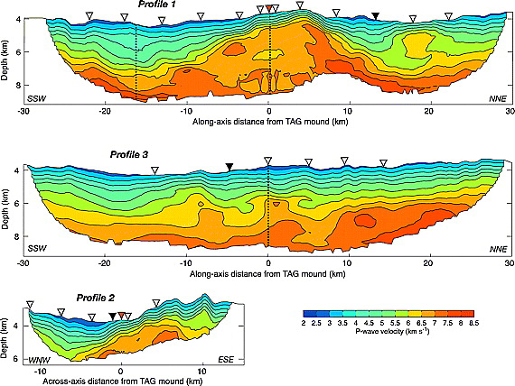
TAG refraction tomography (Canales et al., 2007)
OBS refraction tomography
Canales et al, 2007, Crustal structure of the Trans‐Atlantic Geotraverse (TAG) segment (Mid‐Atlantic Ridge, 26°10′N): Implications for the nature of hydrothermal circulation and detachment faulting at slow spreading ridges

Slide 4
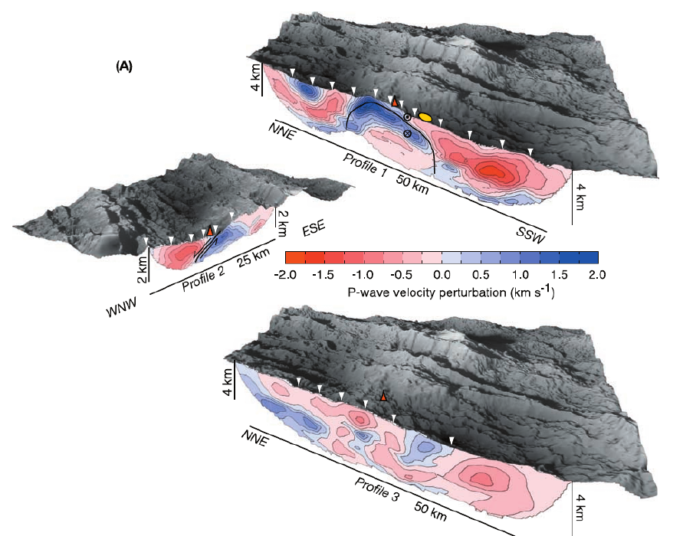
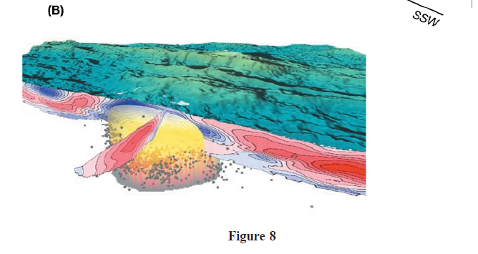
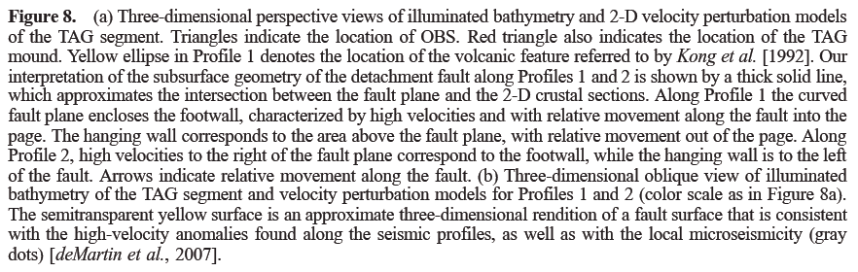

Slide 5
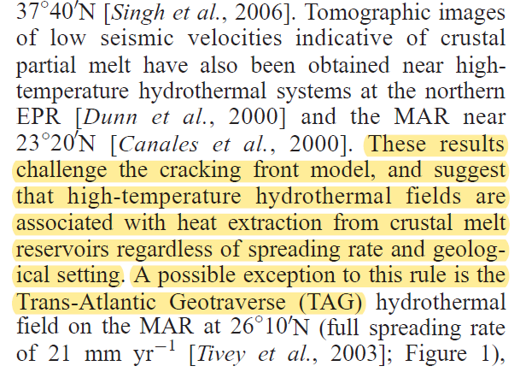
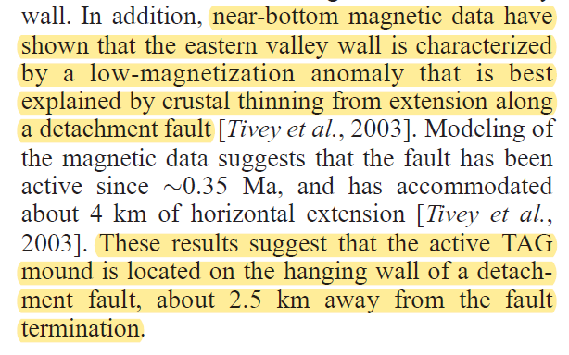
TAG refraction tomography (Canales et al., 2007) – introduction

Slide 6
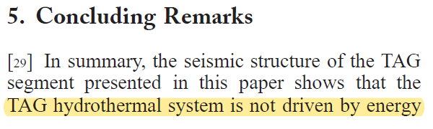
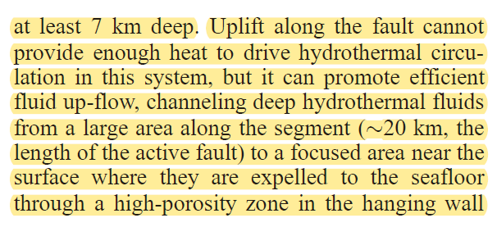
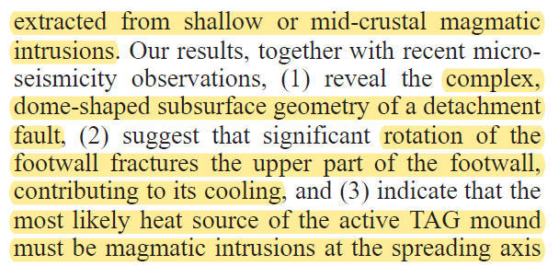

TAG refraction tomography (Canales et al., 2007) – conclusions

Slide 7
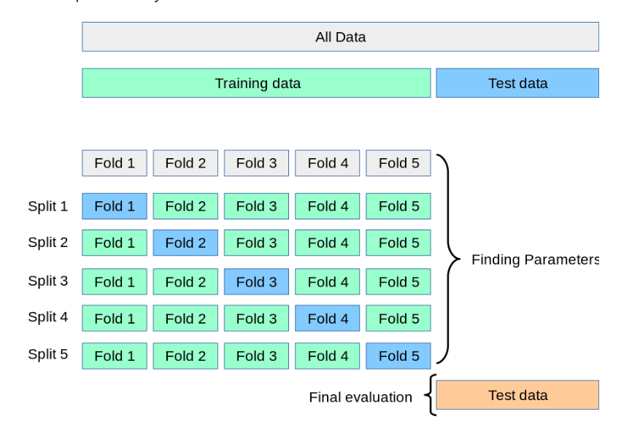


TAG regional propectivity evaluation methodology
(Same Python code as used for the nodule resource assessment in the Clarion Clipperton Zone)
Picking labeled samples on maps
TAG active and inactiv mounds
Adding halluscinatory data (on a random location in the map we would most likely not hit a vent nor mound)
Look up features on picked points in the maps
Feature selection
Maps showing large-scale properties (bathymetry and magnetics)
Maps showing small-scale properties (backscatter, slope, curvature)
Estimation of mean and variance:
2-step ML
Train/test splitting method
Random (short-range prediction)
Spatial (long-range prediction)
Prediction on TAG
Maps

Slide 8
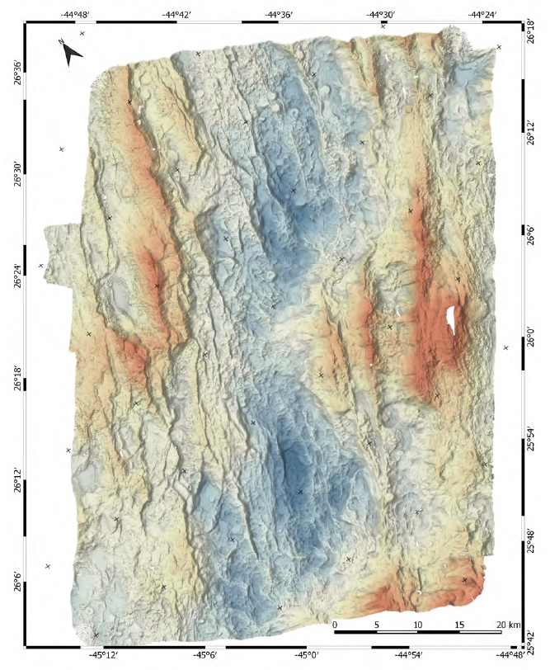
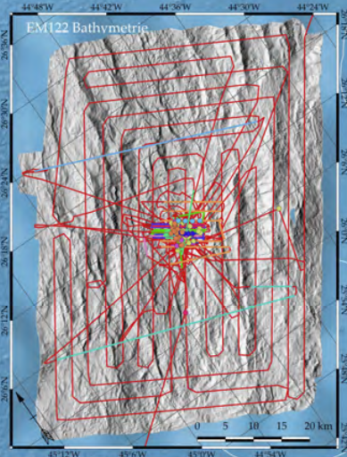
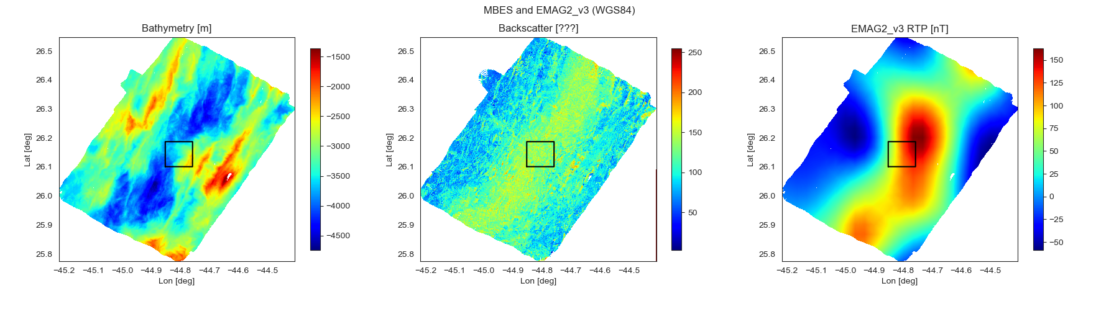
ML using shipborne MBES and EMAG2
Figures from Petersen et al., M127 Cruise Report, 2007
Thanks to Christian Gram for doing the RTP
Backscatter data have unknown scale (color index between 0 and 255)
Public data from M127 cruise
EMAG2.v3, Equinor in-house

Slide 9
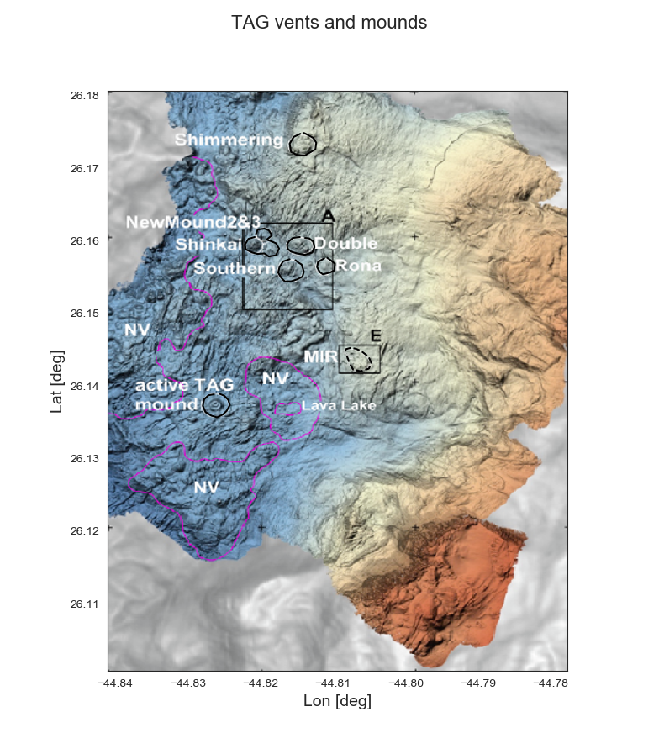
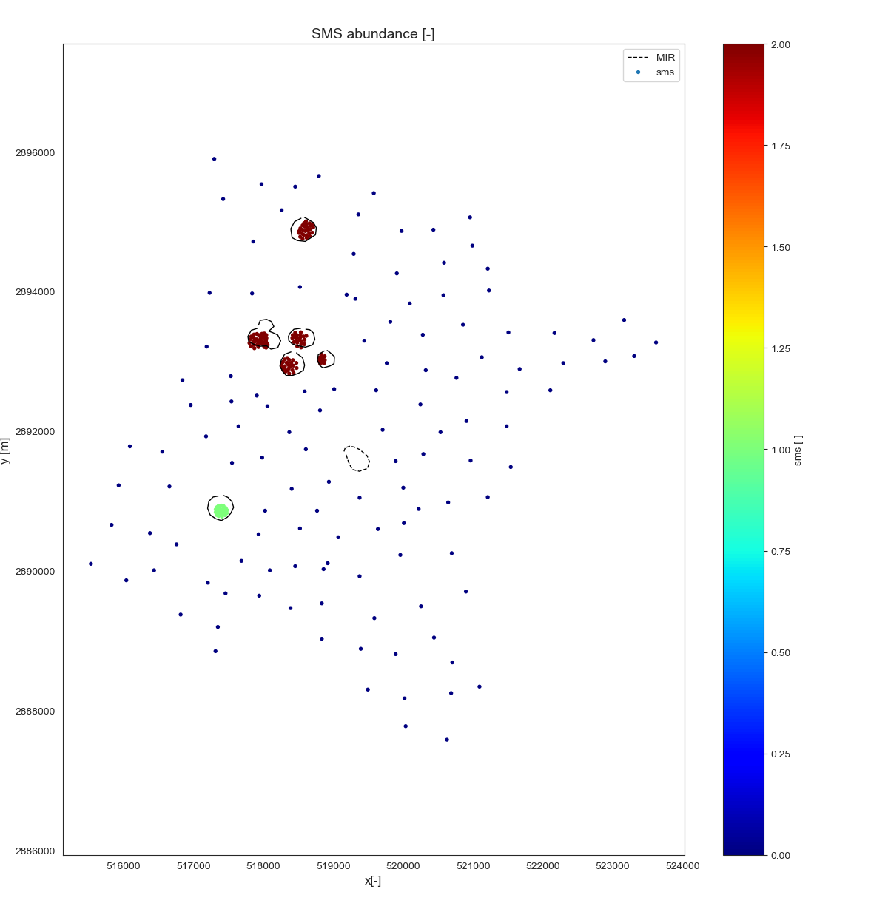
Training sample picks
MIR is the validation; not used in train&test

Slide 10
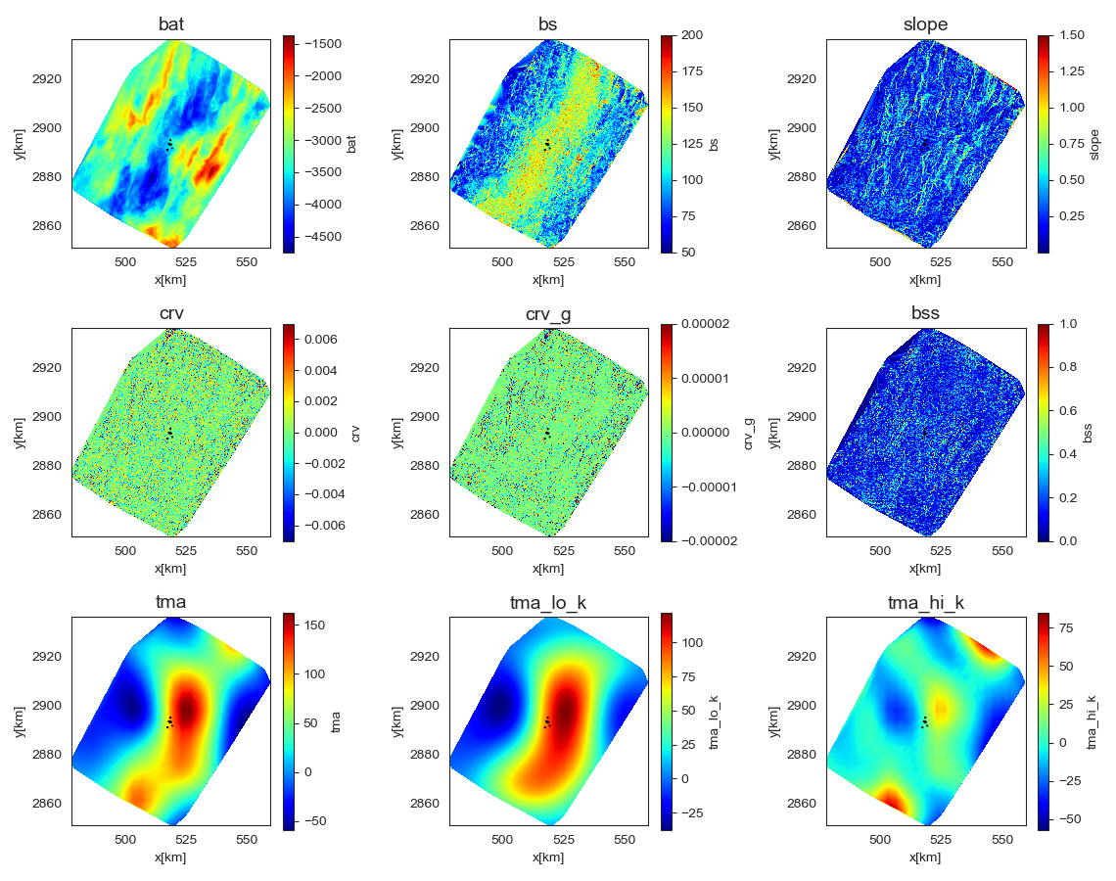
MBES, EMAG2 and derived maps (zone 23N)
bat = bathymetry
bs = backscatter amplitude
slope = magnitude of gradient
crv = mean curvature
crv_g = gaussian curvature
bss = backscatter slope
tma = magnetic anomaly RTP
tma_lo_k = magnetic, low k
tma_hi_k = magnetic, high k

Slide 11
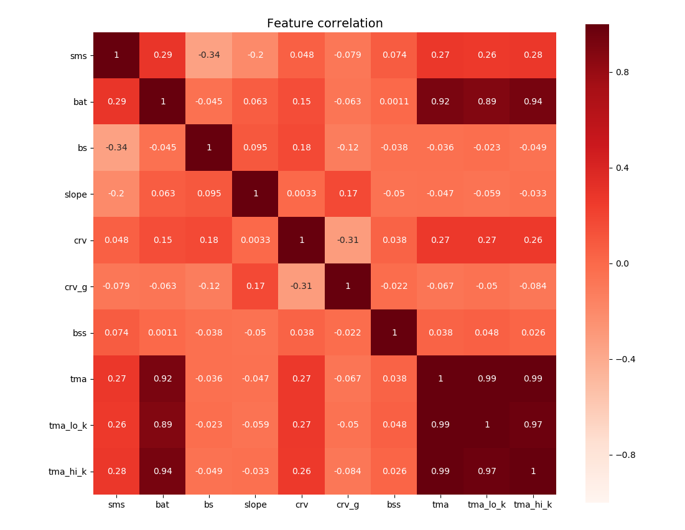
Feature correlation heatmap
sms = cathegorical target variable (0/1/2)*
bat = bathymetry
bs = backscatter amplitude
slope = magnitude of cartesian gradient
crv = mean curvature
crv_g = gaussian curvature
bss = backscatter slope (cartesian)
tma = magnetic anomaly RTP
tma_lo_k = magnetic data, low wavenumbers
tma_hi_k = magnetic data, high wavenumbers
*Cathegories:
0 = bedrock (non-prospective)
1 = active system (not exploration target)
2 = inactive system (exploration target)

Slide 12
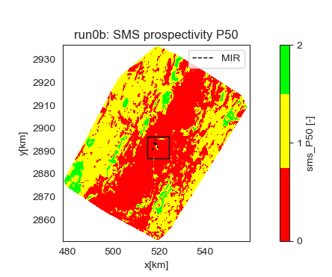
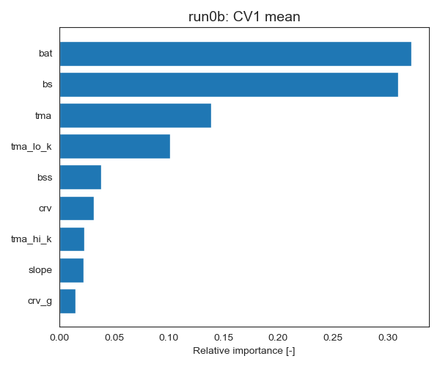
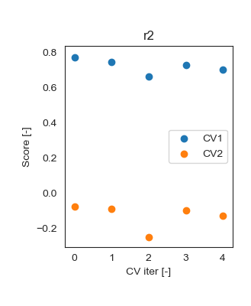
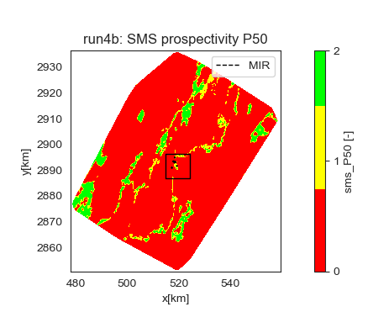
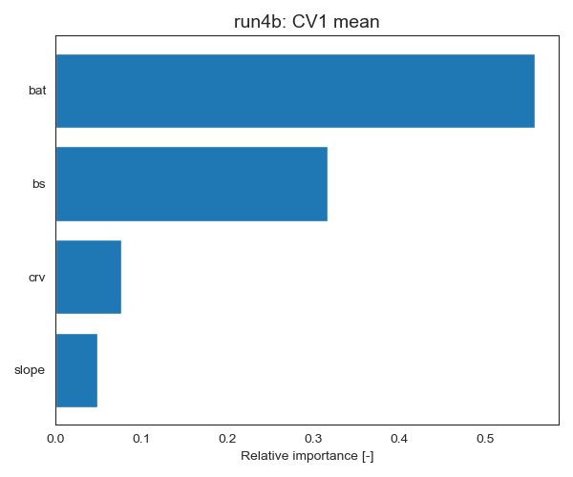
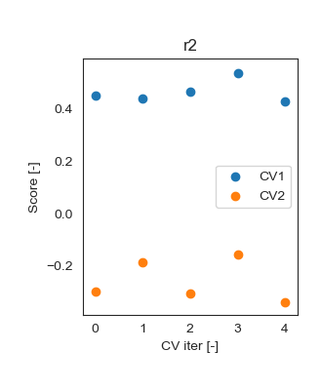
Artifact in prospectivity at the Bruhnes Matuyama transition
Regional propsectivity not using the magnetic data in the prediction

Slide 13
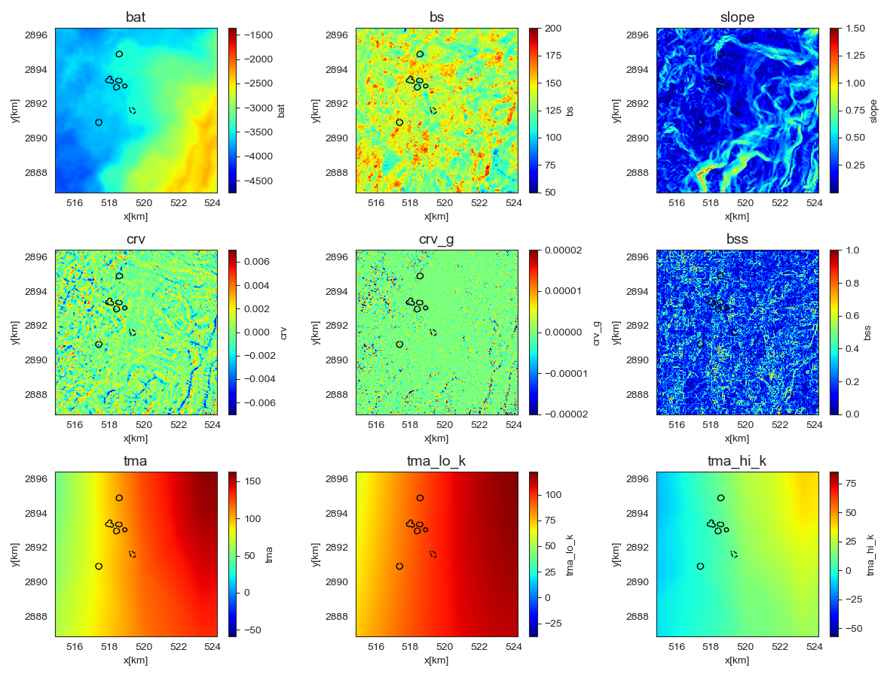
MBES, EMAG2 and derived maps zoomed to AUV area

Slide 14
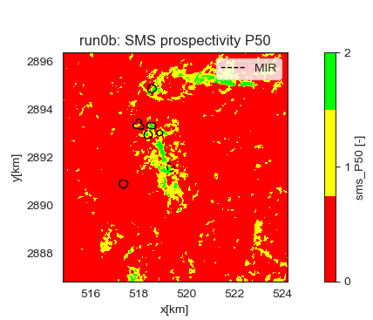
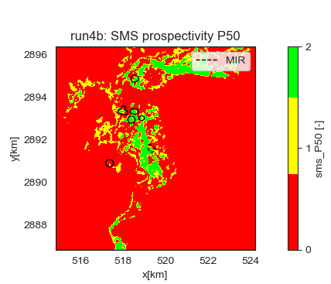
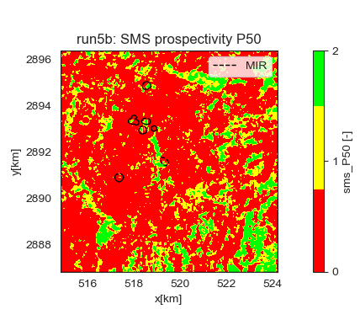
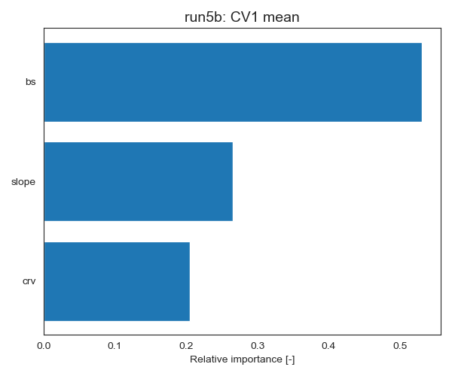
Zoomed to AUV area
Most important features:
Bathymetry
Backscatter
Magnetic TMA

Slide 15
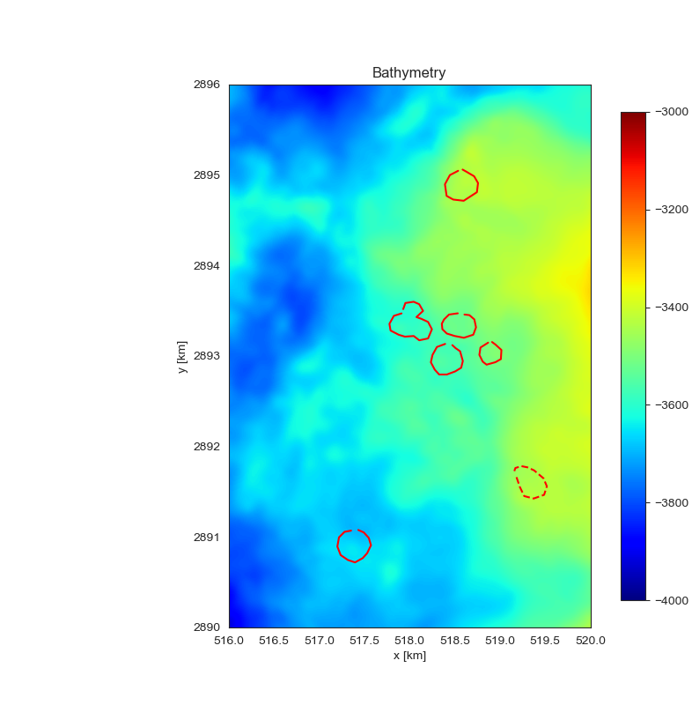
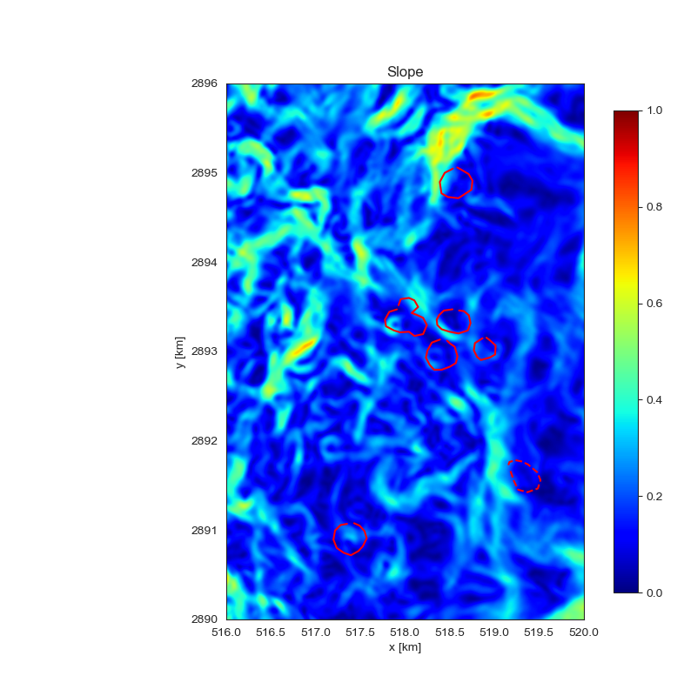
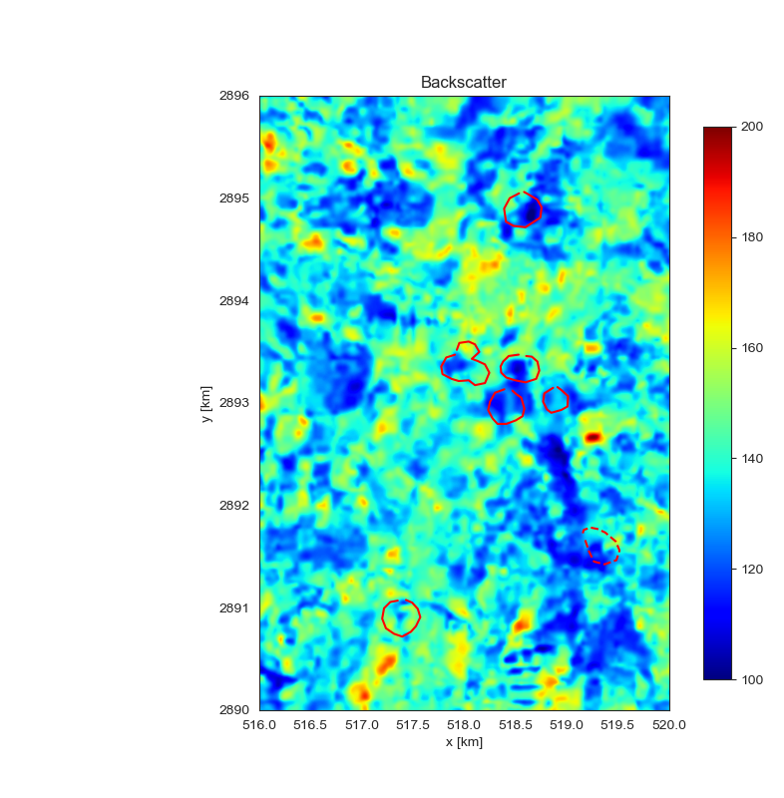
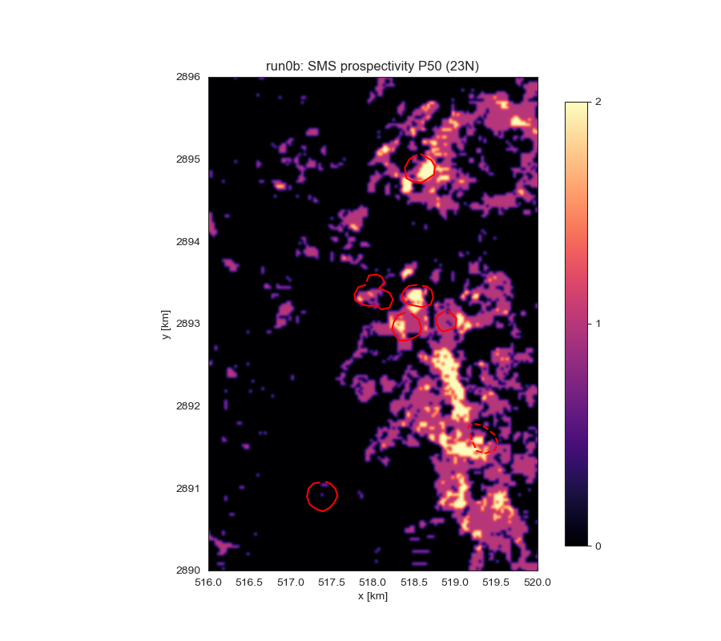
9 features
All available features used in train&test
MIR is detected

Slide 16
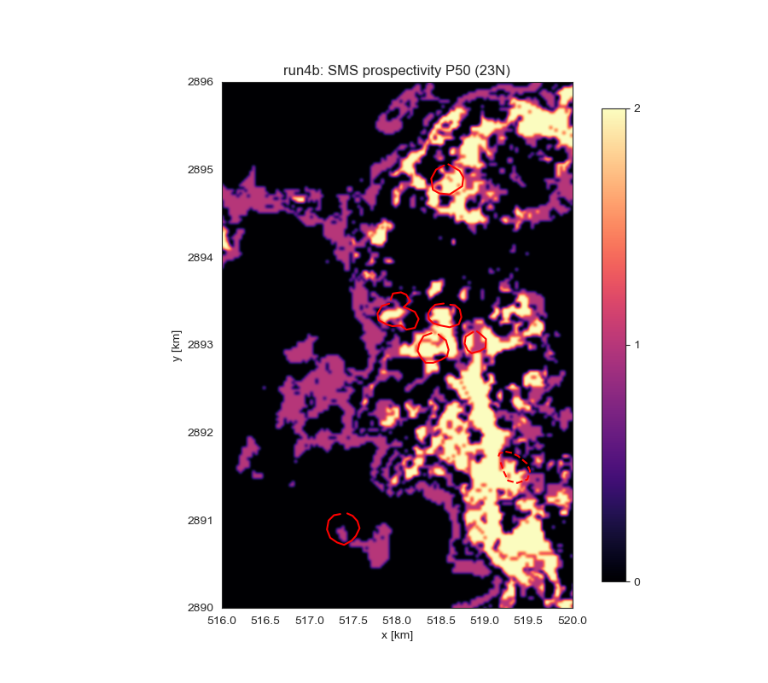
4 features
Dominated by bathymetry
Batymetry relatively is smooth; creates continuity
MIR is detected

Slide 17
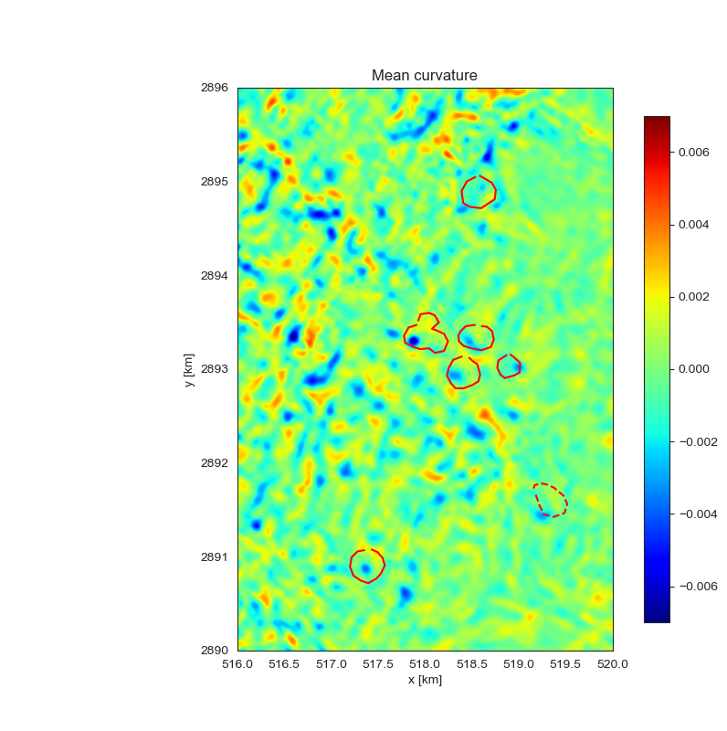
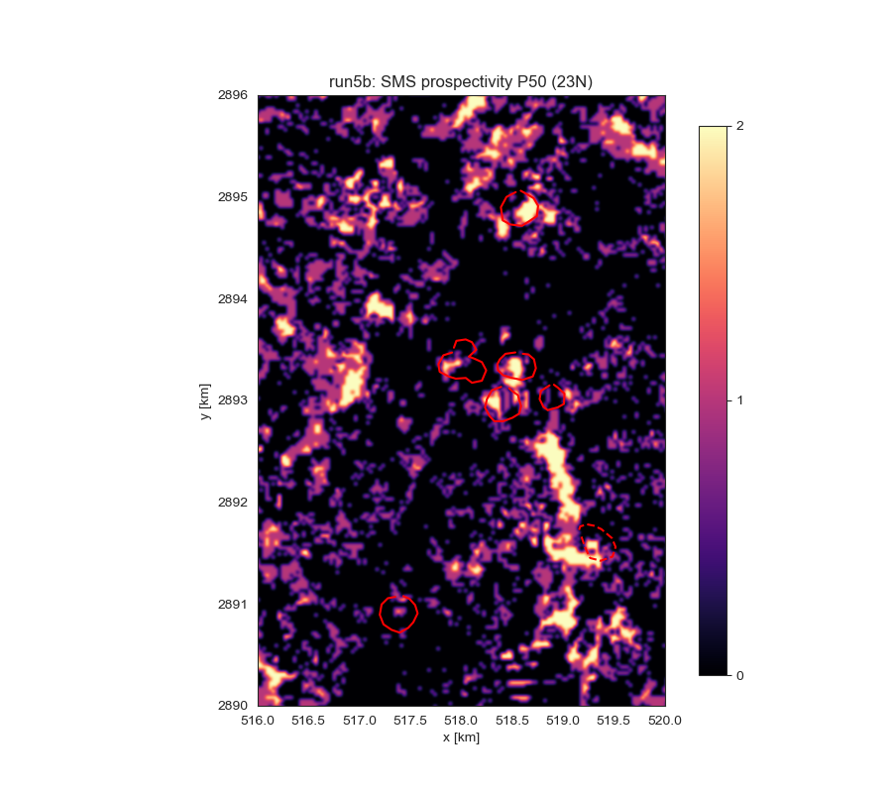
3 features
Hi-res features only used in train &test
MIR is detected

Slide 18
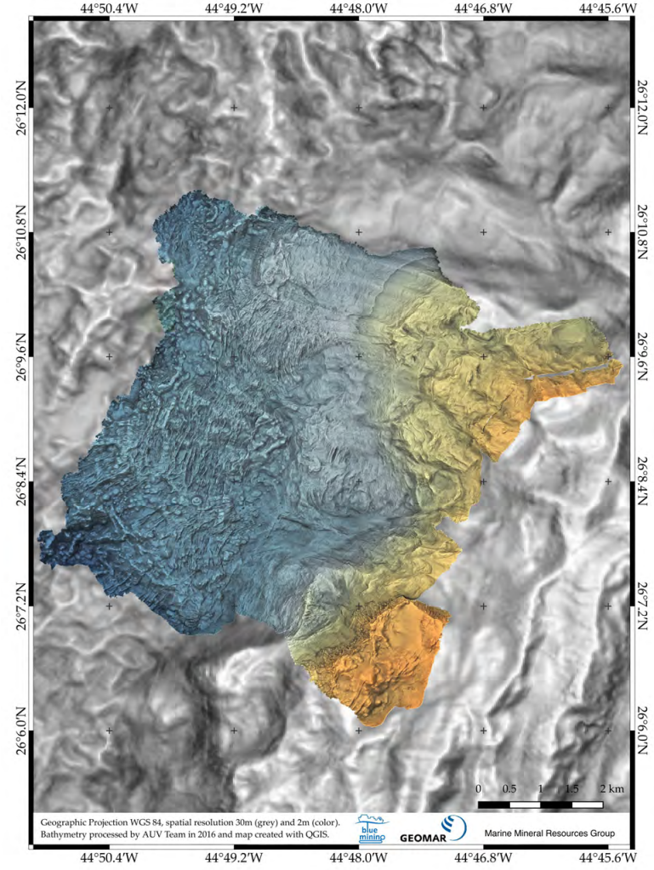
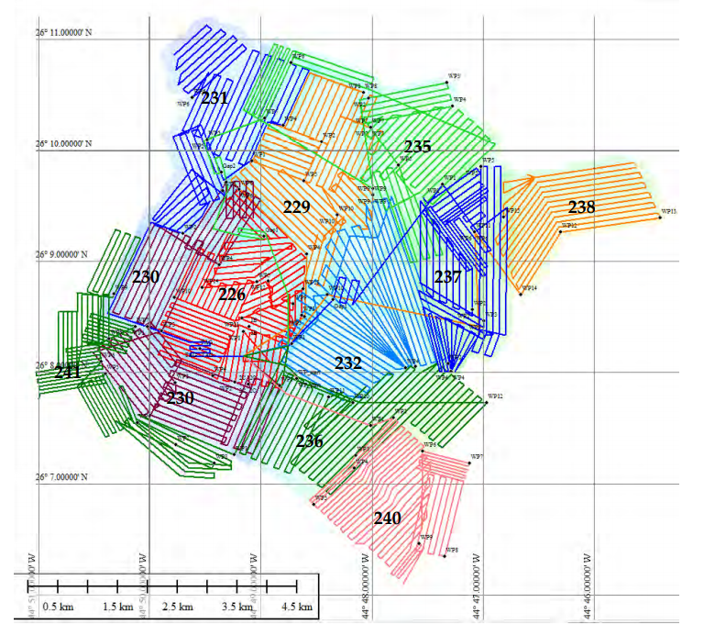
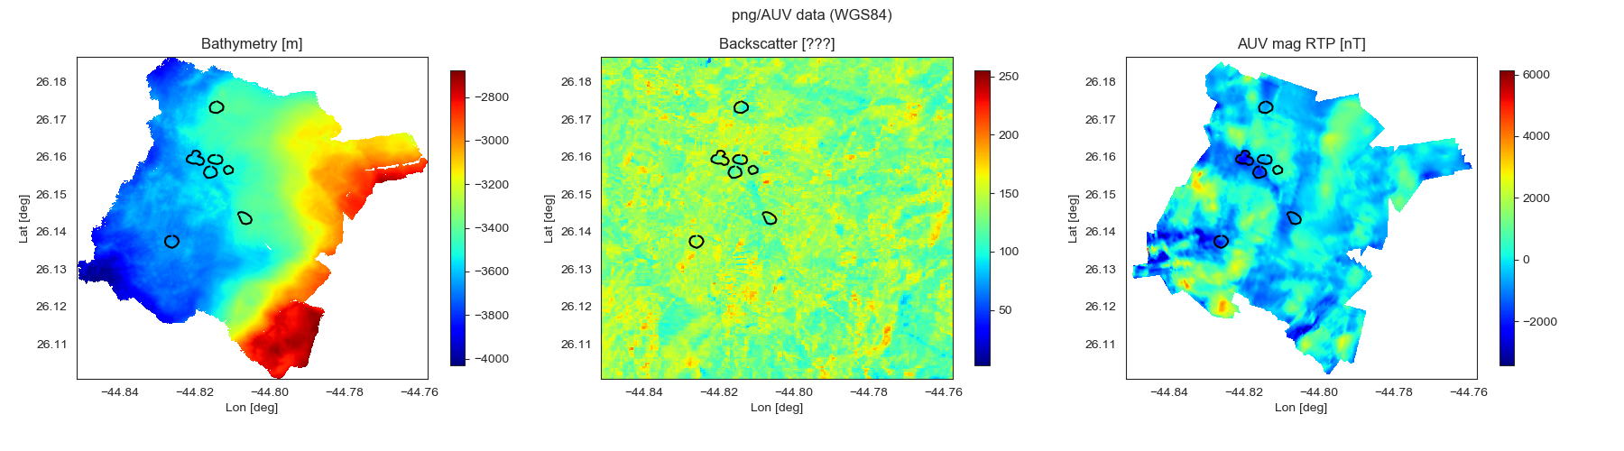
ML using AUV data (and shipborne backscatter)
Figures from Petersen et al., M127 Cruise Report, 2007.
AUV dives and bathymetry
Shipborne backscatter
Backscatter data have unknown scale (color index between 0 and 255)
Data interpolated to 10x10 m2 grid (the resolution of the AUV magnetics)

Slide 19
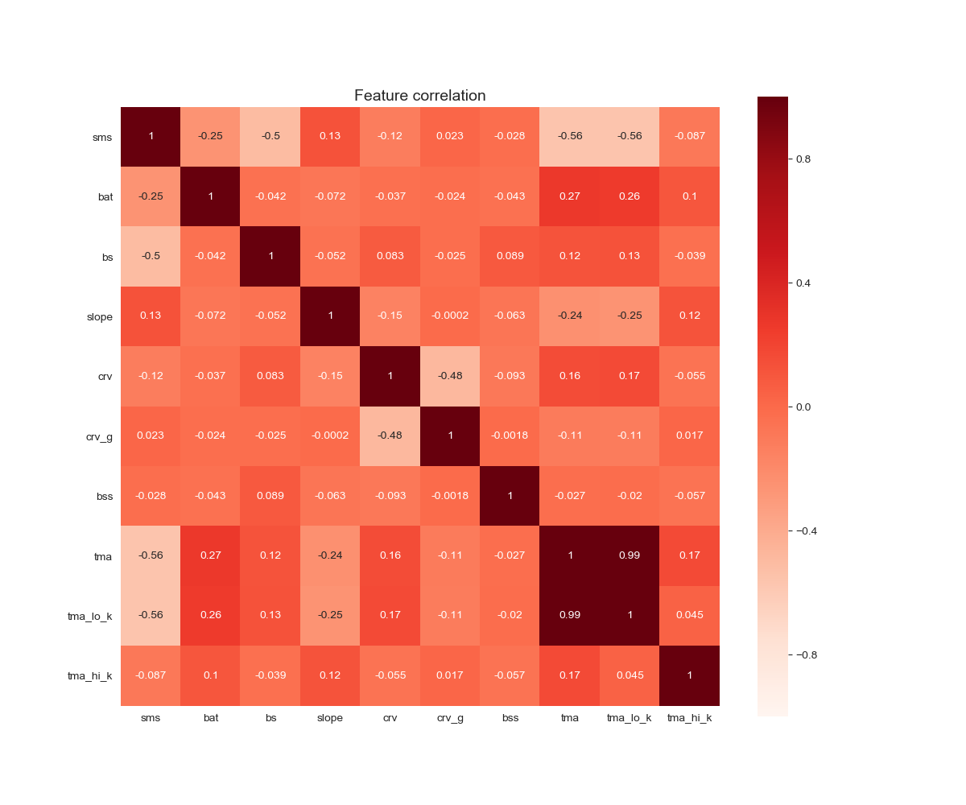
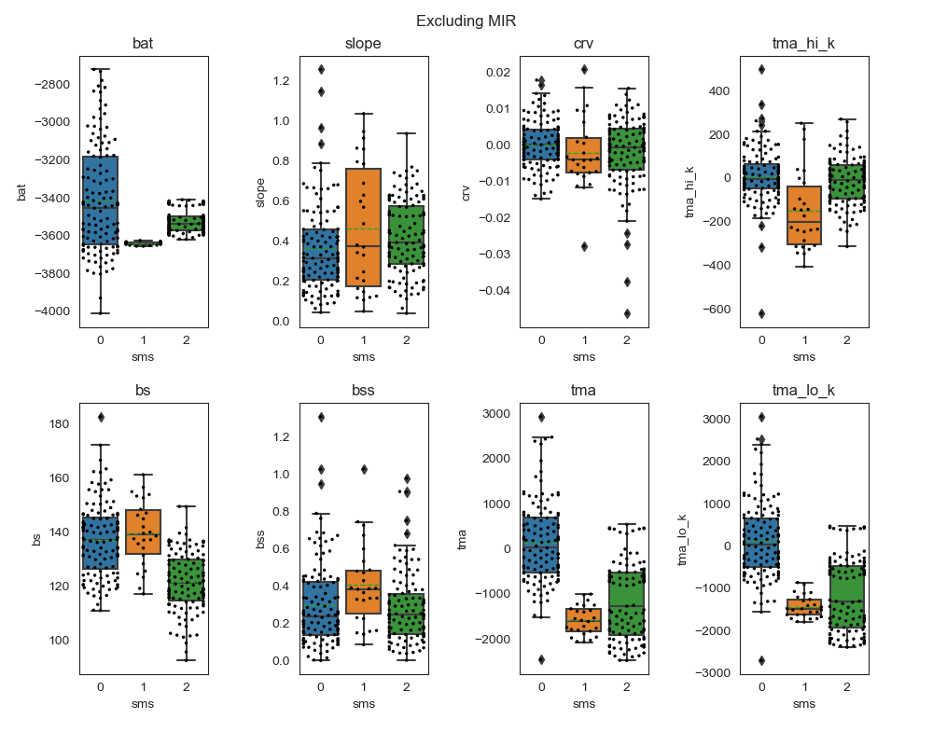
Feature correlations

Slide 20
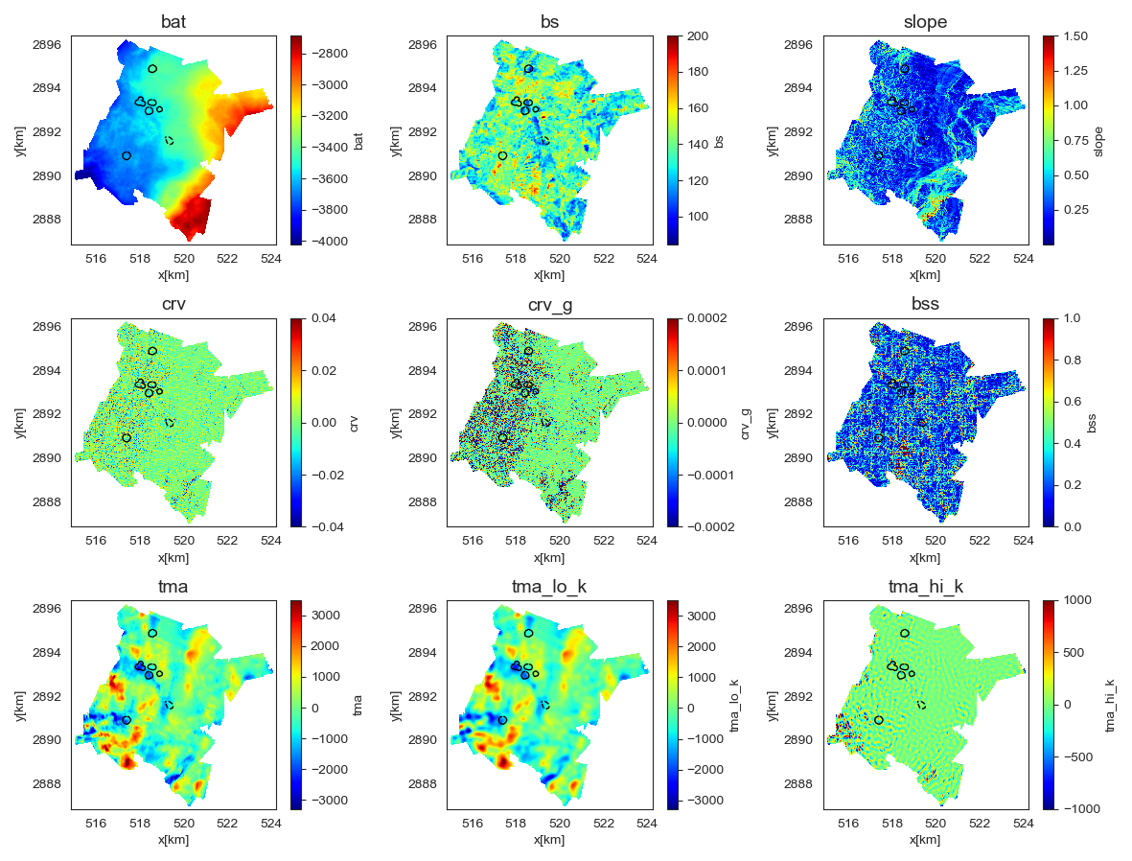
MBES and magnetics from AUV (backscatter from hull)

Slide 21
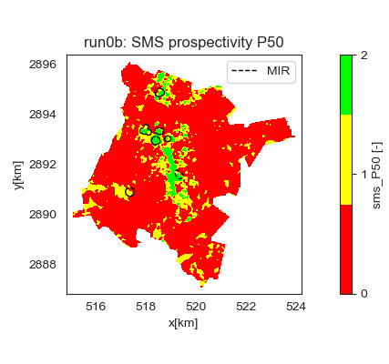

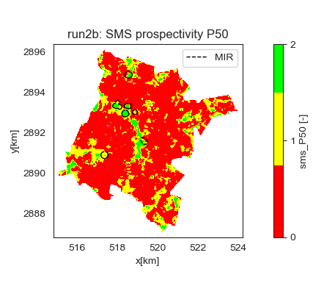

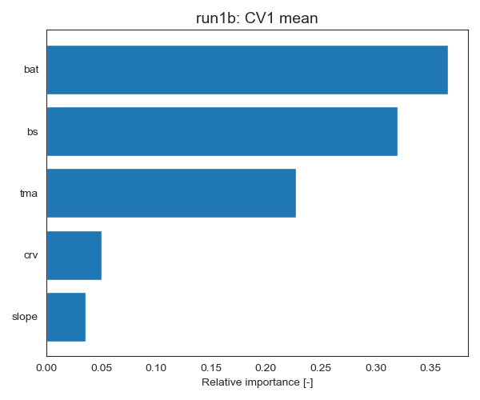
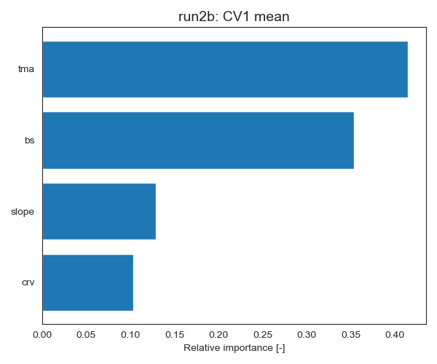
AUV area
Most important features:
Bathymetry
Backscatter
Magnetic TMA

Slide 22
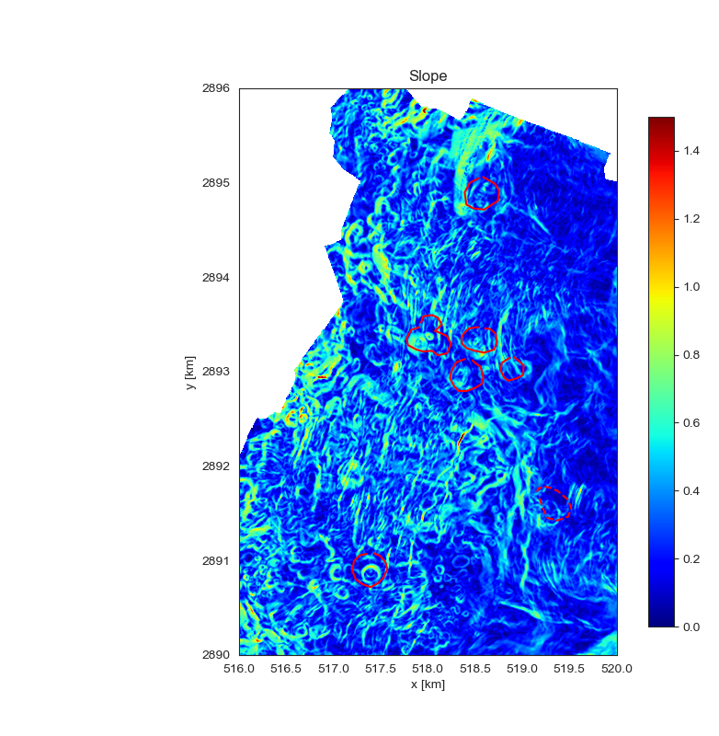
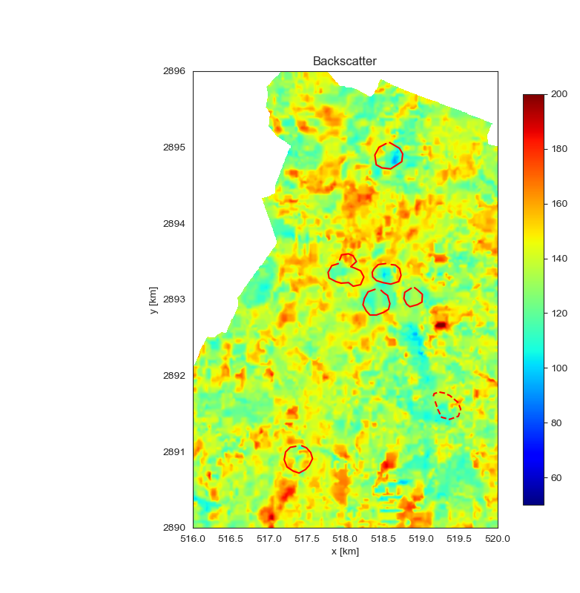


9 features
MIR is detected

Slide 23

9 features
MIR is detected

Slide 24

9 features
MIR is detected

