Slide 1



Social Buzz Analysis Presentation

Slide 2


Today's agenda
Project recap
Problem
The Analytics team
Process
Insights
Summary

Slide 3

Brief info about the client company :
Social Buzz is a content creation company. Over the past 5 years, it has reached over 500 million active users each month.
Key Project Elements:
Audit of Social Buzz Big data practice.
Implementation of an IPO.
Analysis of top 5 popular categories content
Project Recap

Slide 4

Problem
Generation of data on a huge scale.
Over 100,000 pieces of content daily.
36.5M posts annually.
Lack of data driven team.
Therefore Accenture is here to help Social Buzz tackle their biggest challenges.

Slide 5



Andrew Fleming
Chef Technical Architect
Marcus Rompton
Senior Data Expert
Ketkee P. Borade
Data Analyst
The Analytics team

Slide 6
Process
1
Understanding Problem Statement
Data Understanding
2
3
Data Cleaning
4
Data Analysis
5
Data Visualization to
Uncover Insights

Slide 7
After studying the project requirements, the CSV files were loaded into Power Query for cleaning and merging.
Following datasets :
Content
Reaction
Reaction Types
were used for the analysis.
And visualization was carried out using Microsoft PowerBi.

Slide 8

Insights
“Animals”
Most Popular
Category with
1897 reactions
16
Unique Categories
May
Month with
Highest Posts

Slide 9
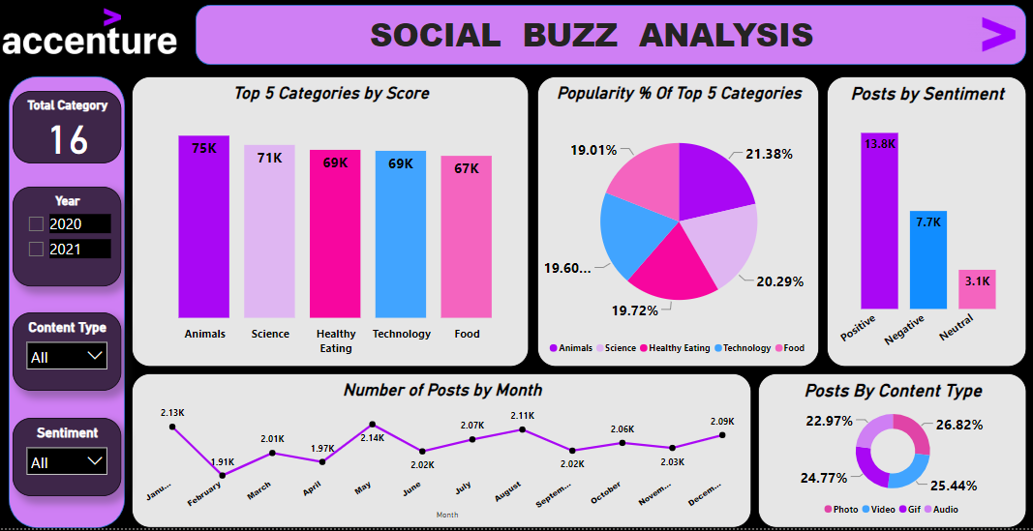

Slide 10
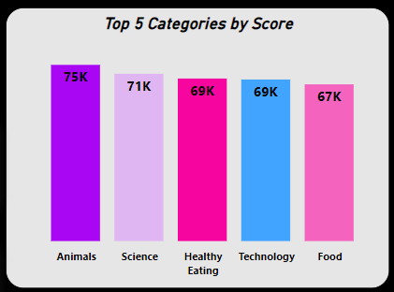
After analyzing the data it has come into attention that there are 16 total content categories.
Majority of the Social Buzz users are Animal and Science Lovers.
May is the month with the highest number of posts.
Users are posting more Photos as compared to videos, audios and Gifs.

Slide 11
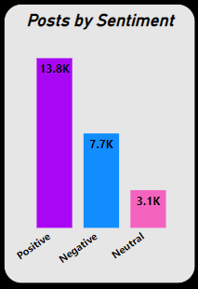
Majority of audience has positive reactions to the posts made on Social Buzz. That lets us know that people are enjoying the platform.
Healthy Eating and Food these 2 categories being in the Top 5 assures that there are many foodies and health conscious users out there.
Also we have scientific posts lovers in large number which makes Science the 2nd most popular category.
Technology being on the 4th position is a pretty good competition to Healthy Eating with almost equal posts..

Slide 12

This insightful analysis helped us determine top 5 content categories along with the monthly distribution of posts with their content type and the user sentiments towards the content that is being posted.
Accenture would love to help you find solutions to your business problems and overcome them in future as well.
Summary

Slide 13
Thank you for this opportunity and please reach out with any questions or feedback.
KETKEE BORADE
EMAIL : boradeketkee28@gmail.com
LINKEDIN : https://www.linkedin.com/in/ketkee-borade-3b1519191/

