Slide 1
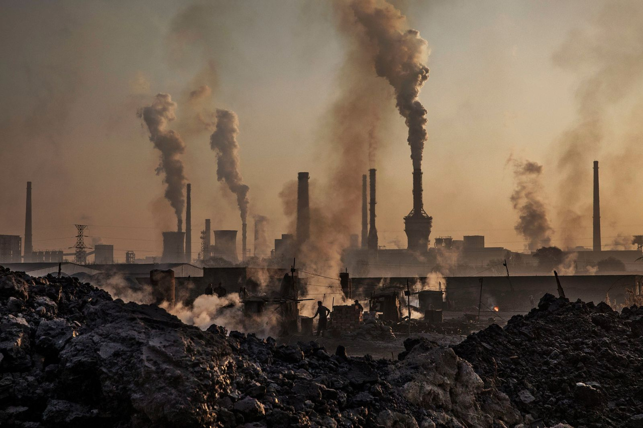


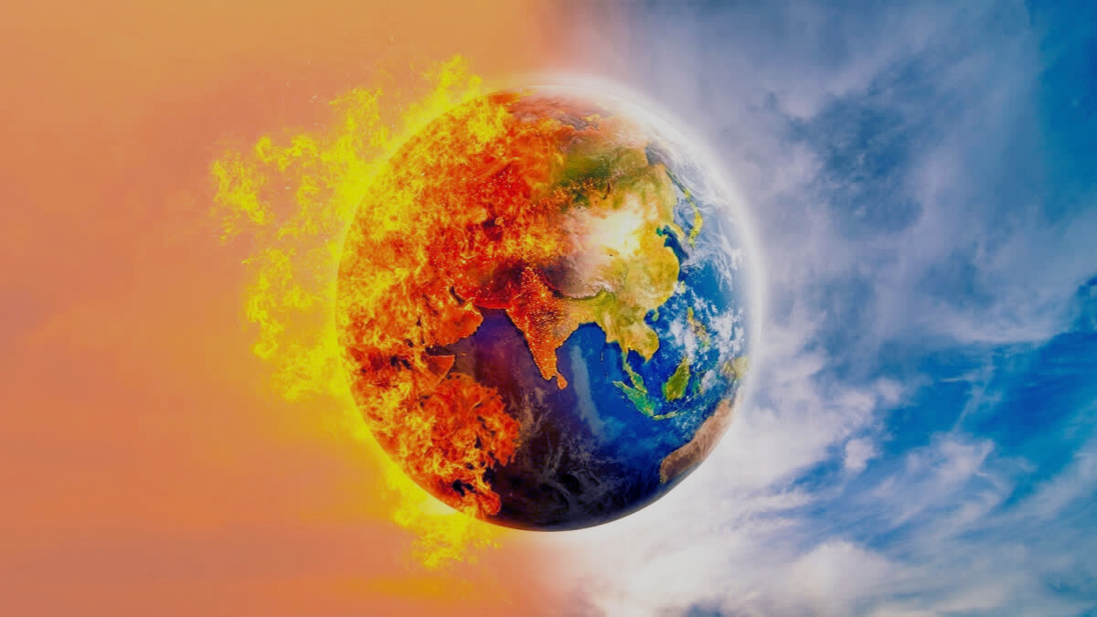
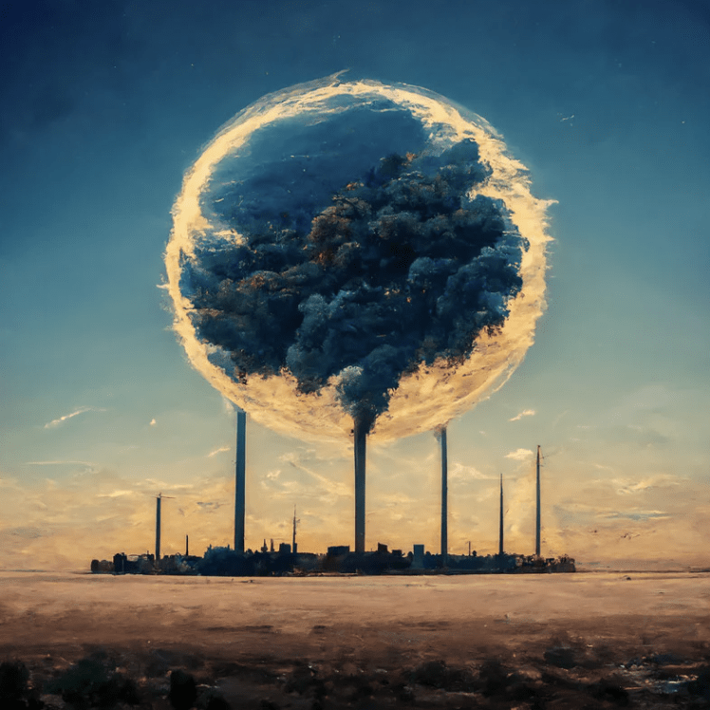

THE CLIMATE EQUATION
ENERGY CHOICES AND TEMPERATURE TRENDS

Slide 2



OUR TEAM
Gokul R
Janvi Chitroda
Ketki Mude

Slide 3






INTRODUCTION
Climate - Energy
Connection:
Energy Generation
GHG emissions
Global Temperature
The Problem:
Rising GHG emissions due to increasing energy demands
Global temperature rise

Slide 4





DATA SOURCES
Electricity generation
Renewables
Fossil fuels
Nuclear
Greenhouse gas emissions
Global temperature

Slide 5





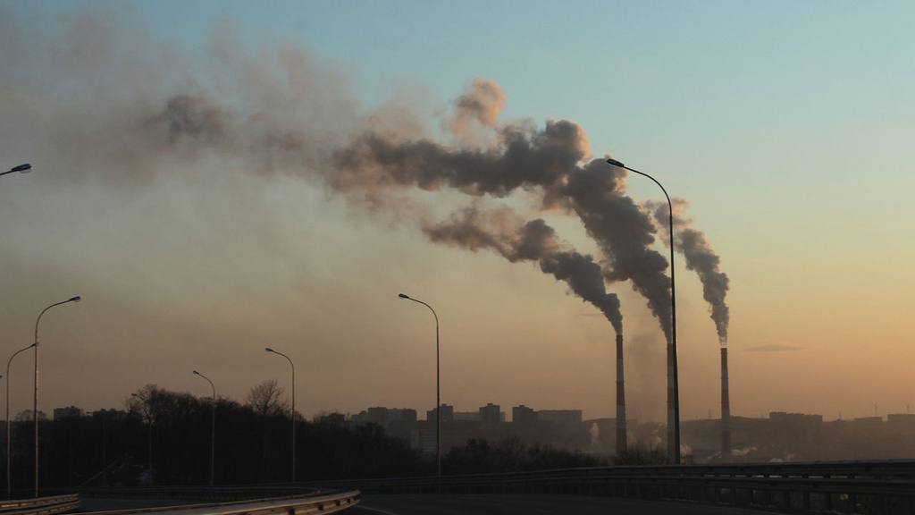

METHODOLOGY
01
02
03
PREPROCESSING DATA
NORMALIZATION OF VARIABLES
DATA VISUALIZATION
WITH STREAMLIT
04
02
HYPOTHESIS ANALYSIS
PREDICT GHG EMISSION & TEMPERATURE CHANGE

Slide 6

THANK YOU

