Slide 1
SonarQube Cloud + Grafana Monitoring
Code Quality + Observability

Slide 2
Learning Outcomes
By the end, students can explain, set up, and demonstrate both tools.
Understand why DevOps teams need code quality checks and production monitoring.
Create a simple SonarQube Cloud project and connect it to a GitHub Actions pipeline.
Understand bugs, vulnerabilities, code smells, coverage, duplication and quality gates.
Explain Grafana, Prometheus, metrics, dashboards and alerts.
Run a small Python application, expose a metric, and visualize it in Grafana.
Connect the two ideas: quality before release → monitoring after release.

Slide 3
Why Do We Need Both?
SonarQube
Code Quality
Application
in Production
Developer writes code
CI/CD
Release
Grafana
Observe & Alert
Think: “Is the code healthy?” → “Is the running system healthy?”

Slide 4
SonarQube Cloud — What Is It?
Cloud-based code quality and security analysis platform from Sonar.
Analyzes source code using language-specific rules and reports issues.
Common findings: Bugs • Vulnerabilities • Code Smells • Security Hotspots.
Also shows useful measures such as coverage, duplication and maintainability.
Quality Gate = a pass/fail-style checkpoint used by a team before accepting code.
Typical DevOps use: Pull Request → analysis → quality gate → merge/release.

Slide 5
SonarQube Vocabulary — Simple Meaning
Finding
Measures
Bug — code that can behave incorrectly.
Vulnerability — security weakness that can be exploited.
Code smell — maintainability/design problem.
Security hotspot — code needing security review.
Coverage — how much code is exercised by tests.
Duplications — repeated blocks of code.
Quality Gate — rules that determine pass/fail.
Technical debt — estimated effort to fix maintainability issues.

Slide 6
Example – What is wrong here??
def calculate_total(price, discount):
total = price - price * discount / 100
print("Total:", total)
return total
def calculate_total_again(price, discount):
total = price - price * discount / 100
print("Total:", total)
return total
password = "admin123"
print(password)

Slide 7
SonarQube Cloud — Setup Flow
1
Create / sign in
2
Connect GitHub
3
Create / import project
4
Generate token
5
Add CI analysis
6 → Run pipeline → Open report → Check Quality Gate

Slide 8
GitHub Actions — Simple SonarQube Cloud Example
name: SonarQube Analysis
on:
push:
branches: [ "main" ]
jobs:
sonar:
runs-on: ubuntu-latest
steps:
- uses: actions/checkout@v4
- name: SonarQube Cloud Scan
uses: SonarSource/sonarqube-scan-action@v6
env:
SONAR_TOKEN: ${{ secrets.SONAR_TOKEN }}
Key DevOps idea: the scanner runs automatically when code is pushed.
Never hard-code tokens in source code; store secrets in GitHub repository secrets.

Slide 9
Where SonarQube Fits in CI/CD
Code
Build
Test
Sonar
Analysis
Quality
Gate
Deploy
If the quality gate fails, the team investigates before promoting the change.

Slide 10
Grafana — What Is Monitoring?
Monitoring = continuously collecting signals about a system and checking its health.
Metrics are numerical measurements over time: CPU %, memory, requests/sec, latency, errors.
Logs are event records: “login failed”, “database connection timed out”.
Traces show the path of a request across services.
Grafana is a visualization and observability platform that connects to data sources and displays dashboards and alerts.

Slide 11
Grafana Architecture — Simple View
Application
/ Server
Exporter /
Instrumentation
Prometheus
Metrics Store
Grafana
Dashboard
CPU • Memory • Requests • Errors • Latency

Slide 12
Grafana Setup — Easiest Classroom Options
Option A — Grafana Cloud
Option B — Local Docker
Create a Grafana Cloud account.
Use a hosted Grafana stack.
Connect / send metrics to the stack.
Good for classroom demonstrations with minimal installation.
Run Grafana in Docker.
Run Prometheus locally.
Expose application metrics on /metrics.
Connect Prometheus → Grafana.

Slide 13
Run Grafana + Prometheus with Docker Compose
services:
prometheus:
image: prom/prometheus:latest
ports:
- "9090:9090"
volumes:
- ./prometheus.yml:/etc/prometheus/prometheus.yml
grafana:
image: grafana/grafana:latest
ports:
- "3000:3000"
depends_on:
- prometheus
Start: docker compose up -d
Open Grafana: http://localhost:3000
Prometheus: http://localhost:9090

Slide 14
Prometheus Configuration
global:
scrape_interval: 5s
scrape_configs:
- job_name: "student-app"
static_configs:
- targets: ["host.docker.internal:8000"]
Prometheus periodically scrapes the target's /metrics endpoint.
On Linux, host.docker.internal may require extra Docker configuration; alternatively run all services in one Compose network.
Concept to remember: Prometheus collects/stores metrics; Grafana visualizes them.
Third Year Engineering • DevOps

Slide 15
Python App — Expose a Custom Metric
from prometheus_client import start_http_server, Counter
import time
requests = Counter("student_requests_total",
"Total requests handled")
start_http_server(8000)
while True:
requests.inc()
print("Request processed")
time.sleep(2)
Run: pip install prometheus-client
The app exposes metrics at http://localhost:8000/metrics
Every 2 seconds, the counter increases.
Third Year Engineering • DevOps

Slide 16
Build the First Grafana Panel
1. Open Grafana → Connections → Data sources.
2. Add Prometheus and enter the Prometheus server URL.
3. Click Save & test.
4. Create Dashboard → Add visualization.
5. Select Prometheus as the data source.
6. Try this PromQL query:
rate(student_requests_total[1m])
Third Year Engineering • DevOps

Slide 17
What Would a Real Dashboard Monitor?
Application
Request rate • Error rate • Response latency
Infrastructure
CPU • Memory • Disk • Network
Database
Connections • Query latency • Errors
Availability
Uptime • Health checks • Service status
Goal: detect → understand → respond
Third Year Engineering • DevOps

Slide 18
SonarQube vs Grafana — Do Not Confuse Them
SonarQube Cloud
Grafana
Focus: source code quality & security.
Mostly used during development / CI.
Answers: “Is our code healthy?”
Typical input: source code + test/coverage data.
Output: issues, measures, quality gate.
Focus: system/application observability.
Mostly used while systems are running.
Answers: “Is our system healthy now?”
Typical input: metrics/logs/traces.
Output: dashboards, queries, alerts.
Third Year Engineering • DevOps

Slide 19
Common Troubleshooting
SonarQube
Grafana
Analysis not appearing → check workflow logs.
Authentication error → verify repository secret/token.
No project → verify organization/project configuration.
Quality gate failed → inspect the actual findings; do not blindly ignore them.
No data → check Prometheus target status.
Connection refused → verify ports/processes.
Wrong localhost → remember container network boundaries.
Empty panel → test the PromQL query in Explore first.
Third Year Engineering • DevOps

Slide 20
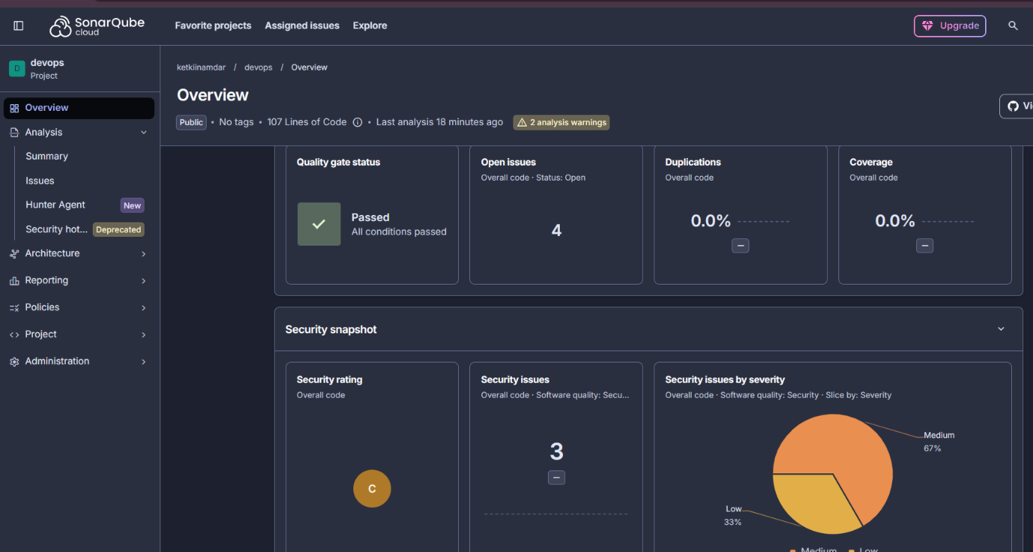

Slide 21
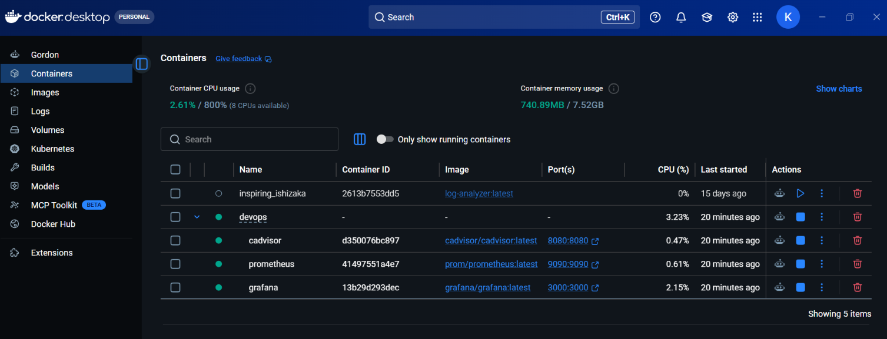

Slide 22
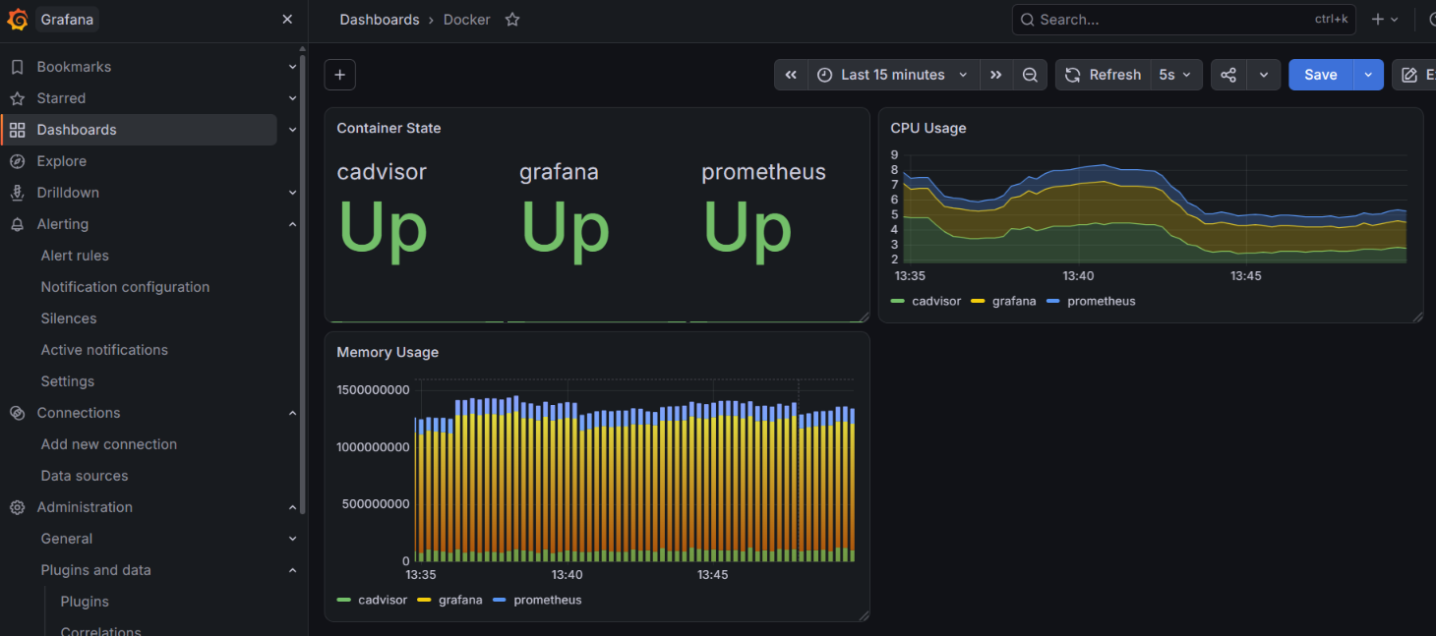

Slide 23
Quick Quiz — Check Understanding
1. What is the difference between a bug and a code smell?
2. Why should a SonarQube token be stored as a secret?
3. What is a Quality Gate?
4. What is a metric? Give two examples.
5. What is Prometheus used for?
6. What is Grafana used for?
7. What does /metrics expose in our Python example?
8. Where would you use SonarQube vs Grafana in a DevOps lifecycle?
Third Year Engineering • DevOps

Slide 24
Takeaway
SonarQube Cloud
Grafana
DevOps
Quality before release
Visibility after deployment
Feedback → improve → repeat
Good software is not only built correctly — it is continuously checked and observed.

Slide 25
Official Learning Resources
SonarQube Cloud documentation: docs.sonarsource.com
Grafana documentation: grafana.com/docs/grafana/latest/
Grafana Cloud getting started: grafana.com/docs/grafana-cloud/learn-and-build/get-started/
Grafana + Prometheus getting started: grafana.com/docs/grafana/latest/fundamentals/getting-started/first-dashboards/get-started-grafana-prometheus/
Use the current product documentation during the live lab because action versions, UI labels and cloud setup steps can change.
References checked September 2026

