Slide 1
Introduction to Software Engineering
Aruna Kumbhar

Slide 2
Revise
Introduction
How software development works - Sandwich Activity

Slide 3
How many of you have ever built a college mini project?
How many of those projects worked perfectly the first time?
What problems did you face?
Typical problems:
Bugs
Team members didn't work
Requirements changed
Last-minute coding
No testing
Deadline pressure
Documentation missing
Congratulations! You have already experienced Software Engineering problems.

Slide 4
Activity
Message Relay Game
Learning Outcomes:
Requirements Can Be Misunderstood
Communication is Critical
Documentation is Important
The biggest reason software projects fail is often not poor programming—it is poor communication. Software Engineering provides processes, documentation, and collaboration practices to ensure that everyone understands the same requirements and works toward the same goal.

Slide 5
Fun Fact
The first computer bug was actually a real bug!
In 1947, engineers working on the Harvard Mark II computer found a moth stuck inside a relay, causing the machine to malfunction. They taped it into their logbook and wrote:
"First actual case of bug being found."
Today when software crashes, we still call it a bug.

Slide 6
What is Software Engineering?
Imagine you want to build 🏠 A House. Can you simply start laying bricks?
What do you need?
Software engineering is also the same
Blueprint
↓
Architect
↓
Engineer
↓
Workers
↓
Inspection
↓
Material
Requirements
↓
Design
↓
Coding
↓
Testing
↓
Deployment
↓
Maintenance
According to Roger Pressman (6th Edition)
Software Engineering is the application of a systematic, disciplined and quantifiable approach to the development, operation and maintenance of software

Slide 7
What it is exactly?
Systematic
Disciplined
Quantifiable
Follow proper steps
Not random coding
Example
Cooking recipe
Everyone follows rules
Example
Traffic signals.
Everything should be measurable
Examples
How many bugs?
How many days?
How much testing?

Slide 8
Summary
Software Engineering is not just writing code
It is:
Planning
Designing
Coding
Testing
Deploying
Maintaining

Slide 9
Software Engineering Process Framework
A Software Process Framework establishes the foundation for a complete software engineering process by identifying a small number of framework activities applicable to all software projects, regardless of size or complexity
Framework means
A roadmap
Like Google Maps:
It tells
What to do
When to do
Who should do

Slide 10
Process Framework Components
Communication
project initiation & requirements gathering
Planning
estimating, scheduling, tracking
Modeling
design & analysis
Construction
code & testing
Deployment
delivery & feedback

Slide 11

Fun Fact
Margaret Hamilton coined the term "software engineering" in the 1960s while working on Apollo missions. She wanted software development to be taken as seriously as other engineering disciplines

Slide 12
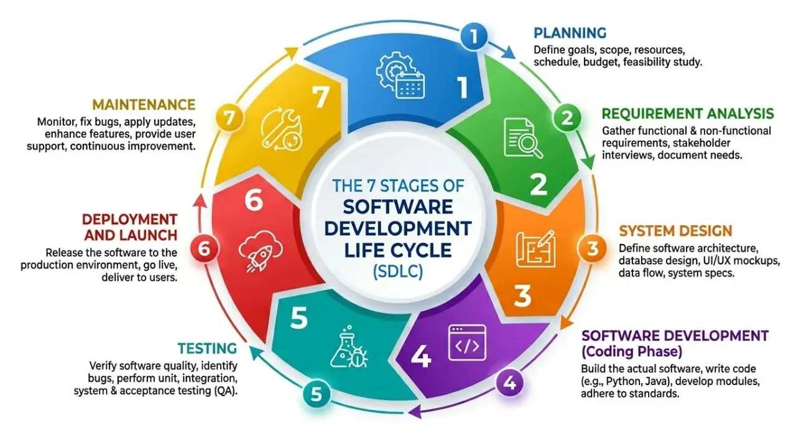

Slide 13
SDLC Process Models
Model 1: The Linear Sequential Model (Waterfall)
Foundation
↓
Walls
↓
Roof
↓
Painting
↓
Interior
Consider building a house:
Can you paint the walls before building them?
Can you install windows before constructing the walls?
Can you build the roof before the foundation?
Notice something? Every step depends on the previous one. You cannot skip or change the order.
Linear Sequential = Step-by-Step Development

Slide 14
SDLC Process Models
Model 1: The Linear Sequential Model (Waterfall)
Concept: Phases cascade like a waterfall — requirements → design → implementation → testing → maintenance. No going back.
Think of water flowing from the top of a waterfall. Once it flows to the next level, it doesn't flow back easily. That is why it is called the Waterfall Model
Real-World Parallel: Building a house, bridge.
Pressman Context: Best for well-understood, stable requirements. Risk: Late discovery of errors
According to Roger Pressman, Software Engineering: A Practitioner's Approach (6th Edition):
"The Linear Sequential Model suggests a systematic, sequential approach to software development that begins with system-level engineering and progresses through analysis, design, coding, testing, and support."

Slide 15
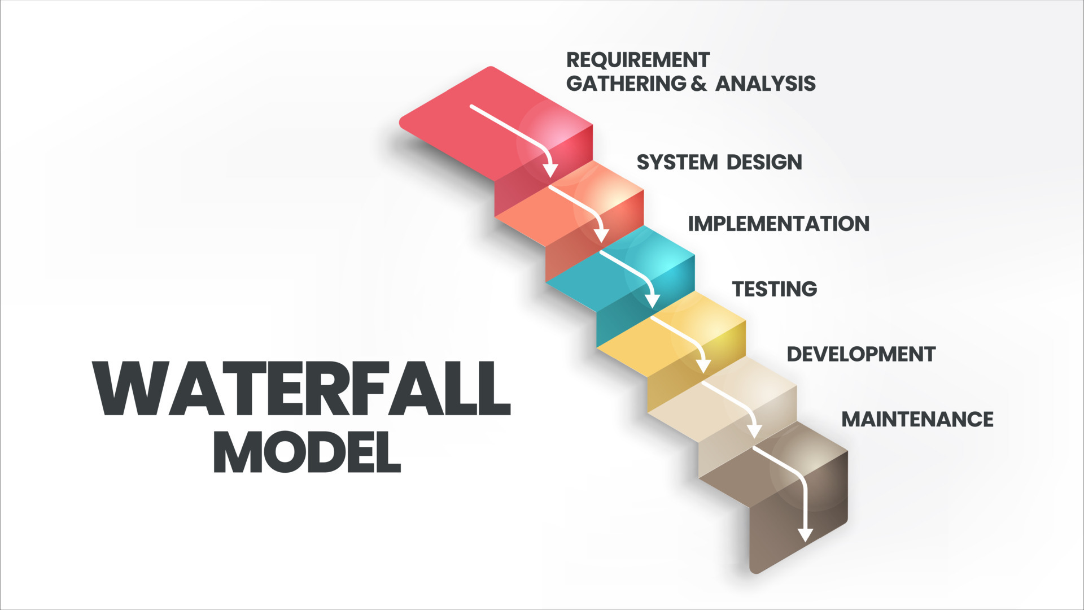

Slide 16
SDLC Process Models
Model 2: The Prototyping Model
Suppose you want to stitch a dress for your graduation ceremony. What would you prefer?
Option A:
Tailor stitches the final dress directly.
Option B:
Tailor first asks you to wear a sample (trial), makes changes, and then stitches the final dress.
Why?
Better fitting
Can make changes
Avoids mistakes
Customer satisfaction
That trial version is called a Prototype in Software Engineering

Slide 17
SDLC Process Models
Model 2: The Prototyping Model
Concept: Build a quick "throwaway" prototype to clarify requirements with users, then build the real system.
Real-World Parallel: Architects create cardboard models before construction.
Pressman Context: Best when requirements are fuzzy. Risk: Users may think the prototype IS the final product.
According to Roger Pressman, Software Engineering: A Practitioner's Approach (6th Edition):
"Prototyping is a process that enables the developer to create a model of the software that is to be built."

Slide 18
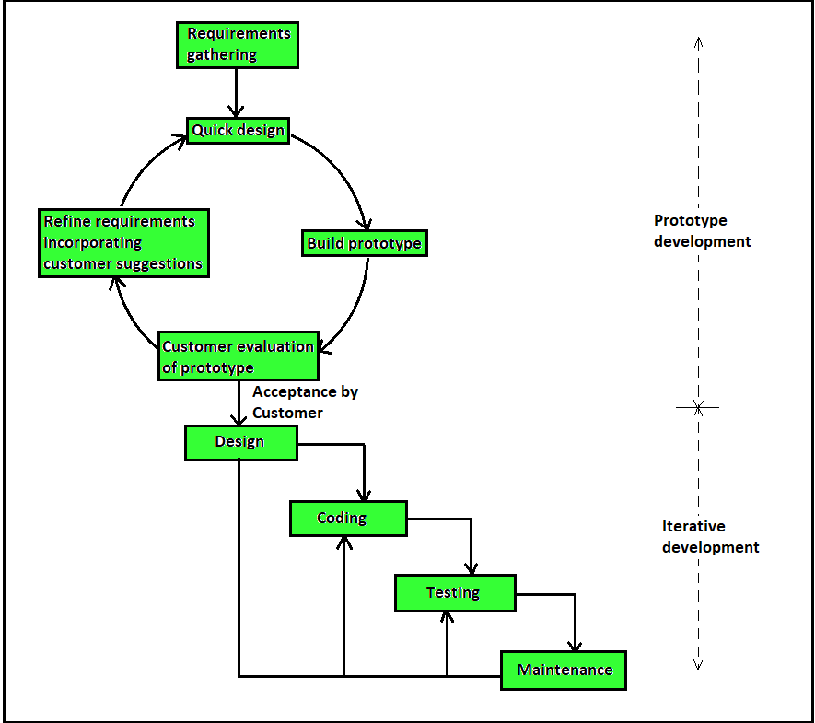

Slide 19
SDLC Process Models
Model 3: The RAD Model
Why?
Prepared ingredients
Standard process
Multiple people working together
Reuse of recipes
Assembly line
Which restaurant serves food faster?
Option A
A traditional restaurant
Option B
McDonald's / Domino's
They don't prepare everything from scratch every time. Software developers also reuse components and work in parallel. That is the basic idea behind the RAD Model

Slide 20
SDLC Process Models
Model 3: The RAD Model
Concept: Rapid Application Development — compressed timeline using component reuse, automated tools, and small teams.
Pressman Context: 60-90 day delivery cycles. Requires modularity and committed users
According to Roger Pressman, Software Engineering: A Practitioner's Approach (6th Edition):
"Rapid Application Development (RAD) is a high-speed adaptation of the linear sequential model in which rapid development is achieved by using a component-based construction approach."

Slide 21
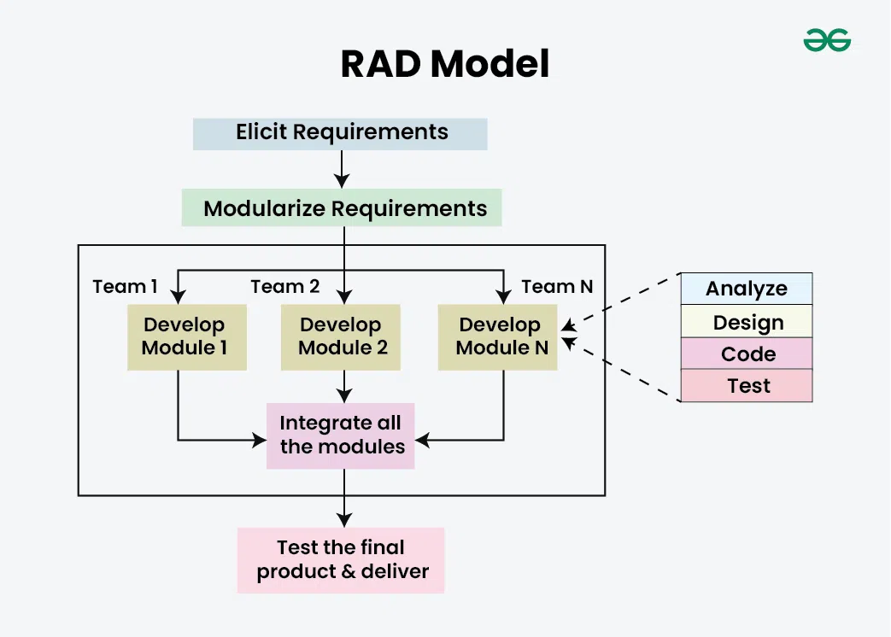

Slide 22
SDLC Process Models
Model 4: The Evolutionary Process Models
Why?
Every few months,
New Features
Better Camera
AI Features
Security Updates
Bug Fixes
Who has an Android phone?
Did your phone receive software updates regularly?
Was your phone perfect when you bought it?
Software Evolves = Evolutionary Process Models
Evolutionary Process Models
Spiral Model
Concurrent Development Model

Slide 23
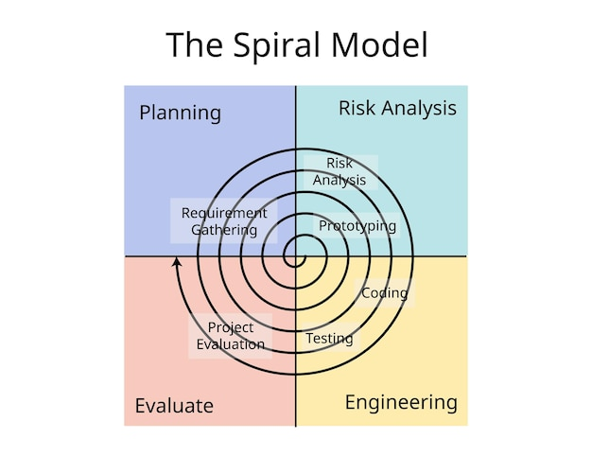
SDLC Process Models
Imagine you are climbing a mountain
Do you jump directly to the top?
You climb a Step
↓
Check safety
↓
Climb again
↓
Check safety
↓
Repeat
That is Spiral Model
According to Roger Pressman,
The Spiral Model couples the iterative nature of prototyping with the systematic aspects of the linear sequential model, adding risk analysis as a key activity

Slide 24
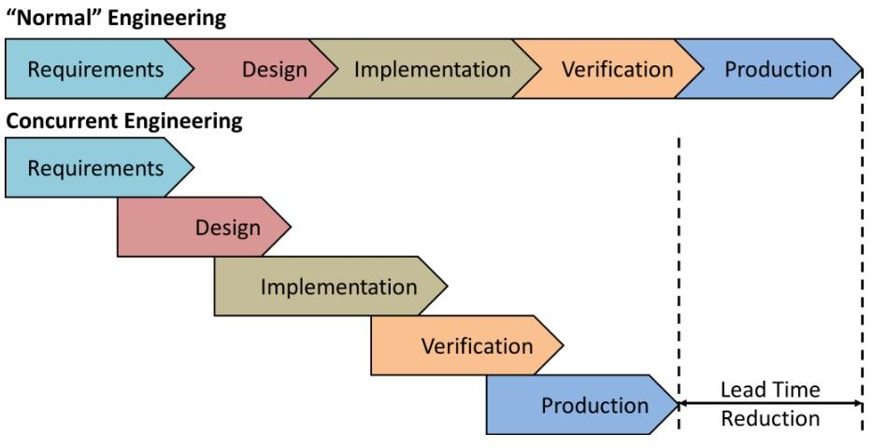
SDLC Process Models
Suppose your class is organizing Annual Tech Fest
Does everyone wait for each other?
Registration Team
↓
Stage Team
↓
Food Team
↓
Photography Team
↓
Sponsorship Team
All work simultaneously.
Software also works similarly
According to Roger S. Pressman, Software Engineering:
"The concurrent development model, sometimes called concurrent engineering, allows software engineering activities to exist simultaneously and to be in different states for different components of the software project."

Slide 25
SDLC Process Models
Model 5: The Agile Process Model
Would you prefer Netflix or Traditional DVD
Option A - DVD:
Watch one movie every six months
Option B - Netflix:
Watch new movies every week
Imagine Google Maps update road information only
once every year. Would you trust it?
Why?
Roads change every day
Traffic changes every minute
Software should evolve continuously
Traditional models assume: Requirements stay fixed
Reality says: Requirements change continuously
Hence, Agile was born

Slide 26
SDLC Process Models
Model 5: Agile Process Model
Concept: Values working software over documentation, customer collaboration over contracts, responding to change over following a plan.
Manifesto (2001): 17 developers at Snowbird, Utah ski resort created the Agile Manifesto. Yes, they were literally skiing between sessions.
Pressman Context: Scrum, XP, Kanban are implementations. Best for dynamic requirements
According to Roger Pressman (6th Edition)
"Agile software engineering combines a philosophy and a set of development guidelines. The philosophy encourages customer satisfaction and early incremental delivery of software, small highly motivated project teams, informal methods, minimal software engineering work products, and overall development simplicity."

Slide 27
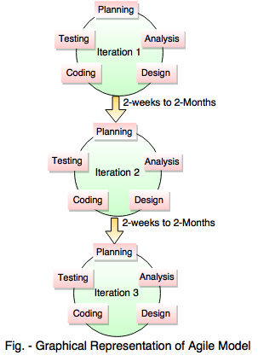

Slide 28
SDLC Process Models
Model 6: Component-Based Development
When you build a LEGO car, do you manufacture each LEGO brick?
You simply
Pick existing blocks
Assemble them
Build something new
Instead of creating everything,
Developers Reuse:
Login Module
Payment Module
Notification Service
Authentication
Database Libraries
Software development can work exactly the same way

Slide 29
SDLC Process Models
Model 6: Component-Based Development
Concept: Assemble systems from pre-built, reusable components (like LEGO blocks, python libraries)
Pressman Context: Requires robust component libraries and interface standards
According to Roger Pressman, Software Engineering: A Practitioner's Approach (6th Edition):
"Component-Based Development (CBD) is an approach to software development that relies on the reuse of software components to build systems."

Slide 30
