Slide 1
Agile Software Development Fundamentals
Aruna Kumbhar

Slide 2
Revise
Introduction to S/W Engineering
Chinese Whisper Activity for understanding how communication matters
S/W Engineering Process Framework – Roadmap – Communication, Planning, Modelling, Construction, Deployment
SDLC Process Models – Waterfall, Prototyping, RAD, Evolutionary (Spiral, Concurrent), Agile, Component-Based Development

Slide 3
SDLC Process Models Summary

Slide 4
Need of Agile S/W Development
What if Amazon released only login and shopping cart in one month?
Customers start using it
Feedback arrives
Developers improve
This is Agile
Definition
According to Roger Pressman
Agile is a software development philosophy that emphasizes incremental delivery, customer collaboration, adaptability, and rapid response to change.

Slide 5
Why Traditional Methods Failed
Problems:
❌ Requirements change
❌ Market changes
❌ Technology changes
❌ Competitors launch earlier
❌ Customer dissatisfied
Requirement
↓
Design
↓
Coding
↓
Testing
↓
Customer
Agile solved:
✔ Frequent delivery
✔ Customer involvement
✔ Early testing
✔ Faster feedback
✔ Lower risk
Customer waits 1–2 years

Slide 6
History of Agile
Before Agile, Software followed
Waterfall
Spiral
V Model
RAD
Prototype
Interesting Fact
In the 1990s, Nearly 70% software projects either failed or exceeded budget
But, Software projects kept failing
Many developers became frustrated

Slide 7

History of Agile
In February 2001
17 software experts met At Snowbird Ski Resort, Utah, USA
What were software engineers doing in a ski resort?
They changed software history

Slide 9
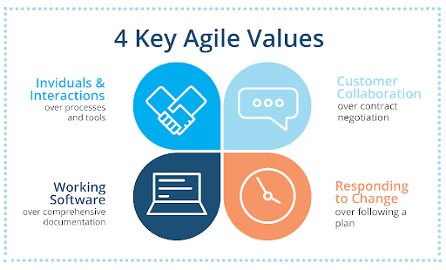
Agile Manifesto – 4 VALUES
Suppose, Wi-Fi stops working.
Instead Following 10 documents
takes hours, Two developers discuss together
Problem solved
People matter more
Netflix continuously asks
"What features do users like?"
Instead of saying
"This wasn't in contract."
COVID arrived.
Food delivery apps started
Medicine delivery.
That's Agile thinking
Which impresses customer?
100-page document
OR
Working mobile app?
Obviously
Working software

Slide 10
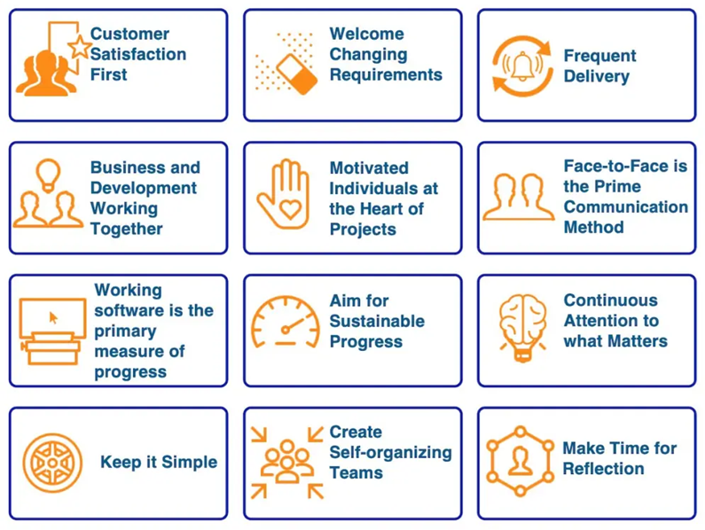
Agile Manifesto – 12 Principles

Slide 11
Traditional vs Agile
Traditional | Agile
Big planning | Small planning
Late delivery | Early delivery
Customer at beginning | Customer throughout
Testing at end | Testing continuously
Changes difficult | Changes welcome
High risk | Lower risk
Documentation heavy | Working software focus
Traditional Write entire book Then publish
Publish one chapter every week. Readers give feedback Improve next chapter

Slide 12
Which is better – Traditional or Agile for
Instagram
Bridges

Slide 13
Stakeholders and Challenges
Stakeholders
Customer
Product Owner
Developers
Testers
Scrum Master
Managers
End Users
Business Team
Operations Team
Example
Food Delivery App
Customer
Restaurant
Delivery Partner
Developer
Tester
Manager
Everyone is stakeholder

Slide 14
Stakeholders and Challenges
Challenges
Changing requirements
Communication
Distributed teams
Customer availability
Team resistance
Poor documentation
Scope creep
Can Agile fail?

Slide 15
Classification of Agile Methods
Agile is not one methodology. It is an umbrella
Agile
├── Scrum
├── XP
├── Kanban
├── Lean
├── Crystal
├── Feature Driven Development
├── DSDM
└── Adaptive Software Development
Scrum → Sprint based
XP → Coding practices
Kanban → Visual board
Lean → Remove waste
Crystal → Team centric
FDD → Feature based
DSDM → Rapid delivery
ASD → Adapt continuously

Slide 16
You have visited a restaurant. And ordered food
Now explain in waterfall model, how the food will arrive
Now explain in Agile model, how the food will arrive
Wait 3 hours.
Chef brings
Soup
Starter
Main Course
Dessert
all together
Soup is cold.
You don't like spicy food.
Too late
Soup first.
You give feedback.
Starter next.
Feedback.
Main course.
Feedback.
Dessert.
Everyone gets exactly what they want

Slide 17
Real World Agile Examples
Company | Agile Example
Netflix | Weekly deployments
Amazon | Continuous feature releases
Google Maps | Frequent updates
WhatsApp | Incremental features
Spotify | Squad-based Agile
Instagram | Regular UI improvements

Slide 18
Agile Teams
Definition (Pressman)
Roger Pressman describes Agile teams as small, self-organizing, cross-functional teams that work collaboratively to deliver working software in short iterations
Product Owner
│
Scrum Master
│
─────────────────────────
Developers Testers UI/UX DevOps
─────────────────────────
│
Customer

Slide 19
Agile Teams
Product Owner
Responsible for
Managing Product Backlog
Prioritizing work
Understanding customer requirements
Decides what should be developed
Development Team
Includes
Developers
Testers
UI Designers
DevOps Engineers
Database Engineers
Decides how the work will be completed
Scrum Master
Responsible for
Removing blockers
Facilitating meetings
Ensuring Scrum practices are followed
Acts like a coach, not a manager

Slide 20
Agile Team Meetings (Ceremonies)
1. Sprint Planning
Purpose: What will be developed during the Sprint?
Duration: 2–4 hours (for a 2-week Sprint)
2. Daily Scrum (Stand-up)
Duration: 15 minutes
Every team member answers
What did I complete yesterday?
What will I do today?
Any blockers?
3. Sprint Review
End of Sprint
Purpose: Team demonstrates the completed software. Customer gives feedback
4. Sprint Retrospective
Internal team meeting.
Discuss
What went well?
What went wrong?
What can be improved?
5. Backlog Refinement (Grooming)
Product Owner updates
Stories
Priorities
Estimates
Not mandatory in Scrum Guide but widely practiced

Slide 21
Agile Team Meetings (Ceremonies)
Ceremony | Purpose
Sprint Planning | Plan work
Daily Scrum | Track progress
Sprint Review | Show work
Retrospective | Improve process
Backlog Refinement | Prepare future work

Slide 22
Agile Drivers
Agile Driver | Example
Changing customer requirements | WhatsApp keeps adding features
Faster delivery | Amazon releases updates frequently
Customer satisfaction | Netflix improves based on feedback
Better quality | Continuous testing
Lower project risk | Small releases reduce failures
Market competition | New features reach users faster
Technological changes | AI features added continuously
Interesting Fact
Netflix reportedly deploys software changes thousands of times per day using Agile and DevOps practices

Slide 23
Agile Capabilities
Agile enables organizations to:
Respond quickly to change
Deliver software rapidly
Improve product quality
Increase customer satisfaction
Reduce project risks
Improve teamwork
Increase transparency
Support continuous improvement
• Adaptability
• Collaboration
• Transparency
• Continuous Improvement

Slide 24
Summary
Software development evolved from rigid, long-cycle models to Agile because business needs and technology change rapidly
Agile is a mindset focused on delivering value, rather than just following a process
The Agile Manifesto is built on 4 values and 12 principles that emphasize collaboration, adaptability, and working software
Agile involves multiple stakeholders working together continuously, with customer feedback guiding development
Scrum, Kanban, XP, Lean, Crystal, FDD, DSDM, and ASD are all different Agile methods, each suited to different project needs

