Slide 1
Agile Processes
Aruna Kumbhar

Slide 2
Revise
Traditional SDLC Models vs Agile
History of Agile
Agile Manifesto – 4 Values, 12 Principles
Stakeholders and Challenges
Classification of Agile Methods
Agile Teams
Agile Team Meetings
Agile Drivers
Agile Capabilities

Slide 3
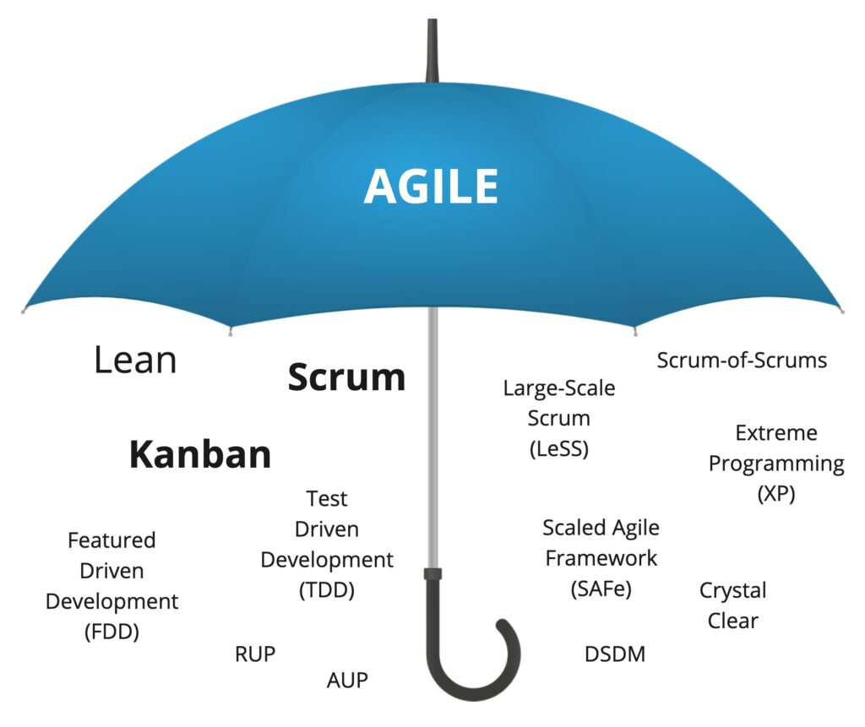
Agile vs Agile Methodologies
Agile is not a methodology.
It is a mindset.

Slide 4

1. Scrum
"Suppose your college is organizing a Tech Fest in one month. Would you wait until the last day to see whether everything is ready?"
Plan weekly
Divide work
Meet regularly
Check progress
Fix problems
Scrum is an Agile framework used to develop software in small, manageable parts called Sprints, with regular planning, teamwork, feedback, and continuous improvement.
The word "Scrum" comes from the game of Rugby
In Rugby,
players stand together,
communicate,
support each other,
and move forward as one team.
Similarly,
Scrum teams work together to achieve a common goal.

Slide 5
1. Scrum
Scrum is the most widely used Agile framework for managing software development in short iterations called Sprints
Best For
Medium to large projects
Frequently changing requirements
Key Concepts
Sprint
Product Backlog
Sprint Backlog
Daily Scrum
Roles
Product Owner
Scrum Master
Development Team
Example
A banking app releases:
Sprint 1 → Login
Sprint 2 → UPI
Sprint 3 → Loan Module
Sprint 4 → Investment

Slide 6
1. Scrum
Product Owner:
Understand customer needs
Prioritize features
Maintain Product Backlog
Scrum Master:
Ensures Scrum is followed correctly
Removes obstacles
Guides the team
Product Backlog
↓
Sprint Planning
↓
Sprint (2 Weeks)
↓
Daily Scrum
↓
Working Software
↓
Sprint Review
↓
Sprint Retrospective
↓
Next Sprint
Development Team
Developers
Testers
UI Designers
DevOps Engineers
Database Engineers
They decide: HOW to build the software

Slide 7
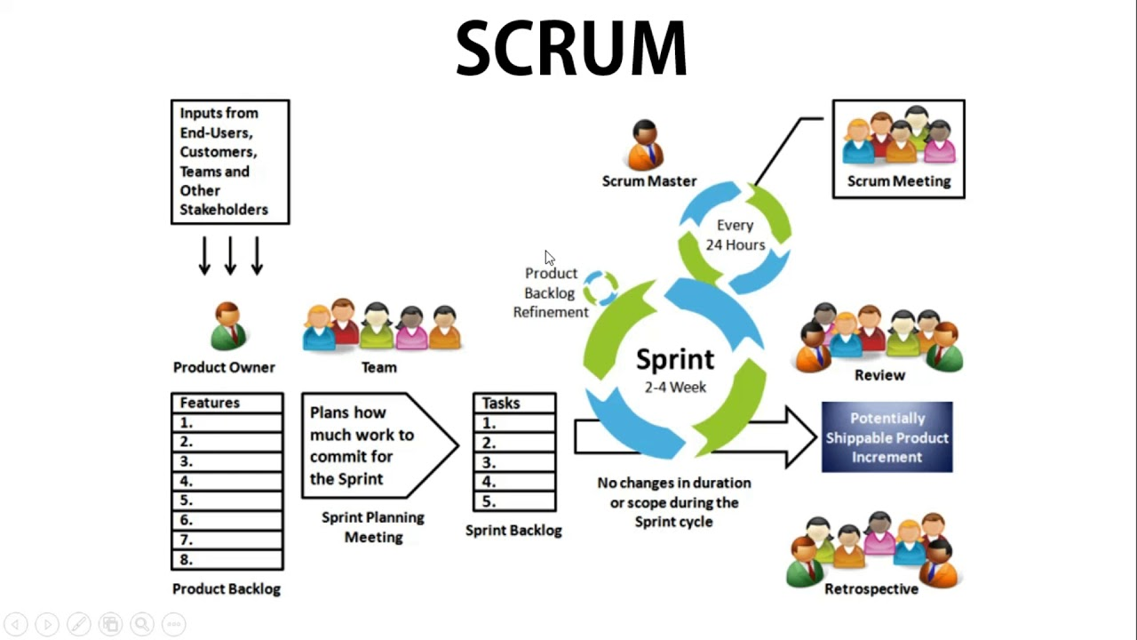

Slide 8
1. Scrum
Empirical Process Control
Learn from Experience
Self-Organizing Team
The team decides how to complete the work
Collaboration
Continuous Communication. Everyone works together
Value-Based Prioritization
Develop the most important features first
Time-Boxing
Every scrum activity has a fixed time limit
Iterative Development
Don't build the entire software at once. Build it piece by piece
Continuous Feedback
Show working software regularly to customers and gather feedback

Slide 9
2. Extreme Programming (XP)
"Imagine you're writing an important exam. Which is better?"
Option A: Write the entire paper and check it only at the end.
OR
Option B: Solve one question, check it immediately, correct mistakes, and then move to the next question.
Plan
↓
Write Code
↓
Test
↓
Improve Code
↓
Repeat
"That's exactly the idea behind Extreme Programming (XP). Build a little, test a little, improve a little, and repeat."
Extreme Programming (XP) is an Agile software development methodology that focuses on high-quality software, close customer collaboration, and continuous improvement through disciplined engineering practices

Slide 10
2. Extreme Programming (XP)
Improve software quality through excellent engineering practices

Slide 11
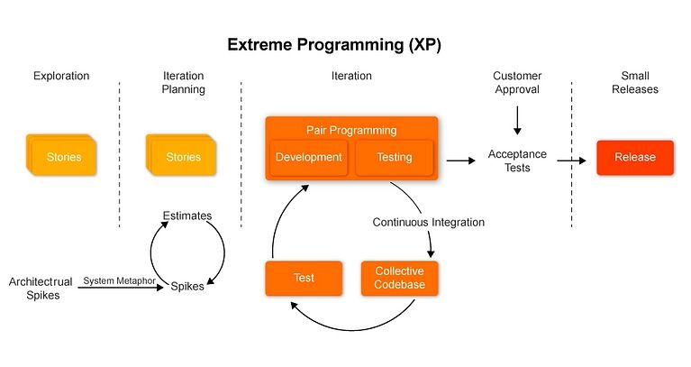

Slide 12
2. Extreme Programming (XP)
Rapid Feedback
Get feedback as early and as often as possible
Assume Simplicity
Build only what is needed today. Don't add unnecessary features "just in case."
Incremental Change
Improve software step by step, not all at once
Embrace Change
Requirements will change. Instead of resisting, accept them
Quality Work
Never compromise software quality, even when working quickly

Slide 13
3. Feature Driven Development (FDD)
Feature-Driven Development (FDD) is an Agile methodology in which software is developed one small, client-valued feature at a time.
Overall Model
↓
Feature List
↓
Plan by Feature
↓
Design by Feature
↓
Build by Feature
↓
Deliver Feature
↓
Repeat

Slide 14
3. Feature Driven Development (FDD)
Develop software feature by feature
Best for
Large enterprise projects
Example
Instagram
Instead of developing everything,
deliver
Login
Stories
Reels
Messaging
one feature at a time
Process
Develop overall model
Build feature list
Plan by feature
Design by feature
Build by feature

Slide 15
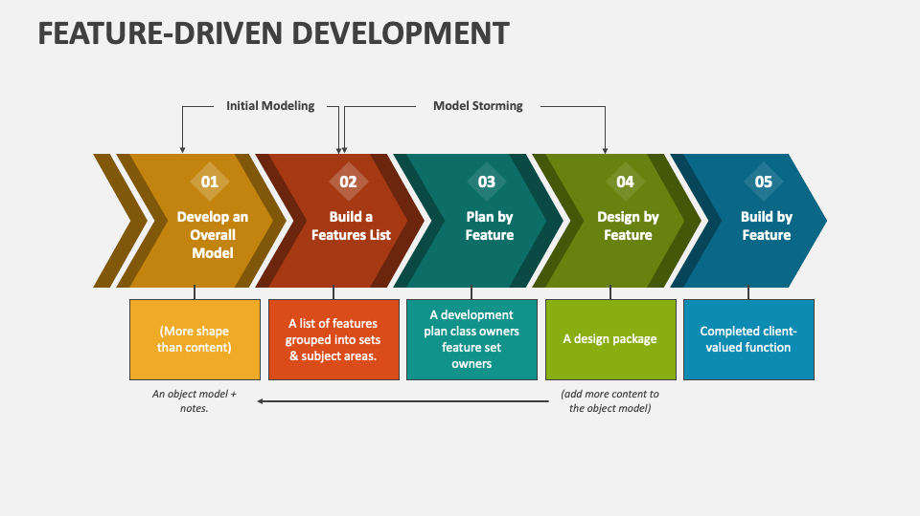

Slide 16
3. Feature Driven Development (FDD)
Develop by Feature
Break a large project into small, customer-valued features
Customer Value First
Every feature should provide real value to the customer
Frequent Delivery
Deliver completed features regularly instead of waiting until the whole project is finished
Domain Object Modelling
Understand the business domain before writing code
Ownership of Features
Each feature has a responsible developer or small team
Regular Inspection & Quality
Review and test every feature before delivering it

Slide 17
4. Crystal Method
Different projects need different methodologies
Imagine a hospital.
Would the doctor prescribe the same medicine to:
A child with fever 👶
A pregnant woman 🤰
An elderly patient 👴
The treatment depends on:
Age
Health condition
Severity
Similarly,
Crystal says:
"Every software project is different. So why should every project use the same development process?"
Crystal is an Agile methodology that adapts the software development process according to the project's size, team size, and criticality (how serious the consequences of failure are)

Slide 18
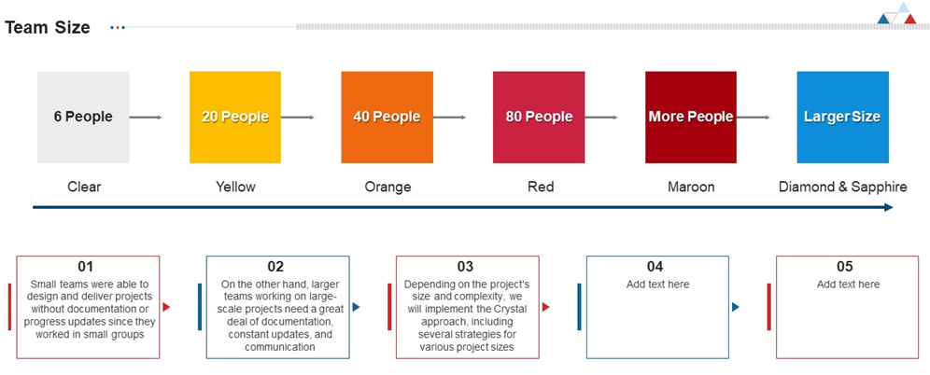
4. Crystal Method
Crystal was developed by Alistair Cockburn, one of the 17 authors of the Agile Manifesto. He named it Crystal because crystals come in many colors, and each color represents a different methodology for different project sizes and criticality.

Slide 19
4. Crystal Method
People First
Good communication is more important than rigid rules
Frequent Delivery
Deliver working software regularly
Continuous Communication
Everyone should communicate regularly
Typical roles include:
Project Sponsor
Project Manager
Business Expert (Domain Expert)
Developers
Testers
Users
Reflect and Improve
What worked well?
What can be improved?
Focus on Safety
People should feel safe to
Ask questions
Admit mistakes
Suggest improvements

Slide 20
5. Kanban
"When you visit Domino's or Pizza Hut, have you noticed the order tracking screen?"
It usually shows:
🍕 Order Received
👨‍🍳 Preparing
🔥 Baking
🛵 Out for Delivery
✅ Delivered
"Why do restaurants show this?"
To track progress
To know the current status
To avoid confusion
Kanban is an Agile method that helps teams visualize their work, limit the amount of work in progress (WIP), and continuously improve the flow of work

Slide 21
5. Kanban
The word Kanban is a Japanese word meaning "Visual Card" or "Signboard."
It was introduced by Toyota in the 1940s to improve manufacturing efficiency.
Instead of producing too many cars, Toyota produced only what was needed.
This reduced waste.
Today, software teams use the same idea
Kanban says: "Stop starting. Start finishing."
Instead of doing many things at once, finish current work first, then take new work

Slide 22
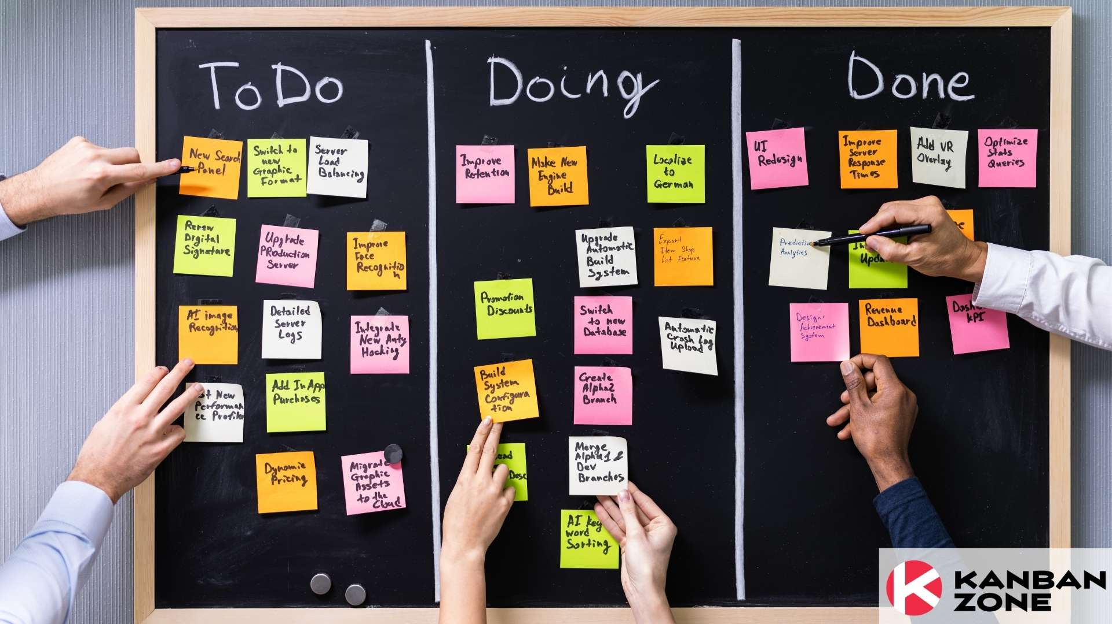

Slide 23
5. Kanban
Visualize Work
Show every task on a board.
Everyone knows
Who is working on what
Limit Work in Progress
Never start too many tasks.
Complete current work first.
Manage Flow
Ensure tasks move smoothly
From To Do -> In Progress -> Done
Continuous Improvement
Every week, ask
Where are tasks getting stuck?
Why are they delayed?
How can we improve?
Kanban has no mandatory roles.

Slide 24
6. Adaptive Software Development (ASD)
"Suppose you are planning a picnic next Sunday. Suddenly, it starts raining heavily. What will you do?"
Change the date
Move the picnic indoors
Choose another location
"Will you continue with the original plan just because it was planned?"
That's exactly what Adaptive Software Development (ASD) says. When the situation changes, don't stick to the old plan—adapt!
Adaptive Software Development (ASD) is an Agile methodology that encourages teams to adapt continuously to changing requirements, customer feedback, and new technologies instead of strictly following the original plan

Slide 25
6. Adaptive Software Development (ASD)
Suppose you score only 55 marks in the first internal exam.
Do you continue studying the same way?
Analyze mistakes
Improve preparation
Score higher next time
This is ASD Thinking
Imagine developing Swiggy. Initially,
only food delivery existed. Then customers requested
Grocery Delivery
Instamart
Dineout
Genie
Instead of saying, "Our plan is fixed,"
the company adapted.
This is ASD thinking

Slide 26
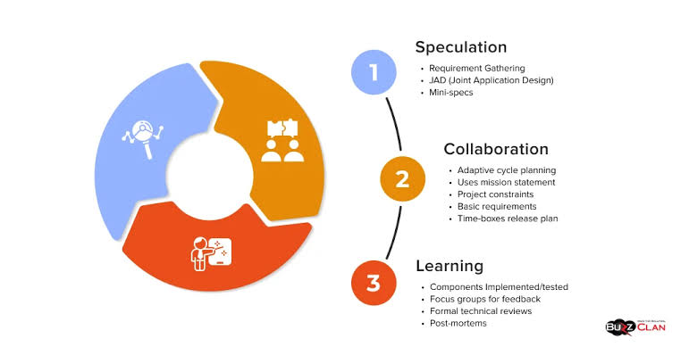

Slide 27
6. Adaptive Software Development (ASD)
Accept Change
Changes are expected,
not feared
Collaboration
Developers, customers, and testers work together continuously
Customer Requirement
↓
Speculate
↓
Develop
↓
Collaborate
↓
Customer Feedback
↓
Learn
↓
Improve
↓
Next Iteration
Learning
Every iteration improves the product and the team
Incremental Development
Build software step by step,
not all at once
Customer Feedback
Customers regularly review the software, and their feedback influences future work

Slide 28
7. Lean Software Development (LSD)
"Suppose your mother asks you to buy only three things from the supermarket: Milk, Bread, and Eggs. Instead, you buy 20 unnecessary items. What will happen?"
Waste of money
Waste of time
Hard to carry
Many things may not even be used
"Exactly! Lean Software Development says—don't build things that the customer doesn't need."
Lean Software Development is an Agile methodology that focuses on delivering maximum value to the customer by eliminating waste, improving quality, and continuously improving the development process.

Slide 29
7. Lean Software Development (LSD)
The word Lean means
Doing more with less.
Less
Time
Cost
Effort
Waste
More
Customer Value
Quality
Productivity
Imagine packing your school bag. Would you carry
Every textbook
All notebooks
Sports equipment
Laptop
Umbrella
Lunch box
Dictionary
Even if you need only two books today?
You carry only what is necessary.
Lean says
"Develop only what is necessary."

Slide 30
7. Lean Software Development (LSD)
In the 1940s and 1950s, after World War II, Toyota was a small automobile company in Japan. Unlike companies such as Ford, Toyota did not have enough money, factory space, or raw materials to manufacture thousands of cars and store them in warehouses. They had to find a smarter way to work.
Many factories followed this approach:
Produce as many cars as possible
Store them in large warehouses
Sell them later
🚗 Unsold cars
💰 Money tied up in inventory
🏭 Large storage costs
⏳ Wasted time and resources
Toyota asked a simple question:
"Why produce something before the customer actually needs it?"
Instead of making 1,000 cars in advance, Toyota produced only what customers ordered, when they needed it.
Reduced waste
Saved money
Improved quality
Increased customer satisfaction

Slide 31
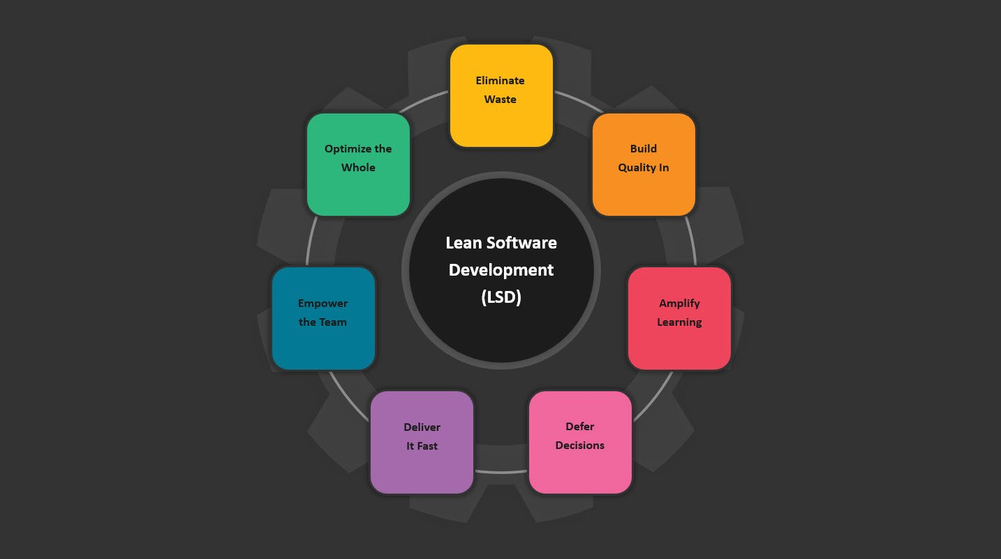

Slide 32
7. Lean Software Development (LSD)
Eliminate Waste
Remove anything that doesn't add value to the customer
Build Quality In
Don't wait until the end to find bugs. Develop software correctly from the beginning
Create Knowledge
Every project teaches something. Developers should continuously learn
and improve
Defer Commitment
Don't make important decisions too early. Wait until enough information is available
Deliver Fast
Deliver useful software quickly. Don't make customers wait for months
Respect People
Trust developers. Encourage teamwork. Listen to ideas
Optimize the Whole
Improve the entire system, not just one part

Slide 33
7. Lean Software Development (LSD)
Customer Requirement
↓
Identify Value
↓
Remove Waste
↓
Develop
↓
Continuous Testing
↓
Customer Feedback
↓
Improve
↓
Deliver Quickly

Slide 34
If your project is... | Choose...
New product with changing requirements | Scrum
Code quality is critical | XP + TDD
Continuous support or operations | Kanban
Large enterprise with many features | FDD
Small team | Crystal
Research or AI prototype | ASD
Need to reduce waste and improve efficiency | Lean

