Slide 1
DevOps Engineering
Docker • Terraform • SonarQube • Selenium • Grafana
Goal: understand what each tool does, why it is selected, how to configure it, and how it fits into a DevOps workflow.
1

Slide 2
Part 1 — DevOps Foundations
Understand the problem before choosing a tool
2

Slide 3
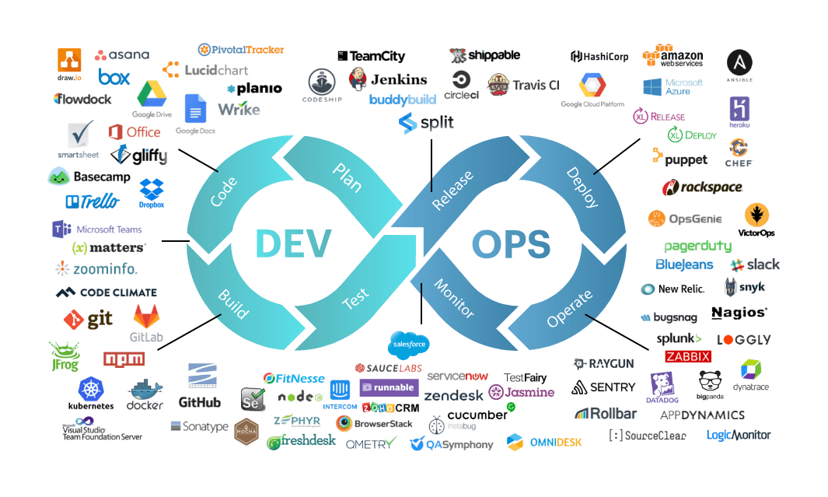
3

Slide 4
How to Choose the Right DevOps Tool
A decision framework students can reuse for any technology
1. Define the problem: What manual, slow, risky or inconsistent activity are we solving?
2. Define the stage: source control, CI, packaging, IaC, testing, security, deployment or observability?
3. Define constraints: language, OS, cloud/on-premises, budget, team skills, compliance and scale.
4. Compare capabilities: integrations, automation, APIs, plugins, reporting and ecosystem.
5. Compare operational cost: licensing, infrastructure, upgrades, backups and administration.
6. Evaluate learning curve and availability of skilled developers/administrators.
7. Prototype with a small proof of concept before standardizing.
8. Select the simplest tool that satisfies the requirements; avoid unnecessary tool sprawl.
4

Slide 5
A Simple Decision Scorecard
Capability fit — 30%: Does it solve the actual problem?
Integration — 20%: Does it connect to the rest of the toolchain?
Security & governance — 15%: Can access, secrets and policies be controlled?
Cost / total effort — 15%: License + infrastructure + administration + training.
Skills & community — 10%: Can the team learn, hire and troubleshoot it?
Scalability & reliability — 10%: Will it remain useful as the project grows?
Use weighted scoring only after defining requirements; a scorecard supports judgment rather than replacing it.
6

Slide 6
Part 2 — Docker
Package applications into portable, repeatable containers
7

Slide 7
Docker Mental Model
Image = packaged blueprint containing application, runtime, libraries and filesystem layers.
Container = running instance of an image.
Registry = place where images are stored and shared.
Dockerfile = text recipe used to build an image.
Volume = persistent storage managed separately from a container's writable layer.
Network = controlled communication path between containers and external clients.
8

Slide 8
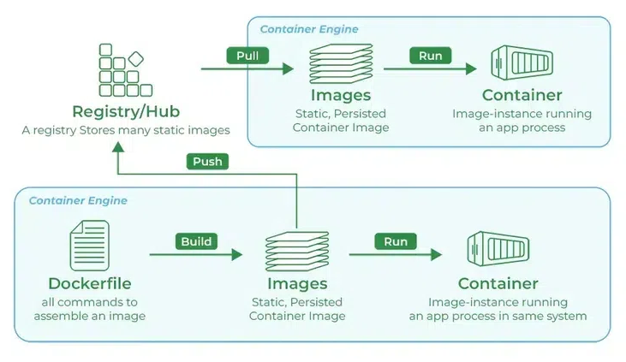
https://hub.docker.com/search?badges=official

Slide 9
Docker Setup & First Commands
`docker --version` → asks the Docker CLI to print its installed version.
`docker run hello-world` → downloads the image if necessary, creates a container, starts it and displays a test message.
`docker images` → lists locally stored images.
`docker ps` → lists currently running containers.
`docker ps -a` → includes stopped/exited containers.
`docker run -d ... nginx` → creates and starts an Nginx container in detached/background mode.
`--name web` → assigns the container a human-readable name.
`-p 8080:80` → maps host port 8080 to container port 80.
`docker stop web` → asks the running container to stop.
`docker rm web` → removes the stopped container.
docker --version
docker run hello-world
docker images
docker ps
docker ps -a
docker run -d --name web -p 8080:80 nginx
docker stop web
docker rm web
9

Slide 10
Dockerfile Example
`FROM python:3.12-slim` → selects a lightweight Python base image.
`WORKDIR /app` → sets `/app` as the working directory for later instructions.
`COPY requirements.txt .` → copies the dependency file into the image's current directory.
`RUN pip install ...` → executes package installation while building the image; `-r` reads dependencies from the file.
`COPY . .` → copies the application source from the build context into the image.
`EXPOSE 5000` → documents that the application is expected to listen on port 5000; it does not publish the port by itself.
`CMD [...]` → default command executed when a container starts.
Build: `docker build -t student-api:1.0 .` — `-t` gives the image a name/tag and `.` is the build context.
FROM python:3.12-slim
WORKDIR /app
COPY requirements.txt .
RUN pip install --no-cache-dir -r requirements.txt
COPY . .
EXPOSE 5000
CMD ["python", "app.py"]
11

Slide 11
Part 3 — Terraform
Infrastructure as Code and declarative provisioning
18

Slide 12
Terraform Core Concepts
Configuration — `.tf` files describing desired infrastructure.
Provider — plugin that translates Terraform configuration into API calls.
Resource — object Terraform creates/manages.
Variable — input parameter.
Output — value exposed after operations.
State — mapping between configuration and real managed objects.
Plan — preview of changes.
Apply — execute approved changes.
Destroy — remove resources managed by the configuration.
19

Slide 13
Terraform Workflow
`terraform init` → initializes the working directory and downloads required providers/modules.
`terraform fmt` → formats Terraform configuration consistently.
`terraform validate` → checks configuration syntax and internal consistency.
`terraform plan` → calculates and displays the proposed changes without applying them.
`terraform apply` → executes the proposed infrastructure changes.
`terraform show` → displays state or plan information in a readable form.
`terraform destroy` → proposes removal of managed resources and, after approval, destroys them.
Good habit: inspect `plan` before `apply`, especially when infrastructure is valuable.
terraform init
terraform fmt
terraform validate
terraform plan
terraform apply
terraform show
terraform destroy
20

Slide 14
First Terraform Example
https://registry.terraform.io/namespaces/hashicorp
terraform {
required_providers {
local = {
source = "hashicorp/local"
}
}
}
provider "local" {}
resource "local_file" "hello" {
filename = "hello.txt"
content = "Hello from Terraform!"
}
`terraform { ... }` → defines Terraform-level configuration.
`required_providers` → declares which provider plugins are required.
`local = ...` → gives the provider a local name inside this configuration.
`source = "hashicorp/local"` → identifies the provider source.
`provider "local" {}` → configures the local provider; no extra settings are required here.
`resource "local_file" "hello"` → declares a resource of type `local_file` with local name `hello`.
`filename = "hello.txt"` → desired filename.
`content = ...` → desired contents of the file.
Terraform compares desired configuration with state and performs the required action to reach the desired state.
22

Slide 15
Terraform Variables & Outputs
variable "student_name" {
type = string
default = "Engineering Student"
}
resource "local_file" "welcome" {
filename = "welcome.txt"
content = "Welcome ${var.student_name}"
}
output "file_name" {
value = local_file.welcome.filename
}
`variable "student_name"` → declares an input variable named `student_name`.
`type = string` → requires a text value.
`default = ...` → supplies a value when the user does not provide one.
`var.student_name` → references the variable in another expression.
`local_file.welcome.filename` → references an attribute of the managed resource.
`output "file_name"` → declares a value to display after Terraform operations.
Override example: `terraform apply -var='student_name=Rahul'`.
Why variables? The same configuration can be reused for different students, environments or projects.
24

Slide 16
Terraform State & Best Practices
State helps Terraform understand which real object corresponds to each resource address.
Do not casually edit state by hand.
For team projects, use an appropriate remote state solution with locking/versioning where supported.
Do not commit secrets to configuration or state repositories.
Use modules when repeated infrastructure patterns become stable.
Pin versions deliberately and review provider/module changes.
Use separate environments carefully; do not copy-paste large infrastructure configurations blindly.
26

Slide 17
Part 4 — SonarQube
Continuous code-quality and security inspection
28

Slide 18
What SonarQube Measures
Bugs — code issues likely to cause incorrect behavior.
Vulnerabilities — security weaknesses requiring attention.
Code smells — maintainability/design problems.
Duplications — repeated code.
Coverage — proportion of code exercised by tests, when coverage data is supplied.
Quality Gate — project rules used to decide whether code passes a defined quality threshold.
https://sonarcloud.io/
29

Slide 19
Part 5 — Selenium
Automate browser interactions and verify user-visible behavior
35

Slide 20
Selenium
Selenium is a robot that uses a web browser like a human.
It opens a website, clicks buttons, enters text, checks results, and tells us whether the test passed or failed.
Concept | Simple Meaning
WebDriver | Controls the browser
Browser | Chrome, Firefox, Edge, etc.
Locator | Finds an element on the webpage
Web Element | Button, textbox, link, checkbox, etc.
Action | Click, type, select, scroll, etc.
Assertion | Checks whether expected result occurred
Wait | Gives webpage time to load/update
Test Case | A sequence of steps to verify functionality
Page Object Model | Organizes Selenium code neatly
Selenium Grid | Runs tests on multiple browsers/machines
36

Slide 21
Python Setup
`python -m venv .venv` → creates an isolated Python virtual environment named `.venv`.
Windows activation → enables that environment in the current shell.
Linux/macOS activation → same purpose with shell-specific syntax.
`pip install selenium pytest` → installs Selenium for browser automation and pytest for test execution.
Virtual environments reduce dependency conflicts between student projects.
python -m venv .venv
# Windows
.venv\Scripts\activate
# Linux/macOS
source .venv/bin/activate
pip install selenium pytest
37

Slide 22
Basic Selenium Test
`from selenium import webdriver` → imports Selenium's browser-driver interface.
`from selenium.webdriver.common.by import By` → imports locator strategies.
`def test_title():` → defines a pytest test function.
`webdriver.Chrome()` → creates a Chrome WebDriver session; current Selenium versions can manage driver setup in common configurations.
`driver.get(url)` → navigates the browser to the application URL.
`assert ... in driver.title` → checks that the expected text occurs in the page title.
`driver.quit()` → closes the browser session and releases resources.
`pytest -v` → runs tests with verbose output.
from selenium import webdriver
from selenium.webdriver.common.by import By
def test_title():
driver = webdriver.Chrome()
driver.get("http://localhost:5000")
assert "Student App" in driver.title
driver.quit()
# Run:
pytest -v
39

Slide 23
Part 6 — Grafana
Visualize metrics, understand trends and create alerts
46

Slide 24
Grafana
Grafana is a visualization and monitoring tool that helps us see what is happening inside our applications, servers, databases, and cloud infrastructure.
Data source → system containing metrics/logs/traces.
Query → asks the data source for useful information.
Panel → visual representation of a query/result.
Dashboard → collection of panels organized around an operational question.
Alert rule → evaluates a condition and can trigger a notification.
Observability question: What is happening? Why? Is the service healthy?
https://grafana.com/grafana/dashboards/
47

Slide 25
Part 7 — Integration
Combine the tools into one learning project
54

Slide 26
End-to-End Student Project
Application: simple web UI + REST API.
Docker: build a repeatable application image and local multi-service environment.
Terraform: provision the approved infrastructure or lab resources.
SonarQube: inspect source quality/security and enforce a Quality Gate.
Selenium: execute browser-based functional tests.
Prometheus/metrics: collect operational measurements.
Grafana: visualize metrics and alert on problems.
CI pipeline: orchestrate build → scan → test → package → deploy → observe.
55

Slide 27
Suggested Repository Structure
devops-student-project/
├── app/
│ ├── app.py
│ ├── requirements.txt
│ └── templates/
├── tests/
│ ├── test_api.py
│ └── test_ui.py
├── docker/
│ ├── Dockerfile
│ └── compose.yml
├── terraform/
│ ├── main.tf
│ ├── variables.tf
│ └── outputs.tf
├── sonar-project.properties
└── README.md
56

Slide 28
Repository Structure — Why Each Folder Exists
`app/` → application source and runtime dependencies.
`tests/` → automated API/UI tests.
`docker/` → container build and local orchestration definitions.
`terraform/` → infrastructure configuration.
`sonar-project.properties` → optional project-specific Sonar analysis settings.
`README.md` → setup, usage, architecture, troubleshooting and reproducibility instructions.
Principle: someone else should be able to clone the repository and understand how to build, test and run it.
57

Slide 29
Example CI/CD Flow
1. Checkout source
↓
2. Build application
↓
3. SonarQube analysis ──X──> Quality Gate failed
↓
4. Build Docker image
↓
5. Deploy to test environment
↓
6. Selenium tests ──────X──> Test failed
↓
7. Publish/release
↓
8. Metrics → Prometheus → Grafana
58

Slide 30
Why the Integration Matters
Docker makes the application environment repeatable.
Terraform makes infrastructure changes repeatable and reviewable.
SonarQube shifts code-quality/security feedback earlier.
Selenium validates behavior from the user's perspective.
Grafana provides operational feedback after deployment.
Together they create a feedback loop instead of five disconnected tools.
59

Slide 31
Final Revision
Docker → application packaging and runtime isolation.
Terraform → infrastructure as code.
SonarQube → continuous code inspection.
Selenium → automated browser testing.
Grafana → visualization and alerting for observability data.
Tool selection → problem → requirements → alternatives → constraints → proof of concept → decision.
Best DevOps engineer habit: understand the problem first, then choose the automation.
70

