Slide 1
Sprint2 Evaluation
Food Ordering App
Capgemini Technology Services India Limited
Guided By :
Mr Vikash Verma
Presented By :
Snehal Ganorkar Sneha Chamlewad
Arati Rananaware Mitali Aherrao
Ketki Kulkarni

Slide 2
Why we choose ?
To Manage the online food ordering. It helps to customer to book products from anywhere. Also make payment on delivery. It help to people to book desired products at their prefer time.

Slide 3
Tools & Technologies Used :
Front End | Back End | Azure
VS code | Visual Studio | Storage Account
Angular 10 | .NET Core | SQL Database
CSS/Bootstrap | Entity Framework | Logic App
HTML | Swagger | Functional App

Slide 4
Functional Architecture
BACKEND
FRONTED
Visual studio
Models
Controller
Database-Table
Package
Contains the attributes of Backend
part
Contains the attributes of Frontend
part
Home
Azure
User Login Page,
New user Registration
Username,
Password
Database Server
Connection-
string
Tables
Admin Login Page
Username, Password
Web Application
Resource group
App services
Azure
Cloud
Services
Restaurant

Slide 5
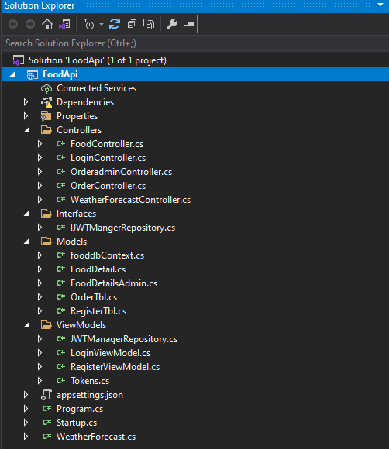
Models & Controllers

Slide 6
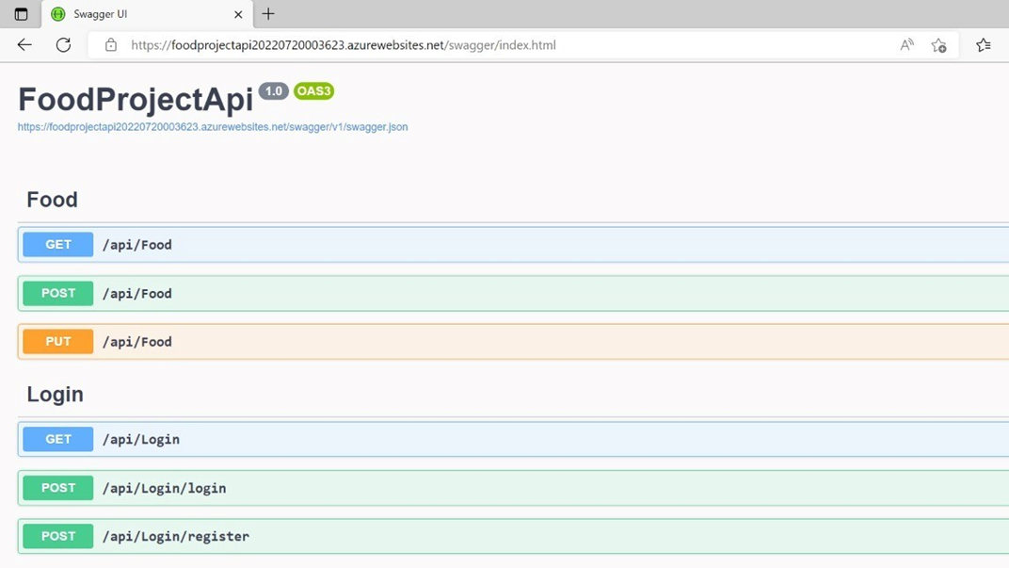
Swagger

Slide 7
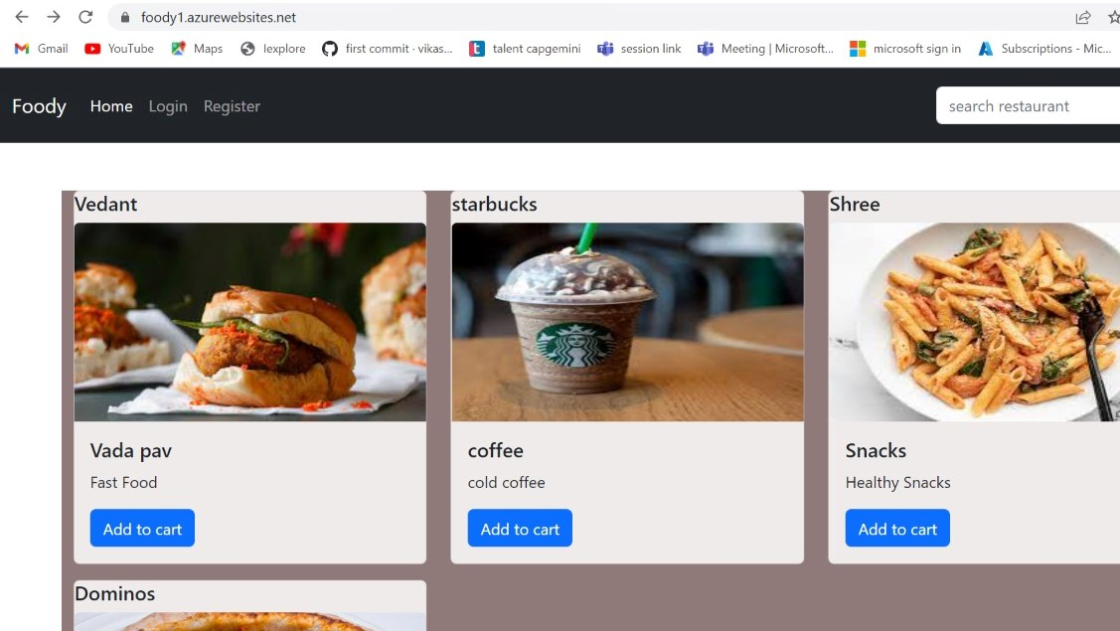
Home Page

Slide 8
Contribution
Snehal Ganorkar Database & Azure
Sneha Chamlewad SQL server azure
Mitali Aherrao backend & azure deployment
Arati Rananaware Angular & Filezilla
Ketki Kulkarni Logic app

Slide 9
Thank You

