Slide 1
Titanic: Machine Learning for disaster management GROUP MEMBERS: KETKI MATKAR PRATIKSHA LOHARE VRUSHALI PAWAR PROJECT GUIDE: AUDUMBAR UMBARE PANEL MEMBERS: AUDUMBAR UMBARE RANDEEP KAHLON

Slide 2
Introduction
RMS Titanic was a British passenger liner that started it's journey with 2200 passenger and four days later sank in the North Atlantic Ocean in the early morning of 15th April 1912. Around 1500 people died and 700 survived the tragedy.
According to encyclopedia titanic of the 712 survivors 500 were passenger (369-women & children,131-men)and 212 were crew (20- women , 192-men).

Slide 3
Problem statement
Hypothesis : Certain source claim that the survivors belonged to one of the following categories - women, children and upper class.
Our problems to confirm if this hypothesis is true or not using the given sample of 342 survivors data and derive conclusion using different models in PYTHON
.

Slide 4
Two data sets have to be imported which are:
training set (train.csv) - building ml models
test set (test.csv) - predict the outcomes

Slide 5
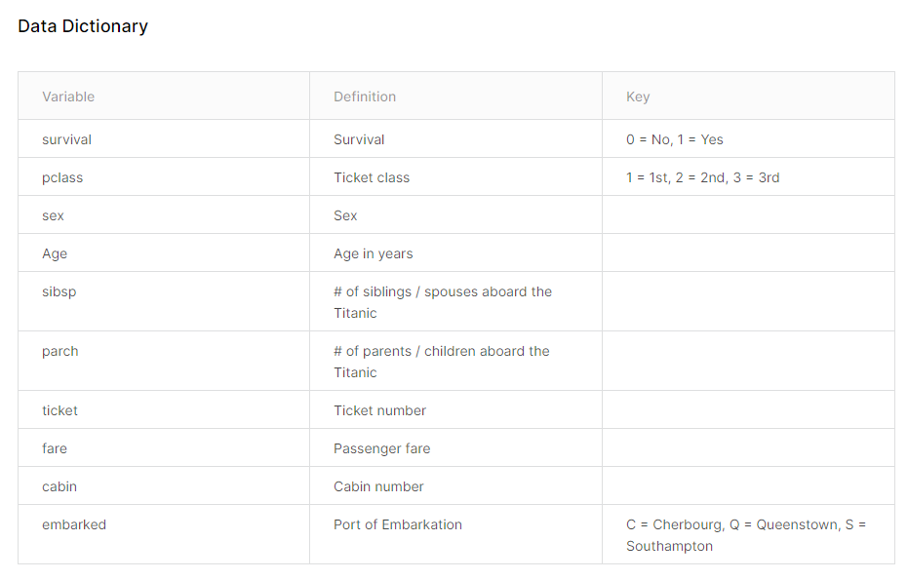

Slide 6
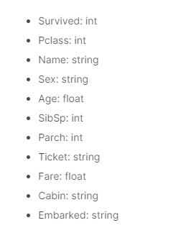
DATA TYPES OF VARIABLES IN DATA-SET

Slide 7

WORKING OF THE PROJECT

Slide 8
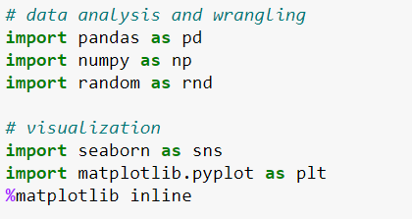
STAGE 1: IMPORTING LIBRARY

Slide 9

STAGE 2: LOADING DATA-SET

Slide 10
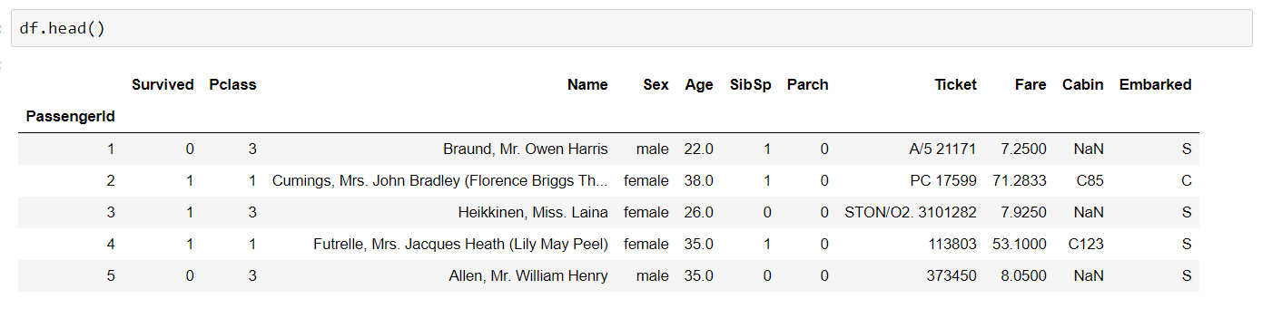
STAGE 3: DISPLAYING DATA-SET

Slide 11
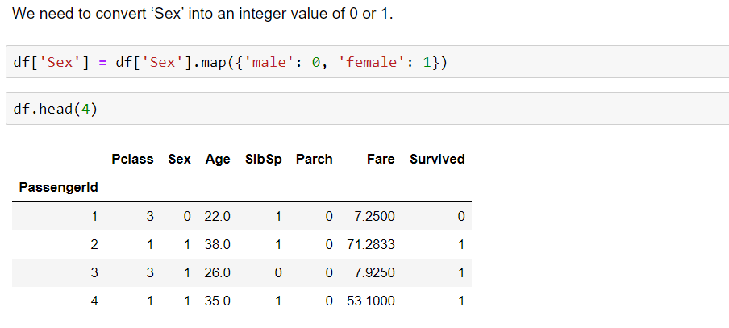
STAGE 4: CONVERSION OF VARIABLES INTO NUMERIC

Slide 12
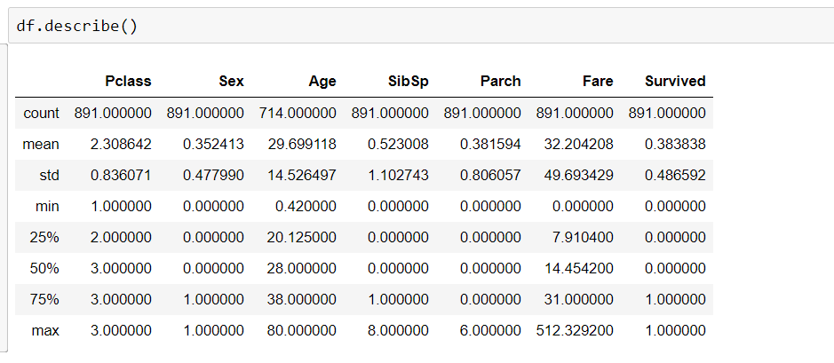
STAGE 5: SHOWING STATISTICAL DETAILS

Slide 13
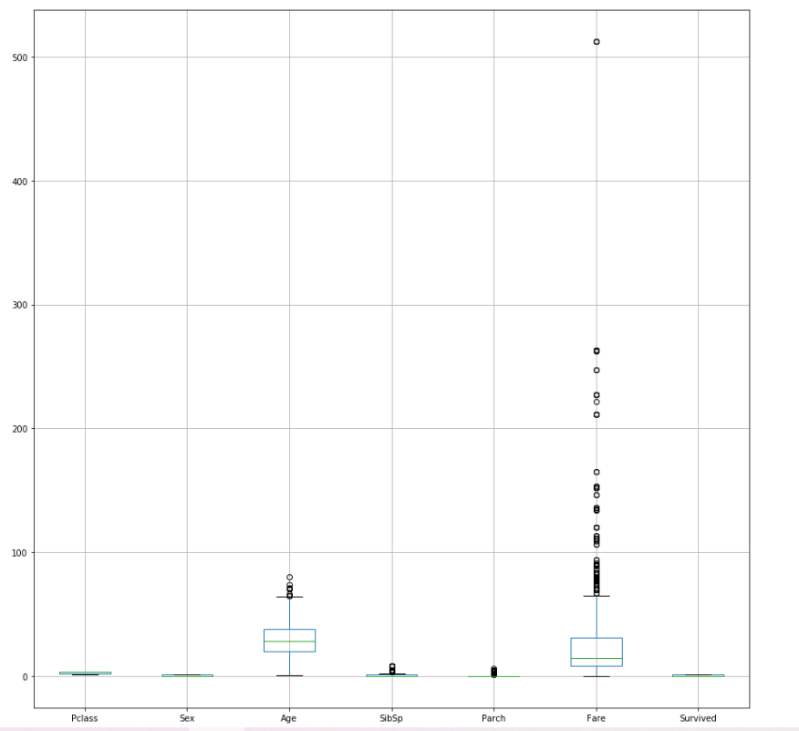
STAGE 6: BOX PLOT visualization

Slide 14
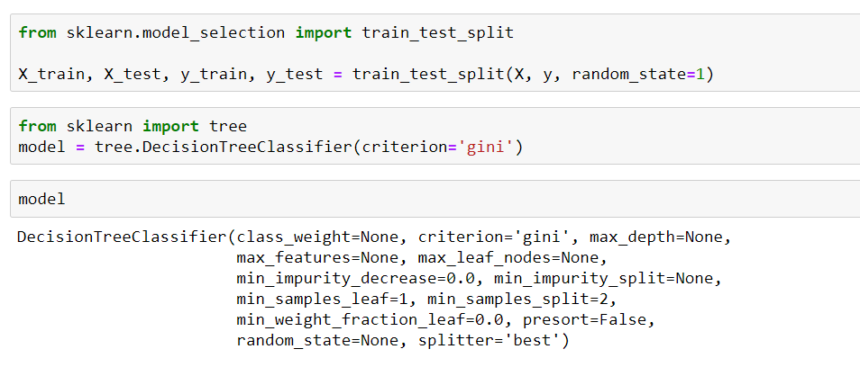
STAGE 7: developing ml model choosing decision tree

Slide 15
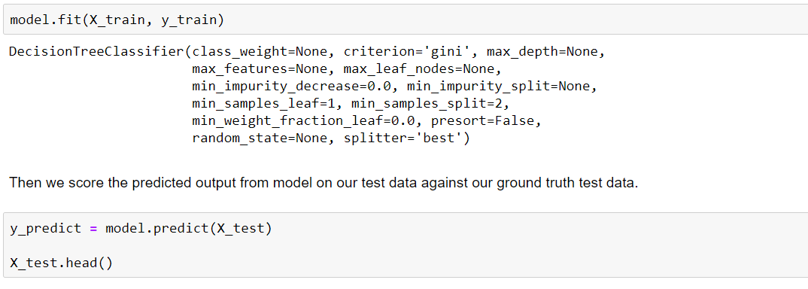
STAGE 8: training ml model

Slide 16
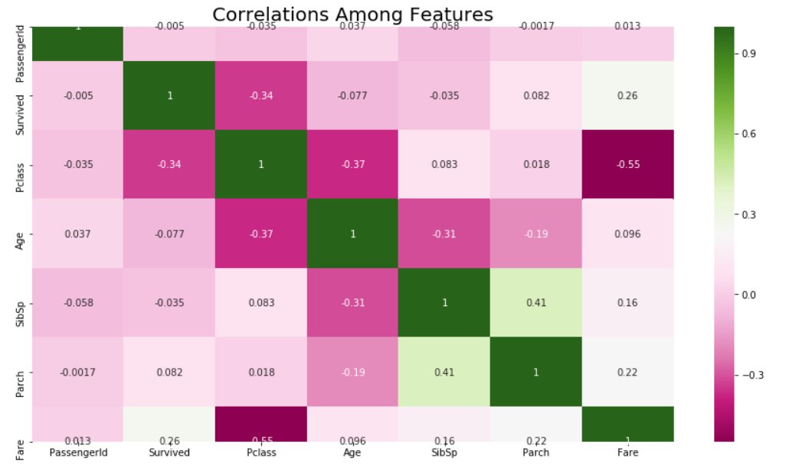
STAGE 9: CORRELATION ANALYSIS

Slide 17
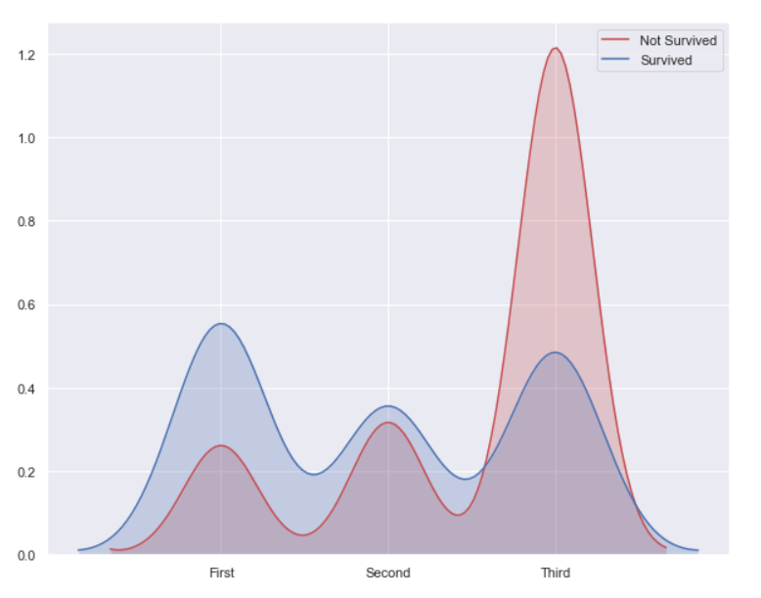

Slide 18
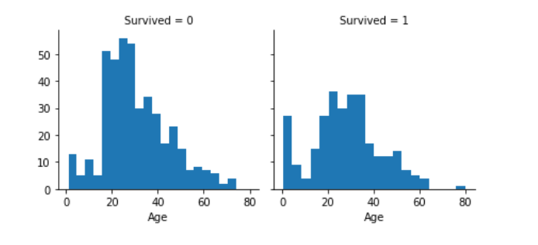

Slide 19
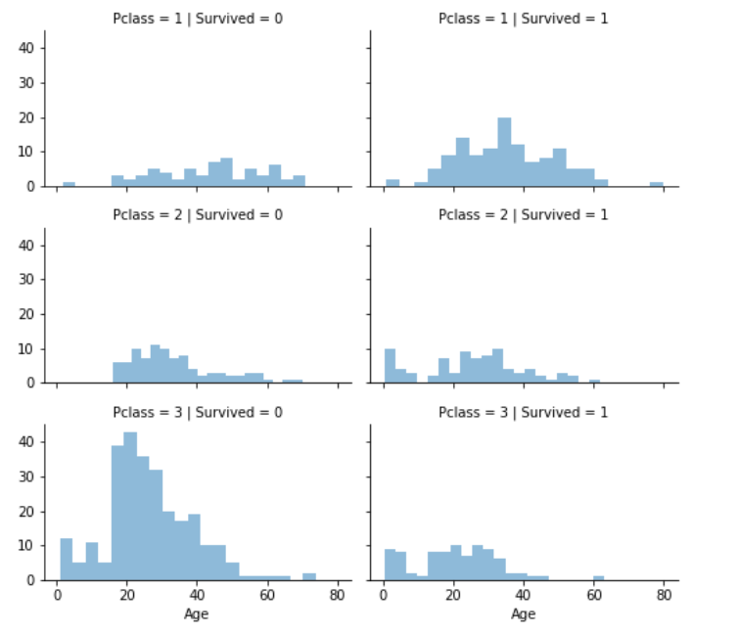

Slide 20
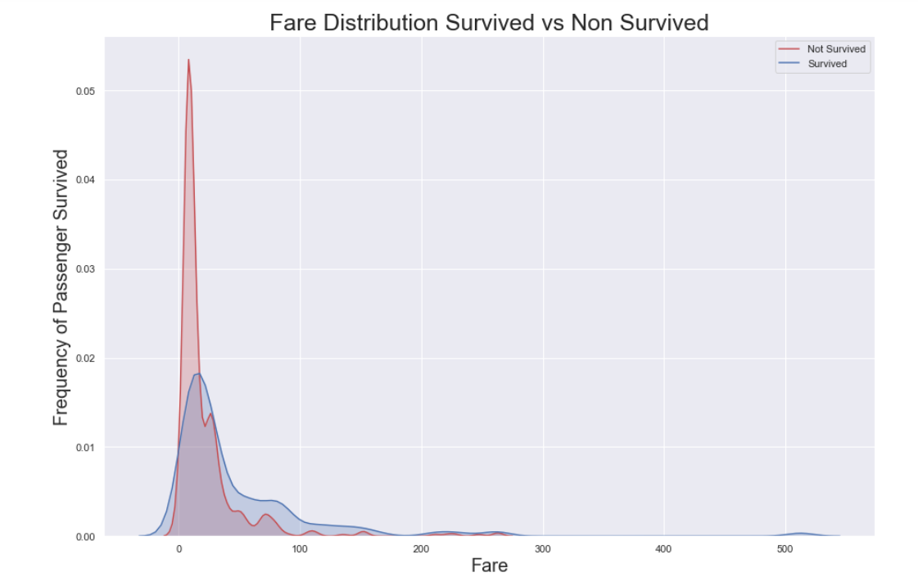

Slide 21
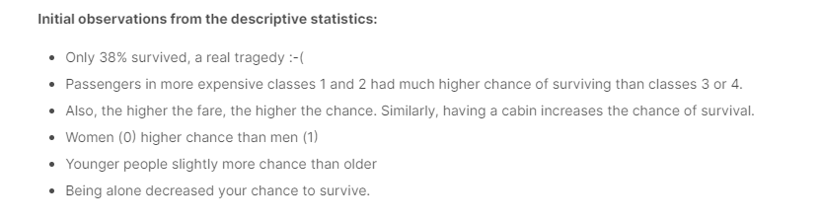
STAGE 10: visualizing data

Slide 22
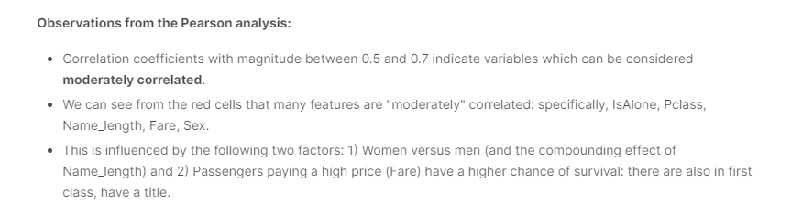

Slide 23
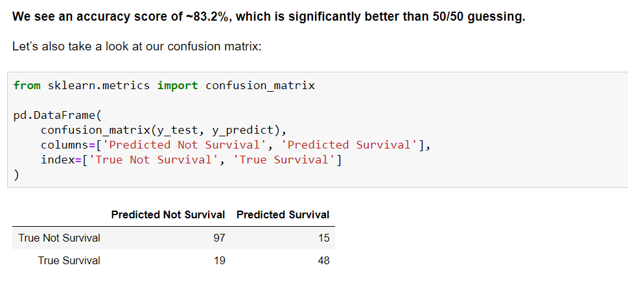

Slide 24
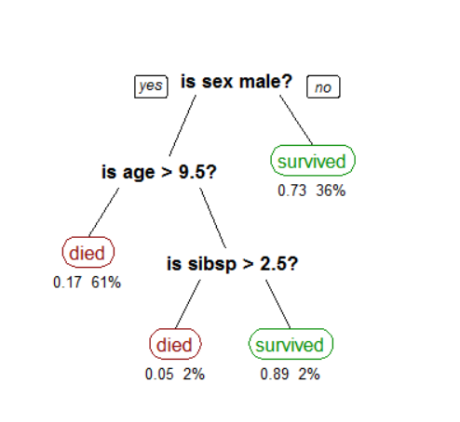
STAGE 11: decision tree

Slide 25
ADVANTAGES
It can be used in future for developing strategies in natural or man-made disaster.
Helpful in reducing losses.
Predictions are very accurate.
Results obtained are according to the trained ML model.
Early Signs of Disaster can be detected.
Very simple for users to handle the system.

Slide 26
Conclusion
The user friendly interface allows for rapid testing different models once the requirements of the datasets are met.
Random Forest model highlights the importance of predictors Sex, Pclass, Fare and Age.
After analyzing all the models we can conclude that predictors Sex, Pclass, Age did played a major role for Titanic survivors.

Slide 27
Thank you so much

