Slide 1
Day 01
EGFR Radiomics Mini Bootcamp
Mo ta du lieu va Table 1
Doc dung cau truc cohort demo
Lap Table 1 ngan gon
Ve ba bieu do co ban
Doc duoc bon con so mo ta dau tien
Bo du lieu demo
So benh nhan 200
Ty le EGFR dot bien 45.5 phan tram
Tuoi trung binh 60.4
Kich thuoc u trung vi 35.5 mm
San pham sau buoi hoc
table1_overall.csv
table1_by_egfr.csv
hist_age.png
boxplot_tumor_size_by_egfr.png
bar_sex.png
Notes:
[Sources] - Demo data data/nsclc_egfr_radiomics_simplified.csv - Notebook book/day01.ipynb

Slide 2
Day 01
EGFR Radiomics Mini Bootcamp
Logic cua buoi 1
Biet so dong va so cot truoc khi tinh toan
Tach bien lam sang va bien radiomics
Tong hop bang mo ta cho toan cohort
Nhin hinh de xem du lieu phan bo ra sao
Code mo du lieu
1 df = read_csv_demo('nsclc_egfr_radiomics_simplified.csv') 2 df.shape 3 df.columns.tolist()[:12]
Code tach nhom bien
1 clinical_cols = ['age', 'sex', 'smoking_status', 'histology', 'stage', 'tumor_size_mm', 'tumor_volume_cm3', 'tp53_mutation'] 2 intra_cols = [c for c in df.columns if c.startswith('intra_')] 3 ring1_cols = [c for c in df.columns if c.startswith('ring1_')]
Notes:
[Sources] - Notebook book/day01.ipynb

Slide 3
Day 01
EGFR Radiomics Mini Bootcamp
Code tao Table 1
Code chinh
Chi so | Gia tri
So benh nhan | 200.0
Tuoi trung binh | 60.4
Do lech chuan tuoi | 14.0
Ty le EGFR dot bien | 45.5
Kich thuoc u trung vi | 35.6
1 table1_overall = pd.DataFrame([ 2 ['So benh nhan', len(df)], 3 ['Tuoi trung binh', round(df['age'].mean(), 1)], 4 ['Do lech chuan tuoi', round(df['age'].std(ddof=1), 1)], 5 ['Ty le EGFR dot bien', round(df['egfr_mutation'].mean() * 100, 1)], 6 ['Kich thuoc u trung vi', round(df['tumor_size_mm'].median(), 1)] 7 ], columns=['Chi so', 'Gia tri'])
Cach doc bang
Chi can chot lai bon con so de hoc sinh noi duoc mo ta cohort.
200 benh nhan
45.5 phan tram EGFR dot bien
60.4 tuoi
35.6 mm
Notes:
[Sources] - Demo data data/nsclc_egfr_radiomics_simplified.csv - Output book/_static/results/day01/table1_overall.csv

Slide 4
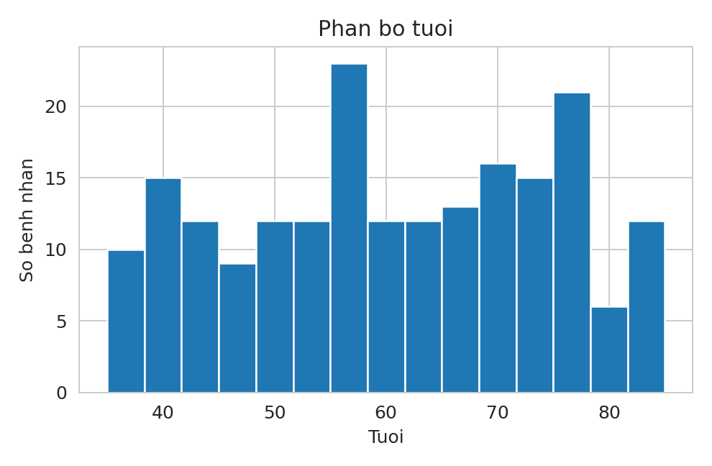
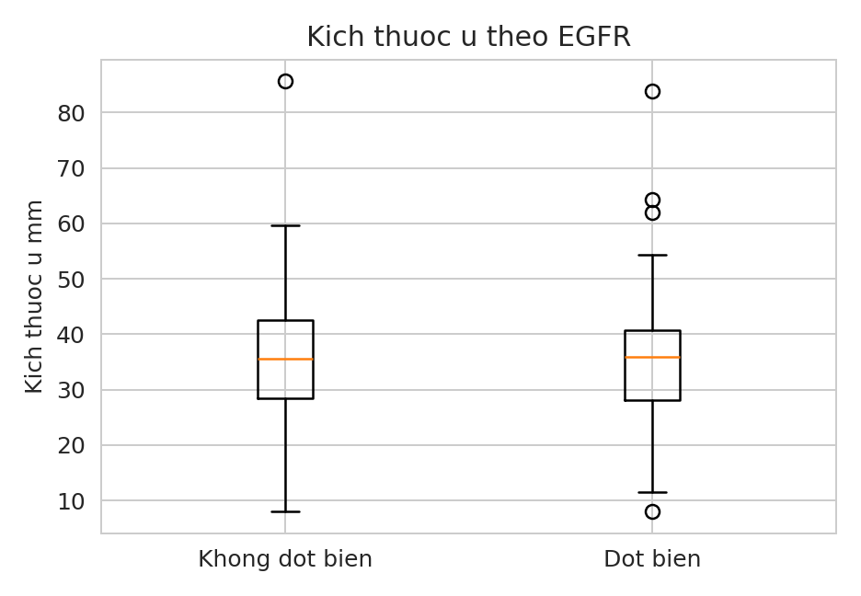
Day 01
EGFR Radiomics Mini Bootcamp
Ket qua demo cua buoi 1
Doc hinh nhu the nao
Nhieu tuoi tap trung quanh 50 den 75.
Kich thuoc u hai nhom co giao nhau.
Buoi nay chi mo ta du lieu.
Chua duoc ket luan ve du doan.
Notes:
[Sources] - Output book/_static/results/day01/hist_age.png - Output book/_static/results/day01/boxplot_tumor_size_by_egfr.png

Slide 5
Day 01
EGFR Radiomics Mini Bootcamp
Tu mo ta du lieu sang cau van ngan
Doan van mau
Cohort demo co 200 benh nhan. Ty le EGFR dot bien la 45.5 phan tram. Tuoi trung binh la 60.4 va kich thuoc u trung vi la 35.5 mm.
Noi duoc 4 con so chinh la du
Khong dien giai qua muc o buoi 1
Mang file csv va png sang Day 05
Chuyen sang Day 02 de nhin hieu nang mo hinh
Checklist cuoi buoi
Da co 2 bang
Da co 3 hinh
Da biet cot dich la egfr_mutation
Da biet cac nhom bien
Notes:
[Sources] - Notebook book/day01.ipynb

