Slide 1
Day 02
EGFR Radiomics Mini Bootcamp
Hieu nang mo hinh va so sanh ROI
Dung mot pipeline ro rang cho tat ca ROI
So sanh intra va ring1 ring3 ring5
Doc ROC AUC va confusion matrix
Chon ROI tot nhat de sang Day 03
Ket qua chot cua demo
ROI tot nhat la ring1
AUC cua ring1 0.815
Intra thap hon ro
ROI | AUC | Sensitivity | Specificity | TN | FP | FN | TP
ring1 | 0.815 | 0.391 | 0.778 | 21 | 6 | 14 | 9
ring3 | 0.747 | 0.522 | 0.852 | 23 | 4 | 11 | 12
ring5 | 0.747 | 0.435 | 0.815 | 22 | 5 | 13 | 10
intra | 0.694 | 0.391 | 0.852 | 23 | 4 | 14 | 9
Notes:
[Sources] - Demo data data/nsclc_egfr_radiomics_simplified.csv - Output book/_static/results/day02/roi_performance_table.csv

Slide 2
Day 02
EGFR Radiomics Mini Bootcamp
Pipeline cua buoi 2
Dien gia tri thieu
Chuan hoa bien so
One hot cho bien phan loai
Logistic regression o cuoi
Code chinh
1 def make_pipe(X): 2 cat = [c for c in X.columns if X[c].dtype == 'object'] 3 num = [c for c in X.columns if c not in cat] 4 pre = ColumnTransformer([ 5 ('num', Pipeline([('imp', SimpleImputer(strategy='median')), ('scale', StandardScaler())]), num), 6 ('cat', Pipeline([('imp', SimpleImputer(strategy='most_frequent')), ('onehot', OneHotEncoder(handle_unknown='ignore'))]), cat) 7 ]) 8 return Pipeline([('pre', pre), ('model', LogisticRegression(max_iter=1000))])
Vì sao dung mot pipeline
Moi ROI phai duoc xu ly bang cung mot cach.
Luc do bang AUC moi co the so sanh cong bang.
Notes:
[Sources] - Notebook book/day02.ipynb

Slide 3
Day 02
EGFR Radiomics Mini Bootcamp
Code chay tung ROI
Code vong lap
ROI | AUC | Sensitivity | Specificity | TN | FP | FN | TP
ring1 | 0.815 | 0.391 | 0.778 | 21 | 6 | 14 | 9
ring3 | 0.747 | 0.522 | 0.852 | 23 | 4 | 11 | 12
ring5 | 0.747 | 0.435 | 0.815 | 22 | 5 | 13 | 10
intra | 0.694 | 0.391 | 0.852 | 23 | 4 | 14 | 9
1 for name, cols in feature_sets.items(): 2 X = df[cols].copy() 3 pipe = make_pipe(X) 4 X_train, X_test, y_train, y_test = train_test_split( 5 X, y, test_size=0.25, random_state=42, stratify=y 6 ) 7 pipe.fit(X_train, y_train) 8 prob = pipe.predict_proba(X_test)[:, 1] 9 auc = roc_auc_score(y_test, prob)
Y canh bang
Bang nay du de hoc sinh doc AUC, sensitivity, specificity.
Khong can them nhieu thuat ngu hon.
Notes:
[Sources] - Notebook book/day02.ipynb - Output book/_static/results/day02/roi_performance_table.csv

Slide 4
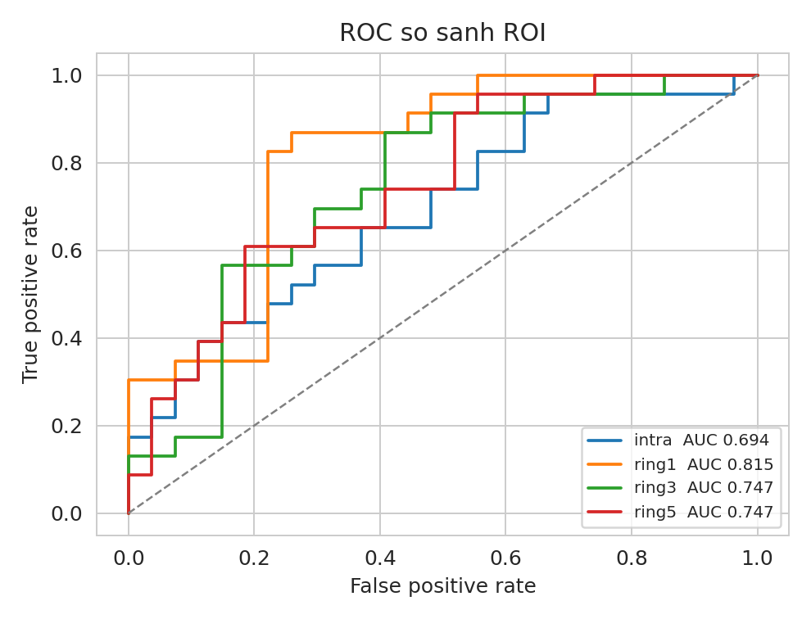
Day 02
EGFR Radiomics Mini Bootcamp
Ket qua demo ROC
Doc hinh
Ring1 la duong nam cao hon trong bo demo.
Do khong co nghia la ring1 se luon dung voi moi bo du lieu.
Vi vay Day 03 phai kiem tra do on dinh.
Notes:
[Sources] - Output book/_static/results/day02/roc_compare_roi.png

Slide 5
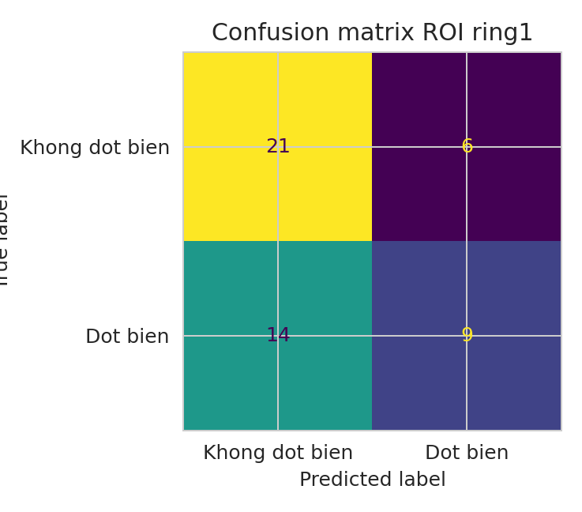
Day 02
EGFR Radiomics Mini Bootcamp
Ket qua demo confusion matrix
Cau noi can nho
AUC dung de so sanh tong quat.
Confusion matrix giup nhin sai o dau.
Hai thu nay nen doc cung nhau.
Ring1 giu lai cho buoi sau
Kiem tra CV va bootstrap
Khong ket luan chi bang mot lan chia du lieu
Notes:
[Sources] - Output book/_static/results/day02/confusion_ring1.png

