Slide 1
Day 03
EGFR Radiomics Mini Bootcamp
Do on dinh va leakage
Tinh AUC theo 5 fold
Tinh bootstrap CI
Xem leakage lam dep ket qua the nao
Noi ket qua than trong hon
Ba con so can nho
Mean AUC cua 5 fold 0.810
Bootstrap CI thap 0.686
Bootstrap CI cao 0.925
Y chinh
Khong doc AUC nhu mot con so co dinh.
Phai xem no dao dong ra sao.
Notes:
[Sources] - Output book/_static/results/day03/cv_auc_table.csv - Output book/_static/results/day03/bootstrap_auc_values.csv

Slide 2
Day 03
EGFR Radiomics Mini Bootcamp
Code cross validation
Code chinh
Fold | AUC
1 | 0.747
2 | 0.833
3 | 0.785
4 | 0.778
5 | 0.909
1 cv = StratifiedKFold(n_splits=5, shuffle=True, random_state=42) 2 cv_scores = cross_val_score(pipe, X, y, cv=cv, scoring='roc_auc') 3 4 cv_table = pd.DataFrame({ 5 'Fold': [1, 2, 3, 4, 5], 6 'AUC': np.round(cv_scores, 3) 7 })
Diem can noi
Neu cac fold chenh nhau qua nhieu thi can canh giac.
O bo demo nay cac fold chua qua vach nhau.
Notes:
[Sources] - Notebook book/day03.ipynb - Output book/_static/results/day03/cv_auc_table.csv

Slide 3
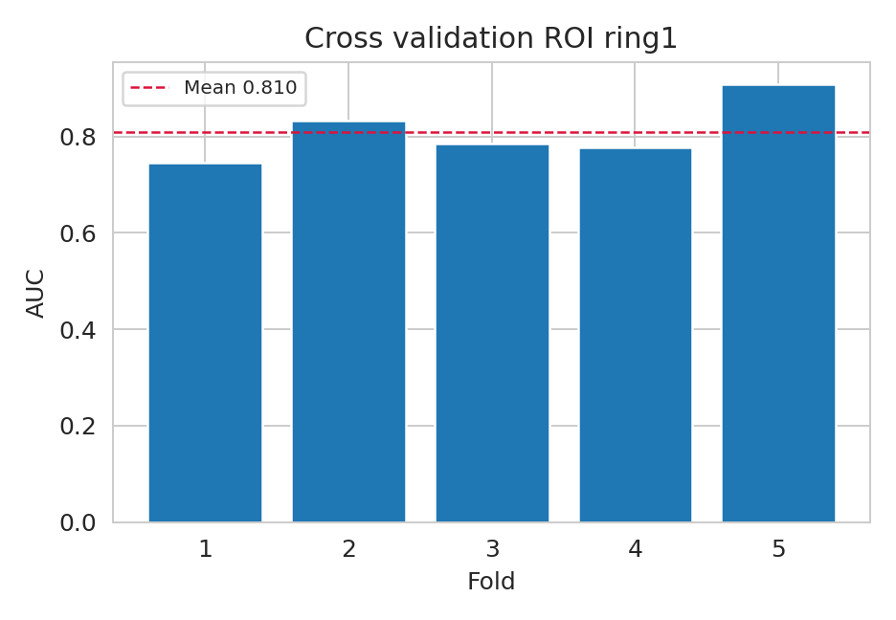
Day 03
EGFR Radiomics Mini Bootcamp
Ket qua demo CV
Cach doc hinh
Duong ngang la mean AUC.
Hoc sinh chi can nhin fold nao cao thap bat thuong.
Muc tieu la biet ket qua co dao dong hay khong.
Notes:
[Sources] - Output book/_static/results/day03/cv_auc_bar.png

Slide 4
Day 03
EGFR Radiomics Mini Bootcamp
Code bootstrap va leakage
Code bootstrap
Cach tinh | Mean AUC
Dung pipeline trong CV | 0.81
Scale truoc roi moi CV | 0.774
1 boot_aucs = [] 2 for _ in range(2000): 3 idx = rng.integers(0, len(y_test_reset), len(y_test_reset)) 4 y_boot = y_test_reset.iloc[idx] 5 p_boot = prob[idx] 6 if y_boot.nunique() < 2: 7 continue 8 boot_aucs.append(roc_auc_score(y_boot, p_boot)) 9 10 ci_low, ci_high = np.quantile(boot, [0.025, 0.975])
Leakage demo
Scale truoc roi moi CV la cach lam sai.
Ket qua co the dep hon thuc te.
Notes:
[Sources] - Notebook book/day03.ipynb - Output book/_static/results/day03/leakage_demo.csv

Slide 5
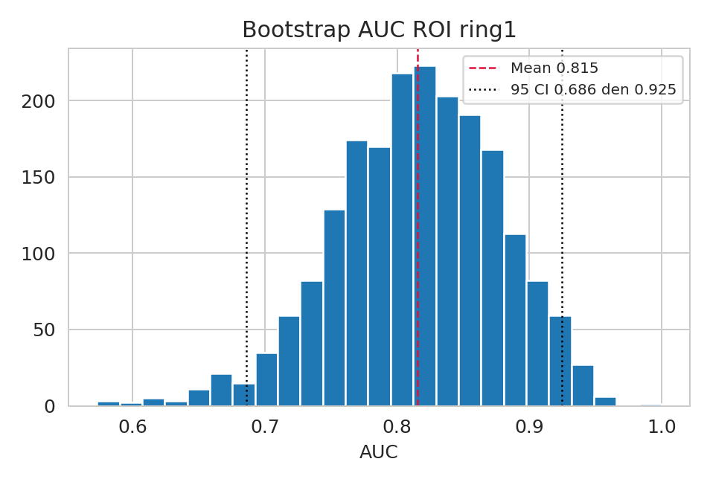
Day 03
EGFR Radiomics Mini Bootcamp
Ket qua demo bootstrap
Cau chot
Bootstrap cho 95 CI tu 0.686 den 0.925.
Noi dieu nay se thuyet phuc hon la chi noi AUC.
Khong noi mot con so duy nhat
Noi them CV va bootstrap
Bao ve ket qua vung hon
Notes:
[Sources] - Output book/_static/results/day03/bootstrap_auc_hist.png

