Slide 1
Day 04
EGFR Radiomics Mini Bootcamp
Delta P theo pathway NGS
Ghep predicted probability voi subset NGS
Tinh delta median P va delta mean P
Ve bar chart va boxplot
Doc ket qua theo huong sinh hoc
Ket qua demo
Pathway noi bat la PI3K
Delta median P 0.232
Pathway | n_mut | Median P mut | Median P wt | Delta median P | Mean P mut | Mean P wt | Delta mean P | p value
PI3K | 24 | 0.596 | 0.364 | 0.232 | 0.576 | 0.395 | 0.181 | 0.028
DNA_repair | 19 | 0.489 | 0.404 | 0.085 | 0.536 | 0.432 | 0.104 | 0.37
Cell_cycle | 24 | 0.498 | 0.418 | 0.08 | 0.47 | 0.459 | 0.011 | 0.851
Notes:
[Sources] - Demo data data/ngs_pathway_demo_64.csv - Output book/_static/results/day04/pathway_delta_table.csv

Slide 2
Day 04
EGFR Radiomics Mini Bootcamp
Code fit mo hinh va ghep NGS
Code chinh
1 X = df[ring1_cols].copy() 2 y = df['egfr_mutation'].astype(int) 3 pipe = make_pipe(X) 4 pipe.fit(X, y) 5 df['pred_prob_ring1'] = pipe.predict_proba(X)[:, 1] 6 ngs2 = ngs.merge(df[['patient_id', 'pred_prob_ring1']], on='patient_id', how='left')
Y nghia
Buoi nay dung predicted probability nhu mot bien lien tuc.
Sau do moi so sanh giua nhom co va khong co pathway.
Code delta
1 for pw in ['pathway_RTK_RAS', 'pathway_PI3K', 'pathway_DNA_repair', 'pathway_Cell_cycle', 'pathway_TP53']: 2 mut = ngs2.loc[ngs2[pw] == 1, 'pred_prob_ring1'] 3 wt = ngs2.loc[ngs2[pw] == 0, 'pred_prob_ring1'] 4 delta_median = mut.median() - wt.median()
Notes:
[Sources] - Notebook book/day04.ipynb

Slide 3
Day 04
EGFR Radiomics Mini Bootcamp
Bang ket qua va cach doc
Pathway | n_mut | Median P mut | Median P wt | Delta median P | Mean P mut | Mean P wt | Delta mean P | p value
PI3K | 24 | 0.596 | 0.364 | 0.232 | 0.576 | 0.395 | 0.181 | 0.028
DNA_repair | 19 | 0.489 | 0.404 | 0.085 | 0.536 | 0.432 | 0.104 | 0.37
Cell_cycle | 24 | 0.498 | 0.418 | 0.08 | 0.47 | 0.459 | 0.011 | 0.851
RTK_RAS | 22 | 0.442 | 0.434 | 0.008 | 0.467 | 0.461 | 0.006 | 0.961
TP53 | 28 | 0.386 | 0.435 | -0.049 | 0.44 | 0.481 | -0.041 | 0.68
Cach doc bang
Neu delta median P duong va lon hon thi xac suat du doan o nhom do thuong cao hon.
PI3K dang dung dau trong bo demo.
Diem can nho
Day la phan bo sung de doc tinh hieu sinh hoc.
Khong thay the danh gia hieu nang mo hinh.
Notes:
[Sources] - Output book/_static/results/day04/pathway_delta_table.csv

Slide 4
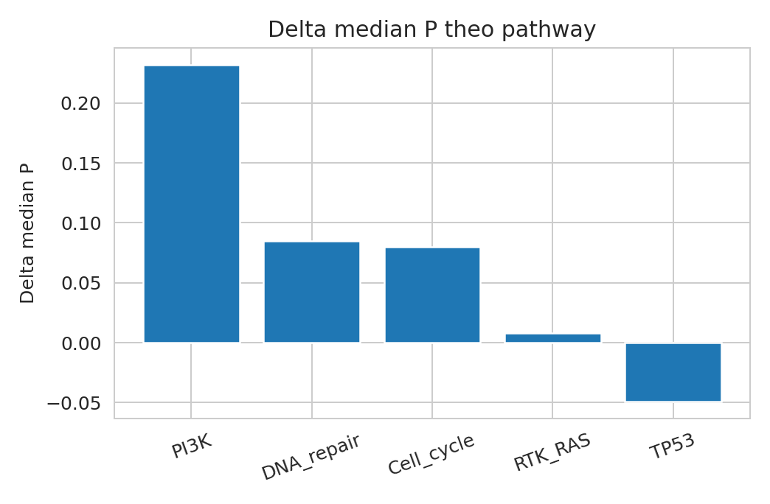
Day 04
EGFR Radiomics Mini Bootcamp
Ket qua demo bar chart
Cach noi gon
PI3K co cot cao nhat.
Delta median P dat 0.232.
Vi vay Day 04 co the noi rang PI3K la pathway noi bat nhat trong bo demo.
Notes:
[Sources] - Output book/_static/results/day04/delta_median_pathway.png

Slide 5
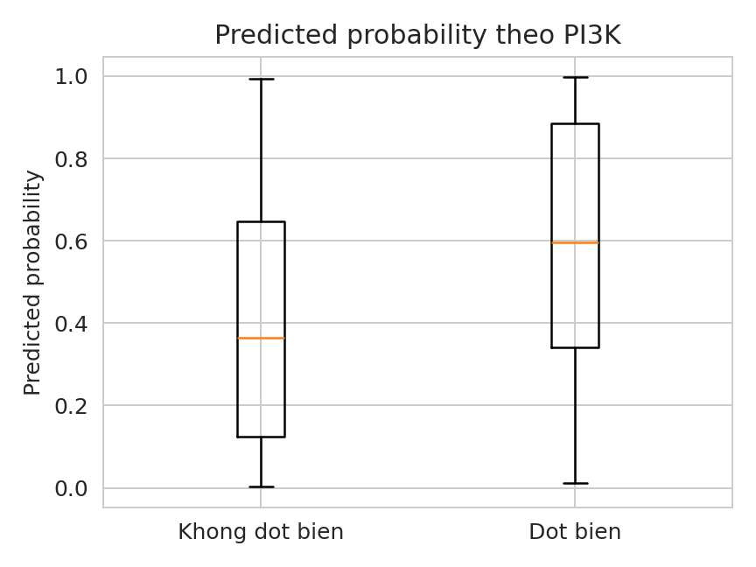
Day 04
EGFR Radiomics Mini Bootcamp
Ket qua demo boxplot PI3K
Nhieu diem cua nhom dot bien nam cao hon
Do giao nhau van con nen khong duoc noi qua muc
Doc ket qua theo huong goi y sinh hoc
Cau chot
Day la mot tang dien giai them cho phan ring1.
No giup hoc sinh noi duoc vi sao co phan NGS trong bao cao.
Notes:
[Sources] - Output book/_static/results/day04/boxplot_pi3k.png

