Slide 1
Day 05
Ghep ket qua thanh bo output cuoi
Doc lai output cua bon buoi truoc
Chon cac con so can noi
Viet doan tom tat ngan
Tao bo file cuoi de nop
Bon y can noi
Cohort 200 benh nhan
AUC ring1 0.815
Mean AUC 5 fold 0.810
PI3K delta median P 0.232
Notes:
[Sources] - Output book/_static/results/day05/summary_demo.txt

Slide 2
Day 05
Code doc lai output
Code
1 day01_overall = pd.read_csv(base_results / 'day01' / 'table1_overall.csv') 2 day02_roi = pd.read_csv(base_results / 'day02' / 'roi_performance_table.csv') 3 day03_cv = pd.read_csv(base_results / 'day03' / 'cv_auc_table.csv') 4 day03_boot = pd.read_csv(base_results / 'day03' / 'bootstrap_auc_values.csv') 5 day04_pathway = pd.read_csv(base_results / 'day04' / 'pathway_delta_table.csv')
Y chinh
Buoi 5 khong them thuat toan moi.
Buoi 5 day cach gom ket qua thanh cau chuyen ngan gon.
Notes:
[Sources] - Notebook book/day05.ipynb

Slide 3
Day 05
Code viet doan tom tat
Code
Doan van demo
1 summary_day05 = ( 2 f'Cohort demo co {n_patient} benh nhan va ty le EGFR dot bien la {egfr_rate:.1f} phan tram. ' 3 f'Trong lan chia minh hoa, ROI {best_roi} dat AUC {best_auc:.3f}. ' 4 f'Cross validation 5 fold cho mean AUC {cv_mean:.3f} va bootstrap 95 CI tu {ci_low:.3f} den {ci_high:.3f}. ' 5 f'Trong subset NGS, {top_pathway} co delta median P {top_delta:.3f}.' 6 )
Cohort demo co 200 benh nhan. Ty le EGFR dot bien la 45.5 phan tram. Trong lan chia minh hoa, ROI ring1 dat AUC 0.815 va cao hon intra. Cross validation 5 fold cho mean AUC 0.810. Bootstrap 95 CI tu 0.686 den 0.925. Trong subset NGS 64 benh nhan, PI3K co delta median P 0.232.
Notes:
[Sources] - Notebook book/day05.ipynb - Output book/_static/results/day05/summary_demo.txt

Slide 4
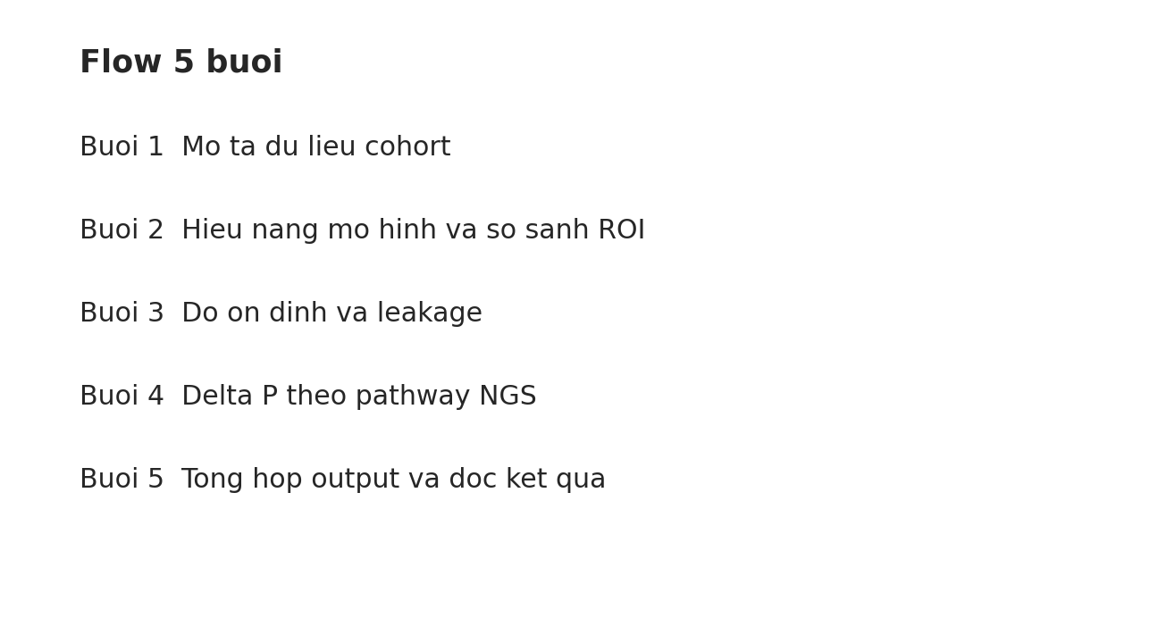
Day 05
Ket qua demo
Buoi 1 cohort
Buoi 2 AUC va ROI
Buoi 3 CV va bootstrap
Buoi 4 pathway
Buoi 5 summary va output
Y nghia
Hoc sinh nhin hinh nay se thay duoc toan bo flow cua bao cao.
Khi noi bai co the bam theo dung 5 buoc nay.
Notes:
[Sources] - Output book/_static/results/day05/flow_5days.png

Slide 5
Day 05
Checklist cuoi khoa
Biet doc Table 1
Biet doc ROC va confusion matrix
Biet vi sao phai xem CV va bootstrap
Biet delta median P la gi
Biet ghep ket qua thanh doan tom tat
Bo file cuoi
key_numbers_table.csv
summary_demo.txt
flow_5days.png
report_roi_table.csv
report_pathway_table.csv
Muc tieu cua website
Hoc sinh khong can thuoc tung dong code.
Can hieu doan code do tao ra bang gi va hinh gi.
Notes:
[Sources] - Notebook book/day05.ipynb

