Slide 1
SUPPLY CHAIN MANAGEMENT DASHBOARD
Tools: Power BI Desktop , Excel
Technologies: business Analyst
Project no: 5 UNID: UMIP17528

Slide 2
Introduction
Supply chain analytics is a valuable part of data-driven decision-making in various industries such as
manufacturing, retail, healthcare, and logistics. It is the process of collecting, analyzing and interpreting
data related to the movement of products and services from suppliers to customers.
Task: Analyze Product Performance and Supply Chain Efficiency

Slide 3
Dataset Overview
dataset we collected from a Fashion and Beauty startup. The dataset is based on the supply chain of Makeup products. Below are all the features in the dataset:
● Product Type
● SKU
● Price
● Availability
● Number of products sold
● Revenue generated
● Customer demographics
● Stock levels
● Lead times
● Order quantities
● Shipping times
● Shipping carriers
● Shipping costs
● Supplier name
● Location
● Lead time
● Production volumes
● Manufacturing lead time
● Manufacturing costs
● Inspection results
● Defect rates
● Transportation modes
● Routes
● Costs

Slide 4




Product Performance Dashboard
Product t…
V
Defect rates by Product type
Average of Price
cosmetics
haircare
skincare
₹ 577.6K
Sum of Revenue generated
4777
Sum of Stock levels
Power BI Desktop
21.91%
Product type
skincare
haircare
41.01%
37.08%
cosmetics
₹ 49.4625
₹ 1.7
₹ 99.1713
Revenue Analysis
Price and Product type
₹ 0.2M
haircare
cosmetics
skincare
10
₹ 0.1M
5
0
0
20
40
60
80
100
₹ 0.0M
Price
skincare
haircare
Product type
cosmetics
Stock levels and Product type
Products sold by Product type
Product type skincare haircare
cosmetics
haircare
skincare
cosmetics
Percentage of Total sold
40%
10
20%
5
0%
skincare
haircare
Product type
cosmetics
0
0
20
40
60
Stock levels
80
100

Slide 5
Product t…
V
Defect rates by Product type
Average of Price
cosmetics
haircare
skincare
₹ 577.6K
Sum of Revenue generated
4777
Sum of Stock levels
Power BI Desktop
21.91%
Product type
skincare
haircare
41.01%
37.08%
cosmetics
₹ 49.4625
₹ 1.7
₹ 99.1713
Revenue Analysis
Price and Product type
₹ 0.2M
haircare
cosmetics
skincare
10
₹ 0.1M
5
0
0
20
40
60
80
100
₹ 0.0M
Price
skincare
haircare
Product type
cosmetics
Stock levels and Product type
Products sold by Product type
Product type skincare haircare
cosmetics
haircare
skincare
cosmetics
Percentage of Total sold
40%
10
20%
5
0%
skincare
haircare
Product type
cosmetics
0
0
20
40
60
Stock levels
80
100

Slide 6
Product t…
V
Defect rates by Product type
Average of Price
cosmetics
haircare
skincare
₹ 577.6K
Sum of Revenue generated
4777
Sum of Stock levels
Power BI Desktop
Product type
skincare
haircare
21.91%
Cards showing total Revenue Generated and total Stock levels
41.01%
37.08%
cosmetics
₹ 49.4625
₹ 1.7
₹ 99.1713
Revenue Analysis
Price and Product type
₹ 0.2M
haircare
cosmetics
skincare
10
5
Bar chart of revenue of each Product type
₹ 0.1M
0
0
20
40
60
80
100
₹ 0.0M
Price
skincare
haircare
Product type
cosmetics
Stock levels and Product type
Products sold by Product type
Product type skincare haircare
cosmetics
haircare
skincare
cosmetics
Percentage of Total sold
40%
10
Bar chart Product sold for each type
20%
5
0%
skincare
haircare
Product type
cosmetics
0
0
20
40
60
Stock levels
80
100

Slide 7
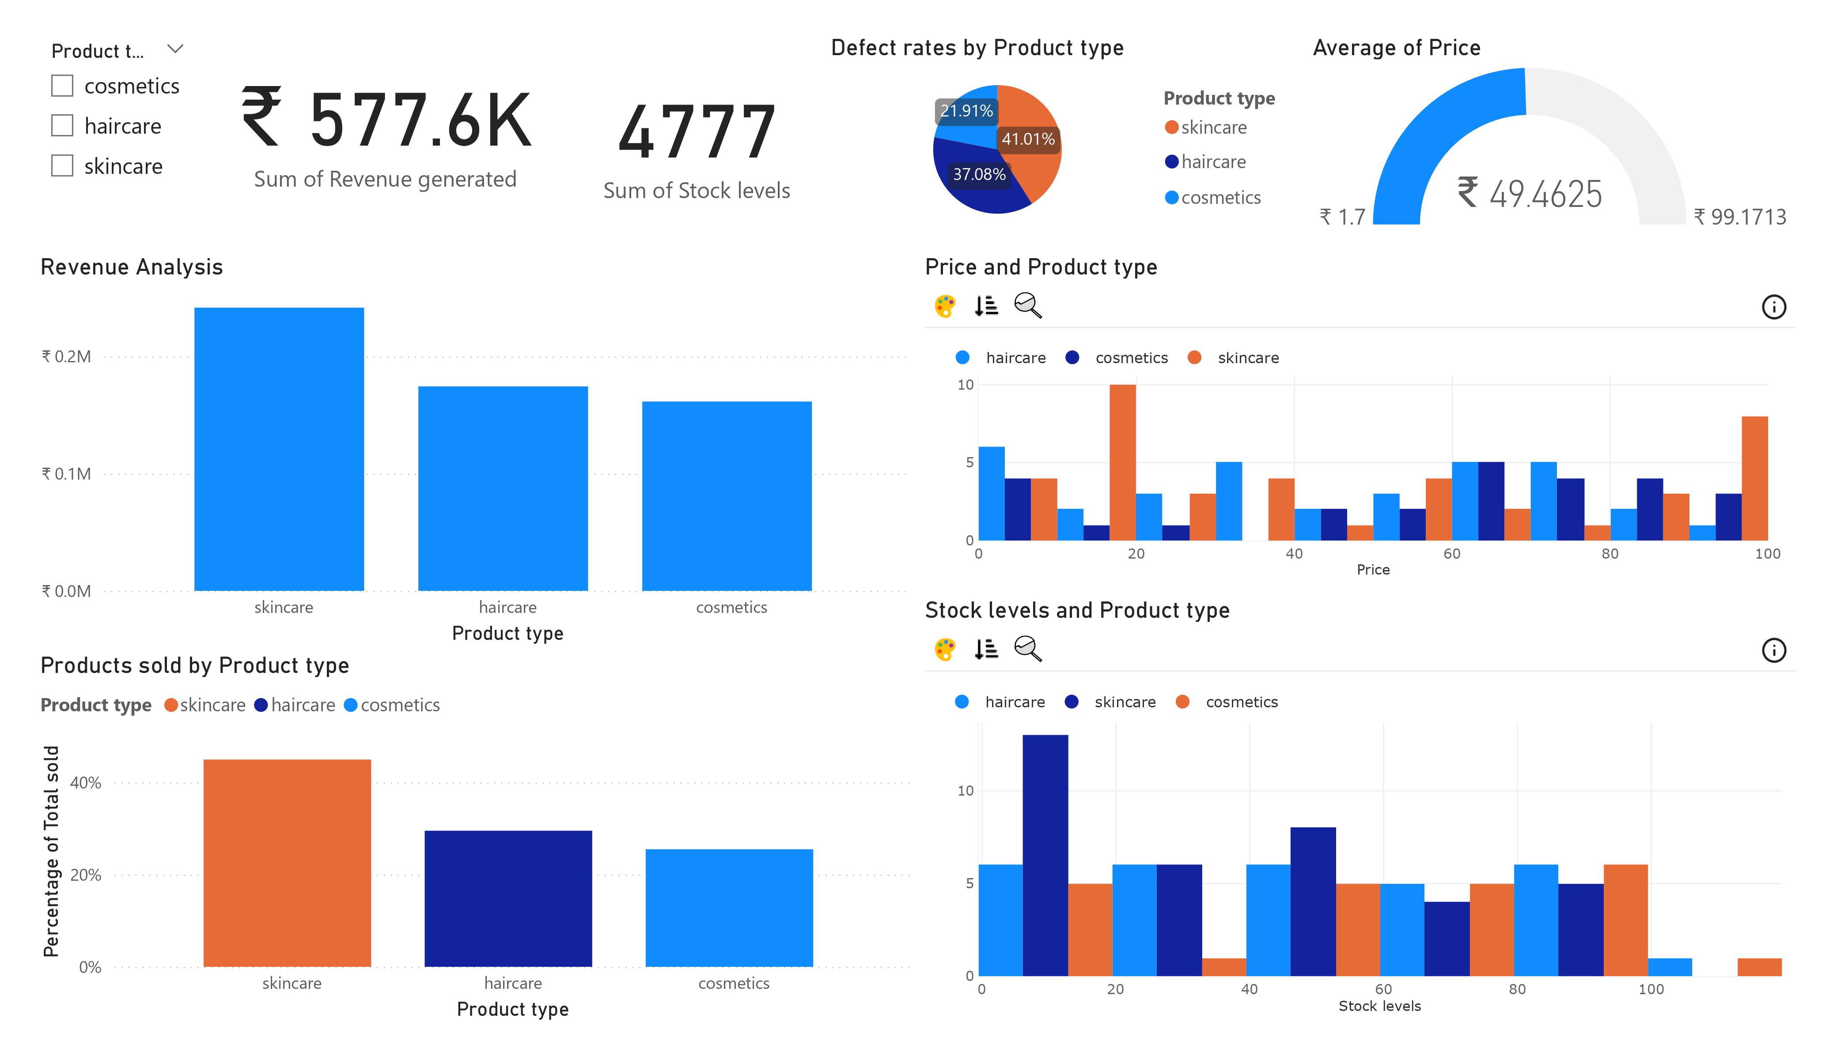
Product t…
V
Defect rates by Product type
Average of Price
cosmetics
haircare
skincare
₹ 577.6K
Sum of Revenue generated
4777
Sum of Stock levels
Power BI Desktop
21.91%
Product type
skincare
haircare
41.01%
37.08%
cosmetics
₹ 49.4625
₹ 1.7
₹ 99.1713
Revenue Analysis
Price and Product type
₹ 0.2M
haircare
cosmetics
skincare
10
₹ 0.1M
5
Slicer to filter dashboard on Product types
0
0
20
40
60
80
100
₹ 0.0M
Price
skincare
haircare
Product type
cosmetics
Stock levels and Product type
Products sold by Product type
Product type skincare haircare
cosmetics
haircare
skincare
cosmetics
Percentage of Total sold
40%
10
20%
5
0%
skincare
haircare
Product type
cosmetics
0
0
20
40
60
Stock levels
80
100

Slide 8
Product t…
V
Defect rates by Product type
Average of Price
cosmetics
haircare
skincare
₹ 577.6K
Sum of Revenue generated
4777
Sum of Stock levels
Power BI Desktop
21.91%
Product type
skincare
haircare
A pie chart which shows defeat raids of prototypes and Gauge Indicator showing average price with minimum and maximum
41.01%
37.08%
cosmetics
₹ 49.4625
₹ 1.7
₹ 99.1713
Revenue Analysis
Price and Product type
₹ 0.2M
haircare
cosmetics
skincare
10
Chart of Price Distribution of each product type
₹ 0.1M
5
0
0
20
40
60
80
100
₹ 0.0M
Price
skincare
haircare
Product type
cosmetics
Stock levels and Product type
Products sold by Product type
Product type skincare haircare
cosmetics
haircare
skincare
cosmetics
Percentage of Total sold
40%
10
Histogram of Stock Levels with each Product type
20%
5
0%
skincare
haircare
Product type
cosmetics
0
0
20
40
60
Stock levels
80
100

Slide 9
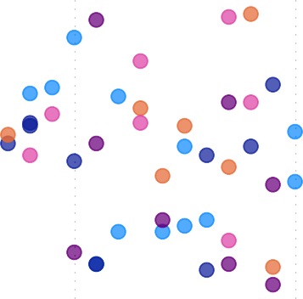


Supply Chain Efficiency Dashboard
2.28
Power BI Desktop
Location
V
Supplier name
V
567.84
14.77
All
V
All
V
Average of Defect rates
Average of Production volumes Average of Manufacturing lead time
Defect rates by Location
Average Shipping costs by Shipping carriers and Lead Times vs. Order Quantities: Location
14.68% (14.68%)
Supplier name Supplier 1 Supplier 2
100
Supplier 3
Supplier 4
25.09% (25.09%)
Location Bangalore Chennai Delhi Kolkata Mumbai
Location
Kolkata
Chennai Mumbai
Bangalore Delhi
16.55% (16.5…)
Shipping carriers
Carrier C
Order quantities
Carrier A
50
Carrier B
20.50% (20.5%)
23.17%
(23.17%)
₹ 0
₹ 10 ₹ 20
Average of Shipping costs
₹ 30
0
0
10
20
30
Lead times
Manufacturing Efficiency:
Average of Production volumes
Average of Production volumes
800
867.00
894.00
849.00
685.00
750.00
739.00
742.67
691.00
702.50
600
605.00
640.67
671.00
644.80
661.50
545.40
535.00
564.80
589.00
596.86
499.67
474.67
476.00
518.25
465.67
516.33
480.25
487.75
400
374.60
404.75
408.00
200
0
5
10
15
Manufacturing lead time
20
25
30

Slide 10
2.28
Power BI Desktop
Location
V
Supplier name
V
567.84
14.77
All
V
All
V
Average of Defect rates
Average of Production volumes Average of Manufacturing lead time
Defect rates by Location
Average Shipping costs by Shipping carriers and Lead Times vs. Order Quantities: Location
14.68% (14.68%)
Supplier name Supplier 1 Supplier 2
100
Supplier 3
Supplier 4
25.09% (25.09%)
Location Bangalore Chennai Delhi Kolkata Mumbai
Location
Kolkata
Chennai Mumbai
Bangalore Delhi
16.55% (16.5…)
Shipping carriers
Carrier C
Order quantities
Carrier A
50
Carrier B
20.50% (20.5%)
23.17%
(23.17%)
₹ 0
₹ 10 ₹ 20
Average of Shipping costs
₹ 30
0
0
10
20
30
Lead times
Manufacturing Efficiency:
Average of Production volumes
Average of Production volumes
800
867.00
894.00
849.00
685.00
750.00
739.00
742.67
691.00
702.50
600
605.00
640.67
671.00
644.80
661.50
545.40
535.00
564.80
589.00
596.86
499.67
474.67
476.00
518.25
465.67
516.33
480.25
487.75
400
374.60
404.75
408.00
200
0
5
10
15
Manufacturing lead time
20
25
30

Slide 11
2.28
Power BI Desktop
Location
V
Supplier name
V
567.84
14.77
All
V
All
V
Average of Defect rates
Average of Production volumes Average of Manufacturing lead time
Defect rates by Location
Average Shipping costs by Shipping carriers and Lead Times vs. Order Quantities: Location
14.68% (14.68%)
Supplier name Supplier 1 Supplier 2
100
Supplier 3
Supplier 4
25.09% (25.09%)
Location Bangalore Chennai Delhi Kolkata Mumbai
Chart of Manufacturing efficiency shows Average Productions Variation with manufacturing lead time
Location
Kolkata
Chennai Mumbai
Bangalore Delhi
16.55% (16.5…)
Shipping carriers
Carrier C
Order quantities
Carrier A
50
Carrier B
20.50% (20.5%)
23.17%
(23.17%)
₹ 0
₹ 10 ₹ 20
Average of Shipping costs
₹ 30
0
0
10
20
30
Lead times
Manufacturing Efficiency:
Average of Production volumes
Average of Production volumes
800
867.00
894.00
849.00
685.00
750.00
739.00
742.67
691.00
702.50
600
605.00
640.67
671.00
644.80
661.50
545.40
535.00
564.80
589.00
596.86
499.67
474.67
476.00
518.25
465.67
516.33
480.25
487.75
400
374.60
404.75
408.00
200
0
5
10
15
Manufacturing lead time
20
25
30

Slide 12
2.28
Power BI Desktop
Location
V
Supplier name
V
567.84
14.77
All
V
All
V
Average of Defect rates
Average of Production volumes Average of Manufacturing lead time
Defect rates by Location
Average Shipping costs by Shipping carriers and Lead Times vs. Order Quantities: Location
14.68% (14.68%)
Supplier name Supplier 1 Supplier 2
100
Supplier 3
Supplier 4
25.09% (25.09%)
Location Bangalore Chennai Delhi Kolkata Mumbai
Location
Kolkata
Chennai Mumbai
Bangalore Delhi
16.55% (16.5…)
Shipping carriers
Carrier C
Order quantities
Slicer to filter data according to location and supplier name
Carrier A
50
A card displaying average defect rates
A Card displaying average production volume
Carrier B
A Card displaying average manufacturing lead time
20.50% (20.5%)
23.17%
(23.17%)
₹ 0
₹ 10 ₹ 20
Average of Shipping costs
₹ 30
0
0
10
20
30
Lead times
Manufacturing Efficiency:
Average of Production volumes
Average of Production volumes
800
867.00
894.00
849.00
685.00
750.00
739.00
742.67
691.00
702.50
600
605.00
640.67
671.00
644.80
661.50
545.40
535.00
564.80
589.00
596.86
499.67
474.67
476.00
518.25
465.67
516.33
480.25
487.75
400
374.60
404.75
408.00
200
0
5
10
15
Manufacturing lead time
20
25
30

Slide 13
2.28
Power BI Desktop
Location
V
Supplier name
V
567.84
14.77
All
V
All
V
Average of Defect rates
Average of Production volumes Average of Manufacturing lead time
Defect rates by Location
Average Shipping costs by Shipping carriers and Lead Times vs. Order Quantities: Location
14.68% (14.68%)
Supplier name Supplier 1 Supplier 2
100
Supplier 3
Supplier 4
25.09% (25.09%)
Location Bangalore Chennai Delhi Kolkata Mumbai
Location
Kolkata
Chennai Mumbai
Bangalore Delhi
16.55% (16.5…)
Shipping carriers
Carrier C
Order quantities
Carrier A
50
Carrier B
20.50% (20.5%)
23.17%
(23.17%)
₹ 0
₹ 10 ₹ 20
Average of Shipping costs
₹ 30
0
0
10
20
30
Lead times
Manufacturing Efficiency:
Average of Production volumes
A bar chart displaying shipping cost varying according to shipping carriers and locations
867.00
894.00
Pie chart of defect varying on location
Average of Production volumes
800
Scatter chart displaying correlation between lead times and order quantities
849.00
685.00
750.00
739.00
742.67
691.00
702.50
600
605.00
640.67
671.00
644.80
661.50
545.40
535.00
564.80
589.00
596.86
499.67
474.67
476.00
518.25
465.67
516.33
480.25
487.75
400
374.60
404.75
408.00
200
0
5
10
15
Manufacturing lead time
20
25
30

Slide 14
Average of Revenue generated by Customer
Female Male
Customer Demographics
Power BI Desktop
Customer demographics by Location
15 (15%)
25 (25%)
Location
Kolkata
Mumbai Chennai
Bangalore Delhi
18 (18%)
₹ 6.46K
₹ 6.03K
Unknown
Non-binary
22 (22%)
20 (20%)
₹ 5.58K
₹ 5.06K

Slide 15
Average of Revenue generated by Customer
Female Male
Customer demographics by Location
Power BI Desktop
15 (15%)
25 (25%)
Location
Kolkata
Mumbai Chennai
Bangalore Delhi
18 (18%)
₹ 6.46K
₹ 6.03K
Unknown
Non-binary
22 (22%)
20 (20%)
₹ 5.58K
₹ 5.06K

Slide 16
Average of Revenue generated by Customer
Female Male
Customer demographics by Location
Power BI Desktop
15 (15%)
25 (25%)
Treemap for visualising average revenue generated by customer identity
Location
Kolkata
Mumbai Chennai
Bangalore Delhi
18 (18%)
₹ 6.46K
₹ 6.03K
Unknown
Non-binary
22 (22%)
20 (20%)
₹ 5.58K
₹ 5.06K

Slide 17
Average of Revenue generated by Customer
Female Male
Customer demographics by Location
Power BI Desktop
A pie chart visualising custom demographics by location
15 (15%)
25 (25%)
Location
Kolkata
Mumbai Chennai
Bangalore Delhi
18 (18%)
₹ 6.46K
₹ 6.03K
Unknown
Non-binary
22 (22%)
20 (20%)
₹ 5.58K
₹ 5.06K

Slide 18
Analysis Questions:
Which Product Type generates the highest revenue?
Are there any significant correlations between Lead times and Order quantities?
How do Shipping costs vary by Shipping carrier and Location?
Which suppliers have the most efficient manufacturing processes based on Manufacturing lead time and Production volumes?
What demographic group contributes the most to sales?

Slide 19
Which Product Type generates the highest revenue?
The product type skin care generated over 200K revenue

Slide 20
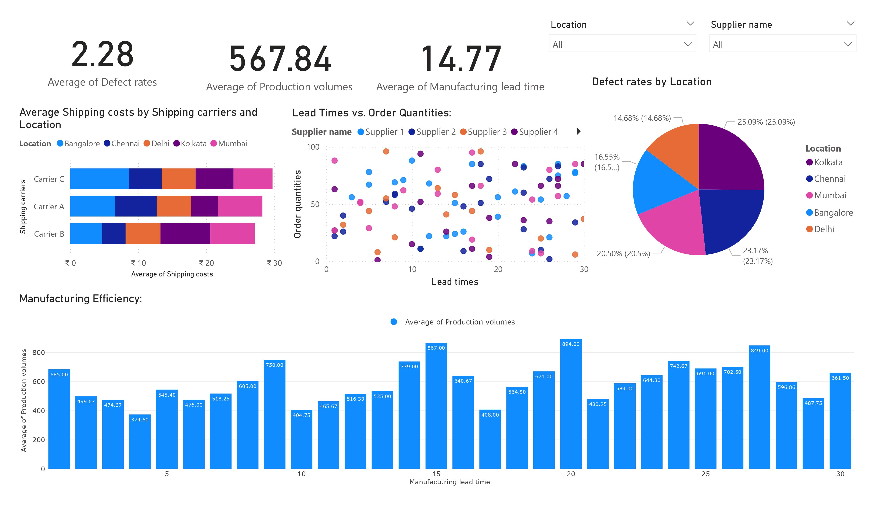
Are there any significant correlations between Lead times and Order quantities ?
After visualising scattered graph of lead times and order quantities result shows there is no effective correlations between them but as we can see there is small correlation when order quantities are above 50

Slide 21
How do Shipping costs vary by Shipping carrier and Location?
We can see on horizontal bar graph carrier C have highest average shipping cost in Bangalore And carrier B have second high average shipping cost in Kolkata And in location Mumbai all three carriers have maintained average of ₹6

Slide 22
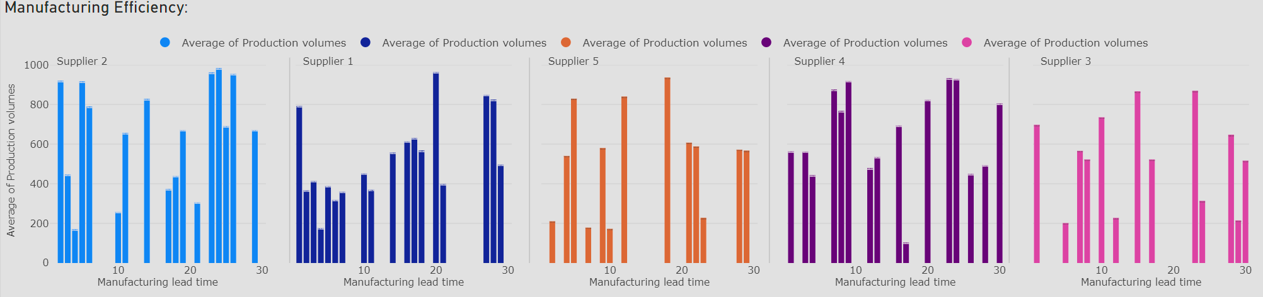
Which suppliers have the most efficient manufacturing processes based on Manufacturing lead time and Production volumes?
From above visual we can see the supply 5 have worst manufacturing process and All others supplier have maintained efficient manufacturing process

Slide 23
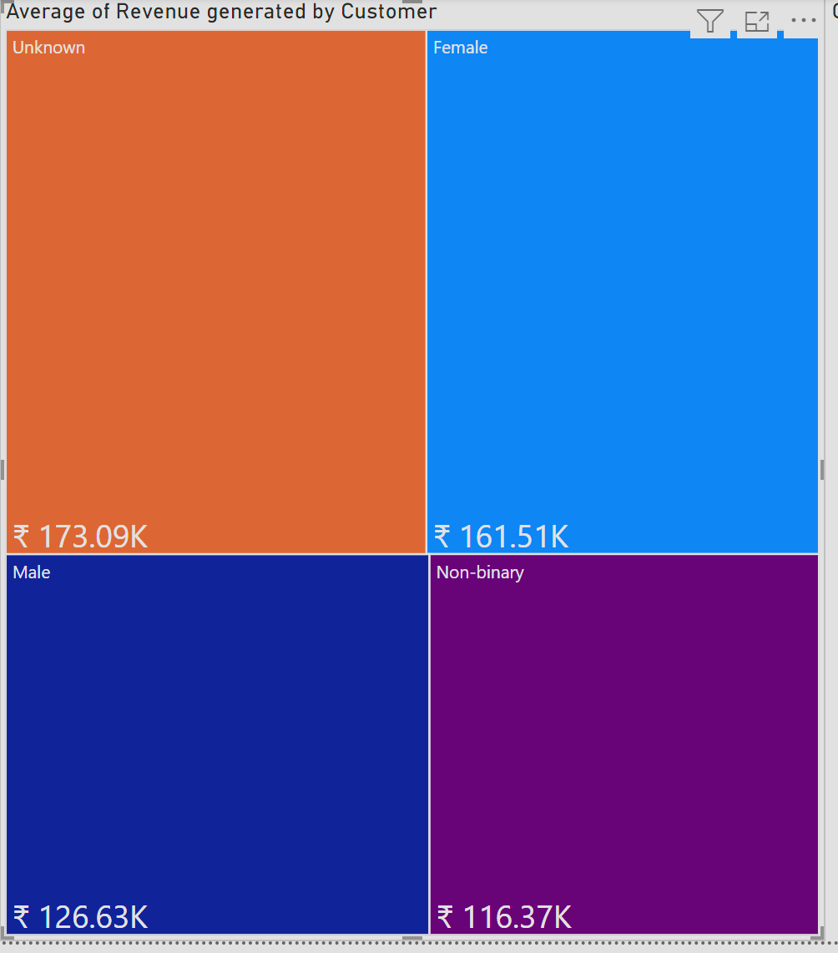
What demographic group contributes the most to sales?
According to data the unknown identity customers have generated over 170K Revenue followed by female customers which have generated 160K

