Slide 1
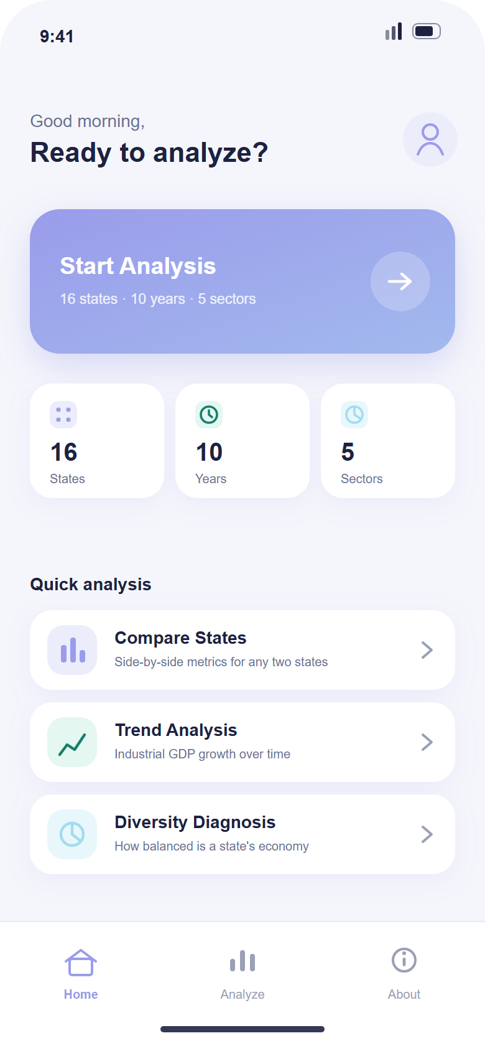
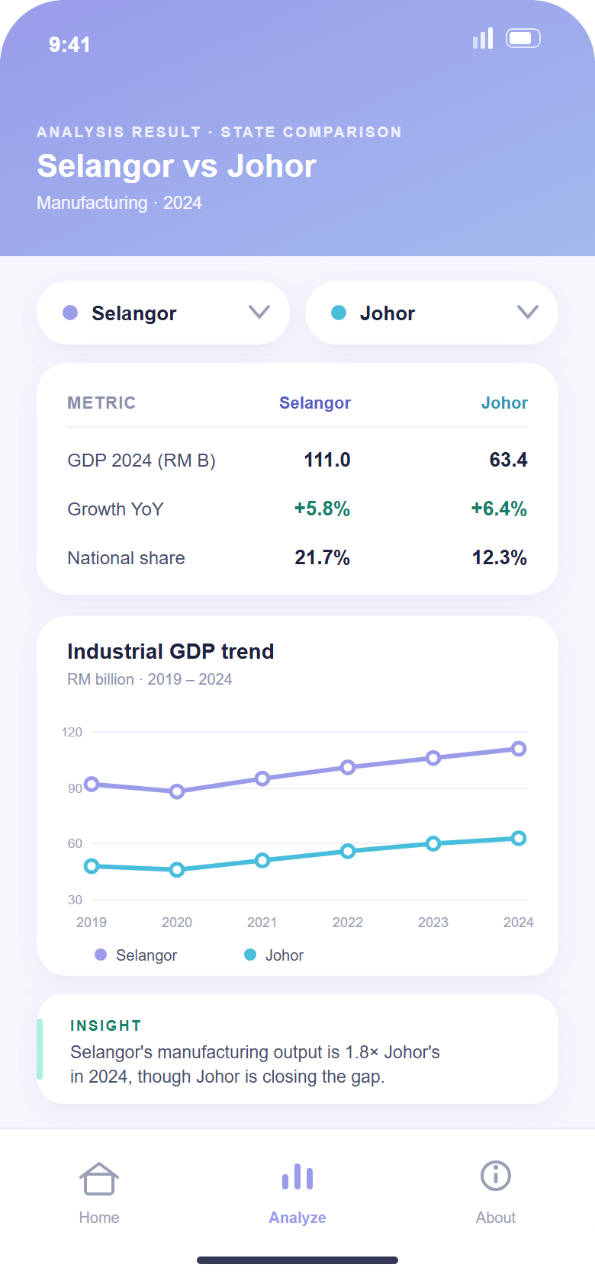
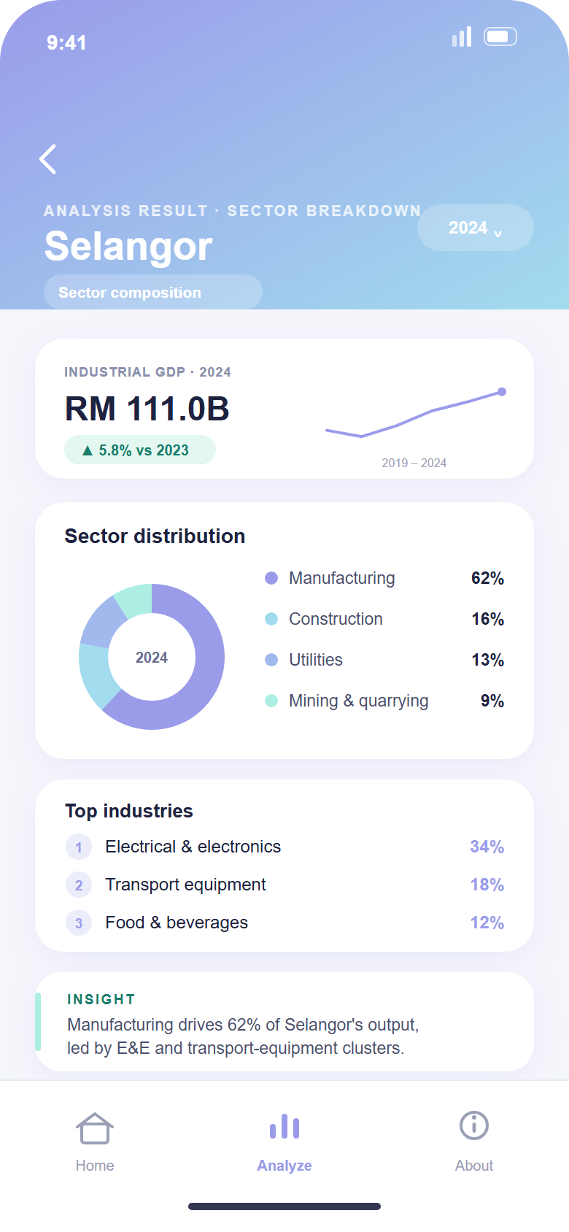
MOBILE APP PROTOTYPE · SDG 9
Industrial GDP
Analyzer
A mobile-first way to explore and compare Malaysia's GDP by state and by economic sector, one chart and one plain sentence at a time.
GROUP MEMBERS
Lam Yong Zhe
Fong Qin Wen
Lai Kang Yong
Lian Teck Wei
2508318
2511719
2508316
2508325

Slide 2
01 · PROJECT BACKGROUND
Introduction
1
Compare across Malaysia
2
One chart, one sentence
Explore and compare GDP by state and by economic sector in one place.
Pick a mode, the states and a sector; get a single chart with a plain-language takeaway.
3
Aligned with SDG 9
4
Official open data
Focused on industrial and manufacturing GDP, linked to Industry, Innovation and Infrastructure.
Every figure comes from data.gov.my, the government's official open-data portal.
Industrial GDP Analyzer · data.gov.my
01 / 06

Slide 3
02 · PROBLEM & SOLUTION
From official reports to a self-service app
PROBLEM
SOLUTION
Built for desktop websites and long PDF reports.
Rebuilt as a mobile-first app for the same official data.
Fixed views — users can't mix states, sectors and years.
Tap filter chips to combine states, sector and year; every choice returns a valid result.
Full of technical terms, hard for an ordinary person to read.
Each answer is one chart plus one plain sentence, e.g. “Penang's manufacturing output is 2.1× Kedah's.”
No mobile app lets a normal person compare the data themselves.
Four self-service modes: compare states, sector breakdown, trend over years, dependence check.
Works offline — data is cached in the app, so results still load without an Internet connection.

Slide 4
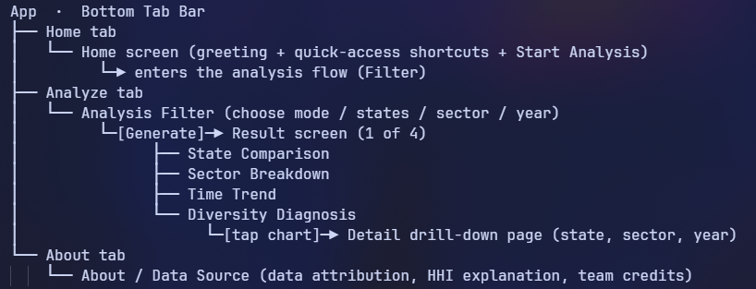
03 · NAVIGATION STRUCTURE CHART
How the screens connect
Navigation structure chart to be added
Place the app flow diagram here (Home → Analysis Filter → the four result screens).
Industrial GDP Analyzer · data.gov.my
03 / 06

Slide 5
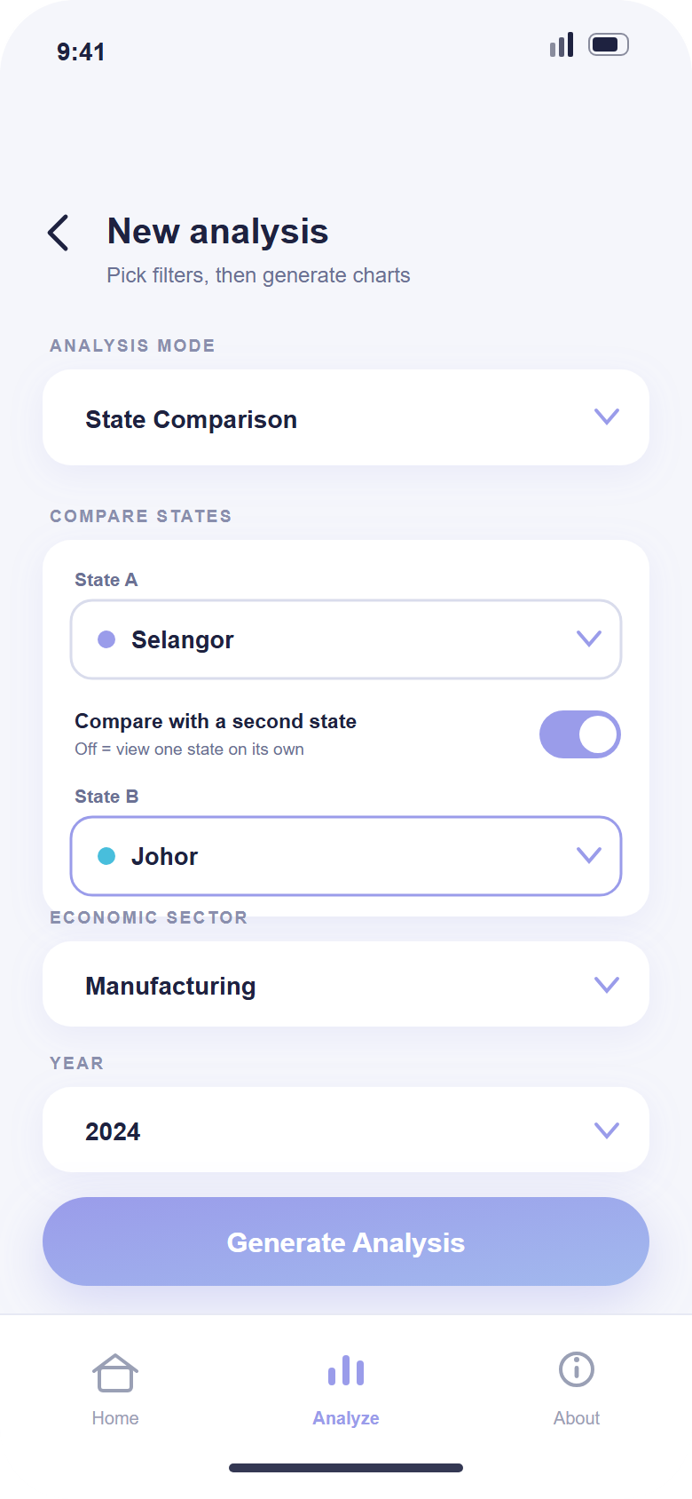
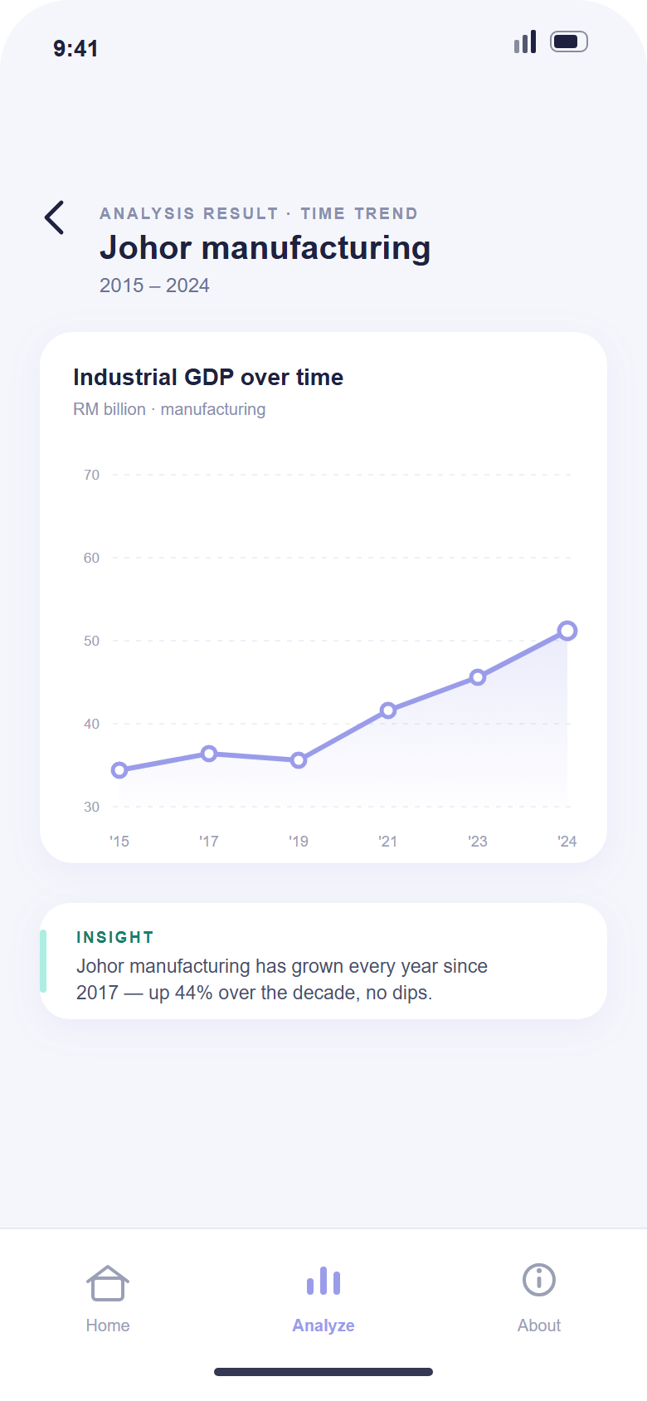
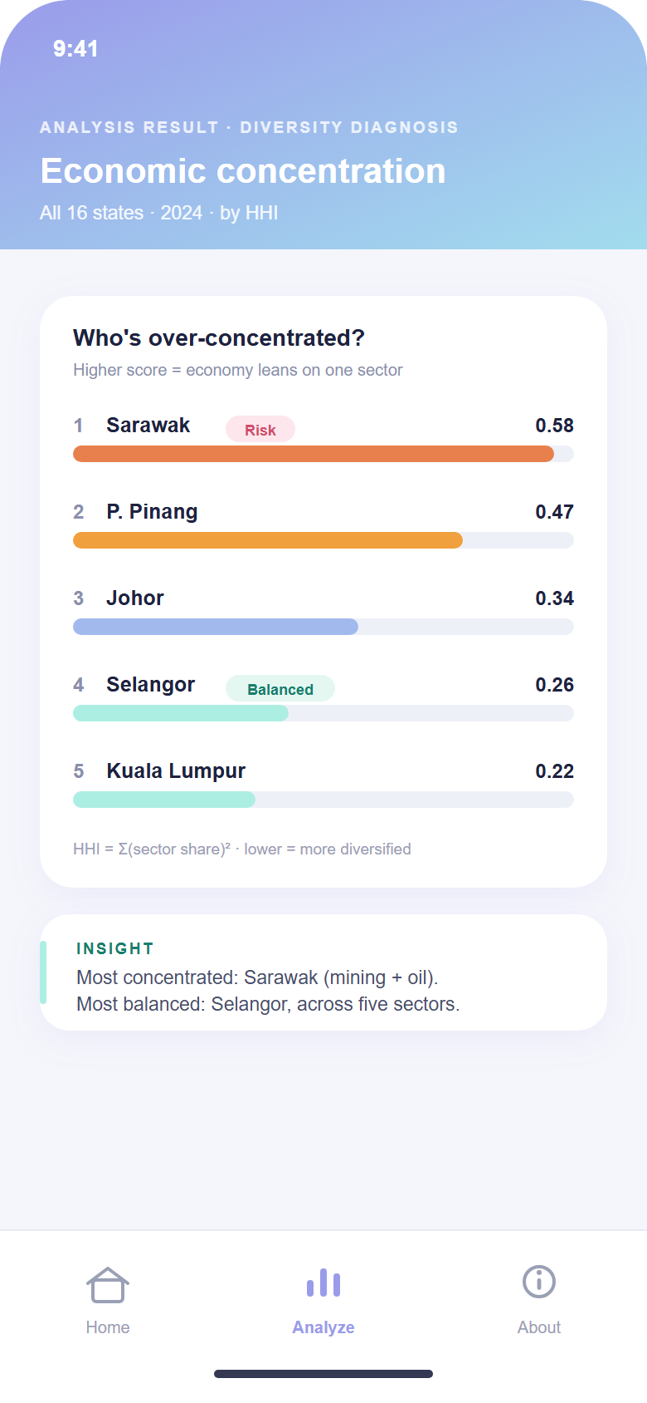
04 · SCREEN DESIGN
One consistent pattern on every screen
Filter chips to choose, one chart to read, one insight sentence to explain — repeated across all six screens.
Home
Analysis Filter
State Comparison
Time Trend
Sector Breakdown
Diversity Diagnosis
Industrial GDP Analyzer · data.gov.my
04 / 06

Slide 6
05 · CONCLUSION
Simple answers from official data
Turns official but hard-to-read GDP data into simple, mobile-friendly answers.
1
Supports SDG 9 by showing which states are industrialised and which lean too much on a single sector.
2
One simple, consistent design: every page is filter chips, one chart, and one insight sentence.
3
Industrial GDP Analyzer · data.gov.my
05 / 06

