Slide 1

LayerNorm & RMSNorm
Optimised SSVE / SME primitives on Apple M4
verified · measured against a validated roofline · JIT-generated
Ketsia Kemkuini · Mariza Sitcheu
Machine Learning Compilers Lab · Friedrich-Schiller-Universität Jena

Slide 2
PROBLEM
The target: a kernel that runs in every Transformer block
LayerNorm BERT · GPT-2/3 · ’16
– y = γ ⊙ (x − μ) / √(σ² + ε) + β
– two-pass: mean & variance, then normalize–scale–shift
– per element: 3 reads + 1 write (x for μ, x for σ², x to normalize)
RMSNorm LLaMA · Mistral · Gemma · ’19
– y = γ ⊙ x / √(mean(x²) + ε)
– single statistic: one Σx² — no mean, no β
– per element: 2 reads + 1 write — a structurally lighter kernel
Run twice per layer, for every token — and memory-bandwidth-bound: ~1 FLOP per 8 bytes moved (FP32 read + write).
So the metric is effective GiB/s against a measured ceiling — not GFLOPS, and optimisation means moving fewer bytes, better.
Deliverable: hand-written SSVE + SME/ZA kernels for both norms → JIT-emitted by mini_jit → composable as a TEIR primitive.
ML Compilers Lab — MLC-Norm · FSU Jena
2

Slide 3
STATE OF PRACTICE — CHECKED IN THE SOURCES, JUNE 2026
What production CPU inference code actually ships
PyTorch — ATen CPU LayerNorm
– statistics: chunked Welford + cascade sums, vectorised (RowwiseMoments, chunk = 16)
– normalize pass fully vectorised (vec::map3)
– 1/√ stays a scalar std::sqrt per row
aten/src/ATen/native/cpu/layer_norm_kernel.cpp · moments_utils.h
llama.cpp / GGML RMSNorm
– the Σx² reduction is a scalar loop, double accumulator (“worth switching to explicit SIMD?”)
– normalize is SIMD; rms_norm × weight is fused; rows split across threads
– multi-accumulator GGML_F32_ARR + SVE WHILELT live in the dot-product path
ggml/src/ggml-cpu/ops.cpp · vec.h
ExecuTorch mobile LayerNorm
– ports the same RowwiseMoments + vectorised second pass
– falls back to scalar below N = 256 — SIMD setup overhead is real
– small-shape regime is a first-class design concern
kernels/optimized/cpu/op_native_layer_norm.cpp
Arm KleidiAI SME2 micro-kernels
– SME2 kernels are matmul (…_sme2_mopa) and depthwise conv only
– no normalization micro-kernel — norms stay on the vector path
– outer-product ZA accumulation ≠ a horizontal reduction
kai/ukernels/{matmul, dwconv}
Three questions to settle on M4: broken reduction chains (GGML’s pattern) · Welford vs two-pass (ATen’s choice) · does SME’s ZA earn a norm kernel at all?
ML Compilers Lab — MLC-Norm · FSU Jena
3

Slide 4
DESIGN · 1 OF 2
Matching the tool to the work — SSVE for the reduction
• The hot work is 1-D: per-row statistic + elementwise normalize — it touches every element, so it owns the bandwidth number.
• Vector-length-agnostic by construction: WHILELO predication handles any M — tails without branches; SVL is queried, never hard-coded.
• Column-major forces the loop order: gather loads are illegal in streaming mode without SMEFA64 (not exposed on M4 — SIGILL). Walk columns instead: every load is a contiguous LD1W of VL rows.
• One streaming region per call — SMSTART/SMSTOP cost real cycles; never toggled per row.
RMSNorm V0 — reduction skeleton (rms_norm_ssve.S)
smstart sm ; one region
.rows: whilelo p1.s, x0, x22 ; any SVL, any M
.cols: ld1w {z0.s}, p1/z, [x8] ; contiguous
fmla z2.s, p1/m, z0.s, z0.s
add x8, x8, x24 ; next column
…
incw x0 ; += VL
addvl x19, x19, #1
b.first .rows
smstop sm
Verified against the C++ reference before any GiB/s is reported — including large-magnitude stress inputs.
ML Compilers Lab — MLC-Norm · FSU Jena
4

Slide 5
DESIGN · 2 OF 2 — HYPOTHESIS, WRITTEN BEFORE MEASURING
Matching the tool to the work — what could ZA buy a norm?
A norm must see the whole row before it can normalize → V6 re-reads x in pass 2 (2R+1W; LayerNorm 3R+1W). 32 Z-registers can’t hold a row block — but ZA adds ~4 KB of on-core storage.
DRAM — x (col-major)
SME ZA array — 4 KB on-core (SVL/32 = 16 on M4, derived)
Z0–Z31 (SSVE)
ZA0
ZA1
z0 = column j
16×16 fp32
16×16 fp32
VL rows × N cols
z2 += x·x
reduction stays here
ZA2
ZA3
16×16 fp32
16×16 fp32
DRAM — y
Hypothesis: stage x in ZA during pass 1, read it back in pass 2 → 2R+1W becomes 1R+1W (−33 % traffic; −50 % for LayerNorm).
ML Compilers Lab — MLC-Norm · FSU Jena
5

Slide 6
DESIGN · 2 OF 2 — PASS 1: REDUCE AND STAGE
Matching the tool to the work — what could ZA buy a norm?
Pass 1 — for each column j: load once, accumulate Σx² in a Z-register, and park the column in a ZA tile slice. The reduction never routes through ZA — a matrix accumulator maps poorly onto a horizontal reduction.
DRAM — x (col-major)
SME ZA array — 4 KB on-core (SVL/32 = 16 on M4, derived)
Z0–Z31 (SSVE)
ZA0
ZA1
z0 = column j
2
16×16 fp32
16×16 fp32
VL rows × N cols
1
z2 += x·x
reduction stays here
ZA2
ZA3
16×16 fp32
16×16 fp32
DRAM — y
① ld1w column j — the one DRAM read → fmla Σx² in z2 ② mova za(j)h[w], z0 — park the column in ZA
mova za(j)h[w], z0 parks column j — ZA as storage, not compute. Capacity: the row block fits only while N ≤ 4·SVL (= 64 on M4).
ML Compilers Lab — MLC-Norm · FSU Jena
6

Slide 7
DESIGN · 2 OF 2 — PASS 2: NORMALIZE FROM ZA
Matching the tool to the work — what could ZA buy a norm?
Pass 2 — read x back from ZA instead of DRAM, scale by γ[j]·inv_rms, store. The second memory read is gone: 1R+1W, exactly the traffic RMSNorm’s math needs.
DRAM — x (col-major)
SME ZA array — 4 KB on-core (SVL/32 = 16 on M4, derived)
Z0–Z31 (SSVE)
ZA0
ZA1
z0 = column j
2
16×16 fp32
16×16 fp32
VL rows × N cols
1
z2 += x·x
reduction stays here
ZA2
ZA3
✕ 2nd read of x — saved
3
16×16 fp32
16×16 fp32
DRAM — y
4
③ mova z0, za(j)h[w] — x comes back from ZA, not DRAM ④ × γ[j] · inv_rms → st1w — the one write
Pre-registered expectation: a possible small-N win — if the saved read outweighs shuffling x through ZA. (Spoiler: it doesn’t. Measured on slide 11.)
ML Compilers Lab — MLC-Norm · FSU Jena
7

Slide 8
METHOD — EVERY VARIANT VERIFIED, THEN MEASURED; EACH ISOLATES ONE LEVER
The experiment: one optimisation family per version
ver
the one change
where it is practice
V0
vectorised VLA SSVE baseline, predicated tails
the WHILELO/WHILELT predication pattern GGML’s SVE path uses
V1
FRSQRTE + one Newton step for 1/√x
classic SIMD fast-math; notably NOT in ATen CPU (scalar 1/√ per row)
V2
hoist the loop-invariant 1/N divide
classic strength reduction
V3
2× column-loop unrolling
standard SIMD practice
V4
4 independent FMLA accumulator chains
GGML’s GGML_F32_ARR multi-accumulator pattern (its dot-product path)
V5
software-pipelined load groups
hand-scheduled Arm kernels
V6
4-row-block contiguity grouping (256 B per touch)
DRAM access density — the lever the footprint sweep exposed
ZA
SVL×SVL tile staging → pass fusion (1R+1W)
SME’s headline feature — the kernel no library ships (slide 3)
Discipline: correctness gates performance — no GiB/s is reported for a kernel that hasn’t passed verification (incl. stress inputs).
ML Compilers Lab — MLC-Norm · FSU Jena
8

Slide 9
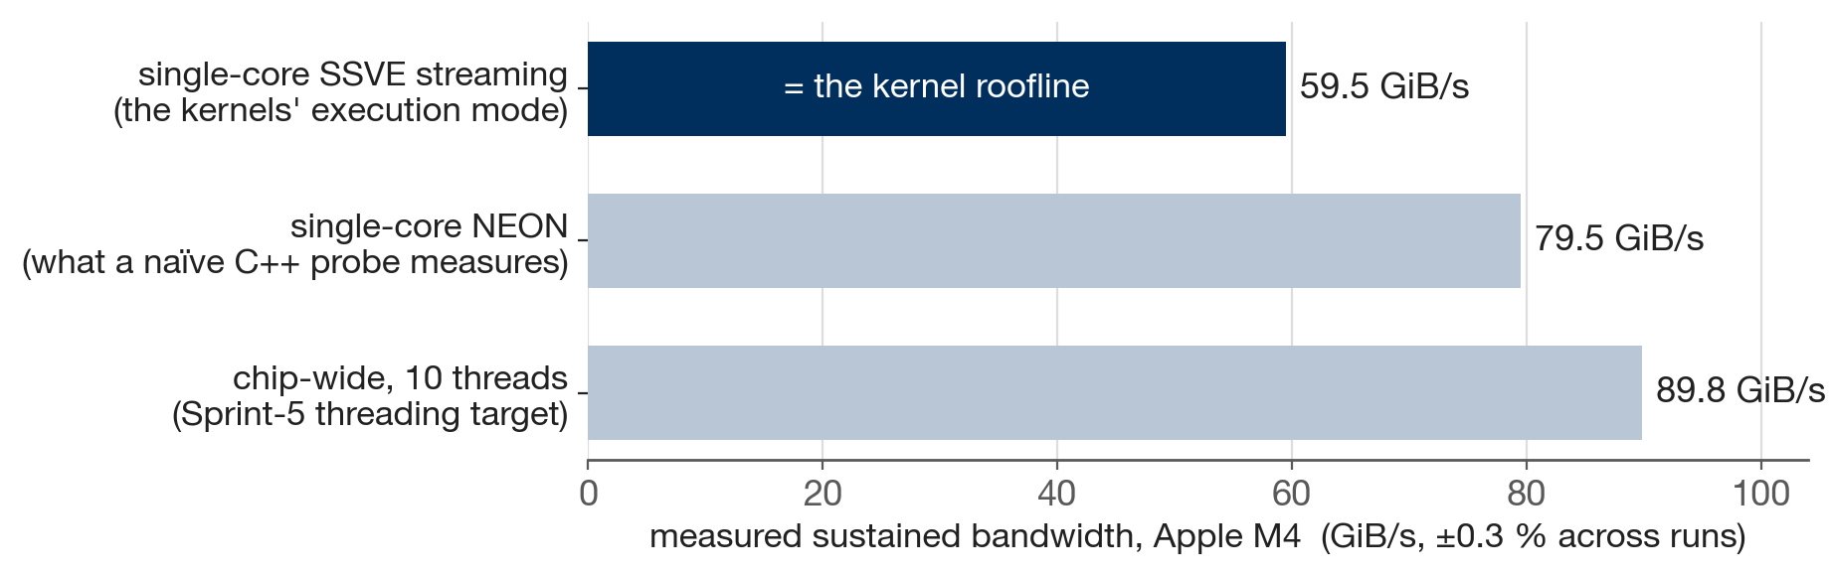
METHOD — “PEAK BANDWIDTH” OF WHAT, EXACTLY?
Before any number: validate the ruler itself
The naïve probe lies. Our first C++ STREAM-style probe autovectorised to NEON — the wrong execution mode: the kernels run streaming-mode LD1W/ST1W.
Streaming mode has ~25 % less single-core bandwidth on M4 (59.5 vs 79.5 GiB/s) — every “% of peak” had to be restated.
One core already sustains ~66 % of the chip aggregate → threading (Sprint 5) can buy at most ~1.5×.
Convention: GiB/s counts useful bytes (1R+1W). The two-pass kernels physically move 2R+1W — both figures are reported.
ML Compilers Lab — MLC-Norm · FSU Jena
9

Slide 10
RESULTS · WHAT ACTUALLY MOVED THE NEEDLE
The decisive change — V0 → V6, RMSNorm reduction loop
V0 — one column touch, one chain
.red_col: ; per column
ld1w {z0.s}, p1/z, [x8]
; ONE load = 64 B touch
fmla z2.s, p1/m, z0.s, z0.s
; ONE accumulator chain
add x8, x8, x24
subs x9, x9, #1
b.ne .red_col
V6 — four blocks per touch, four chains
.red_col_v6:
ld1w {z0.s}, p0/z, [x8]
ld1w {z24.s}, p0/z, [x8,#1,mul vl]
ld1w {z25.s}, p0/z, [x8,#2,mul vl]
ld1w {z26.s}, p0/z, [x8,#3,mul vl]
; FOUR loads = 256 B contiguous
fmla z2.s, p0/m, z0.s, z0.s
fmla z16.s, p0/m, z24.s, z24.s
fmla z17.s, p0/m, z25.s, z25.s
fmla z18.s, p0/m, z26.s, z26.s
; FOUR independent chains (ILP)
add x8, x8, x24
subs x9, x9, #1
b.ne .red_col_v6
+131 % in the DRAM regime (11.1 → 25.6 GiB/s) — same math, not one extra FLOP. LayerNorm: +71 %.
ML Compilers Lab — MLC-Norm · FSU Jena
10

Slide 11
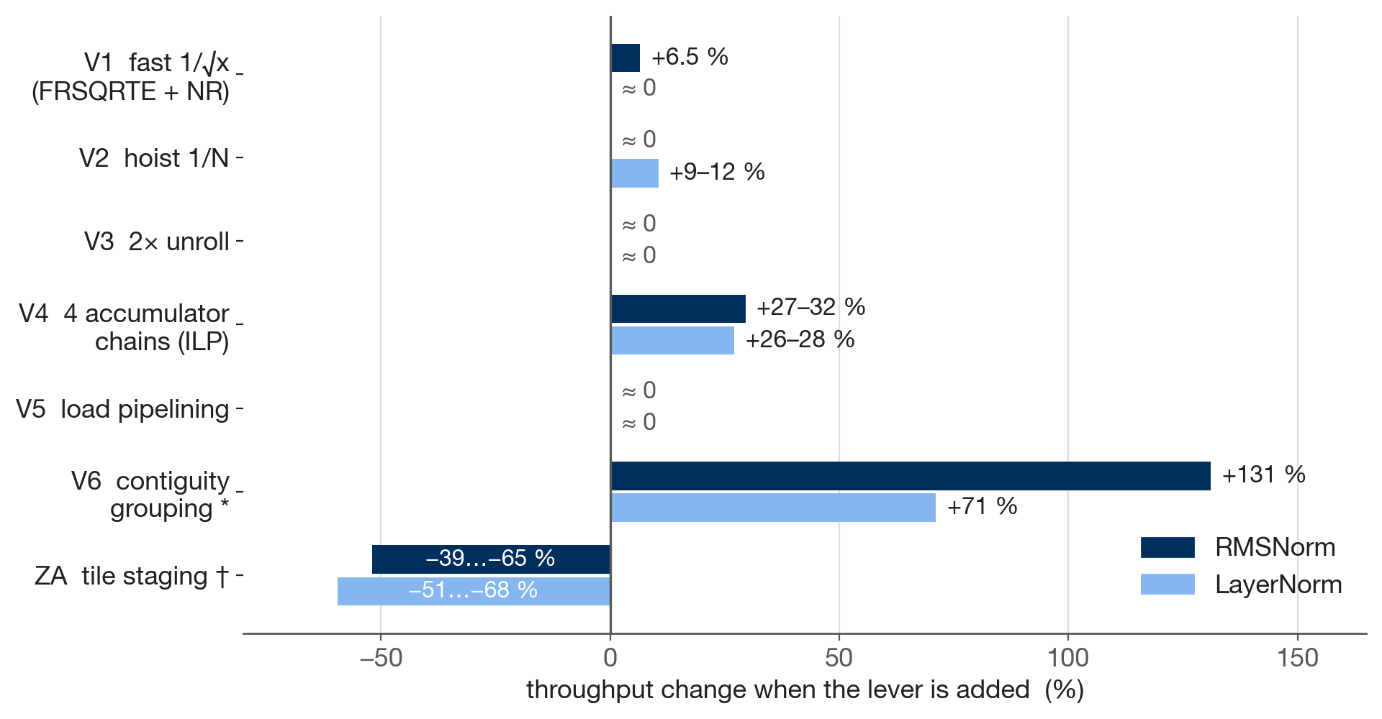
RESULTS · THE ABLATION
Which levers mattered — measured, per norm
verdicts do not transfer
V2 pays only on LayerNorm — two per-block divides at serialization points.
V3/V5 ≈ 0:
the OOO core + prefetcher already cover unrolling and load hoisting.
ILP before arithmetic:
breaking the FMLA chain (V4) dwarfs every arithmetic tweak.
* V6 vs V0 in the 64 MB true-DRAM regime (cache-resident: ties V4) · † ZA fast path vs V6, N ≤ 4·SVL · others vs the incumbent at cache-resident shapes.
ML Compilers Lab — MLC-Norm · FSU Jena
11

Slide 12
RESULTS · THE PRE-REGISTERED HYPOTHESIS MEETS THE HARDWARE
The ZA verdict — a measured, explained negative
• ZA-resident fast path loses 39–65 % (RMS) and 51–68 % (LN) to V6 — despite moving strictly fewer bytes (1R+1W).
• The clinching data point: the ZA kernel’s own streaming fallback beats its ZA fast path (25.1 vs 8.4–11.0 GiB/s for RMSNorm).
• Mechanism: mova throughput, not DRAM, is the binding constraint — 2 (RMS) / 3 (LN) extra mova per element cost more than the read they save.
• The bigger traffic cut lost by more — LayerNorm’s −50 % traffic → larger loss, exactly as pre-registered. The finding is norm-agnostic.
V6 — per element
ld1w · fmla · (ld1w again) · st1w
2 DRAM reads + 1 write — but 256 B-dense
ZA — per element
ld1w · fmla · mova→ZA · mova←ZA · st1w
1 read saved, 2 mova bought — a net loss at 10–35 GiB/s, where memory was never the binding constraint
This is why no library ships an SME norm kernel (slide 3) — and why our JIT deliberately never emits the ZA path.
ML Compilers Lab — MLC-Norm · FSU Jena
12

Slide 13
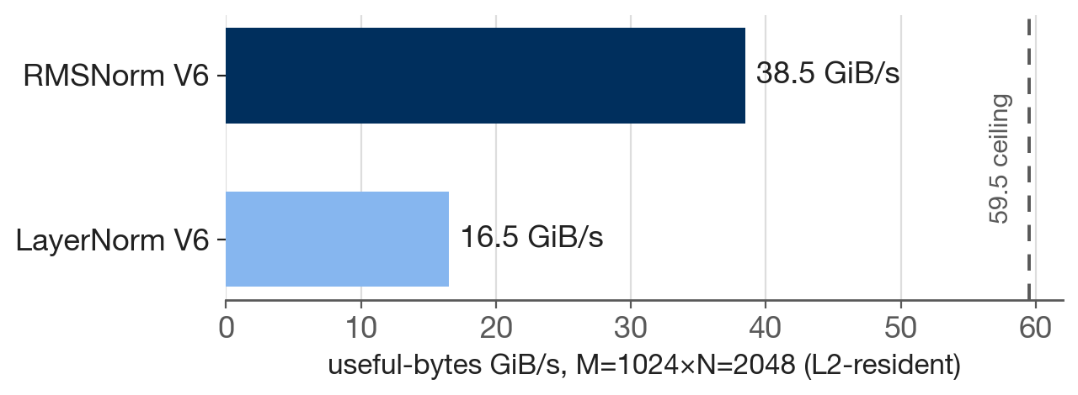
RESULTS · SAME HARNESS, SAME SHAPES
RMSNorm vs LayerNorm — the gap is structural
LayerNorm
R
R
R
W
16 B/elt
RMSNorm
R
R
W
12 B/elt
Structural traffic floor: 1.33×. Measured: 1.8–2.3× — the rest is per-byte work: mean-subtract, β, two serialization points per block. Well beyond the literature’s 10–40 %.
And the single-sweep escape? Welford (ATen’s choice) is a double negative here.
Moves 25 % fewer bytes (2R+1W) yet runs 25–30 % slower — the per-element 1/count recurrence serializes on SIMD — and is ~100× less accurate on shifted FP32 data (max err 1.2e-3 vs 1.2e-5 at shift 10⁴, our SIMD port; ATen softens this with chunking + cascade sums).
Fewer bytes ≠ faster: the stable two-pass wins both speed and accuracy on this hardware.
ML Compilers Lab — MLC-Norm · FSU Jena
13

Slide 14
CODEGEN · EMISSION IS ONE-TIME, THE POINTER IS REUSED
From hand-written to generated — mini_jit::Norm
Norm::generate(ntype)
parameterised on the norm type
Trust by construction — the encoding diff
The generated buffer is diffed word-by-word against the linked hand-written kernel, read from its function address at runtime:
RMSNorm 143/143 · LayerNorm 194/194 words identical
→ the JIT inherits the verified kernels’ correctness; runtime parity within 0.6 %.
instruction words
30 new InstGen encoders — each pinned to a toolchain golden word + the Arm ARM
executable buffer
one streaming region · MAP_JIT, W^X respected
• ZA path deliberately not emitted — it never earned its row (slide 12); the reasoned skip is the emission decision at SVL = 512.
• Exactness pays: the golden words exposed two latent week-6 encoder bugs (PTRUE size bits; SMSTART SM encoding SM+ZA) every behavioral test had passed over.
• Plus one harness bug: a per-call sysctl in cpu_supports_sme() — worth ~1 µs/call, found because word-identical code “couldn’t” differ by 76 %.
function pointer
emitted once (~4.7 µs) · reused every call
ML Compilers Lab — MLC-Norm · FSU Jena
14

Slide 15
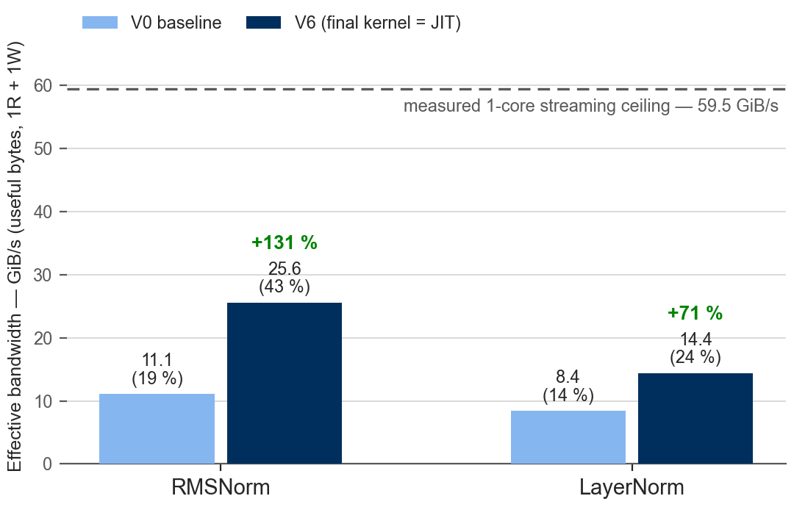
RESULTS · APPLE M4, USEFUL-BYTES CONVENTION (1R+1W)
Where the kernels land against the machine
• Chart: 64 MB working set — the true-DRAM regime.
• At L2-resident shapes: RMSNorm V6 reaches 38.5 GiB/s = 65 % useful-bytes ≈ 95 % moved-bytes of the streaming ceiling.
• LayerNorm V6: 16.5 GiB/s (28 % useful ≈ 55 % moved) — the 3R+1W structure is the remaining gap.
• JIT = hand-written within 0.6 % at every shape — word-identical code, equalized call paths.
ML Compilers Lab — MLC-Norm · FSU Jena
15

Slide 16
LESSONS
Three lessons the measurements insisted on
1
Break dependency chains before tuning arithmetic
Four independent accumulators: +27–32 %. All arithmetic tweaks together: ≤ +6.5 %.
2
Shape memory access for the DRAM, not the FLOP count
256 B-contiguous touches: +131 %. Loop unrolling: 0 %. Same math in every case.
3
Newer silicon is not automatically faster
ZA staging lost 39–68 % — hypothesis pre-registered, measured, and explained (mova throughput).
Measure, don’t assume — every verdict re-measured per kernel; every kernel verified before it was benchmarked.
ML Compilers Lab — MLC-Norm · FSU Jena
16

Slide 17
ROADMAP
Status & outlook — from kernels to compiler building blocks
Done — and verified
Next
• C++ reference — the correctness oracle
• SSVE V6 kernels, both norms — verified (352 k assertions), measured vs the validated ceiling
• ZA kernels, both norms — measured, explained negative; kept in the ablation
• JIT emission — word-identical, parity within 0.6 %
• TEIR primitive (Sprint 5) — the norm as an Invocation the week-7 runtime places in a loop nest; verified through the full path
• OpenMP across row tiles — is_parallel on the outer axis, toward the 89.8 GiB/s chip-wide ceiling (≤ ~1.5×)
• Consolidated ablation + stability/overhead study — Sprints 6–7; final report (Sprint 8)
Thank you — questions? github.com/kets01/MLC-Project
ML Compilers Lab — MLC-Norm · FSU Jena
17

Slide 18
Backup
roofline validation · signature & layout · numerics · the eps bug · encoding diff · ZA tables · small-N & emission · sources

Slide 19
BACKUP
B1 · Roofline validation & byte-counting convention
• Disassembly showed the C++ probe autovectorised to NEON (ldp q/fadd.4s/stp q), single-threaded → 79.5 GiB/s was the wrong mode.
• bw_probe_ssve.S: streaming-mode LD1W/ST1W scale-add, one streaming region, VLA tail, verified bit-exact; QOS_CLASS_USER_INTERACTIVE as P-core hint (macOS has no pinning API).
• Useful bytes = 1R+1W for kernels AND probes; two-pass kernels physically move 2R+1W → moved-bytes = 1.5× printed. V6 ≈ 95 % of ceiling in moved bytes.
• One core ≈ 66 % of the chip aggregate → Sprint-5 threading buys ≤ ~1.5×.
ML Compilers Lab — MLC-Norm · FSU Jena
19

Slide 20
BACKUP
B2 · Canonical signature, layout, and the gather restriction
// one signature — reference, JIT, TEIR (decision A)
void rms_norm(const float* a, float* b,
const float* gamma,
int64_t m, int64_t n,
int64_t ld_a, int64_t ld_b,
float epsilon);
// LayerNorm adds: const float* beta
// column-major: data[i + j*ld]
• Why column-major dictates the loop order: row elements are strided ld apart → would need gather loads; gathers are illegal in streaming mode without SMEFA64, which Apple does not expose (SIGILL). Walking columns makes every load a contiguous LD1W of VL rows.
• TEIR mapping (Sprint 5): reconcile with CompiledKernel = void(float*,float*,float*) — input / γβ / output onto a/b/c; strides via leading dimensions.
ML Compilers Lab — MLC-Norm · FSU Jena
20

Slide 21
BACKUP
B3 · Numerical stability: why two-pass, and what we tolerate
• Naive single-pass variance E[x²] − E[x]² cancels catastrophically in FP32 on shifted inputs — the stress suite (shift = 10⁴) is part of correctness, not an extra.
• Welford in FP32 rounds `mean` at input magnitude on every element; the centered two-pass squares small deviations instead → max err 1.2e-3 vs 1.2e-5 at shift 10⁴ (our SIMD port). ATen mitigates with chunk-16 accumulation + cascade merging — at the cost of the serial recurrence that makes it slow on SIMD.
• RMSNorm sidesteps the problem: Σx² needs no mean subtraction — part of why it is both faster and stable.
• Tolerances are documented, never widened silently: kTol = 1e-5; V4/V5’s tree-order summation is verified at a documented kTolReassoc = 2e-5; V6 restores strict sequential order per block → back to kTol.
ML Compilers Lab — MLC-Norm · FSU Jena
21

Slide 22
BACKUP · WHAT AN FP32 TOLERANCE CAN HIDE
B4 · The eps register-stash bug — found by an empirical zero
• 13 of 15 kernels silently lost ε across smstart — stashed in S8/D8, but streaming-mode entry clobbers D8 too (not only D9–D15), and one stack reload aliased the caller’s old d8.
• Invisible to every tolerance-based test: ε’s effect on non-degenerate data is far below FP32 comparison tolerance.
• Only observable when sumsq/variance is exactly zero — then ε is all that stands between 1/0 = inf and NaN propagating through the normalize step. An all-zero row found it.
• Fix: ε goes to a dedicated stack slot before smstart, reloaded after — memory, unlike any register, survives a PSTATE.SM transition. Two regression tests lock it in; suite re-verified green (352 473 assertions, 93 cases).
• Third appearance of the streaming-entry register hazard in this project — each time in a new disguise.
ML Compilers Lab — MLC-Norm · FSU Jena
22

Slide 23
BACKUP · “IT ASSEMBLES” ≠ “IT’S THE INSTRUCTION YOU MEANT”
B5 · Encoding-diff methodology — and what exactness caught
• Three verification layers, weakest → strongest: per-encoder golden words (objdump + Arm ARM field layouts) → whole-kernel word diff vs the linked hand-written kernel (read from its function address — can never go stale) → execution vs the C++ reference.
• sve_ptrue_all(fp32) emitted PTRUE P.B, not the P.S its comment promised — functionally masked (ALL-true .B governs .S identically), still wrong. Fixed, pinned by test.
• sme_smstart_sm() actually encodes SMSTART SM+ZA — correct for Gemm, wrong by name, and wrong for norms (SM-only avoids ZA lazy-save hazards). Correctly-named SM-only forms added.
• The parity run found a harness bug: a word-identical JIT kernel “+76 % faster” → impossible → cpu_supports_sme() did an uncached sysctl syscall (~1 µs) per wrapped call. Cached; Sprint-2a’s small-N t0 restated (≈70 % of it was syscall; true t0 ≲ 0.4 µs).
ML Compilers Lab — MLC-Norm · FSU Jena
23

Slide 24
BACKUP · APPLE M4, USEFUL BYTES
B6 · ZA measurements in full
RMSNorm — rms_norm_za vs V6 (GiB/s)
LayerNorm — layer_norm_za vs V6 (GiB/s)
shape
path
V6
ZA
Δ
shape
path
V6
ZA
Δ
128×16
ZA (1 tile)
11.5
6.8
−41 %
128×16
ZA (1 tile)
7.5
3.7
−51 %
128×64
ZA (4 tiles)
21.5
8.4
−61 %
128×64
ZA (4 tiles)
11.8
4.6
−61 %
1024×64
ZA (4 tiles)
30.2
10.9
−64 %
1024×64
ZA (4 tiles)
14.7
4.8
−68 %
4096×64
ZA (4 tiles)
31.1
11.0
−65 %
4096×64
ZA (4 tiles)
15.0
5.1
−66 %
128×2048
fallback
34.8
25.1
−28 %
128×2048
fallback
15.1
13.4
−11 %
1024×2048
fallback
38.0
24.7
−35 %
1024×2048
fallback
16.3
14.3
−12 %
Fallback = each ZA kernel’s own streaming path (no ZA) for N > 4·SVL — plain single-block passes without V6’s contiguity grouping/ILP; it exists for correctness on every shape, not to compete.
ML Compilers Lab — MLC-Norm · FSU Jena
24

Slide 25
BACKUP · WHEN DOES THE SME KERNEL WIN?
B7 · Small shapes, fixed costs, and emission
• Per-call fixed cost is real but small: after the sysctl fix, the linear fit’s intercept is within noise of zero (≲ 0.4 µs); throughput is flat ≈ 29 GiB/s from N = 32 upward at M = 128.
• The whole norm runs inside one streaming region — SMSTART/SMSTOP are never toggled per row; the small-N regime is measured and reported, not hidden.
• JIT emission is one-time: ~4.7 µs (RMS, 143 words) / ~4.8 µs (LN, 194 words) vs 0.4–135 µs per kernel call — amortized after a handful of calls; the pointer is reused thereafter.
• Deeper / parameterized contiguity-group depth stays a shape-specialized emission decision — deferred to the Sprint-6 optimization backlog.
ML Compilers Lab — MLC-Norm · FSU Jena
25

Slide 26
BACKUP · ALL CLAIMS CHECKED AGAINST THE CODE, JUNE–JULY 2026
B8 · Sources for the state-of-practice survey
PyTorch (ATen CPU) github.com/pytorch/pytorch — aten/src/ATen/native/cpu/layer_norm_kernel.cpp; moments_utils.h (RowwiseMoments: “Welford algorithm + cascade sum”, kChunkSize = 16)
llama.cpp / GGML github.com/ggml-org/llama.cpp — ggml/src/ggml-cpu/ops.cpp (ggml_compute_forward_rms_norm_f32: scalar loop, ggml_float accumulator, fused MUL variant); vec.h (GGML_F32_ARR, SVE svwhilelt)
ExecuTorch github.com/pytorch/executorch — kernels/optimized/cpu/op_native_layer_norm.cpp (RowwiseMoments; scalar fallback N < 256)
Arm KleidiAI github.com/ARM-software/kleidiai — kai/ukernels/{matmul, dwconv}; SME2 matmul micro-kernels (…_sme2_mopa), no normalization kernel
Papers LayerNorm: Ba, Kiros & Hinton 2016, arXiv:1607.06450 · RMSNorm: Zhang & Sennrich, NeurIPS 2019, arXiv:1910.07467
Hardware ground truth Arm Architecture Reference Manual (SME/SSVE) · Apple M4 = SME1, SVL 512 bit · all bandwidth figures measured on our M4 with the repo harness
ML Compilers Lab — MLC-Norm · FSU Jena
26

