Slide 1
Developing a Django Web Application for IoT Data
Developing a Simple Django Web Application in a Local Server
Jong-Dae Park
Notes:
In this module, we will develop a simple Django web application for IoT data.
We will use our computer to run the Django web application.

Slide 2
Learning Objectives
Get Experienced in Django Web Framework
Meet Customers Requirements for IoT App
Using AI tools such as ChatGPT to develop Web Applications
Notes:
In this module, we’ll be building a simple web application using Django, a powerful and popular web framework written in Python.
When it comes to web development, we have a variety of programming languages at our disposal — including PHP, Python, Java, JavaScript, and many others.
These languages are used to dynamically generate the HTML pages that users request in their web browsers.
Although we often have the freedom to choose which language or framework to use, in some cases, the choice may be influenced or dictated by client requirements or existing systems.
That’s why it’s valuable to understand the basic process of web development across different programming languages — even if you specialize in just one.
And today, we also have the advantage of using AI tools like ChatGPT, which can help us write code, debug problems, and accelerate web development in smart and efficient ways.

Slide 3
Web Development
Front End Language
Back End Programming Languages
HTML/CSS
Javascript
TypeScript
PHP
Java
Python
Node.js
Ruby
html
Ruby
Java
Python
php
nodsjs
Javascript
css
Notes:
Web development is broadly categorized into frontend (client-side) and backend (server-side) development.
We’ll begin with the frontend — the part of the web that users interact with directly.
HTML is a markup language for web pages and css is used for style sheets.
JavaScript is the most dominant language, used by over 99% of all websites. JavaScript continues to be the most commonly used programming language.
For developers working on large-scale applications, TypeScript — a typed superset of JavaScript — is becoming increasingly popular, thanks to its enhanced reliability and tooling.
Now let’s move to the backend — where the logic and data processing happen behind the scenes.
PHP remains a major player, powering around 74% of websites.
Java is often chosen for large-scale enterprise applications due to its performance and scalability.
Python is rising fast in popularity, largely because of its simplicity and powerful web frameworks like Django and Flask.
Meanwhile, Node.js allows developers to use JavaScript on the server side, enabling full-stack development with a single language. And finally,
Ruby, especially with the Ruby on Rails framework, is known for its developer-friendly syntax and rapid development capabilities.

Slide 4

What is Djanogo?
Django is a high-level Python web framework that enables rapid development of secure and maintainable websites.
Django was initially developed between 2003 and 2005 by a web team who were responsible for creating and maintaining newspaper websites.
It was designed to simplify the development process by providing a set of tools and features that handle many of the common tasks in web development.
Notes:
Django is a high-level Python web framework that enables rapid development of secure and maintainable websites.
Django is an open-source, high-level web framework designed to help developers build secure and maintainable websites quickly.
It was initially developed between 2003 and 2005 , and since then, it has become a favorite among developers for its simplicity, robustness, and scalability.
One of Django’s biggest strengths is that it comes with a wide range of built-in features — like an admin interface, authentication, database handling, form processing, and security protections — all ready to use out of the box.

Slide 5
Key Features of Django
MTV Architecture:
Model: Defines the data structure (e.g., database tables).
Template: Controls how the data is presented (HTML output).
View: Contains the logic that connects the model and template.
Admin Interface
ORM (Object-Relational Mapping)
URL Routing
Security
Scalability
Notes:
When learning Django, one of the first concepts to understand is its architecture — known as MTV, which stands for Model–Template–View.
In the Model layer, we define the data structure. It’s where we describe what our data looks like — like database tables, fields, and relationships — all using Python classes.
The Template layer is all about presentation. It controls how the data is displayed on the web, typically as HTML pages.
Next, the View acts as the bridge between models and templates. It contains the core logic of the application — it retrieves data from the model and passes it to the appropriate template for rendering.
Another powerful feature Django provides is the Admin Interface. This is a web-based control panel that’s automatically generated from your models. With just a few lines of code, you can get a fully functional backend interface for managing your data.
Django also comes with an ORM, or Object-Relational Mapping system. Instead of writing raw SQL queries, you interact with the database using Python objects. This not only makes code easier to write and read, but also more secure and portable.
Speaking of routing, Django includes a built-in URL routing system, allowing you to map incoming web requests to specific functions — known as views — that handle the request logic.
Security is another core strength of Django. It protects against many common web vulnerabilities — like SQL injection, cross-site scripting, and cross-site request forgery — right out of the box.
And finally, Django is highly scalable. It’s suitable for everything from small academic projects to high-traffic enterprise-level web applications, thanks to its modular structure and robust design.

Slide 6
How to start a Django-project?
C:\Users\your-folder> python -m pip install Django
C:\Users\your-folder> python -m django version
C:\Users\your-folder> md django-iot
C:\Users\your-folder> django-admin startproject myproject django-iot
C:\Users\your-folder> cd django-iot
C:\Users\your-folder\django-iot > dir
Notes:
Let’s walk through the basic steps to install Django and start a new Django project.
We begin in the command prompt. First, we install Django using Python’s package manager, pip. Type:
python -m pip install Django
This command ensures Django is installed in your current Python environment.
Next, you may want to check that Django was installed correctly. To verify the version, enter:
python -m django --version
Make sure to use double hyphens before the word 'version'.
Now, let’s create a folder for your new Django project. Use the md command — short for 'make directory' — like this:
md django-iot
This will create a new folder named ‘django-iot’.
Then, to start your Django project, run:
django-admin startproject myproject django-iot
This command creates a new Django project called ‘myproject’ and places it inside the ‘django-iot’ directory.
Once you start a new Django project, several important files and folders are automatically created for you. Let’s take a closer look at what each of these does.
Lets move into our project directory:
cd django-iot
Type dir to see the generated files and folders.

Slide 7
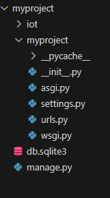
django-admin startproject myproject django-iot
manage.py: A command-line utility that lets you interact with this Django project in various ways.
myproject/: A directory that is the actual Python package for your project.
myproject /__init__.py: An empty file that tells Python that this directory should be considered a Python package.
myproject /settings.py: Settings/configuration for this Django project.
myproject /urls.py: The URL declarations for this Django project; a “table of contents” of your Django-powered site.
myproject /asgi.py: An entry-point for ASGI-compatible web servers to serve your project.
myproject /wsgi.py: An entry-point for WSGI-compatible web servers to serve your project.
Notes:
In vscode, look at the files and folders created by django-admin startproject command.
Let’s look at the last file manage.py. This is a command-line utility that allows you to interact with your Django project. You’ll use it to run the development server, apply migrations, create apps, and more.
Next, let’s look at the folder, myproject. This directory is the core Python package for your project.
Inside myproject , there are a few key files:
__init__.py: This empty file tells Python that this folder should be treated as a package.
settings.py: This is where your project’s configuration lives — things like database settings, installed apps, middleware, and security options are all defined here.
urls.py: Think of this as your site’s table of contents. It defines how URLs are routed to views within your project.
asgi.py: This file acts as an entry point for ASGI-compatible web servers. It’s used when you want to handle asynchronous features like WebSockets or background tasks.
wsgi.py: Similarly, this is the entry point for WSGI-compatible web servers, like Gunicorn or uWSGI. It’s commonly used for deploying traditional web applications.
Together, these files form the foundation of your Django project — providing structure, configuration, and connection points for development and deployment

Slide 8
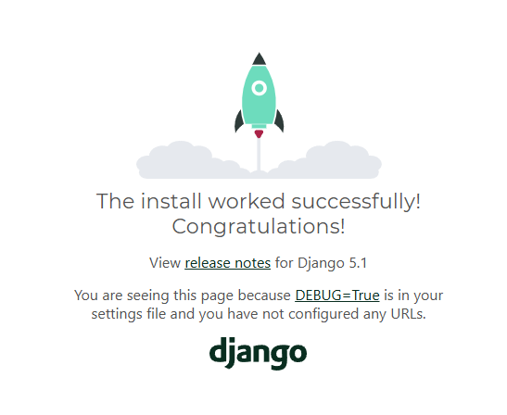
In CMD, type python manage.py runserver Then visit http://localhost:8000
Notes:
Finally, you’re ready to launch the development server. Run the following command:
python manage.py runserver
This starts Django’s built-in web server, and you can now open your browser and visit http://127.0.0.1:8000.
And that’s it — your Django project is now up and running!

Slide 9
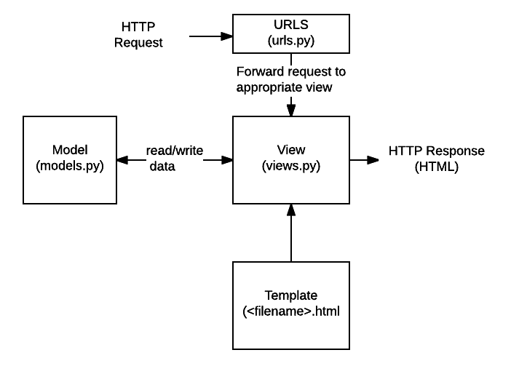
Structure of Django Web Applications
Notes:
Web applications handles http request from clients and process the request and then return responses in HTML.
A URL mapper is used to redirect HTTP requests to the appropriate view based on the request URL.
The URL mapper can also match particular patterns of strings or digits that appear in a URL and pass these to a view function as data.
A view is a request handler function, which receives HTTP requests and returns HTTP responses.
Views access the data needed to satisfy requests via models, and delegate the formatting of the response to templates.
Models are Python objects that define the structure of an application's data, and provide mechanisms to manage (add, modify, delete) and query records in the database.
A template is a text file defining the structure or layout of a file (such as an HTML page), with placeholders used to represent actual content.
A view can dynamically create an HTML page using an HTML template, populating it with data from a model.
A template can be used to define the structure of any type of file.

Slide 10
Create iot app in django-iot project folder
C:\Users\your-folder\django-iot > python manage.py startapp iot
C:\Users\your-folder\django-iot > code .
iot/
__init__.py
admin.py
apps.py
migrations/
__init__.py
models.py
tests.py
views.py
Inspect the files in vscode.
You may refer sample codes at
https://github.com/jdpark7/unsia-iot/tree/main/week10
Notes:
When you create a new Django app using the command python manage.py startapp iot,
Django automatically generates a set of essential files and folders to help you structure your application properly.
Let’s go through them one by one in vscode.
First, we have __init__.py. This file is empty, but it tells Python that this directory should be treated as a Python package.
It’s required for the app to be recognized and imported by Django.
Next is admin.py. This file is used to register your models with Django’s built-in admin interface. By doing so, you can manage your app’s data through a user-friendly web dashboard.
Then we have apps.py. This file defines the configuration class for your app. It’s used by Django to identify and include your app in the project.
Most of the time, you don’t need to modify this unless you’re customizing app behavior.
The migrations/ folder stores database migration files. These are automatically created when you make changes to your models and run the makemigrations command.
Inside this folder, you’ll also see a __init__.py file — again, marking it as a Python package.
Moving on, we have models.py.
This is where you define your app’s data models — the Python classes that represent tables in your database. Django’s ORM translates these models into actual database tables.
Then comes tests.py. This file is used for writing unit tests to verify that your app’s code works as expected. Django makes it easy to write and run tests as part of your development workflow.
And finally, there’s views.py. This is where the logic for handling incoming web requests goes. Views retrieve data from the database, apply business logic, and return responses — usually rendered HTML pages or JSON.

Slide 11
Use ChatGPT to create your Django Applicaions
Ask ChatGPT: “I would like to build a Django app using the following database table name : sensor_data and fields of the table: apikey, device_id, temperature, humidity, timestamp. I want to use a REST API. A Wemos Mini board will send temperature and humidity data to the server, and the server will store the data in the database. When a user visits the webpage with a specific device ID, the page should display the data sent from that device.”
Notes:
I would like to recommend to use AI tools such as chatgpt in developing web applications. AI can be used to solve the problems and expediate the development process.
Ask ChatGTP using the text in the slide.

Slide 12
Installed Apps in settings.py
django.contrib.admin – The admin site. You’ll use it shortly.
django.contrib.auth – An authentication system.
django.contrib.contenttypes – A framework for content types.
django.contrib.sessions – A session framework.
django.contrib.messages – A messaging framework.
django.contrib.staticfiles – A framework for managing static files.
Notes:
When you create a new Django project, several built-in applications are automatically added to the INSTALLED_APPS list in the settings.py file.
These default apps provide essential features that help you build fully functional web applications right from the start. Let’s take a closer look.
First, there’s django.contrib.admin. This enables the powerful Django admin interface — a web-based dashboard that allows you to manage your site’s data with ease.
You’ll use it soon to manage models without writing any code for forms or views.
Next, we have django.contrib.auth. This is Django’s built-in authentication system. It handles everything from user login and logout to password management and permissions.
Then comes django.contrib.contenttypes. This app provides a framework for tracking all the models installed in your project.
It’s essential for working with generic relationships between models.
The django.contrib.sessions app manages session data — allowing you to store information about users across different requests.
For example, this is how Django remembers who is logged in.
After that, there’s django.contrib.messages. This framework enables you to send temporary messages to users, such as success notifications or error alerts, which can be displayed in the user interface.
And finally, we have django.contrib.staticfiles. This app helps you manage static files like CSS, JavaScript, and images — all the resources that make your website visually appealing and interactive

Slide 13
Edit settings.py
INSTALLED_APPS = [
'django.contrib.admin',
'django.contrib.auth',
'django.contrib.contenttypes',
'django.contrib.sessions',
'django.contrib.messages',
'django.contrib.staticfiles',
'rest_framework',
'iot', # Your app name
]
Notes:
We will use rest framework and we are going to include iot app in our Django project.
In vscode, open settings.py and add 'rest_framework’ and 'iot’ in the Installed Apps array as shown in the slide.
Open a command terminal and Install 'rest_framework’ python package by
pip install djangorestframework command.

Slide 14
model.py
from django.db import models
class SensorData(models.Model):
apikey = models.CharField(max_length=50)
device_id = models.CharField(max_length=50)
temperature = models.FloatField()
humidity = models.FloatField()
timestamp = models.DateTimeField(auto_now_add=True)
def __str__(self):
return f"{self.device_id} at {self.timestamp}"
Notes:
In vscode, open model.py
Edit the file using suggested answers from chatgpt or sample source code at github.
In model.py,
The SensorData class inherits from Django’s models.Model class.
We use field classes like CharField and FloatField from the models package to define database columns.
Model.py is used to create a database table in Django.
The default database for Django is sqlite3.

Slide 15
Create database table (sqlite3)
C:\Users\your-folder\django-iot > python manage.py makemigrations iot
C:\Users\your-folder\django-iot > python manage.py migrate
Notes:
By running the makemigrations command, you’re telling Django that you've made changes to your models and want to generate a new file in the migrations folder to reflect those changes.
Migrations are Django’s way of recording and applying changes to your database schema — such as adding new models or modifying existing fields.
If you're curious, you can actually open and read the migration file for your new model. It will typically be located at iot/migrations/0001_initial.py.
Next, when you run the migrate command, Django looks at the INSTALLED_APPS setting in your settings.py file.
It then applies the migration files to create the actual database tables, using the database configuration also defined in that settings file.

Slide 16
urls.py of myproject
from django.contrib import admin
from django.urls import path, include
urlpatterns = [
path('admin/', admin.site.urls),
path('', include('iot.urls')),
]
urls.py of iot app
from django.urls import path
from . import views
urlpatterns = [
path('api/sensor/', views.receive_sensor_data, name='receive_sensor_data'),
path('api/sensor/<str:device_id>/', views.get_device_data_api, name='get_device_data_api'),
path('device/<str:device_id>/', views.device_data_view, name='device_data_view'),
path('device/<str:device_id>/gauge/', views.sensor_gauge_view, name='sensor_gauge_view’),
]
Notes:
In Django, URL configuration is how we map web addresses to specific functions that handle the request.
We start with the project-level urls.py file:
This file tells Django how to route URLs at the global project level. The line path('admin/', admin.site.urls) sets up the admin interface at the /admin/ URL.
The second line — path('', include('iot.urls')) — includes the URL patterns from our iot app. That means any URL not starting with /admin/ will be handled by the iot/urls.py file.
Now, let’s look at the app-level urls.py file inside the iot app.
The first parameter of the path function is the URL pattern that the client will request. The second parameter specifies the function or class-based view that will handle the request.
For example, the route 'api/sensor/' points to the receive_sensor_data view. This view is likely used for devices to send sensor data to the server, typically via a POST request
The name parameter in path function is used for reverse URL resolution, template navigation, and maintainable URL management in Django applications.

Slide 17
Templates (templates/sensor_data.html)
<!DOCTYPE html>
<html>
<head>
<title>Sensor Data - {{ device_id }}</title>
</head>
<body>
<h2>Sensor Data for {{ device_id }}</h2>
<table border="1">
<tr>
<th>Timestamp</th>
<th>Temperature (°C)</th>
<th>Humidity (%)</th>
</tr>
{% for entry in data %}
<tr>
<td>{{ entry.timestamp }}</td>
<td>{{ entry.temperature }}</td>
<td>{{ entry.humidity }}</td>
</tr>
{% endfor %}
</table>
</body>
</html>
Notes:
In Django, a template file is used to define the structure and presentation of your website’s front-end — the HTML that users see in their web browser.
Django’s templating system allows you to mix static HTML with dynamic content, using a simple and readable syntax. This lets you display information from your database, user input, or server-side logic directly in your web pages — without writing any raw Python code in the HTML.
A typical Django template file has a .html extension and lives inside a templates folder. Within this file, you can use template tags and template variables.
Template variables, written with double curly braces like {{ temperature }}, are placeholders that Django replaces with actual values when rendering the page.
Template tags, enclosed in {% ... %}, are used for logic and control structures — like loops ({% for entry in data %}).
When the template is rendered by a view, Django fills in the values dynamically — turning your data into a complete HTML page.

Slide 18
views.py
from rest_framework.decorators import api_view
from rest_framework.response import Response
from rest_framework import status
from .models import SensorData
from .serializers import SensorDataSerializer
from django.shortcuts import render
@api_view(['POST'])
def receive_sensor_data(request):
serializer = SensorDataSerializer(data=request.data)
if serializer.is_valid():
serializer.save()
return Response({"message": "Data saved"}, status=status.HTTP_201_CREATED)
return Response(serializer.errors, status=status.HTTP_400_BAD_REQUEST)
def device_data_view(request, device_id):
data = SensorData.objects.filter(device_id=device_id).order_by('-timestamp')[:50]
return render(request, 'sensor_data.html', {'device_id': device_id, 'data': data})
(refer views.py at https://github.com/jdpark7/unsia-iot/tree/main/week10/iot)
Notes:
In Django, the view.py file plays a central role in how your web application responds to incoming requests.
It contains the logic that processes data and determines what the user should see or receive.
In simple terms, a view is a Python function or class that takes a web request and returns a web response.
This response could be an HTML page, a JSON object, a redirect, or even an error message.
Each view is linked to a specific URL pattern through the urls.py file.
When a request comes in, Django looks at the URL, finds the matching view, and runs the associated function or class.

Slide 19
utils.py
# iot/utils.py
VALID_API_KEYS = {
"abc123": "device01",
"xyz789": "device02",
}
def is_valid_apikey(apikey, device_id):
return VALID_API_KEYS.get(apikey) == device_id
Notes:
We will use a python file, named utils.py which will be used for validating API keys in view.py.
Let’s break it down.
At the top, we have a dictionary named VALID_API_KEYS. This dictionary maps API keys to device IDs.
For example:
"abc123" corresponds to "device01",
and "xyz789" corresponds to "device02".
These key-value pairs represent authorized devices that are allowed to send data to your server.
is_valid_apikey function takes two arguments: an apikey and a device_id.
It checks whether the provided API key is valid and whether it matches the correct device.
This function is used in view.py

Slide 20
serializers.py
from rest_framework import serializers
from .models import SensorData
class SensorDataSerializer(serializers.ModelSerializer):
class Meta:
model = SensorData
fields = '__all__'
Notes:
In Django REST Framework, the serializers.py file plays a key role in converting complex data — such as Django model instances — into formats like JSON, which can be sent over the web.
It also works the other way around, converting incoming JSON data into Python objects that can be saved into the database.
This serializer can now be used in your views to
Convert sensor data from the database into JSON for API responses.
Validate incoming POST requests from IoT devices before saving them

Slide 21
Send data using curl command
C:\Users\your-folder\django-iot > python manage.py runserver
C:\Users\your-folder\django-iot > curl -X POST http://127.0.0.1:8000/api/sensor/ -H "Content-Type: application/json" -d "{\"apikey\":\"abc123\", \"device_id\":\"device01\", \"temperature\":25.3, \"humidity\":56.7}"
Notes:
Let’s run the development server and send a data to the server using curl.
Copy and paste the curl command in the CMD window to send the data using curl.

Slide 22
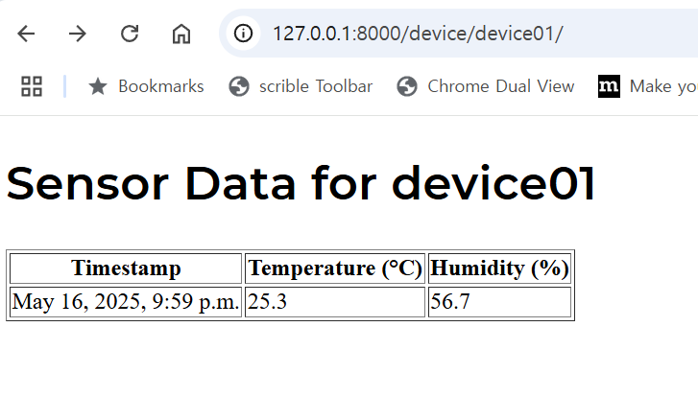
Visit http://localhost:8000/device/device01
Notes:
In the web browser, visit http://127.0.0.1:8000/device/device01
It will show the temperature and humidity as shown in the slide.

Slide 23
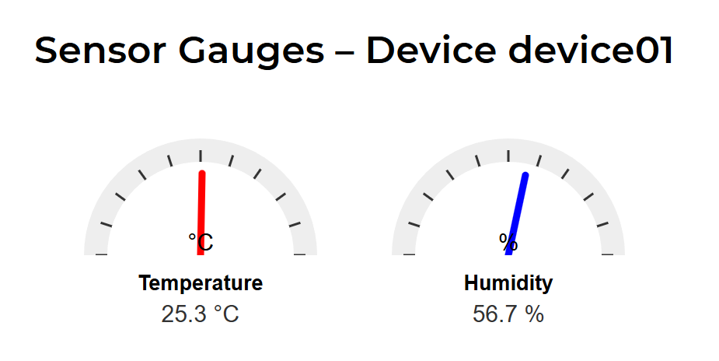
Visit http://localhost:8000/device/device01/gauge/
Notes:
If we want graphical display of temperature and humidity, we may add sensor_gauge_view function in the view.py and add a path pattern in urls.py.
You may refer the source code at github.

Slide 24
Summary
django-admin startproject is used to create the basic structure and default files of a new Django project.
The command python manage.py startapp is used to create the basic file structure for a new Django app.
python manage.py makemigrations is used to create new migration files based on the changes you made to your models.py
python manage.py migrate is used to apply the migrations to the actual database.
Notes:
In summary,
We have used django-admin startproject command for creating its default directory structure and essential configuration files.
We have used python manage.py startapp command to set up the foundational files and folders needed for a new Django app.
python manage.py makemigrations generated migration files to record changes made to our models in models.py.
And finally, python manage.py migrate takes those migration files and applies them to the actual database, creating or modifying tables as needed.
AI tools such as ChatGPT can be used to get assistance in developing Django web application.
Thank you for your attention.

