Slide 1
Developing a Django Web Application for IoT Data
Developing a Simple Django Web Application in a Remote Server
Jong-Dae Park
Notes:
In this module, we will develop a simple Django Web Application in a Remote Server.
Developing a django Web Application in a Remote Server is similar to the Django Web Application in a local computer.
Since we use one server for many users, we cannot use the Django development server.
Rather, we will use a gunicorn WSGI server and Nginx reverse proxy to host django applications for many users using only one server.

Slide 2
Learning Objectives
Get Experienced in Django Web Framework
Meet Customers Requirements for IoT App
Using AI tools such as ChatGPT to develop Web Applications
Notes:
We will use the almost same code to develop Django application in a remote server.
Practices several times are important to get competencies in programming and web development.

Slide 3
Development Environment
/home/username
/srv/php/username : php web application – week 9
/srv/django/username : django application – week 10
/srv/spring/username : spring boot application – week 11
/srv/nodejs/username : nodejs application – week 12
Notes:
we will use a gunicorn WSGI server and Nginx reverse proxy to host multiple django applications using only one server.

Slide 4
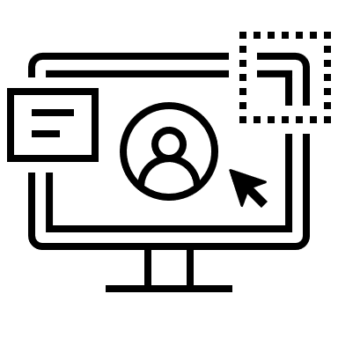

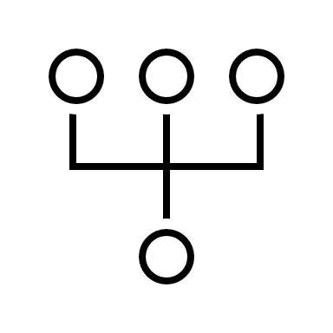
Hosting Multiple Users using a Single Server
django_username.sock
User 1
User 1 port 8001 or 9001
User 2 port 8002 or 9002
User 2
Port 8001~8080 for spring boot app
80/443 ports
Port 9001~9080 for nodejs app
Each user's Django app is assigned a unique subdomain, which maps incoming requests to the appropriate socket managed by Supervisor. => Isolate user’s Django applications.
Notes:
We are going to use only one server but we want users’ environments to be isolated as possible.
Each user is assigned a unique subdomain, which maps incoming requests to the appropriate port or socket.
We will use port numbers to isolate each users’ spring boot applications and nodejs applications.

Slide 5
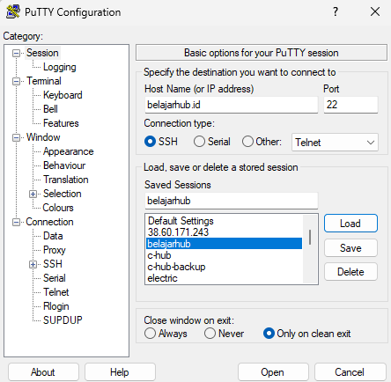
Use putty program
Notes:
To securely connect to your server from a Windows computer, we will use PuTTY.
In the ‘Host Name’ field, type your server’s IP address or domain name — for example: your-subdomain.belajarhub.id
Click open.

Slide 6
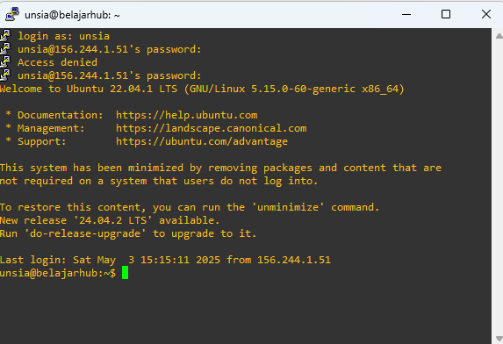
Connect to your server
Your username : your name initial 1 character + last 5 digits of your student ID
Your Password : Your_username*01
Notes:
You'll be prompted for your server's username (Your name initial and last 5 digits of your student ID)
Then, enter the password. The default password is your username*01
For security, it won’t show the characters as you type.
Once logged in, you’ll see a command-line interface — and you’re now connected to your server over a secure SSH connection.

Slide 7
How to edit source code at the server?
Use vim (recommended)
Use VS Code with SSH to Develop on a Remote Server
Install Remote – SSH extension
Press Ctrl+Shift+P (or Cmd+Shift+P on Mac)
Type and select: Remote-SSH: Connect to Host...
username@username.belajarhub.id
Enter your password.
Notes:
We can edit the source code using nano or vim.
Or, we can use vscode with SSH to connect to the remote Server.
To use Visual Studio Code to develop directly on a remote server,
First, make sure you have the Remote - SSH extension installed in VS Code. Next, open the command palette by pressing Ctrl + Shift + P on Windows or Cmd + Shift + P on macOS.
In the command palette, start typing "Remote-SSH: Connect to Host..." and select the matching option when it appears.
You’ll then be prompted to enter the address of your remote server. Type in: username@username.belajarhub.id — replacing "username" with your actual user ID.
When prompted, enter your password. After a successful login, you'll be connected to the remote development environment — ready to start coding directly on the server.
When you connect to a remote server using VS Code via SSH, a VS Code Server is automatically launched on the server side.
This server component consumes system resources to enable remote development features.
However, when multiple users connect simultaneously using Remote SSH, the combined resource usage can put a load on the server.
As a result, the server may slow down due to the increased load caused by running multiple instances of the VS Code Server.
It is recommended to use Vim to edit the source code on the server.

Slide 8
Development of web application in a Server
Refer https://github.com/jdpark7/unsia-iot/tree/main/week10
cd to your django folder at /srv/django/username/ in (username.belajarhub.id)
django-admin startproject myproject .
cd myproject
python -m venv venv
source venv/bin/activate
python manage.py startapp iot
Edit settings.py in myproject folder
Edit files in iot folder
python manage.py makemigrations iot
python manage.py migrate
python manage.py collectstatic
Notes:
The development procedure of Django web application in a remote server is very similar to that of local development.
In this part of the project, we’ll use a virtual environment, or venv, to manage our Python dependencies.
Go to your Django app folder /srv/django/username.
First, make sure your virtual environment is activated by running source venv/bin/activate

Slide 9
Edit settings.py – add corsheaders
INSTALLED_APPS = [
.
.
'rest_framework’,
'corsheaders',
]
MIDDLEWARE = [
'corsheaders.middleware.CorsMiddleware’,
.
.
]
Notes:
Next, open the settings.py file located in the myproject folder.
To enable Cross-Origin Resource Sharing in a Django project, we need to use the corsheaders app.
First, make sure to add 'corsheaders' to the INSTALLED_APPS list in your settings.py file. This registers the app with Django.
Next, you must include 'corsheaders.middleware.CorsMiddleware' in the MIDDLEWARE array — and it should be placed near the top, ideally just after 'django.middleware.security.SecurityMiddleware’.
This ensures that CORS headers are added to responses before any other middleware processes them.
The corsheaders app is essential when you have frontend clients — such as JavaScript applications or browser-based dashboards — that are served from a different origin, like a subdomain or a different port.
For example, when a client sends a request to your Django app through a subdomain, that request is passed to the Gunicorn server via a UNIX or TCP socket.
Even though the backend and frontend are part of the same overall system, the browser sees them as cross-origin — and blocks the request unless proper CORS headers are set.
By using the corsheaders app, we explicitly tell the browser which domains are allowed to access our server — ensuring smooth, secure cross-origin communication.

Slide 10
Create iot app
python manage.py startapp iot
Then
Edit files in iot folder refer https://github.com/jdpark7/unsia-iot/tree/main/week10
Add templates folder and template files
Notes:
Now, let’s create a new Django app named iot. To do that, enter:
python manage.py startapp iot.
After creating the app, edit the relevant files in the iot folder — such as models.py, views.py, and urls.py.

Slide 11
myproject urls.py
urlpatterns = [
path('admin/', admin.site.urls),
path('', include('iot.urls')),
]
iot.urls.py
urlpatterns = [
path('api/sensor/', views.receive_sensor_data, name='receive_sensor_data'),
path('api/sensor /<str:device_id>/', views.get_device_data_api, name='get_device_data_api'),
path('device/<str:device_id>/', views.device_data_view, name='device_data_view'),
path('device /<str:device_id>/gauge/', views.sensor_gauge_view, name='sensor_gauge_view'),
]
Notes:
Add urls.py in the iot folder.
In Django, URL configuration is how we map web addresses to specific functions that handle the request.
We start with the project-level urls.py file:
This file tells Django how to route URLs at the global project level. The line path('admin/', admin.site.urls) sets up the admin interface at the /admin/ URL.
The second line — path('', include('iot.urls')) — includes the URL patterns from our iot app. That means any URL not starting with /admin/ will be handled by the iot/urls.py file.
Now, let’s look at the app-level urls.py file inside the iot app.
The first parameter of the path function is the URL pattern that the client will request. The second parameter specifies the function or class-based view that will handle the request.
For example, the route 'api/sensor/' points to the receive_sensor_data view. This view is likely used for devices to send sensor data to the server, typically via a Post request.
The name parameter in path function is used for reverse URL resolution, template navigation, and maintainable URL management in Django applications.

Slide 12
'<str:device_id>' in Django URL patterns
It’s a feature used in Django’s URL dispatcher to extract variables from the URL and pass them into view functions.
If the user accesses /device/abc123/,
Django will call:
device_data_view(request, device_id='abc123’)
Notes:
In Django, we can define dynamic parts of a URL using path converters like <str:device_id>.
This allows our application to extract information directly from the URL.
If a user accesses the URL /device/abc123/, Django will automatically extract the value 'abc123' from the URL and pass it as an argument to the view function.

Slide 13
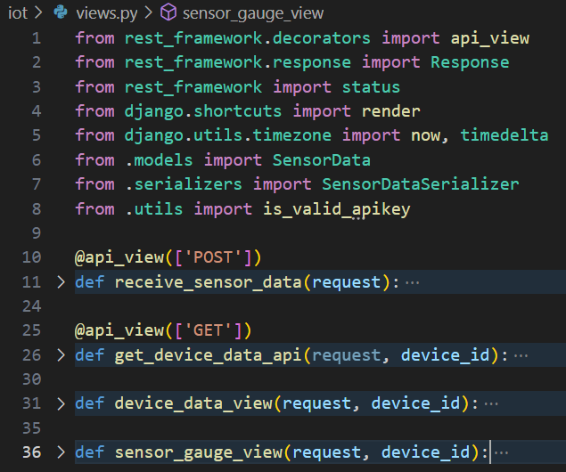
Edit views.py
Notes:
In Django, the view.py file plays a central role in how your web application responds to incoming requests.
It contains the logic that processes data and determines what the user should see or receive.
In simple terms, a view is a Python function or class that takes a web request and returns a web response.
This response could be an HTML page, a JSON object, a redirect, or even an error message.
Each view is linked to a specific URL pattern through the urls.py file.
When a request comes in, Django looks at the URL, finds the matching view, and runs the associated function or class.

Slide 14
Add additional files to iot folder
Add serializers.py
Add utils.py
Add templates folder
Add sensor_data.html file in the template folder
Notes:
We add the serializers.py file in the IoT folder.
In Django Rest Framework, the serializers.py file plays a key role in converting complex data — such as Django model instances — into formats like Json, which can be sent over the web.
We will use a python file, named utils.py which will be used for validating API keys in view.py.
In Django, a template file is used to define the structure and presentation of your website’s front-end
For this we make template folder and create sensor_data.html file in the template folder.

Slide 15
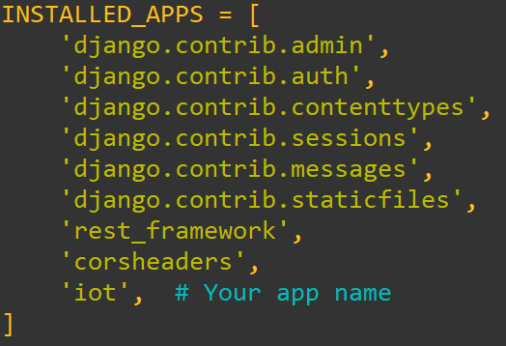
Add iot in the Installed app in settings.py
Notes:
We need to edit settings.py file in myproject folder.
Goto the my project folder and add iot in the Installed Apps array.

Slide 16
Create a database and edit admin.py
Database migration
python manage.py makemigrations iot
python manage.py migrate
python manage.py collectstatic
Edit admin.py for the object description in the admin page
Create superuser who can login admin page
Refer https://github.com/jdpark7/unsia-iot/tree/main/week10/iot
Notes:
Once the models are ready, create migration files with:
python manage.py makemigrations iot
Then, apply the migrations to the database:
python manage.py migrate
Finally, if you're using static files in your project, don’t forget to collect them using:
python manage.py collectstatic.
With that, your Django app is now structured and ready for further development and testing.

Slide 17
Edit admin.py
from django.contrib import admin
from .models import SensorData
@admin.register(SensorData)
class SensorDataAdmin(admin.ModelAdmin):
list_display=('temperature','humidity','timestamp')
Notes:
To make your Django app manageable through the admin interface, you’ll need to configure the admin.py file. In this file, register the models you’ve created so that they appear on the Django admin page. You can also customize how objects are displayed by modifying their list and detail views.

Slide 18
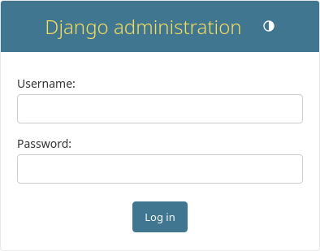
Creating an superuser
python manage.py createsuperuser
Username: admin
Email Address : your-email-address
https://your-domain/django/admin
Notes:
Next, you’ll need to create a superuser — a special account with full access to the Django admin panel. To do that, run the following command:
python manage.py createsuperuser
You’ll be prompted to enter a username, email address, and password.
Once the superuser is created, you can log in to the admin site by visiting.
https://your-domain/admin

Slide 19
We will use a Gunicorn WSGI Server
manage.py runserver is intended for development purpose.
Gunicorn is a production-grade WSGI server designed for speed, stability, and concurrency.
Gunicorn works well behind a reverse proxy like Nginx, which handles HTTPS, static file serving, and load balancing.
This is a standard and scalable architecture for deploying Django applications.
Gunicorn can be run under a process manager like Supervisor.
Notes:
While Django’s built-in manage.py runserver command is useful during development, it’s not designed for production use.
For a production environment, we use Gunicorn, a WSGI server that is optimized for speed, stability, and handling multiple requests concurrently.
Gunicorn is typically deployed behind a reverse proxy, such as Nginx. In this setup, Nginx takes care of serving static files, handling HTTPS encryption, and distributing traffic — while Gunicorn handles the application logic.
This combination of Nginx + Gunicorn is widely considered a standard and scalable architecture for deploying Django applications.
To ensure that Gunicorn stays running even after a reboot or a crash, we use a process manager like Supervisor. Supervisor monitors the Gunicorn process and automatically restarts it if needed, making the deployment more reliable.

Slide 20
How to start gunicorn in your folder
Instead of using supervisorctl restart, start, status, stop:
Use following commands in /home/username/bin
restart_mine.sh
start_mine.sh
status_mine.sh
stop_mine.sh
Notes:
There are many Django applications running in the server and it is necessary for each user to restart their own Django applications, not affecting other applications.
Please use the commands in /home/username/bin folder to start and stop your gunicorn server.
You can Use restart_mine.sh to restart your service and
You can Use stop_mine.sh to stop the service.

Slide 21
Send data using curl command
unsia@belajarhub:/srv/django/unsia$ /home/unsia/bin/restart_mine.sh
unsia@belajarhub:/srv/django/unsia$ curl -X POST https://unsia.belajarhub.id/django/api/sensor/ -H "Content-Type: application/json" -d "{\"apikey\":\"abc123\", \"device_id\":\"device01\", \"temperature\":25.3, \"humidity\":56.7}"
Notes:
Let’s run the remote server and send a data to the server using curl.
Copy and paste the curl command in the Putty terminal to send the data using curl.

Slide 22
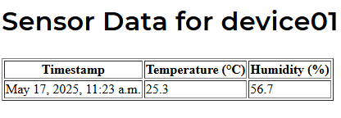
https://your-domain. belajarhub.id/django/device/device01/
https://github.com/jdpark7/unsia-iot/tree/main/week10/iot
Notes:
In the web browser, visit https://your-domain. belajarhub.id/django/device/device01
It will show the temperature and humidity as shown in the slide.

Slide 23
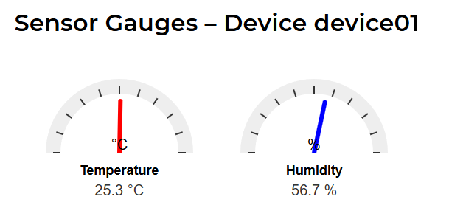
https://your-domain. belajarhub.id/django/device/device01/gauge/
https://github.com/jdpark7/unsia-iot/tree/main/week10/iot
Notes:
If we want graphical display of temperature and humidity, we may add sensor_gauge_view function in the view.py and add a path pattern in urls.py.
You may refer the source code at github.

Slide 24
Summary
We have developed a simple Django Web Application in a Remote Server.
We used a Gunicorn WSGI server with Nginx.
We accessed the admin page of Django App.
Notes:
In this session, we successfully developed a simple Django web application on a remote server.
For deployment, we used Gunicorn, a high-performance WSGI server, and placed it behind Nginx, which handled client requests, static files, and reverse proxying.
After setting everything up, we accessed the Django admin page through the browser — confirming that our application was running smoothly and ready for further development or management.
Thank you for your attention.

