Slide 1

Université d’Ottawa | University of Ottawa
Lung Cancer Diagnosis
Leveraging CT-Scans for Precise Diagnosis
Presented By:
Ketul Patel
Vibhu Puri
This presentation is submitted to Professor Ali Hassan Abbas in partial fulfilment of the requirements for course ELG 6131
www.uOttawa.ca

Slide 2

Overview
Problem
Project Approach
Challenges
Demonstration
Future Work

Slide 3
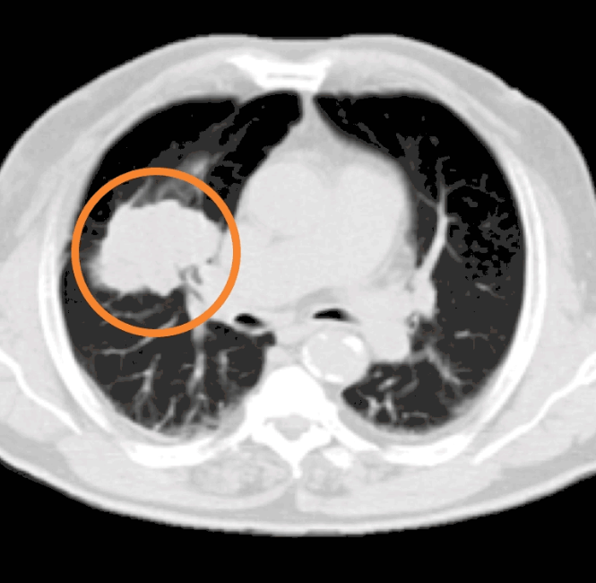
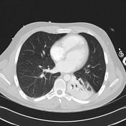
Problem
Non-Small Cell Lung Cancer (NSCLC)
- Common lung cancer type
- Characterized by rapid cell growth
Importance of Early Diagnosis
- Vital for timely intervention
- Enhances treatment effectiveness
Key Role of Detection
- Distinguishes NSCLC from similar diseases
- Guides appropriate diagnostic pathways
Stage 4 Lung Cancer
Pneumonia

Slide 4
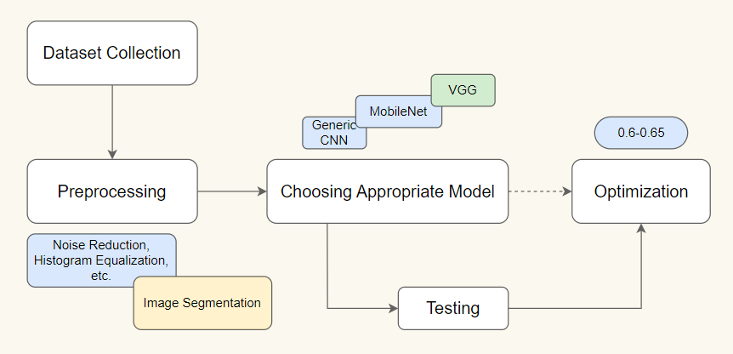
Project Approach

Slide 5
Challenges
**Challenges in Medical Dataset Collection:**
1. **Data Quality and Integrity:**
- Ensuring accurate, complete, and reliable patient information.
- Addressing issues like missing data and inconsistencies.
2. **Data Diversity and Privacy:**
- Managing diverse formats and sources.
- Ensuring compliance with privacy regulations and safeguarding sensitive information.
**Challenges in Cleaning Medical Data:**
1. **Outlier and Noise Handling:**
- Identifying and dealing with outliers.
- Reducing noise to maintain data accuracy.
2. **Data Standardization and Duplicate Resolution:**
- Normalizing measurements and resolving duplicate records.
- Ensuring consistency and a single accurate representation.
**Efforts in Preprocessing for Improved Model Accuracy:**
1. **Feature Engineering and Augmentation:**
- Extracting meaningful features.
- Augmenting data for model robustness.
2. **Normalization and Class Imbalance:**
- Scaling and centering data.
- Addressing class imbalances for fair representation.

