Slide 1

Towards process migration in Windows 10
Master Computer Science – Cyber Security
Wietze D. Mulder
Radboud University Nijmegen
July 12, 2023

Slide 2
Agenda
What is process migration?
Research Question 1: Is process migration possible?
Research Question 2: Can we migrate malware?
Conclusions & Recommendations
Questions?

Slide 3


What is process migration?

Slide 4
Process migration: background
What is a process?
What is a thread?
What is virtual memory?

Slide 5

Why process migration?
Why is process migration in Windows 10 relevant?
Does not exist yet
Already done in Linux
How can this be useful for malware analysis?
83% of malware in Windows

Slide 6
Process migration: Feasibility
Research Question 1:
Is it possible to migrate a running process from one Windows 10 machine to another machine?

Slide 7
Process migration:
Overview of the main approach used

Slide 8
Process migration:
Scope
Windows 10 only (version 22H2).
x86-64 bit architecture.
No GUI applications.
Only in user-space; we cannot modify kernel-space

Slide 9
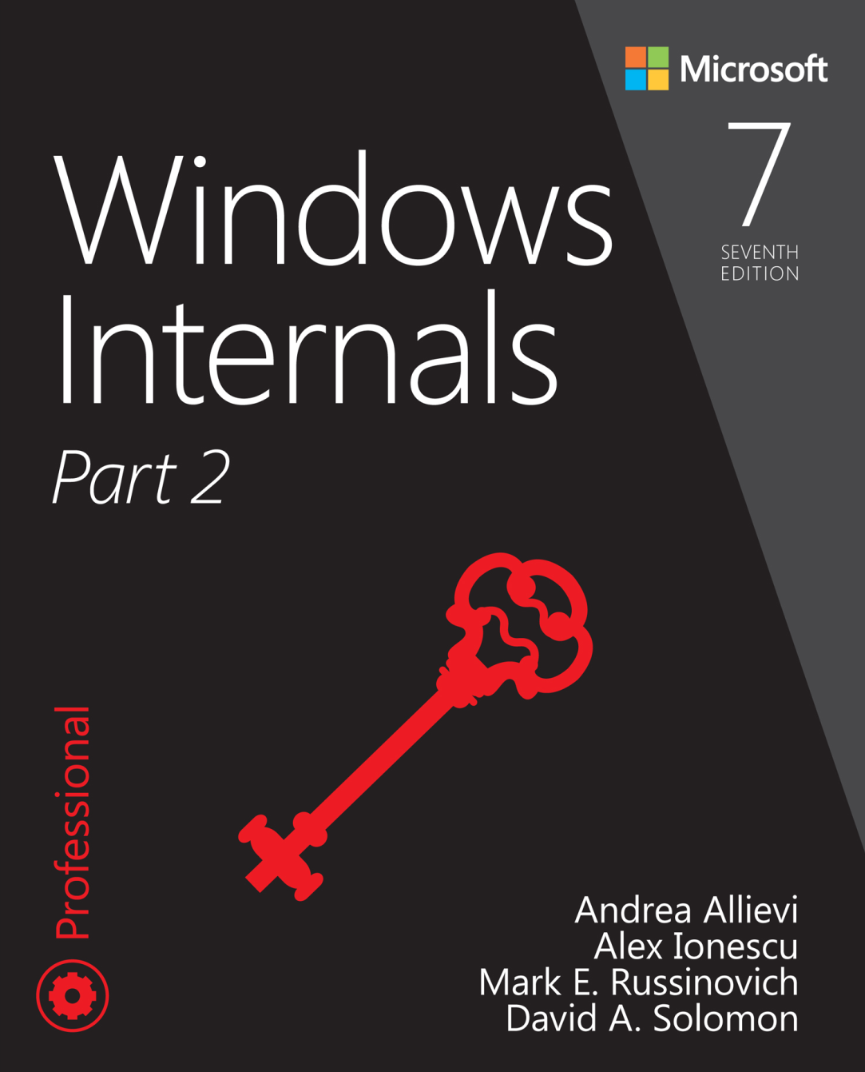
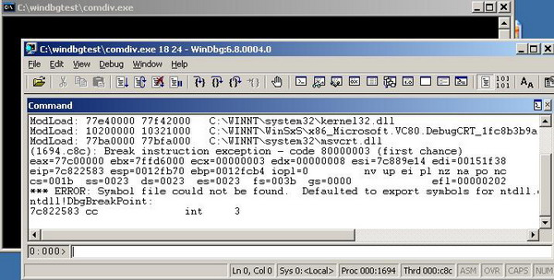
Process migration:
A lot of Windows API calls
Windows API calls are mostly documented
Not everything however

Slide 10
Process migration:
Chosen approach
Migrating threads
Migrating Memory
Migrating external resources

Slide 11
Process migration:
A) Migrating threads
Collecting Threads
Get list of thread of process
Get thread registers (GetThreadContext)
Restoring Threads
Create thread (CreateRemoteThread)
Set thread registers (SetThreadContext)

Slide 12
Process migration:
B) Migrating memory
Collect info & content per memory region
Start an empty process + process initialization
Allocate content per memory region
Adjust metadata of new process

Slide 13
Process migration:
B) Collecting memory
Iterate over every memory region in the virtual memory:
Collect information about memory region (VirtualQueryEx)
Read Content (ReadProcessMemory)

Slide 14
Process migration:
B) Restoring memory
Start ‘Empty.exe’
  For correct initialization

Slide 15
Process migration:
B) Restoring memory
Start ‘Empty.exe’
For every memory region:
  Allocate if region is free (VirtualAllocEx)
  Write content to region (WriteProcessMemory)
  Adjust read/write protection (VirtualProtectEx)

Slide 16
Process migration:
B) Migrating Memory: adjusting the metadata
What is the metadata?
  EPROCESS structure
  Process Environment Block (TEB)
  Thread Environment Block (TEB)
How to restore the metadata?

Slide 17
Process migration:
C) Migrating external resources: what is a handle?
A handle table for every process
For communication with external resources
Around 70 different types of handles

Slide 18
Process migration:
C) Migrating external resources: chosen approach
External sources we can migrate:
  Files
  Console handles (standard in/out)
  Events, Mutexes, Semaphores

Slide 19
Process migration:
C) Collecting handles
Retrieve all handles from the system
For every handle with a matching
process ID:
  Copy handle to checkpoint process (DuplicateHandle)
  Read index, name, type, and access granted (NtQueryObject)
Source machine

Slide 20
Process migration:
C) Restoring handles
Iterate over every handle from the checkpoint file
For every handle:
  Create the handle (type specific)
  Copy handle over to restored process
Destination machine

Slide 21
Process migration:
C) Migrating files
Information to collect:
Filename (NtQueryObject)
Content of file (ReadFile)
Current position in file (SetFilePointerEx)
Restoring a file:
Create the file (CreateFile)
Write the content (WriteFile)
Set current position in file (SetFilePointerEx)

Slide 22
Process migration:
C) Migrating console handles
How to collect console handles:
Find console handle type in handle table
Locate standard in/out/err from metadata
How to restore console handles
Inherited from checkpointing process
Placed at the start of the handle table
Also duplicated at position of standard in/out

Slide 23
Process migration:
C) Events, mutexes, semaphores
How to Collect:
Events
Mutex (WaitForSingleObject, ReleaseMutex)
Semaphore (NtQuerySemaphore)
How to Restore:
Events: (CreateEvent)
Mutex: (CreateMutex)
Semaphore: (CreateSemaphore)

Slide 24
Process migration: Verification
Demonstration

Slide 25
Process migration: Viability
Research Question 2:
To what extent is process migration a useful method for the analysis of malware?

Slide 26

Real-world malware
\
Motivation
Possible challenges
We have tried to migrate two malware samples
  Shadowpad malware
  Turian malware

Slide 27
Real-world malware
Turian malware (sample of malware)
Behavior:
Creates a service and starts the service
The service connects to C2 server
Goal: migrate the service

Slide 28
Real-world malware – Crash report
Migrate the process
Attach debugger before we resume the process
Observation: Crash due to missing ALPC Port handle (Inter-process communication)

Slide 29
The issue with handles

Slide 30
Final notes
Conclusions

Slide 31
Conclusions
Research Question 1:
Process migration is possible in Windows 10
Threads & memory can be migrated
A selection of handles can be migrated
Research Question 2:
A great start for migrating malware
Further research to migrate more handle types

Slide 32
Final notes
Find the code on Github:
https://github.com/keukentrap/process-copy

Slide 33
What makes process migration challenging?

Slide 34
Extra: Networking

Slide 35
Agenda
What is process migration?
Research Question 1: Is process migration possible?
Research Question 2: Can we migrate malware?
Conclusions & Recommendations
Questions?

