Slide 1




2023-08-07
Connection through SSH
(VS Code or MobaXterm)
Security barrier

Slide 2

1. VPN (local IP)
Location A
Location B
2. Connection through SSH
1. VPN (local IP)
Location A
Location B
2. Connection through SSH
(VS Code or MobaXterm)
3. Connection through SSH

Slide 3
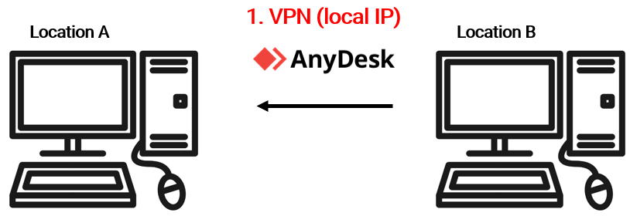
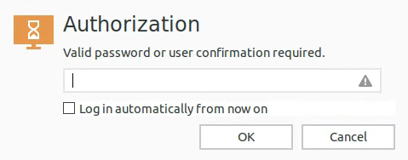
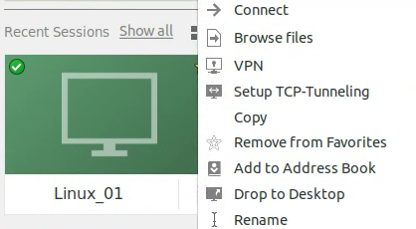
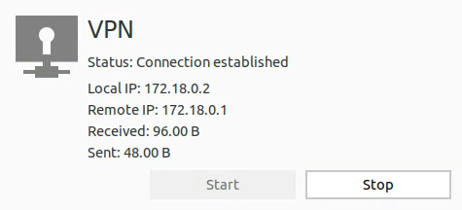
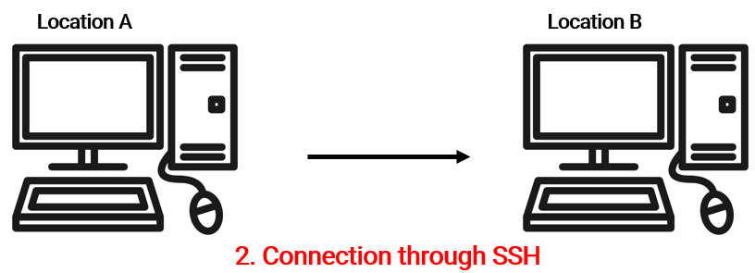

Slide 5
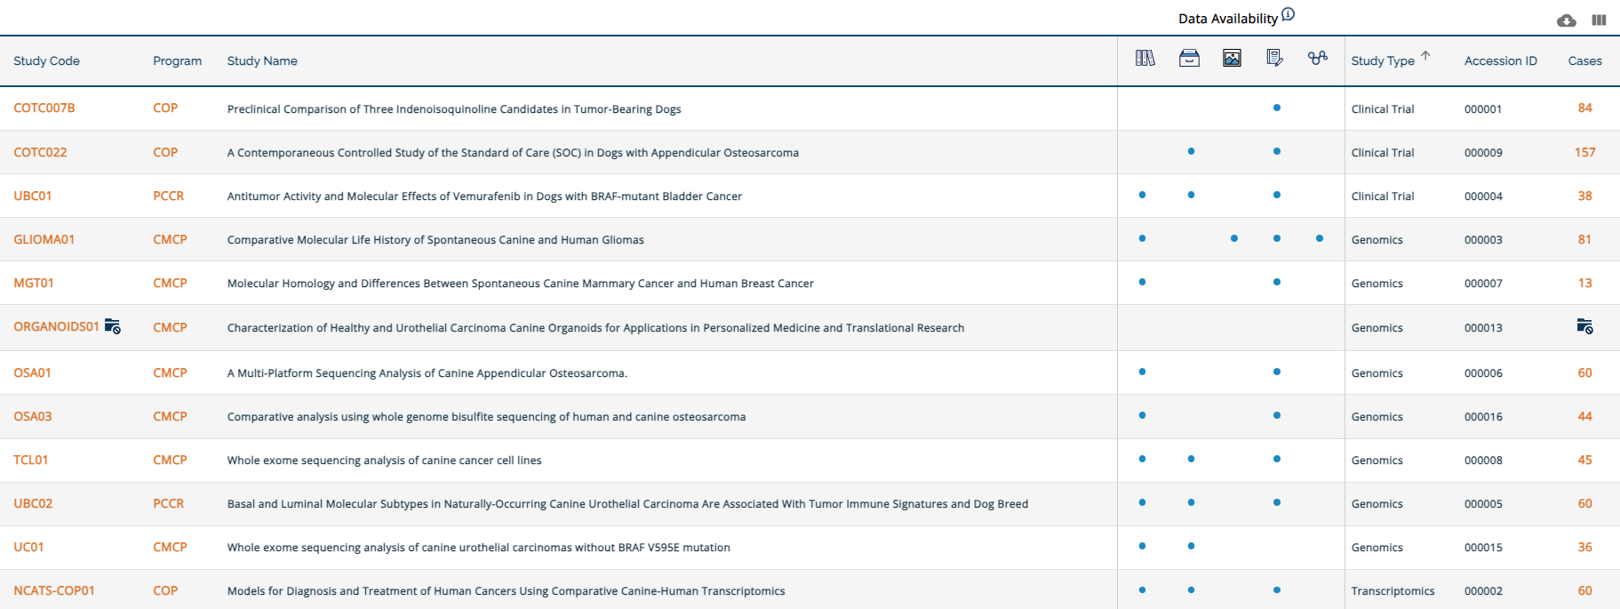
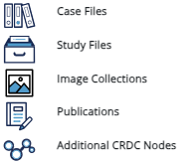
2023-09-18

Slide 6

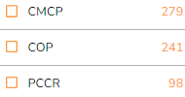
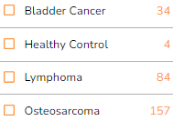
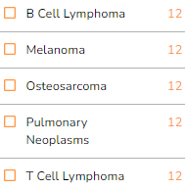
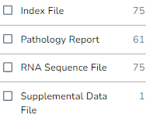



Program
Clinical Trial
Transcriptomics
File Type
.bai
.doc, .pdf, .rtf, .tif
.bam
Study type
Merged read counts
Genomics
download File Manifest from ICGC
upload this file in CGC
get file download link

Slide 7
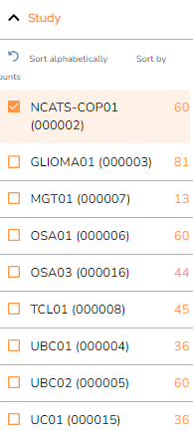
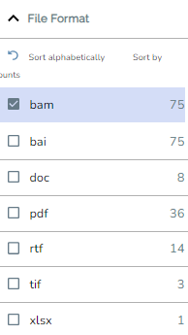
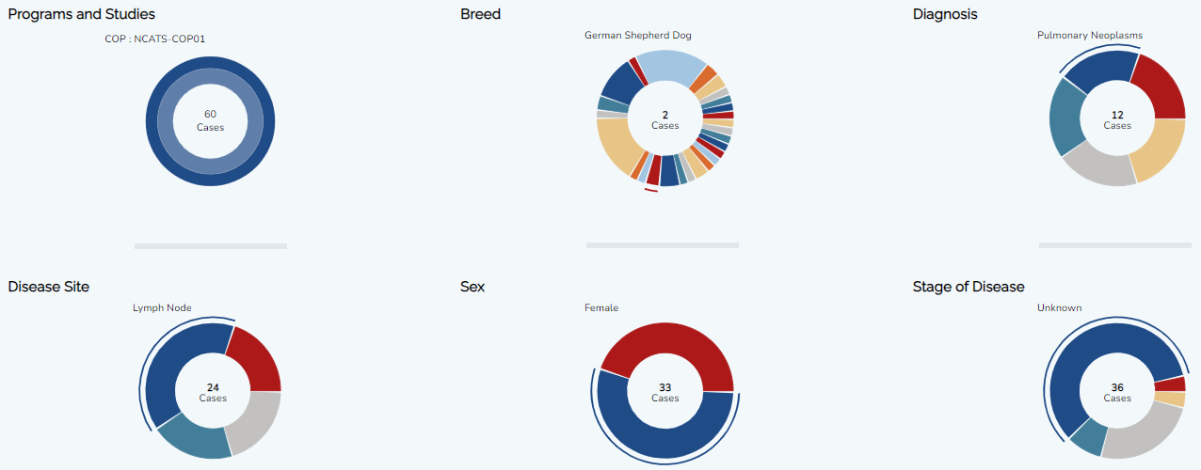

Slide 8



③
①
②
④
⑤ ICDC File Manifest.csv

Slide 9
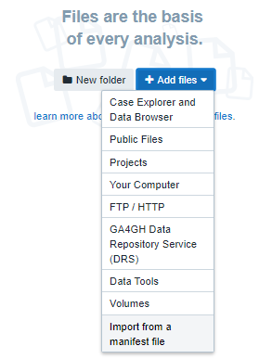
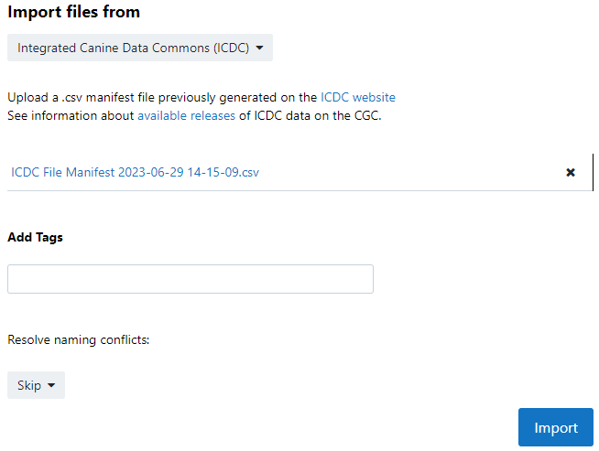
②
①
③

Slide 10

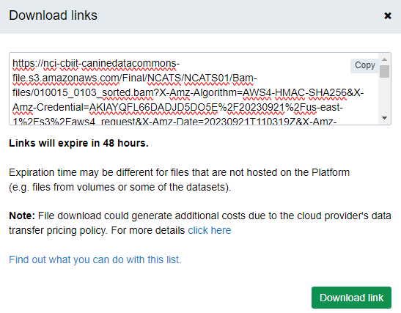
②
①

Slide 11


Slide 12
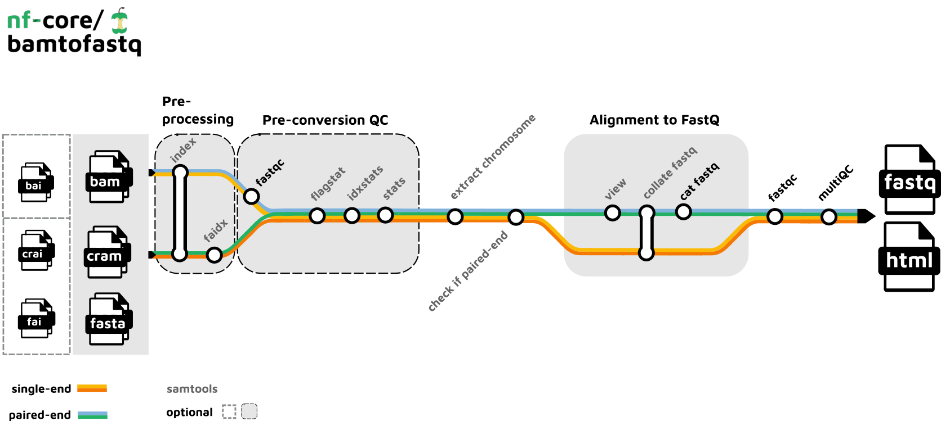
2023-09-19

Slide 13
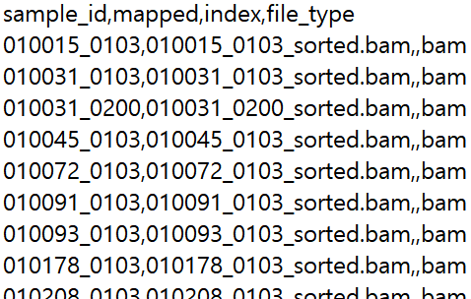

Slide 14
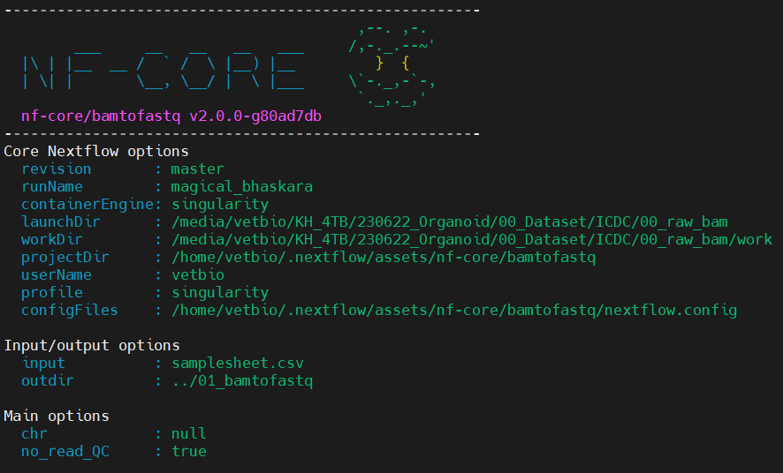

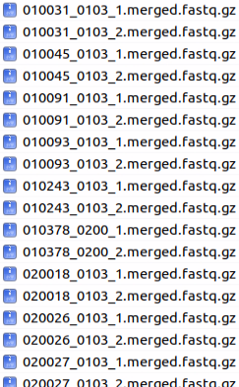

outdir/read/

