Slide 1
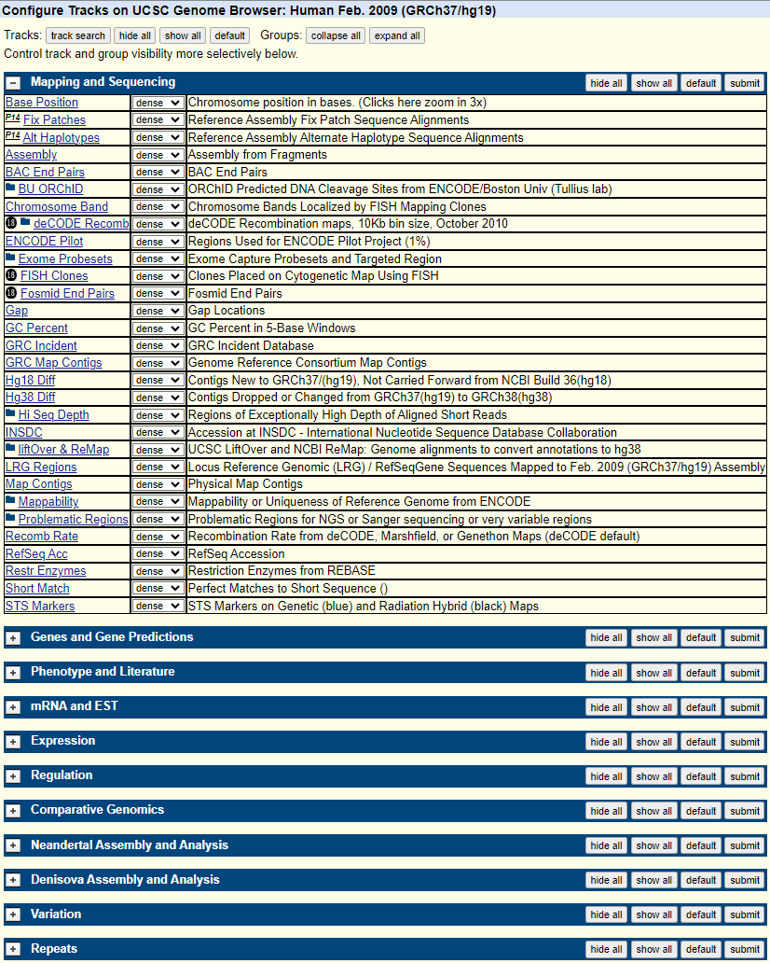
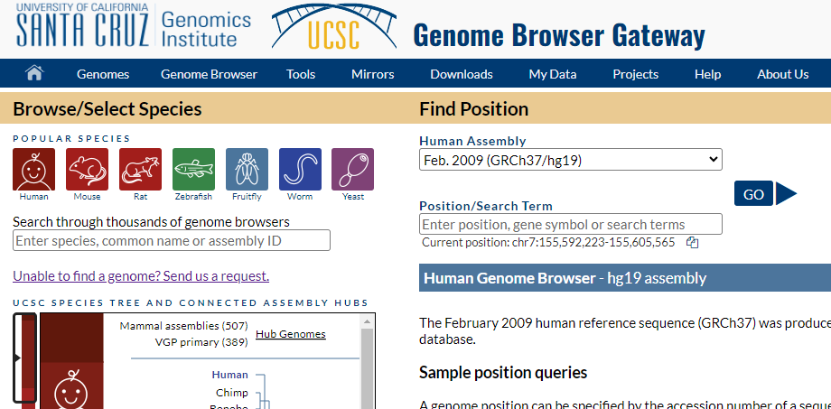
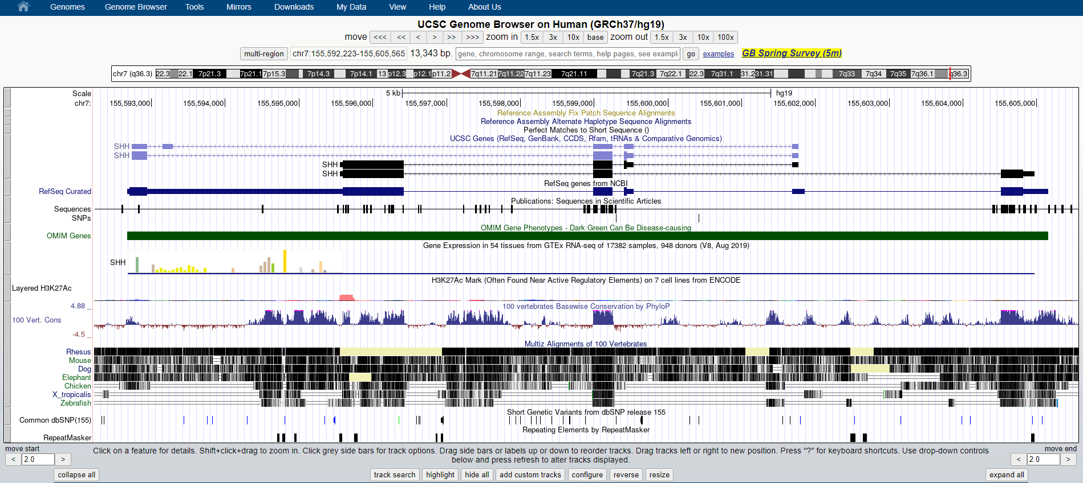
1. Click the “Genomes” button
2. Select the species & genome assembly
3. Click
3. Click the “configure” button

Slide 2
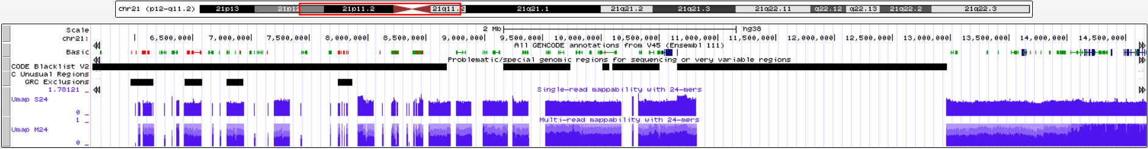
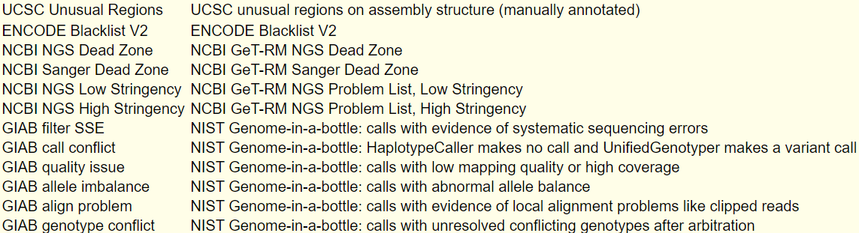
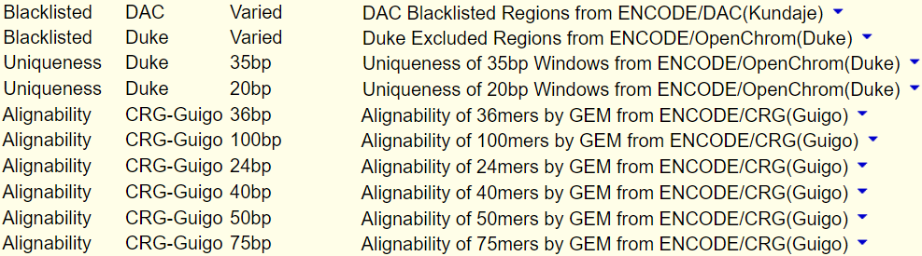
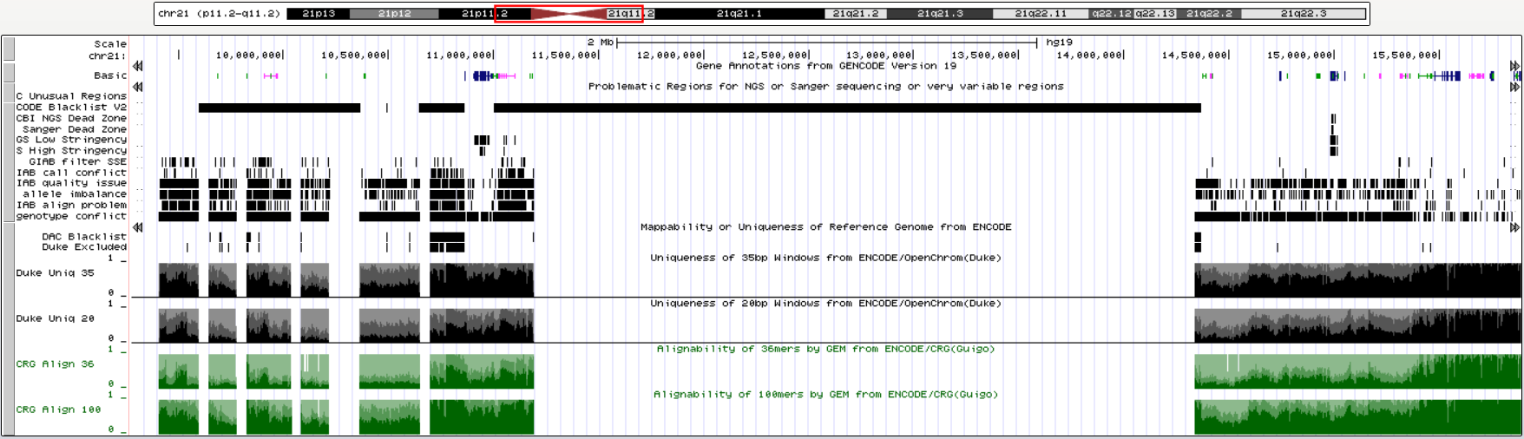
GRCh 38 (hg38)
Problematic Regions
Mappability
GRCh 37 (hg19)
Problematic Regions
Mappability

