Slide 1
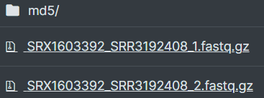
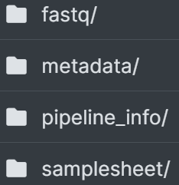

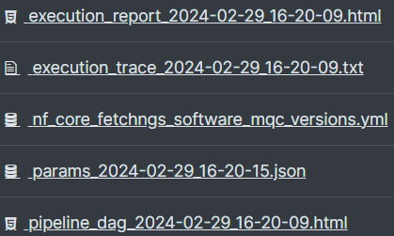
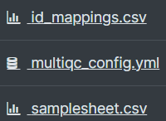

Slide 2
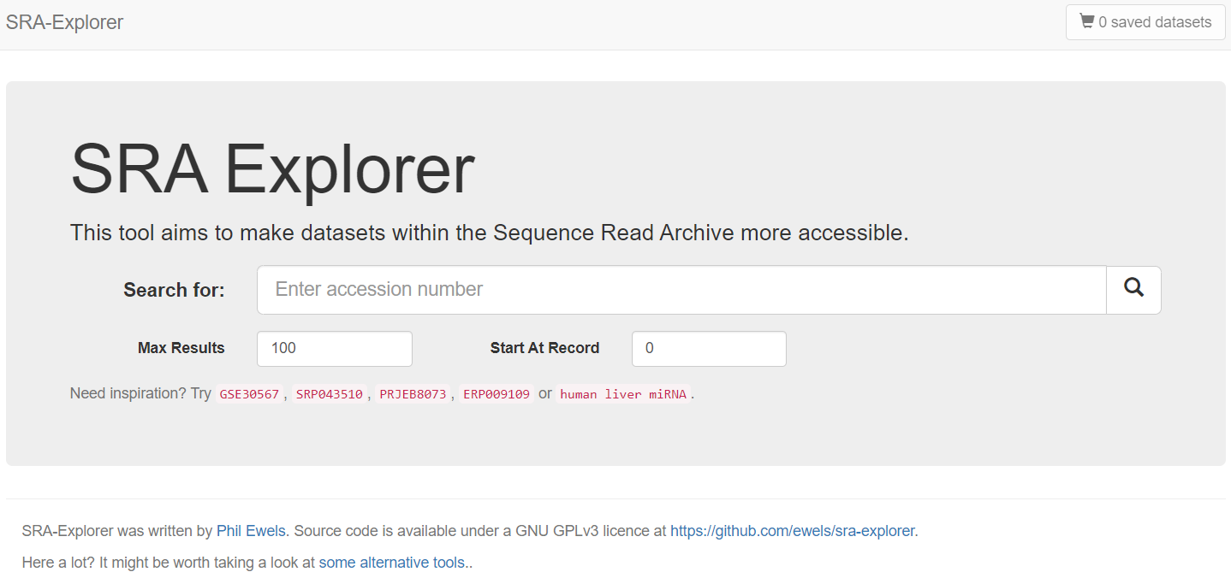
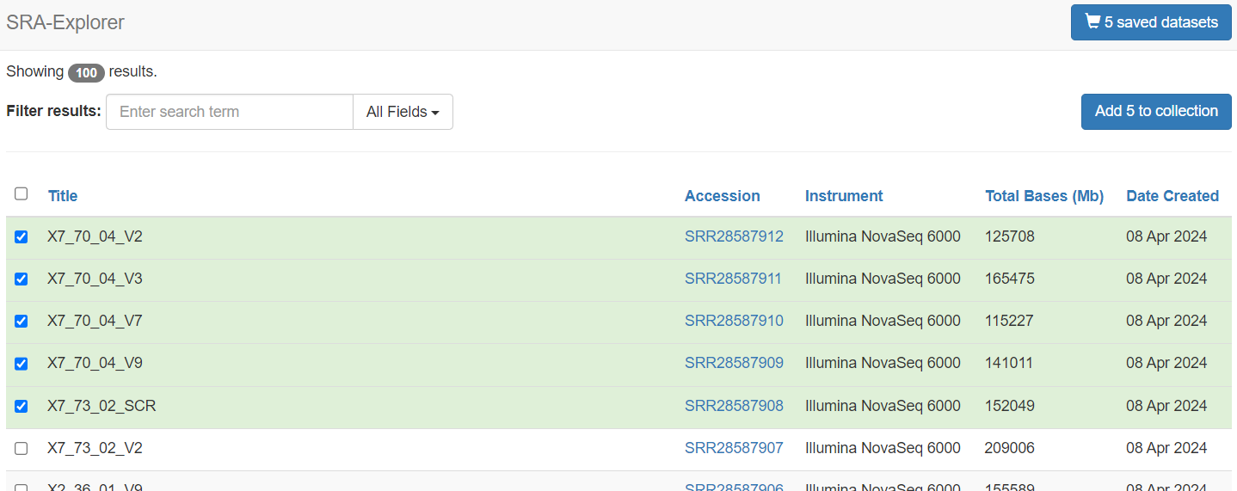
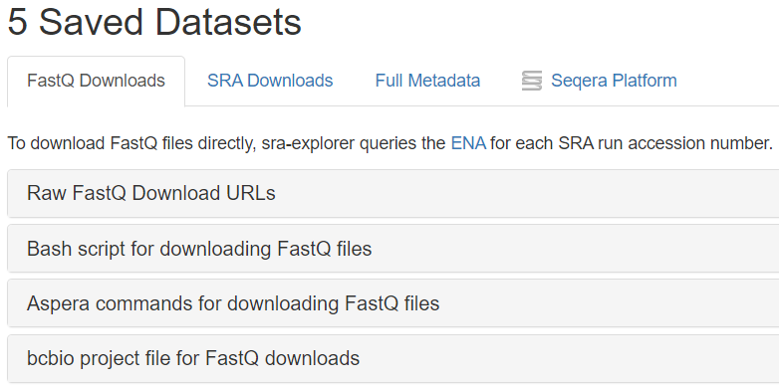
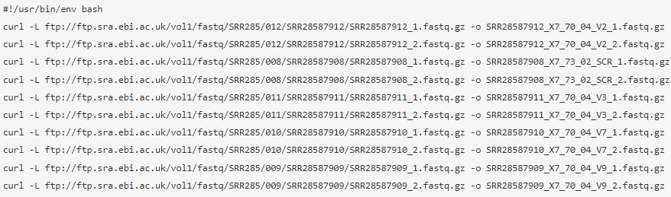
1. Enter “accession number” or
“the keywords as if you are searching in the SRA database”
The results when searching for "Homo sapiens"[Organism] AND RNA-Seq[Strategy].
3. Click “Add to collection”
& move to “saved datasets”
2. Select relevant datasets
4. You can get ftp or aspera download links

Slide 3
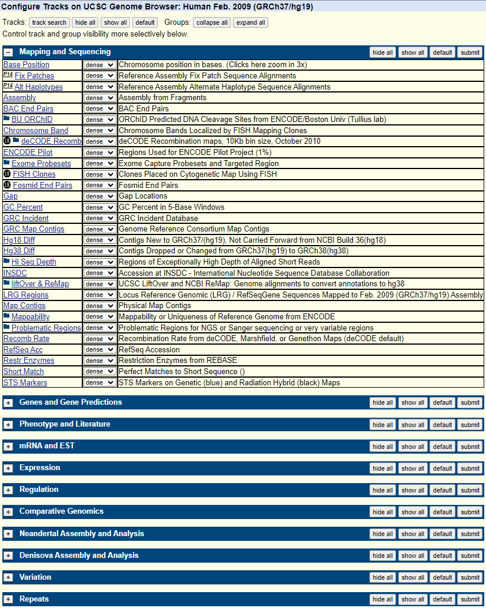
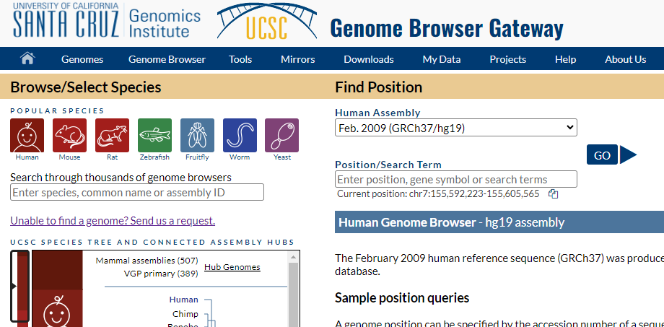
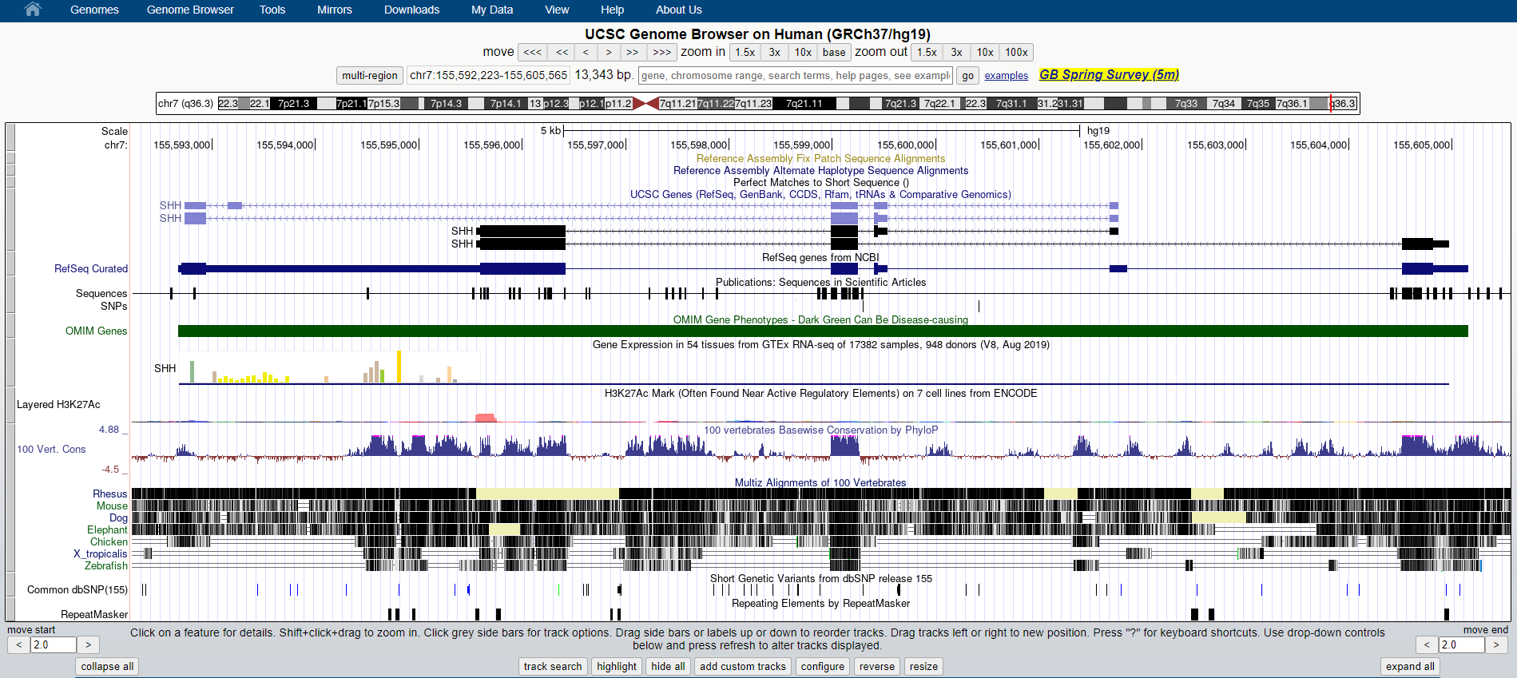
1. Click the “Genomes” button
2. Select the species & genome assembly
3. Click
3. Click the “configure” button

Slide 4
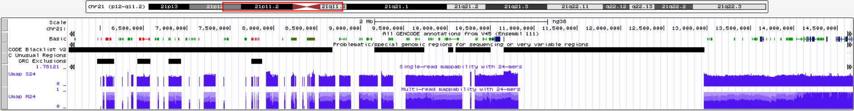
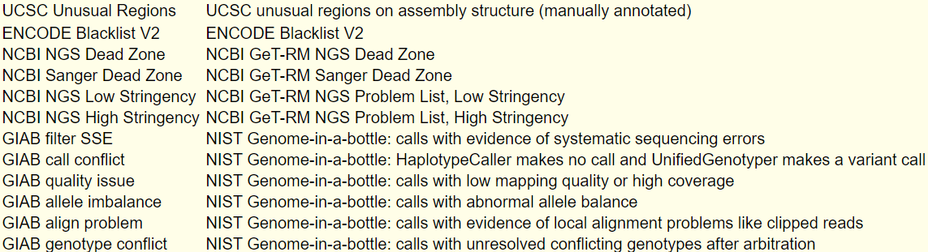
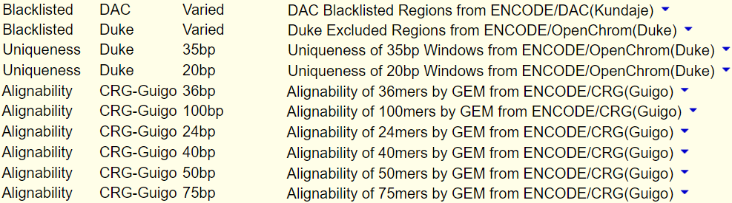
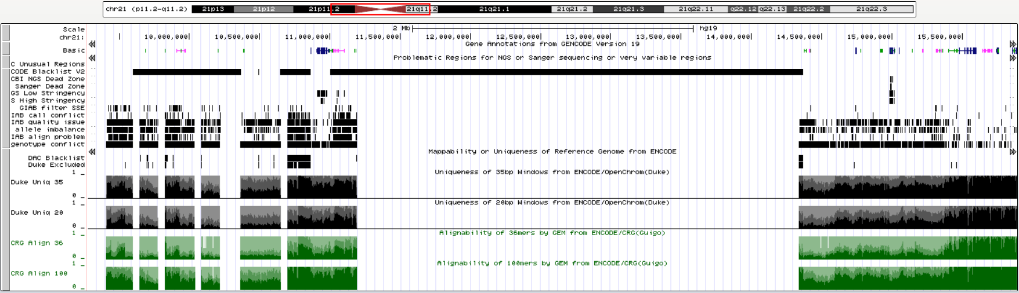
GRCh 38 (hg38)
Problematic Regions
Mappability
GRCh 37 (hg19)
Problematic Regions
Mappability

