Slide 1
Stock Prediction using Machine Learning
Keunjoo Park

Slide 2
Introduction
Make Effective Presentations
Using Awesome Backgrounds
Engage your Audience
Capture Audience Attention

Slide 3
Methodology
Data Pre-Processing
Feature Selection
Data Normalization
Analysis of Different Machine Learning Models
Conclusions

Slide 4
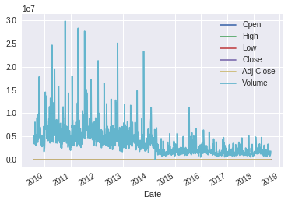
Data Pre-Processing
Data acquisition
Yahoo Finance: Google, S&P 500
Periods: 08/01/2009 ~ 08/31/2018
Base Features: Open, High, Low, Close, Volume, Adjusted Close Prices

Slide 5
Feature Selection
To see more in depth of relationship with stock price and technical analysis index, features added.
To get rid of less useful features, features selected by the R^2 in order.
1, 5 and 10 day percentage changes, EMA, Bollinger Bands, StochK, MACD, CCI, William’s R, Chaikin A/D Oscillator, Moving Average and RSI
'1d_cp','5d_cp','10d_cp','1d_fc','5d_fc','10d_fc','rsi10','wma14','rsi14','rsi30', 'wma50','EMA','upperband','middleband','lowerband','slowk','fastk','fastd','willr

Slide 6
Col | Score | Col | Score | Col | Score
1d_cp | 0.545442 | wma14 | 0.991720 | lowerband | 0.999050
5d_cp | 0.797936 | rsi14 | 0.992252 | slowk | 0.999973
10d_cp | 0.857465 | rsi30 | 0.990177 | fastk | 0.999974
1d_fc | 0.998863 | wma50 | 0.990507 | fastd | 0.999972
5d_fc | 0.997991 | EMA | 0.998609 | willr | 0.999972
10d_fc | 0.997968 | upperband | 0.998970
rsi10 | 0.990891 | middleband | 0.999663

Slide 7
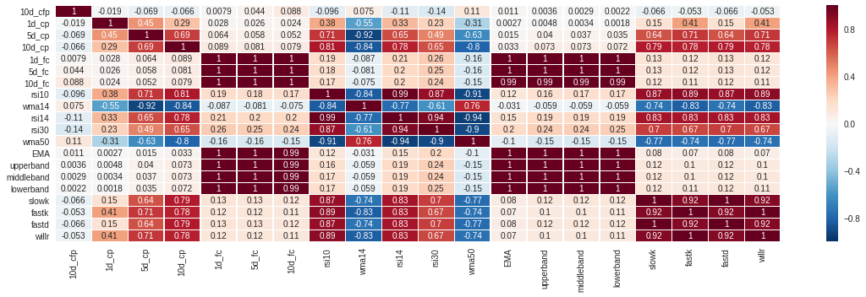

Slide 8
Models Used
Linear Regression
Decision Tree Regressor
Random Forest Regressor
Support Vector Regression
GradientBoostingRegressor

Slide 9
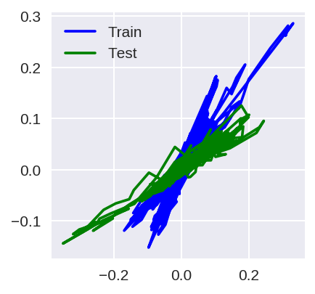
Linear Regressor
R2 score for Training set : 0.8517.
R2 score for test set : 0.6559.

Slide 10
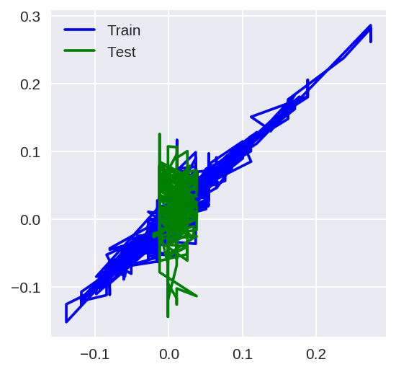
DecisionTreeRegressor
R2 score for training set : 0.8885.
R2 score for test set : -6.0558.

Slide 11
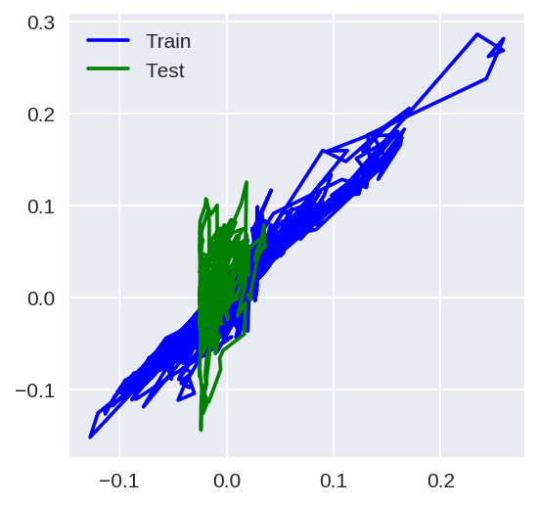
Random Forest Regressor
R2 score for training: 0.8631.
R2 score for test set: -10.9161.

Slide 12
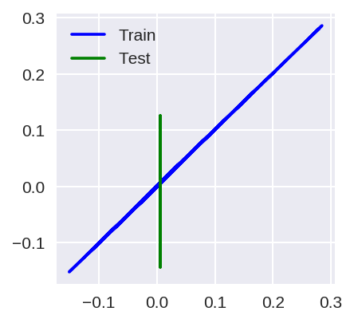
Support Vector Regressor
R2 score for training set: 0.9996.
R2 score for test set :
-1329424029650418688.0000.

Slide 13
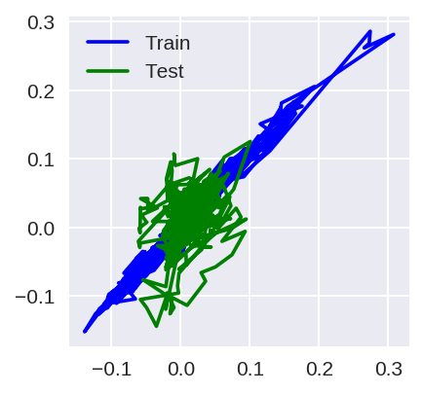
Gradient Boosting Regressor
R2 score for training set : 0.9696.
R2 score for test set: -1.2243.

Slide 14
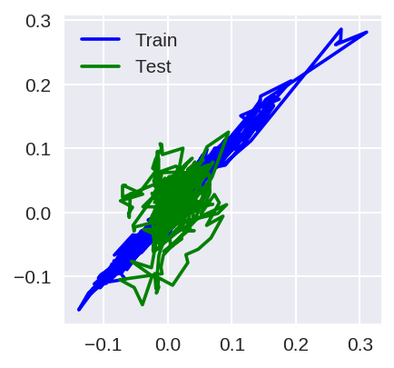
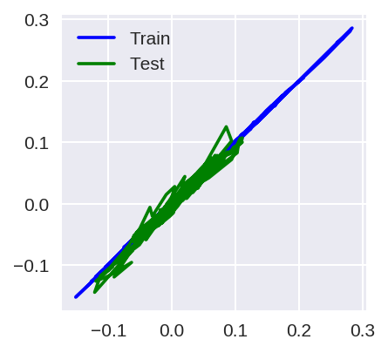
Overfitting Problem
Previous
Scale
Normalization

Slide 15
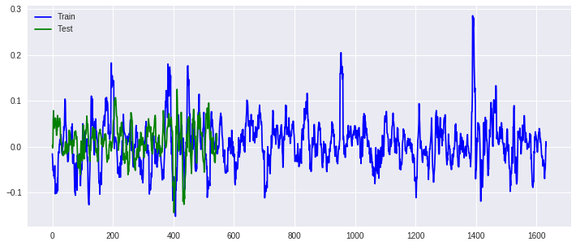
Results
Normalized data with Gradient Boosting Regressor had best accuracy.
Best Model Parameters: 'max_depth': 3, 'n_estimators': 500

Slide 16
Thank you.

