Slide 1


Sentiment Analysis of Apple Tweets
GROUP 8
This presentation outlines a machine learning project focused on analyzing public sentiment towards Apple and Google on Twitter.

Slide 2
Business Understanding: The Importance of Social Sentiment
Overview
Objectives
Google and Apple's brand reputation is significantly influenced by social media discourse. Real-time analysis of public sentiment on platforms like Twitter is crucial for informed decision-making across marketing, public relations, and investment strategies. Understanding the public pulse allows for proactive issue management and capitalizing on positive trends.
1
To pre process the tweet data using Natural Language Processing techniques
Problem
Manually processing thousands of tweets to gauge sentiment is inefficient, resource-intensive, and prone to human error. Automating this process through machine learning provides a scalable, consistent, and rapid solution.
2
To build a machine learning classifier that accurately predicts the sentiment of tweets.
3
To evaluate the performance of different classifiers using appropriate classification metrics such as F1-score and roc-auc score
4
To Deploy the best performing models

Slide 3
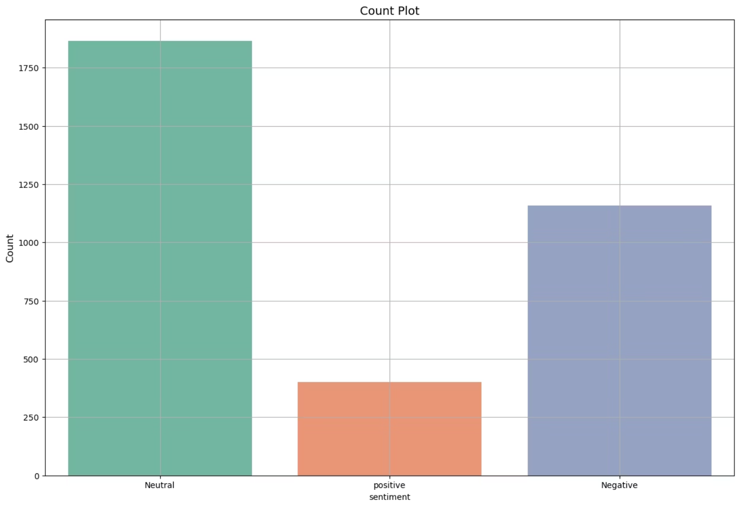
Data Understanding: Dataset Overview
Size: The dataset comprises 3,886 unique tweets, providing a substantial basis for model training and validation.
Labels: Each tweet is annotated with a sentiment label: positive, neutral, or negative, crucial for supervised learning.
Additional Fields: Beyond the core text and sentiment, the dataset includes metadata such as 'confidence' scores, 'tweet text', and 'date', which can be leveraged for deeper insights or data integrity checks.
Origin: The data we used was from Kaggle(Apple-sentiment-Analysis-csv file) and the was collected via crowdsourcing and had manual labeling applied, contributing to the quality and relevance of the sentiment labels.

Slide 4

Data Preparation: Cleaning and Feature Engineering
Cleaning Steps
.
filtered dataset to retain only relevant rows and columns.
Renamed and casted columns for consistency.
Removed nulls and duplicates.
Cleaned text: removed punctuation, links, emojis, and stopwords.
Applied tokenization and lemmatization using NLTK.
.
Feature Engineering
Engineered new features:
Tweet length
Word/sentence counts
Lexical diversity
Augmentations:
SMOTE applied to handle class imbalance.
TF-IDF vectorization for model input.
Did text augmentation for the minority class
.

Slide 5
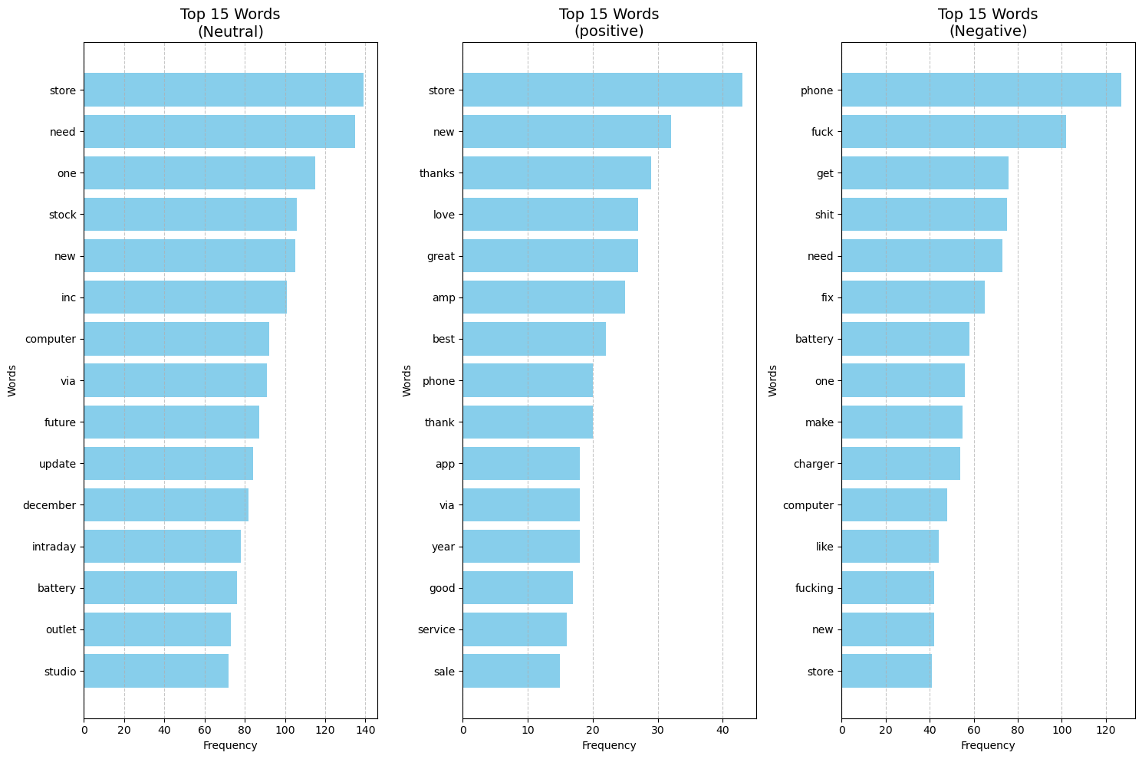
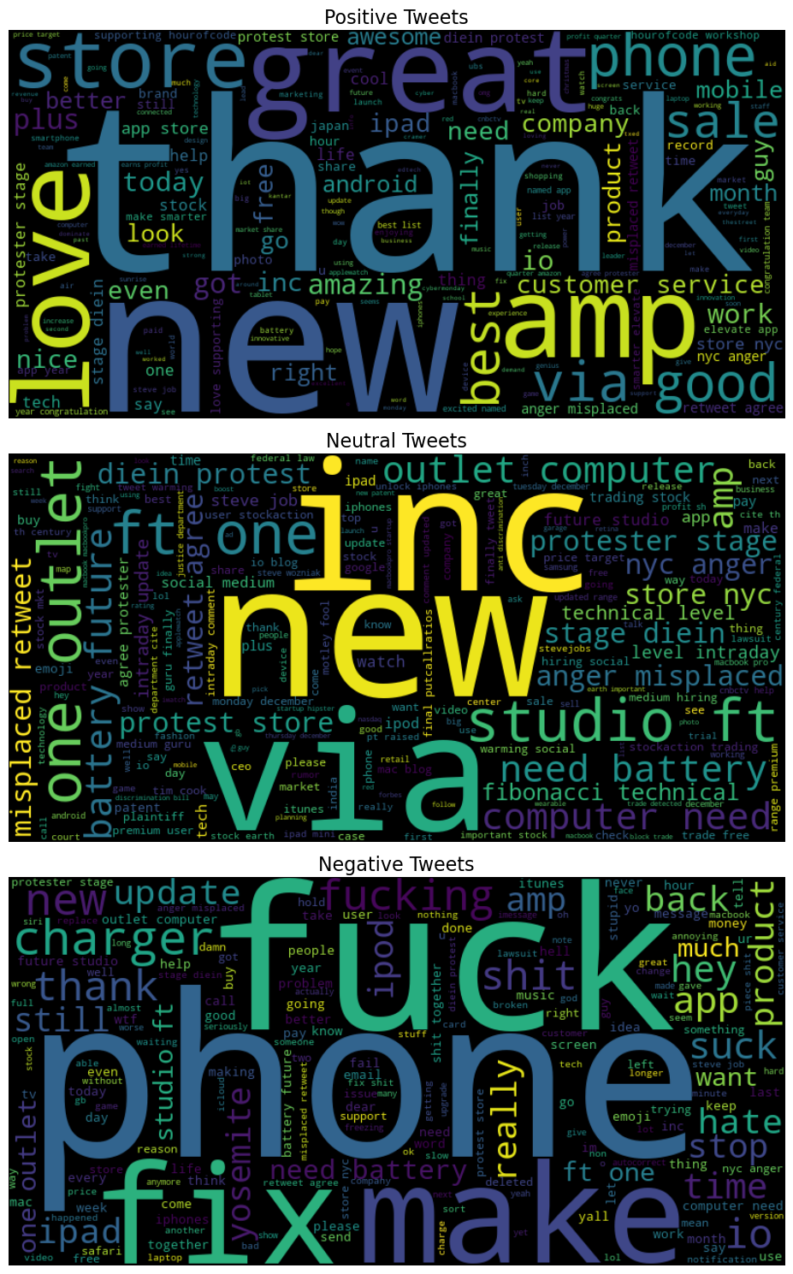
In our data the top word per sentiment were: store, new, thanks for positive. Need, new ,stock for neutral and fix, make phone and suck for negative sentiments

Slide 6



Modeling: Candidate Selection & Refinement
Initial Candidates
Top Performers
Model Improvements
A broad range of classifiers were initially considered for their diverse algorithmic approaches:
After initial cross-validation and benchmarking, the following models emerged as top-tier candidates for further refinement:
To enhance performance and address specific challenges, each top model underwent significant improvements:
Logistic Regression
Logistic Regression (chosen as baseline)
SMOTE Integration
Support Vector Machine (SVM)
Random Forest Classifier
Decision Trees
XGBoost
Augmented Features
Random Forest Classifier
XGBoost
Hyperparameter Tuning
This systematic approach ensures that the selected models are not only effective but also robust and tailored to the unique characteristics of the tweet sentiment data.

Slide 7
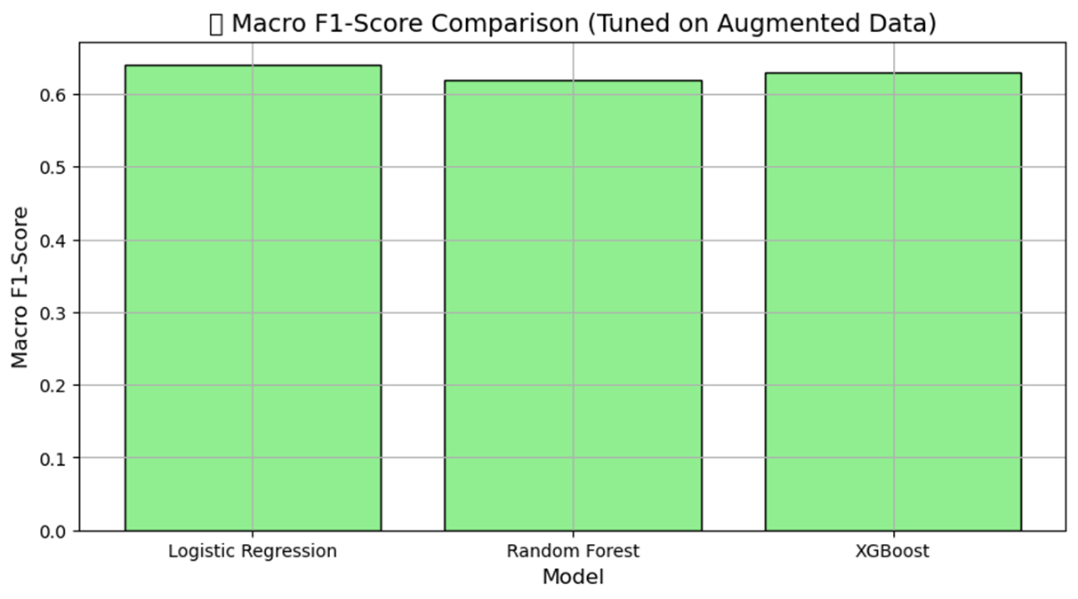
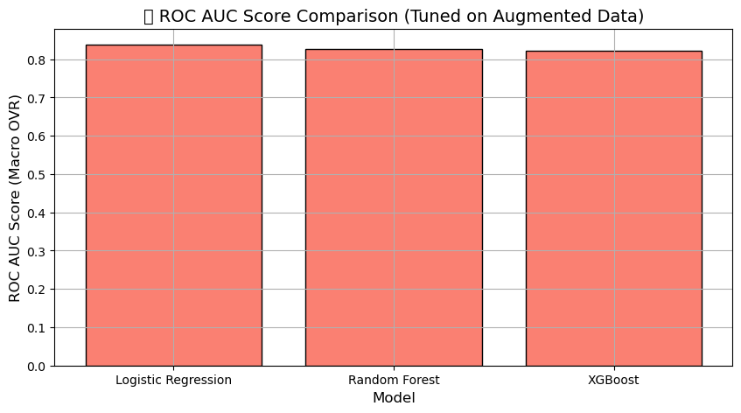
Evaluation: Metrics & Performance
The performance of all tuned models was rigorously evaluated using a comprehensive suite of classification metrics.
Key Metrics:
Observations & Decision:
Logistic Regression Selected: Logistic Regression emerged as the most suitable. It portrayed:
Precision
Recall
Highest ROC AUC:
F1 Score
Competitive Recall
ROC AUC Score
Interpretability & Stability

Slide 8
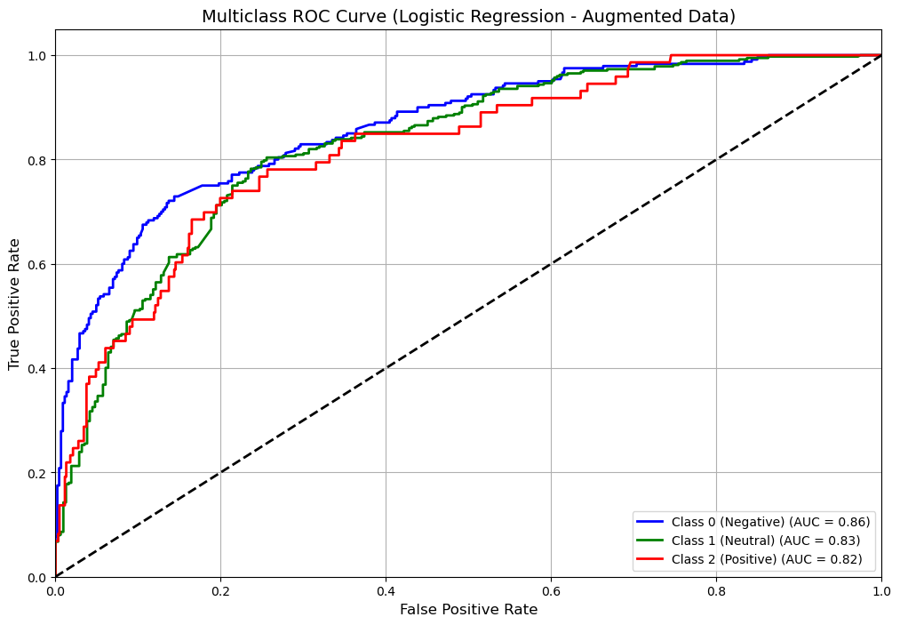
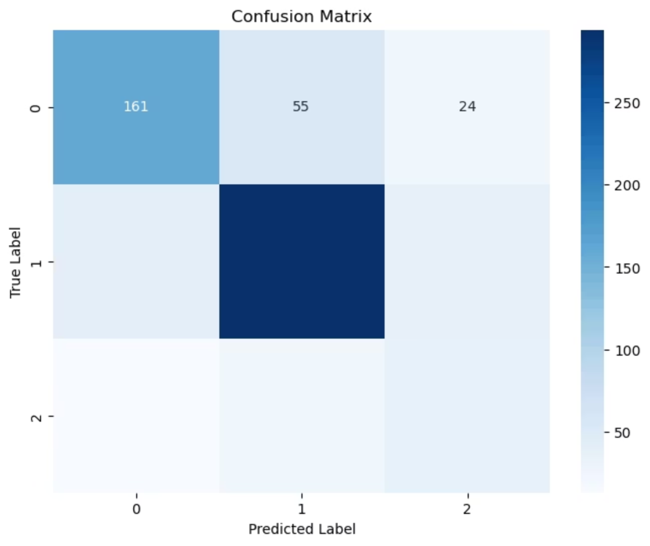
Evaluation: Final Model Analysis
A deeper, multi-faceted evaluation of the selected Tuned Logistic Regression model was conducted to thoroughly assess its performance, generalizability, and interpretability.
Analysis Components:
Classification Report
Confusion Matrix
ROC Curve
Model Interpretability with LIME
Feature Importance
The trained model was saved using Joblib to facilitate quick deployment and prevent redundant retraining, ensuring efficiency for future use.

Slide 9
Recommendations And Future Work
Based on our analysis, we recommend the following strategic deployment and future development steps:
1
Deploy Tuned Logistic Regression
2
Regularly retrain the model with updated tweets
3
Explore Advanced Models for future gains
Use sentiment analysis results to drive actionable outcomes i.e:
Monitor brand sentiment (e.g., Apple) in real-time.
4

Slide 10
Challenges Faced and Assumptions
Assumption of Text Representation
Quality and Bias in Augmented Data.
Assumption of Data Stationarity.
Subjectivity in Sentiment Labels

Slide 11
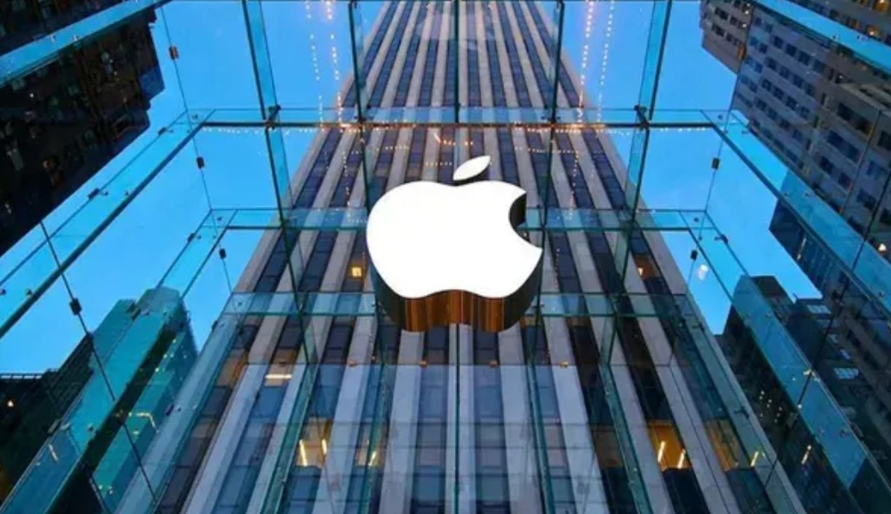
Thank you!
Any Questions?
Group 8:
Kevin Kibet
Vincent Ngochoch
Chris Gitonga

