Slide 1

liquid flow rate predictions with machine learning for scale detection
imperial college London
In collaboration with wintershall dea
MSc Applied Computational Science and engineering
Kevin fung
Notes:
TODO:
Understand why random forests does well on smaller feature sample set.
Understand how random forests works, how does it ignore the multi-collinearity of features?
The ensembling of decision trees selects random subsets of features for its trees, thereby ignoring the multi-colinearity of features
Explain nested K-Fold clearly/quickly. Whys it good for small dataset.
15 min:
Front slide
Agenda
4 min
Background – Why are we doing this?, what is scaling? How does this benefit us?
Background – Given data for an oilwell, calcium carbonate scaling. Liquid flow rate to detect scaling.
Background – liq flow rate measurement system, field measurement system
Background – Quickly describe amound of test sep and field data, Explain what MIKON is
Project Definition - what is it, split it to the three objectives.
Mlflowrate – Designed to investigate liquid flow rates, follows the data science pipeline, encapsulated by 3 modules. Go through each module quick.
Data engineering – what we cleaned in our data<<<<<MAY CUT OUT
Data engineering – propose 2 different datasets for investigations, exclude whp
Data engineering – apply a novel way to increase our sample sizes, 112->144, recognise well shut ins
4 min:
Exploratory preparation – validation and evaluation methods
Exploratory preparation – Two approaches carried out
Exploratory preparation – ML models
7 min:
Results and findings – validation results naive methods
Results and findings – Evaluation on dataset 1
Results and findings – Evaluation on dataset 2
Results and findings – Findings of naive methods
Results and findings – validation results FA methods
Results and findings – Evaluation on dataset 1
Results and findings – Evaluation on dataset 2
Results and findings – Findings of FA methods
Summary
Investigative mentions/future works

Slide 2
AGENDA
liquid flow rate predictions for scale detection
Background and Project Definition
mlflowrate Software
Data Engineering
Exploratory Preparations
Results and Findings
Questions
Notes:
Make it short. Just read it out.

Slide 3
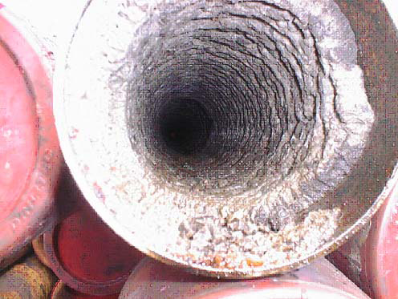
Project background
liquid flow rate predictions for scale detection
Offshore oil wells are typically prone to scaling affecting the integrity and production efficiency of wells.
Scaling is the build up of chemical precipitation due to a chemical reaction along the inner tubing.
Scale treatments are expensive and operators must optimize this process.
Residual calcium carbonate scaling found within the tubing of a North Sea Oil Well after an acid wash.
Notes:
Why are we doing this?
Offshore oil wells are susceptible to a variety of maintenance issues during its lifetime. One pressing issue which stands out is an occurrence of scale build-up inside wells and can have an effect on the production efficiency and well integrity.
Scaling is the formation of chemical precipitates along the inner tubing which can eventually plug an oil well if left untreated.
This becomes a significant challenge in optimizing the production efficiencies of an oil well, as operators must know when best to apply these costly scale treatments by analyzing live well characteristic data.

Slide 4
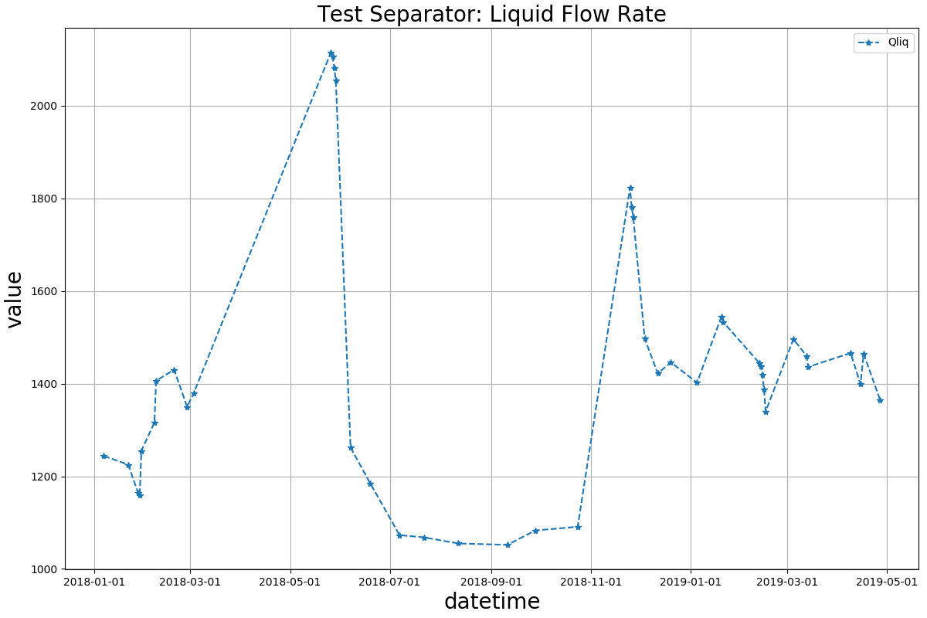
Project background
Qliq
liquid flow rate predictions for scale detection
Scale Treatment Period
Data provided for an oil well with significant calcium carbonate scaling.
Liquid flow rate data best indicates the occurrence of scaling.
Restricting tube diameter due to scaling decreases liquid flow rate.
Scale Build-up
Period
Notes:
In regards to this highlighted challenge, our motivation for this project is to detect scaling for a specific oil well located in the North Sea and its data has been provided for this project.
The oil well is prone to calcium carbonate scaling due to sharp changes in fluid pressure and temperatures across its system. The main indicator for detecting this scaling is to analyse the gradual decline in liquid flow rate over time.
Shaded in red, the decline is due to the restriction of the tube diameter caused by scaling, so its intuitive to look at this data to detect scaling.

Slide 5
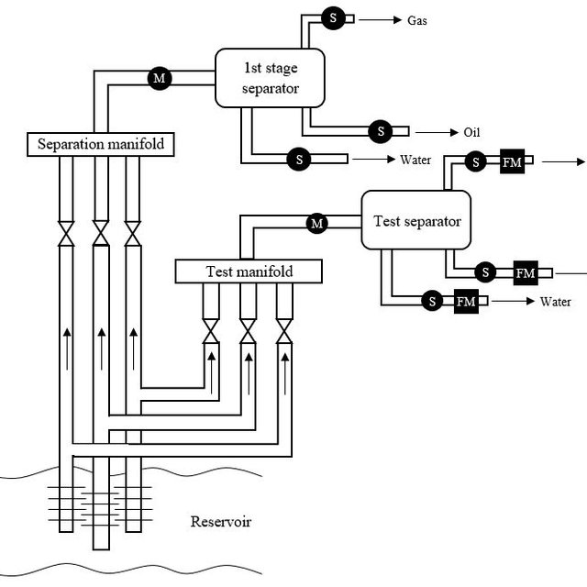
Project Background
liquid flow rate predictions for scale detection
Data Understanding and Overview
Oil well separator flow system
Notes:
The majority of fluid characteristic measurements such as temperature and pressure reside in the well itself, as shaded in blue, and these are recorded at an hourly rate at different positions inside the well.
Every few weeks operators redirect production flow into the test separator, shaded in red, to accurately measure liquid flow rates, as well as this, several other physical measurements are also collected relevant to flow rates.

Slide 6
Project background
liquid flow rate predictions for scale detection
Data Understanding and Overview
- 117 Samples
- (Every few weeks)
- (2016-2019)
- 1204 Samples
- (Every day)
- (2016-2019)
Test Separator Data
Field Data
MIKON Liquid Rate Data
(15% uncertainty range)
- 30,000 to 86,000 Samples
- (Every hour)
- (2016-2019)
Notes:
The amount of liquid rate data provided was fairly limited, with only 117 samples available, this is due to the infrequent measurements of liquid flow rates.
In contrast to the limited labelled dataset, we are also provided the hourly measurements recorded within the well whose samples are between 30,000 to 86,000 which span back to 2016. These are measurements such as pressure and temperature. This large unlabeled dataset can potentially be leveraged for investigating liquid flow rates and shall be referred to as our field data.
A final data which was provided was what engineers currently use to predict daily flow rates. Its based on a simple linear regression model whose coefficients must be tuned frequently to produce predictions with a 15% uncertainty range from the true value.

Slide 7
Project Definition
liquid flow rate predictions for scale detection
Apply machine learning models to predict daily liquid flow rates and attempt to produce a model at a similar prediction capacity to the MIKON model.
Project Objectives:
Produce a data integration and machine learning software for oil well data.
Perform feature selection and assemble suitable datasets for predictive exploration.
Apply and investigate the effects of different machine learning models to predict daily liquid flow rates.
Notes:
With regards to scale detection and the data available, our objectives for this project is to investigate the application of modern machine learning models to estimate daily liquid flow rates and to capture the scale build up of wells.
To add, provided the limited test separator dataset for our well, we cannot take a standard data science approach for exploring the different machine learning models that are available. During the investigation, we’ll introduce several techniques that address the data shortage.
Therefore our project aims are:
Produce a data integration and machine learning software for applicable machine learning.
Perform feature selection and assemble suitable datasets for machine learning.
Apply and investigate the effects of different machine learning models to predict daily liquid flow rates.

Slide 8
mlflowrate: solution software
liquid flow rate predictions for scale detection
Software Workflow and Key Features
Import Raw Data
Reorganize raw files into suitable formats.
Analyse and Clean Data
Remove nulls from data.
Visualize and compare predictions
Generate appropriate performance estimations for the models.
Feature selection for datasets
Apply machine learning models
Average out duplicate samples.
Assemble datasets suitable for machine learning.
Analyse features in different data.
Apply common machine learning models to the datasets.
Visualize end predictions
DataClean.py
DataSets.py
DataExplore.py
Notes:
The workflow diagram shows the design intentions in more detail.
Users:
First import raw and disorganized data into suitable formats.
Describe the process, follow through each stage.

Slide 9
Data engineering
liquid flow rate predictions for scale detection
Data Cleaning
Daily average of all data
Remove missing values, zero values, and time duplicates.
Test Separator Data
112 Samples
Field Data
1234 Samples
MIKON Liquid Rate Data
1180 Samples
Reduced samples after cleaning
Notes:
Following our designed workflow, we first integrate our data into the software pipeline.
We first import the raw data and clean it.
Feature selection is one of the key processes in the data science pipeline.
For our given data, we must choose the features which most contribute to our prediction variable so that we can produce highly accurate machine learning models.
Since we have the test separator and field data, we decide to construct two datasets based on the features present in each one.
The first dataset includes all the features from the test separator. This is because after plotting the pearsons correlation matrix we found that all features highly correlated to the measured liquid rate data.
The second dataset consists of all the features in the field data except for DHT. By plotting the bivariate pairwise distribution of features down hole temperature does not vary at all with the liquid rate.
\In assembling the second dataset, it should be noted that the test separator samples are used wherever we have the same features in both test separator and field data.
we use only data which correspond to the measured test separator liquid rate samples by time.

Slide 10
Data engineering
liquid flow rate predictions for scale detection
Investigative Datasets
Constructed 2 labelled datasets for modelling.
First dataset includes all test separator features.
Second dataset includes all field features excluding WHP.
Pearson’s Correlation Matrix show small correlation between WHP and liquid rate.
Dataset 1
Well head temperature (WHT)
Dataset 2
Well head temperature (WHT)
Well head pressure (WHP)
Down hole pressure (DHT)
Gas lift rate (GLR)
Choke
Down hole temperature (DHT)
Down hole pressure (DHP)
Gas lift rate (GLR)
Choke
Gas lift pressure (GLP)
Acoustic Sand Detection (ASD)
Features of constructed labelled datasets
Notes:
Feature selection is one of the key processes in the data science pipeline.
For our given data, we must choose the features which most contribute to our prediction variable so that we can produce highly accurate machine learning models.
Since we have the test separator and field data, we decide to construct two datasets based on the features present in each one.
The first dataset includes all the features from the test separator. This is because after plotting the pearsons correlation matrix we found that all features highly correlated to the measured liquid rate data.
The second dataset consists of all the features in the field data except for DHT. By plotting the bivariate pairwise distribution of features down hole temperature does not vary at all with the liquid rate.
\In assembling the second dataset, it should be noted that the test separator samples are used wherever we have the same features in both test separator and field data.
we use only data which correspond to the measured test separator liquid rate samples by time.

Slide 11
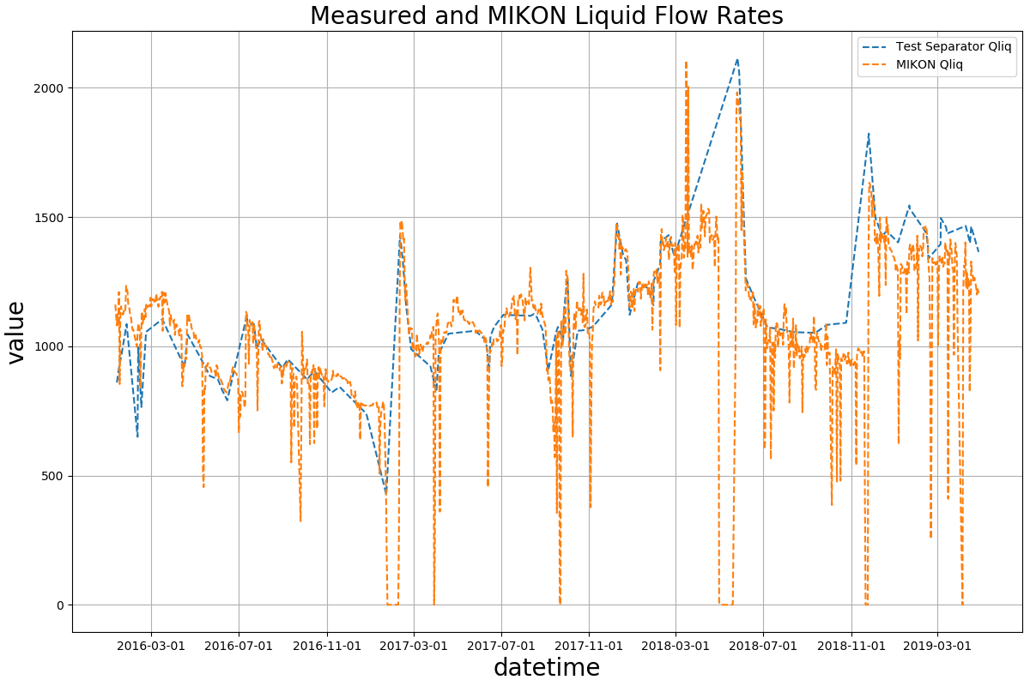
Data engineering
liquid flow rate predictions for scale detection
Boosting Sample Sizes of Labelled Datasets
Well shut-ins: where production flow is stopped.
Identify well shut-ins in Field data and label those samples as 0 liquid rate.
Increased dataset sizes from 112 to 144 samples.
Models are able to learn well shut-ins.
Well Shut-in Periods
Notes:
In addition to our datasets, we provide a novel way to boost the number of labelled samples.
It is common for wells to experience shut-ins, where the well is temporarily closed and production flow is stopped.
As seen in the liquid flow rate graph, the measured liquid rate in the test separator do not

Slide 12
Exploratory preparations
liquid flow rate predictions for scale detection
Explorative Ideas
Naïve Approach: Hyper parameter tuned modelling with no data preprocessing.
Factor Analysis Approach: Hyper parameter tuned modelling on latent factors found with Factor Analysis.
Factor Analysis
Form of dimensionality reduction.
Assumes there are unknown variables which explain the multi-collinearity between features.
Preprocessing Approach: generate all polynomial and interaction features to the second order degree, then reduce the number of features down using factor analysis.
Notes:
We will not split our model for train, validation, and test sets. It is not appropriate due to our limited labelled set with the high risk to overfitting to a train split that contains not all recorded well interventions. This means we must use non-conventional methods to judge our model performance, and it is better to fit our model to the entire labelled dataset to maximize model accuracy.
Performance metrics: R2 score and RMSE.
Validation: - nested cross validation for general error estimation,
- removes overfitting from hyperparameter tuning.
Evaluation: - visualisation against the MIKON liquid rate model.
- calculate the RMSE from the 15% uncertainty range in the MIKON model.

Slide 13
Exploratory preparations
liquid flow rate predictions for scale detection
Machine Learning Models Used
Regression Models
Linear Regression
Lasso
Elastic Net
Non-Regression Models
PLS Regression
Ridge
Random Forests
Data standardised before learning.

Slide 14
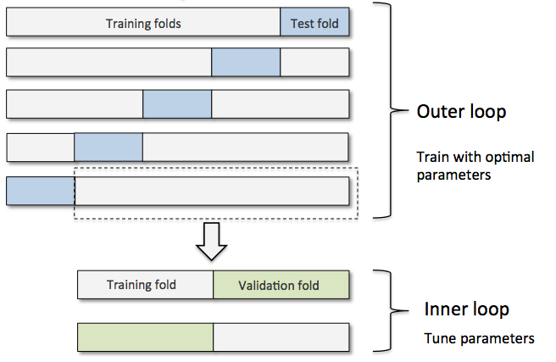
Exploratory preparations
liquid flow rate predictions for scale detection
Model Performance Metrics
Error metrics: R2 and RMSE.
Validation: Nested K-Fold Cross Validation
Uses entire labelled dataset for estimation.
Evaluation: MIKON Comparison
Visualize against the MIKON model.
Calculate RMSE away from the MIKON uncertainty boundaries.
10 outer folds, 5 inner folds used.
Calculate percentage of predictions that lie within MIKON uncertainty.
Removes biasing from hyperparameter tuning.
Includes hyperparameter tuning of models into estimation.
Nested K-Fold Cross Validation
(Sebastian Raschka, 2019)
Notes:
Before we apply any machine learning models to our datasets, we must use the appropriate validation methods to find the general error estimates of our models.
We use the nested kfold cross validation method
uses the entire labelled dataset for estimation
eliminates the need to hyperparameter tune models by standardly splitting our small labelled dataset into train, validation, and test splits. To briefly describe, the approach can be considered as a standard k-fold cross validation but now includes hyperparameter tuning as part of the model fitting procedure for each fold.
Hyperparameter tuning within the model fitting procedure.
For evaluation, we test our models on the field data and compare predictions to the MIKON liquid flow rates. We calculate the rmse away from the MIKON’s 15% uncertainty range and also calculate the percentage of predictions which lie within its range. If all model predictions lie inside the MIKON uncertainty range, then the model will be a potential model for estimating flow rates instead.
Performance metrics: R2 score and RMSE.
Validation: - nested cross validation for general error estimation,
- removes overfitting from hyperparameter tuning.
Evaluation: - visualisation against the MIKON liquid rate model.
- calculate the RMSE from the 15% uncertainty range in the MIKON model.

Slide 15
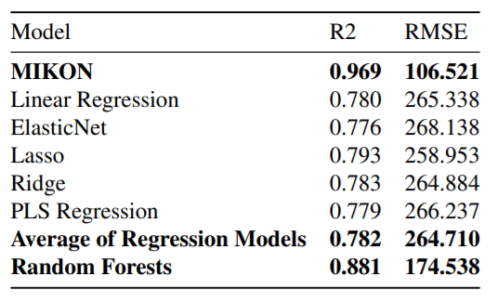
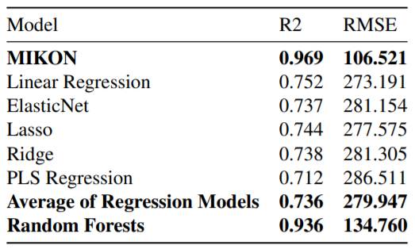
Results and findings
liquid flow rate predictions for scale detection
Naïve Approach:
General Model Error Estimations
Dataset 1: Test Separator Features
Dataset 2: Field Features without WHP
Notes:
Regression models perform better on the first dataset.
Random forests produce significantly higher scores than regression models.
Random forests on the second dataset seems to produce the best accuracies.
Why does RF work better with less features

Slide 16
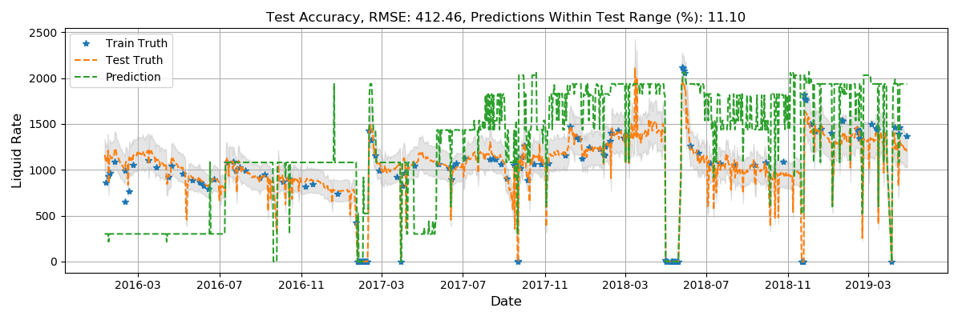
Results and findings
liquid flow rate predictions for scale detection
Naïve Approach:
Evaluation on Dataset 2, Random Forest Regression
Notes:
Unsatisfactory, but captures most of the well shut-ins, as its been trained on the same data.

Slide 17
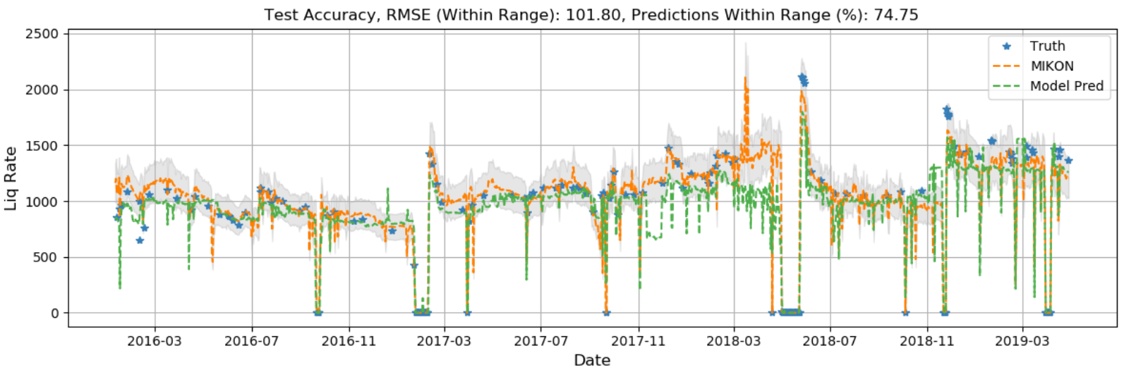
Results and findings
liquid flow rate predictions for scale detection
Naïve Approach:
Evaluation on Dataset 1, Random Forest Regression
Notes:
Reasonable results for detecting scaling, 75% of predictions lie within the 15% uncertainty range of the MIKON model.

Slide 18
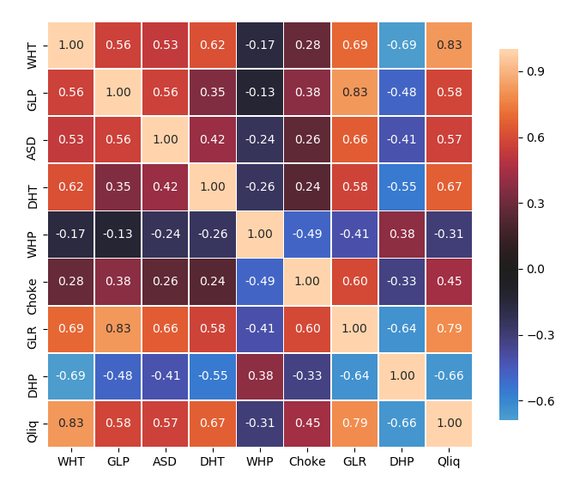
Results and findings
liquid flow rate predictions for scale detection
Naïve Approach Findings
Dataset 1 produces better model results: less features means lower model variance.
Small dataset with uneven distribution is another reason.
The differences may be explained by multi-collinearity of features.
Validation method produces optimistic performance estimations:
May be due to the limited data provided.
Pearson's Correlation Matrix of Field Data
Notes:
Random forests are not effected by collinearity due to the ensemble strategy with decision trees.
Nested cross validation shows that we are still overfitting to the labelled train set, this may be due to unstable/high error variance estimations inside the inner layer (hyper parameter tuning part of our model).
Essentially need more labelled data for validation!

Slide 19
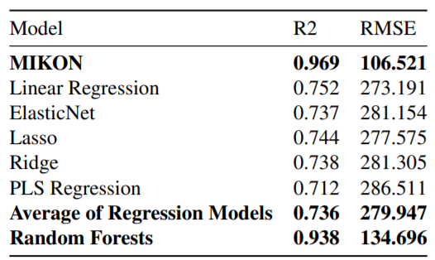
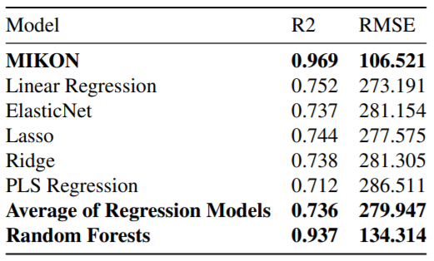
Results and findings
liquid flow rate predictions for scale detection
Factor Analysis Approach:
General Model Error Estimations
Dataset 1
Dataset 2
Notes:
Number of latent factors to reduce into for each dataset is determined by a scree plot.
Regression method evaluations are identical!
This may be because latent variables found explain the same variances for both features in our datasets, therefore regression models produce the same accuracies.
Random Forests are near identical as well.

Slide 20
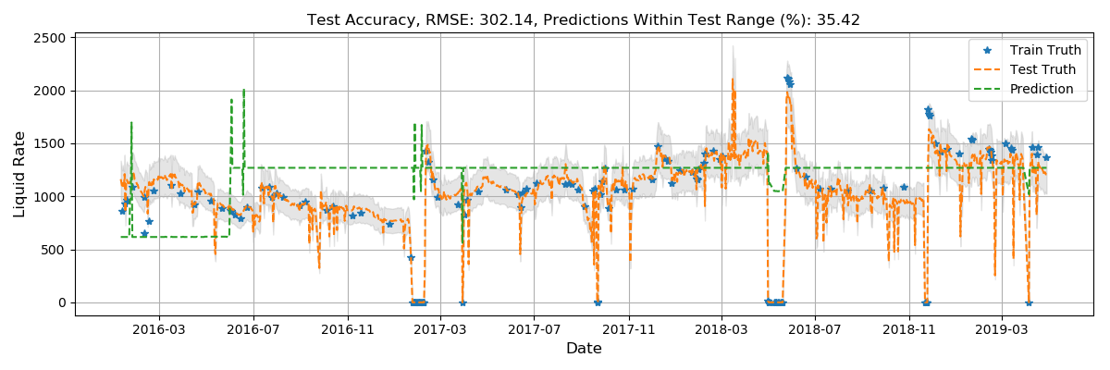
Results and findings
liquid flow rate predictions for scale detection
Factor Analysis Approach:
Evaluation on Dataset 1, Random Forest Regression

Slide 21
summary
liquid flow rate predictions for scale detection
Developed a solution software for integrating raw oil well data to predict liquid rates.
Produced reasonable daily liquid rate predictions with Random Forest Regression with 75% of predictions inside the MIKON model: Scale detection is possible.
Models are able to recognize well shut-ins.
More test separator data must be acquired to improve predictions.
This may be why our larger featured dataset produced lower accuracies.
Notes:
Include scaling
Produced a deployment platform for machine learning models, so allowing for easy training and analysis, once the stake holders provides suitable data for liquid flow rate predictions.

Slide 22
Exploratory Mentions and future works
liquid flow rate predictions for scale detection
ZCA pre-whitening of data to remove multi-collinearity of features: insufficient results.
Features had non-gaussian distributions.
Investigated 2 layer neural network to model liquid flow rate predictions.
Limited amount of data which may not represent the unseen field data
Investigated several 2 layer neural networks to predict highly correlated features to liquid flow rate, then transfer learn gradients and pretrain another neural network to predict liquid rate.
Potential to utilize autoencoders to train on the large unlabeled dataset, then pretrain a neural network to predict liquid flow rates.
May alleviate the small dataset problem.

Slide 23
questions

Slide 24
Data engineering
liquid flow rate predictions for scale detection
Data Cleaning
We prepare:
Daily average of all data
We remove:
Missing values across time samples.
Zero values due to malfunctioning sensors.
Daily time duplicates due to repeated measurements made in a day.
Test Separator Data
112 Samples
Field Data
1234 Samples
MIKON Liquid Rate Data
1180 Samples
Reduced samples after cleaning
Notes:
Following our designed workflow, we first integrate our data into the software pipeline.
We first import the raw data and clean it.
Feature selection is one of the key processes in the data science pipeline.
For our given data, we must choose the features which most contribute to our prediction variable so that we can produce highly accurate machine learning models.
Since we have the test separator and field data, we decide to construct two datasets based on the features present in each one.
The first dataset includes all the features from the test separator. This is because after plotting the pearsons correlation matrix we found that all features highly correlated to the measured liquid rate data.
The second dataset consists of all the features in the field data except for DHT. By plotting the bivariate pairwise distribution of features down hole temperature does not vary at all with the liquid rate.
\In assembling the second dataset, it should be noted that the test separator samples are used wherever we have the same features in both test separator and field data.
we use only data which correspond to the measured test separator liquid rate samples by time.

Slide 25
mlflowrate: solution software
liquid flow rate predictions for scale detection
WorkFlow.py
DataClean.py
DataSets.py
DataExplore.py
Design Architecture
High level software for new users.
Based on Spark for big data processing.
Integration of raw messy data into data science pipeline.
Supportive machine learning tools for model performance estimations and visualisation.
Base.py
Dsets.py
Results.py
Backend Modules
Notes:
The mlflowrate software was developed in order to achieve our objectives for liquid flow rate predictions.
It is a high level software designed for users to integrate raw and messy data into the data science pipeline.
As you can see from the diagram behind me, users are exposed to a nested module structure for easy code interpretability. The parent module is WorkFlow whilst the child modules are DataExplore, DataSets, and DataClean.
The design intention is so that the child modules follow the data science pipeline, whereas the WorkFlow module manages and transfers the processed data across these modules.

Slide 26
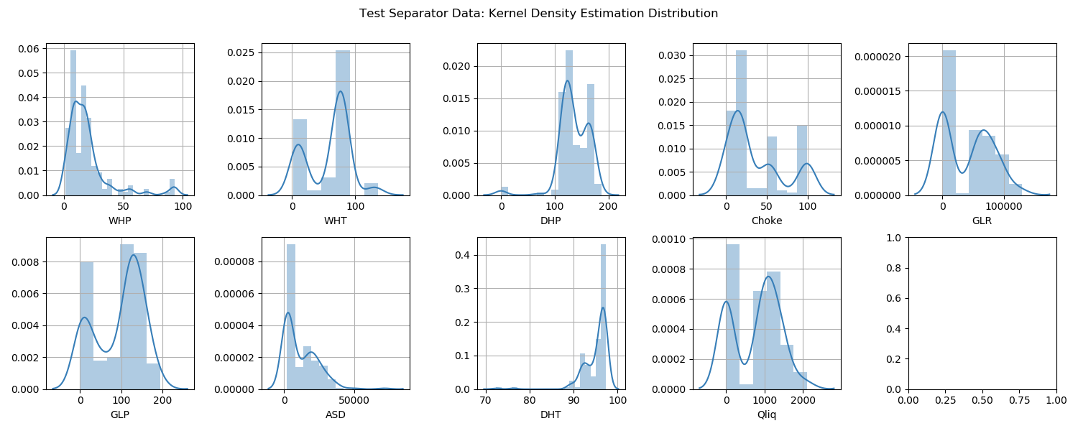
liquid flow rate predictions for scale detection

Slide 27
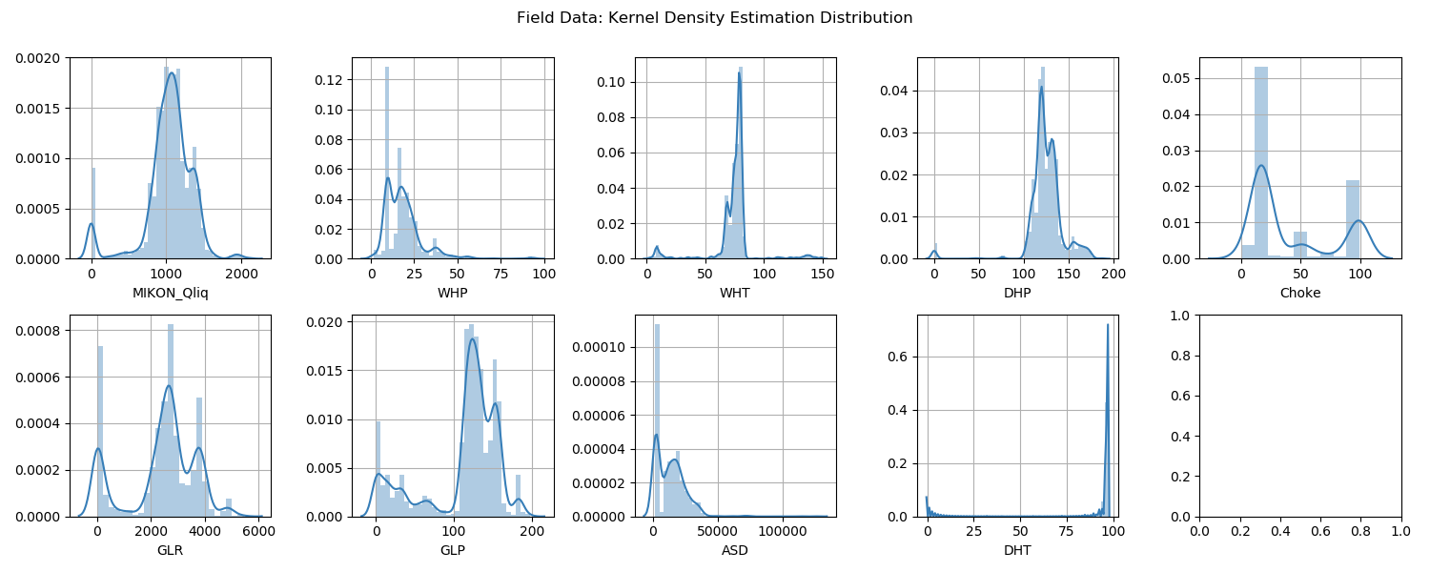
liquid flow rate predictions for scale detection

Slide 28
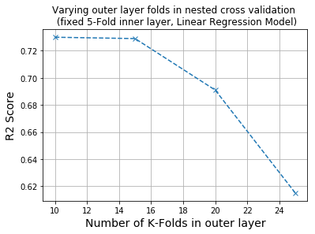
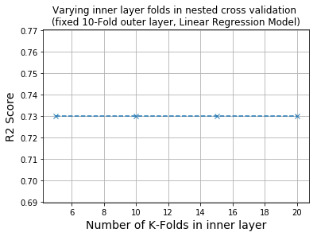
Investigating validation technique
liquid flow rate predictions for scale detection

Slide 29
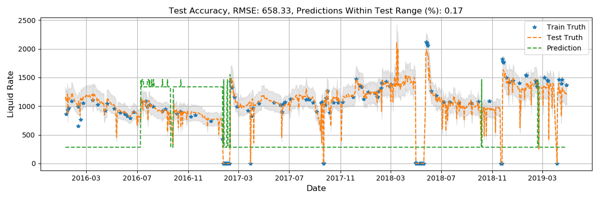
Results and findings
liquid flow rate predictions for scale detection
Factor Analysis Approach:
Evaluation on Dataset 2, Random Forest Regression

Slide 30
Results and findings
liquid flow rate predictions for scale detection
Factor Analysis Approach Findings
Results for both datasets do not predict the trends correctly: Scale build-up cannot be detected.
Dataset 1 evaluations are better than Dataset 2.
Latent variables are not enough to accurately predict liquid flow rates.
Feature selection is important to producing better accurate models, may also be because of the limited number of samples.

Slide 31
